Slide 1
Get on your Soapbox
By Will Wiese, Advocacy Chair MO PTA

Slide 2
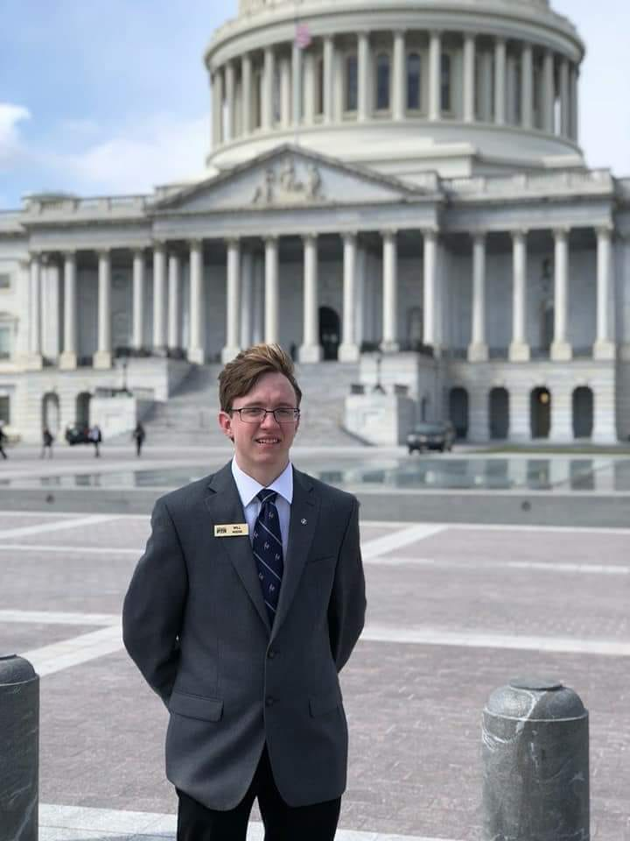
MO PTA Student Representative 2 years
MO PTA Advocacy Chair 2 years
Selected to attend National PTA Youth Advocacy Summit
Implemented the student led campaign for #18in18

Slide 3
What is advocacy

Slide 4
ADVOCACY
The act of supporting an idea or cause.
Notes:
What is Advocacy?
Advocacy is a process not an event
It happens at all levels- local, regional, state, national and international
It is about achieving specific outcomes
Who can advocate?
Anyone who is passionate about and idea or cause
Do I have to be 18?
Anyone can be an advocate all it takes is a passion for an issue and a desire to make a difference and effect change.

Slide 5
How do you get started?
Identify the issue
Develop a plan
Identify the audience
Notes:
Identify the issue
What are you trying to accomplish?
2. Identify your audience
Who is effected
Is this a local, state or federal issue?
3. Develop an action plan
What is the timeframe for action?
Are there other individuals or groups that will want to join a coalition on the issue
Who will be in charge?
What type of campaign will be effective?

Slide 6
Promote your cause
Take ask to appropriate officials
Evaluate
Notes:
4. Promote your cause
Use social media to take your message to a greater number of people
5. Take your Ask to appropriate officials
Use personal stories to highlight the ask
Give legislators facts
Keep them engaged via follow up and social media
6. Evaluate
Did you accomplish your goal?
If not how can you “change” your action plan?
Do not give up, often it takes numerous years to make legislative changes.

Slide 7
ASK: Raise the CAPS!
Congress must act in a bipartisan way to raise the fiscal year (FY) 2020 budget to avoid automatic spending cuts to education and protect existing Federal investments in education.

Slide 8
116th Congress
Notes:
Democratic majority in the House, 235 to 199
Republican majority in the Senate, 53 to 47
Most diverse Congress ever
Large amounts of younger representatives joining to congress. Minority groups also growing in representation

Slide 9
Committees
Notes:
House Education and Labor Committee
Senate Health, Education, Labor and Pensions
(HELP) Committee
House and Senate Appropriations Committee
House and Senate Budget Committees
Committees are a major part of meeting with people who you are meeting about, while they may not be on a committee directly related to education they may be able to relate to the issues surrounding education. For example in meeting with Vicky Hartlizer we were able to get her attention relating education to the military and the funding that the military receives.

Slide 10
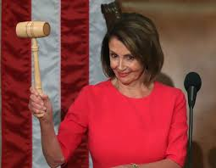
116th Congress: The House
Notes:
Democrats will pursue increased oversight of the Trump Administration
Seek passage of gun safety and violence prevention & school infrastructure bills, ESSA oversight
Address school safety and discipline

Slide 11
116th Congress: The Senate
Notes:
Will need a bipartisan approach for any legislation to pass.
Senator Alexander, Chairman of HELP is retiring in 2020. He wants to see reauthorization of HEA (Higher Education Act)before he retires. The Higher Education Act of 1965 (HEA) The Higher Education Act of 1965 is a law designed to strengthen the educational resources of the colleges and universities of the United States and to provide financial assistance to post-secondary students

Slide 12
Preparing for Hill Visits
Notes:
Email the legislator’s office and request a meeting
Include all who will be attending
Your ask
Any supporting documentation
2. Prepare for you meetings
Most meeting last 30 minutes or less. You want to maximize the amount of time you have.
Remember you are the expert in your subject. Be prepared with facts and follow up information.
Schedule out how your meeting will go including who will talk and about what.
Personal stories are great but keep them brief and relevant.
If you do not know the answer to a question be honest but say you will find out the answer and let the individual know.
. Dress for success
Dress professional
Women: jacket or sweater with dress, slacks or skirt
Men: suit and tie
4. Arrive at least 10 minutes before the meeting
5. After meeting send “Thank You” note.
6. Follow up with legislators

Slide 13
Formulating a persuading argument
Notes:
Logos- appeal to logic. Facts and figures
Pathos- appeal to emotion. Raw emotional appeal
Ethos- appeal to ethics, not like it sounds argument using authority

Slide 14
Meeting
Ask: Increase CAP funding
Fact:
Without increase in funding NO program in HHS will be able to be funded.
How can our students be competitive on a global stage when we underfund public education?
May states are struggling to meet their budget obligations causing strains or cuts to public education at the state level. Increased funding from the National government will keep school equitable across the country.
Story:
I graduated from a school district that receives a large amount of its taxes from several big corporations including GM. Our high school course booklet looks like a community college course book. Each high school has new STEM labs and many varied courses in science, art and the humanities. The neighboring school district does not have any have a large corporate ta base. Its schools have old and outdated labs. When these students enter college they are already behind students from my district with all the labs etc. If federal funding is increased schools could afford to modernize and increase their facilities.
Questions?
Conclusion: Thank you for your time and remember to please increase CAP funding.

Slide 15
Meeting Debrief
What went well during your meetings?
What about your meetings didn’t meet your expectations?
What do you still have questions about after your meetings?

Slide 16
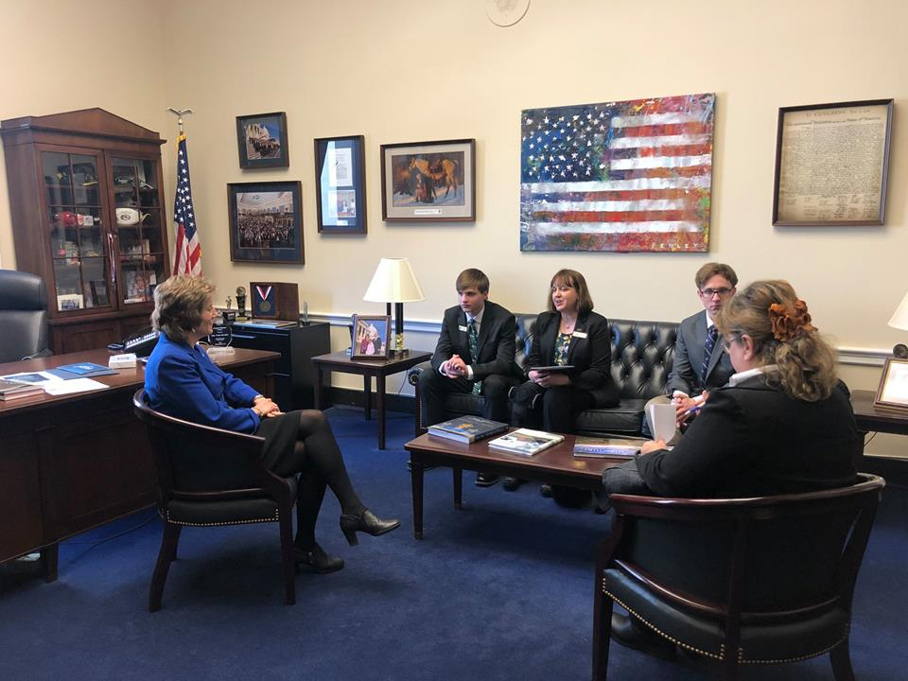
After the Meeting: Keep the Pressure on
@Senator/RepName Thank you for meeting with @mopta please vote to increase budget CAPS #moptaadvocacyinaction
@mopta thanks @senator/rename for meeting with us to discuss increasing the budget CAPS in the FY 2020 budget.

Slide 17
After the Meeting: Keep the Pressure On
Invite your Member of Congress to visit or attend a PTA meeting and/or event
Schedule to meet with the state or district office when you get back to follow up

Slide 18
Any Questions????
Group Activity

Slide 19
Group I:
Issue: Your local school district has schools that are in need of repair.
Problem: Water issues in schools, outdated restrooms, roof leaks
Ask: How could you start and advocacy campaign around securing funding to make necessary repairs?
Group II
Issue: Counselors in your school do not have the time to adequately help struggling student because they are being assigned to many other duties. This lack of counseling services could be dangerous to the safety of the school.
Distractions: acting as registrars helping students pick classes and fill in substitute teachers.
Ask: How do you alert legislators to the issue and what would a solution be?
Group III
Issue: It has been brought to your attention that many juveniles are waiving their right to counsel without having a guardian present.
Problem: This is leading to a much higher rate of incarceration. How can youth sign their rights away if a minor?
Ask: What would you ask legislators to ensure this does not happen?

Slide 20
THANK YOU
Will Wiese, Advocacy Chair
willw@mopta.org

