Slide 1
Community Collaboration in
PTA Service Projects
Hazelwood – Food 4 Thought
Springfield – The PTA Clothing Bank

Slide 2
Two Projects in Missouri
Food 4 Thought
in Hazelwood
Presented by
Margaret Slaughter,
Chairperson
Since 2014
Hazelwood PTA Council
The PTA Clothing Bank
in Springfield
Presented by
Allison Lawson,
Council VP
Since 1974
Springfield Council of PTAs

Slide 3
Sponsored by Hazelwood PTA Council
Margaret Slaughter, Chairperson

Slide 4
Food 4 Thought was launched in January, 2014 to aid Hazelwood School District students and families in need.

Slide 5
What is Food 4 Thought?
Food 4 Thought is a food closet operated and maintained by Hazelwood PTA Council

Slide 6
Why Food 4 Thought?
Statistics show that food insecurity contributes to a students’ poor academic performance. The USDA defines food insecure as “household or individual condition of limited or uncertain access to adequate food”.

Slide 7
How is Food 4 Thought maintained?
Food 4 Thought is maintained by
100% donations:
food drives
community donations
monetary donations

Slide 8
The District houses FOUR closets at each of the High Schools (Central, East and West), as well as one at the Opportunity Center, however, assistance is available to ALL 33 schools in the District.

Slide 9
Students and families in need are identified by District staff (i.e., social worker, teacher, cafeteria staff, etc.), and items are distributed by the social workers.

Slide 10
Food 4 Thought stock
The Closets are stocked with non-perishable food items. We discourage donation of cans or glass.

Slide 11
All donated items must be microwavable & individually packed. We do not accept frozen or refrigerated items.

Slide 12
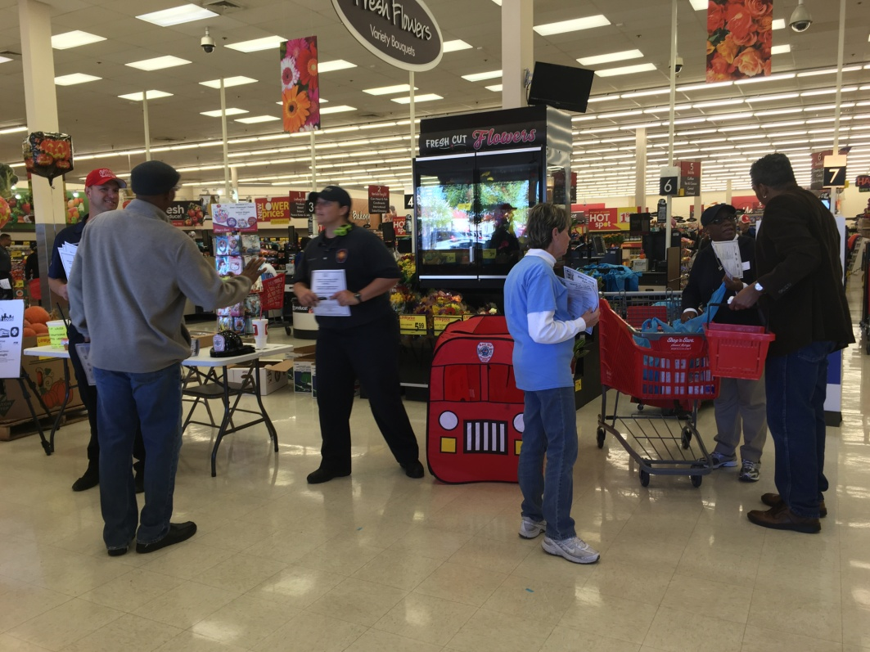
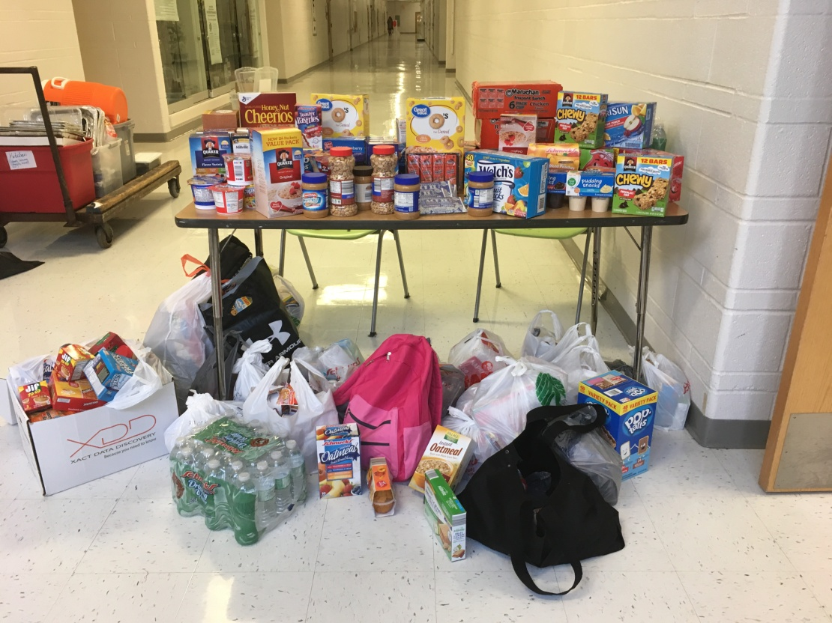
Examples of food drives hosted

Slide 13
Food Items
Box of instant oatmeal (individual packets)
Full or mini sized boxes of cereal
Breakfast bars
Microwavable Stew, Ravioli, Pasta bowl, Soup
(no cans, please)
Libby’s microwaveable vegetables
(green beans, sweet corn, sweet peas & diced carrots)
Microwavable macaroni & cheese bowls
Peanut Butter (plastic jar OR ‘To Go’ serving size)
Jelly or Jam (plastic jar)
Pop Tarts
Ramen Noodle bowls / packets
Boxed Macaroni & Cheese / Spaghetti
Hormel Compleats Meals (Breakfast and dinner)
Pasta sides
Tuna or Chicken pouches
Bumblebee on-the-go Chicken or Tuna
Crackers (in individual sleeves)
Pasts sauce (plastic jar)
Snack Items
Granola Bars / Luna bars
Pretzels, Goldfish or Cheezits (individual bags)
Rice Krispy Treats
Cheese or Peanut Butter Crackers
Fruit Snacks
Muffins / Sun Chips
Applesauce, Peaches, Pears, Mixed Fruit
(individual fruit cups- no cans)
Miscellaneous
New or gently used back packs, Plastic bags, recyclable bags, Paper Plates, Bowls, Forks, Spoons, Napkins, Bottled water, Hand sanitizer, Wipes
$10.00 Gift Cards (Schnucks, Wal-Mart)

Slide 14
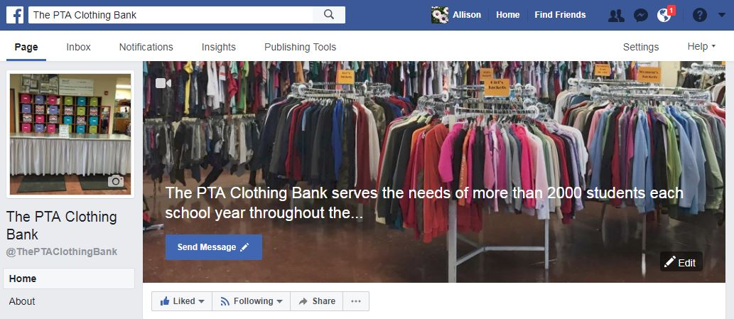
The PTA Clothing Bank
Project of Springfield Council of PTAs
Allison Lawson,
Vice-President Health & Public Services

Slide 15
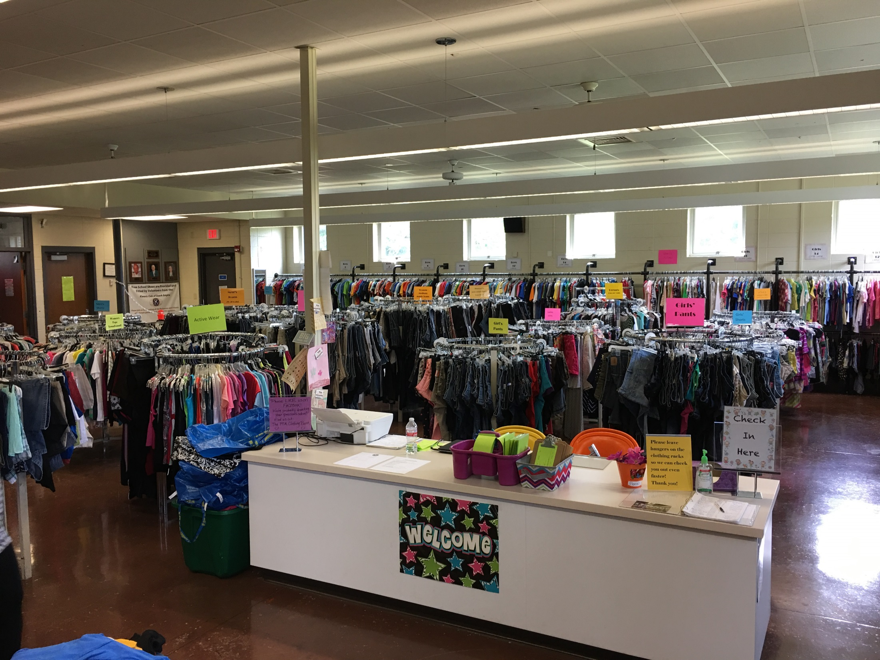

Slide 16
The PTA Clothing Bank operated by Springfield Council of PTAs since 1975 assists with clothing & shoes for students identify as being in need of assistance.

Slide 17
What is
The PTA Clothing Bank?
The PTA Clothing Bank is a free clothing store visited more than 2000 times each school year by students from the 55 schools
in the Springfield Public Schools R-12 district.

Slide 18
What does The PTA Clothing Bank provide?
3 shopping visits per referred student during each regular school year (Aug-May) + 1 visit during summer school
At each visit: 5 tops, 3 bottoms, 1 light-weight jacket, 1 pair used shoes, other items as available
At two visits per year: 1 package of new socks & 1 package of new underwear
At one visit per year: 1 winter coat

Slide 19
What are our goals?
Basic needs - Our goal is to make sure students are ready to learn. Providing clothing & shoes removes one obstacle.
Self-esteem – All clothing is either new, like-new or gently-used. We strive to provide in-style, fashionable clothing to bring joy to our students, with no stigma.
Positive experience – The PTA Clothing Bank is setup to feel like a boutique clothing store to provide a fun shopping experience for students with a great selection and great customer service - there is just no money needed to shop.
Every child and family should feel like valued and appreciated customers.

Slide 20
How do we operate & maintain
The PTA Clothing Bank?
The PTA Clothing Bank is managed by the Springfield Council of PTAs on behalf of our PTA units.
No paid staff – all volunteers
All donation – we do not sell any clothing
In partnership with school & community

Slide 21
Who are our major partners at
The PTA Clothing Bank?
Springfield Public Schools provides our building along with IT, security, utilities, custodian & general services.
  The PTA Clothing Bank data collection & reporting for school district including number & value of items provided and volunteer hours worked. The PTA Clothing Bank assists the school district in their efforts to meet requirements of McKinney–Vento Homeless Assistance Act of 1987
The Kiwanis of Ozark Empire provides a Shoe Bank that operates within The PTA Clothing Bank. They provide students with a pair of new shoes one time per year.
  The PTA Clothing Bank handles all student information & data reporting for the Kiwanis Shoe Bank.

Slide 22
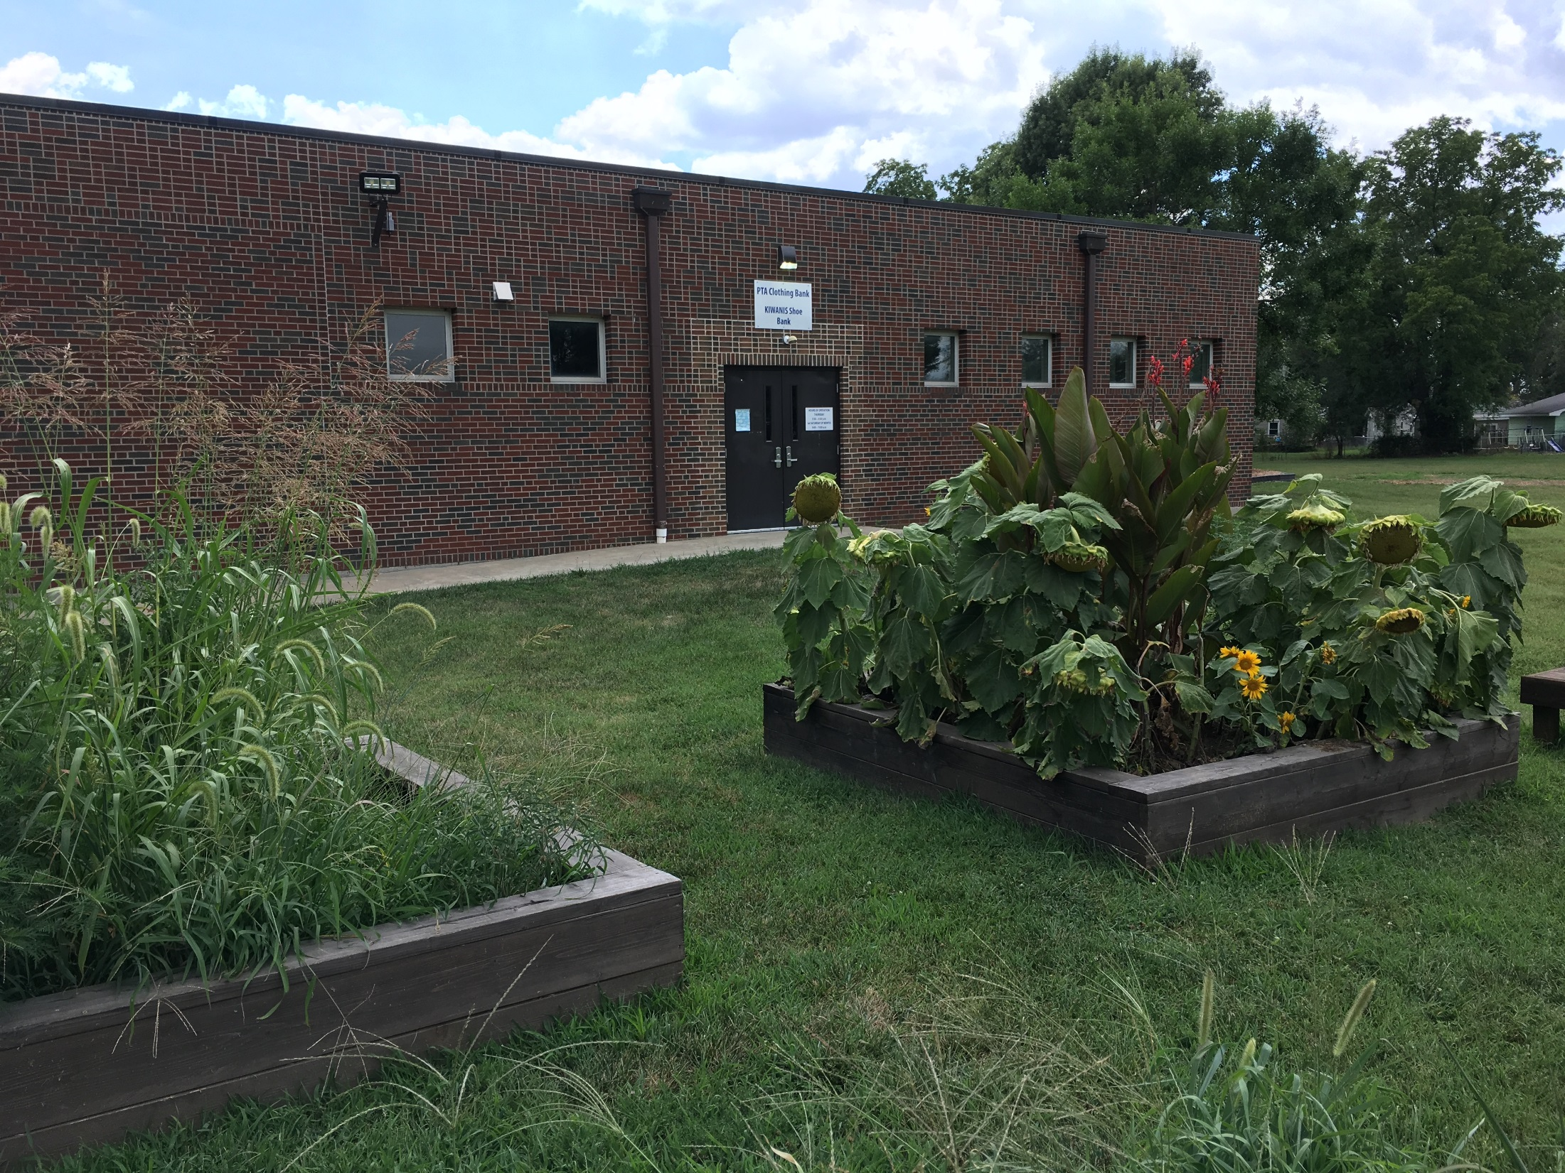

Slide 23
Other major partners at
The PTA Clothing Bank?
The Missouri Council of the Blind
& MCB Thrift Stores
provide us with the essential service of removing all unusable donations from our facility every week!
  We receive more donations than we can use, especially in women’s clothing. We also receive many items that do not meet our requirement to be “gently-used” or “like-new”. We send everything on to other charities with the bulk going to MCB. We would be buried under donations without them.
  ..

Slide 24
How is The PTA Clothing Bank funded?
Springfield Council of PTAs
One fundraiser per year – MajorSaver card sale to fund all council projects, including The PTA Clothing Bank
  Our budget is $13,000 for new socks & underwear –
  but we give out substantially more than $13,000 worth of socks & underwear.
PTA units & community partners
Sock & underwear donation drives
Gently-used or like-new clothing donations
Monetary donations
Volunteers

Slide 25
How do we The PTA Clothing Bank funded?
Springfield Council of PTAs
One fundraiser per year – MajorSaver card sale to fund all council projects, including The PTA Clothing Bank
  Our budget is $13,000 for new socks & underwear –
  but we give out substantially more than $13,000 worth of socks & underwear.
PTA units & community partners
Sock & underwear donation drives
Gently-used or like-new clothing donations
Monetary donations
Volunteers

Slide 26
What does it take to make
The PTA Clothing Bank successful?
Shoppers – students & their families
Our goal is to get clothes to kids!
Donations
A constant flow of new donations are necessary. We have had over 2,000 student visits to The PTA Clothing Bank already this year.
Volunteers
There is too much work for any one person or even one small group. Though we have a core team that always volunteers, it is essential to have a constant pool of additional volunteers. We need about a minimum of 10-15 volunteers working from 1-10 hours each every week.

Slide 27
QUESTIONS?

Slide 28
If anyone is interested, you can visit
The PTA Clothing Bank in Springfield for a brief tour immediately after convention….
Google Maps “The PTA Clothing Bank”

Slide 29
Additional Resource
E-learning Course from National PTA:
Running a Successful Program Learn the steps for taking a program idea from concept to reality. approx. 30 min
http://www2.pta.org/NewRunningProgram

Slide 30
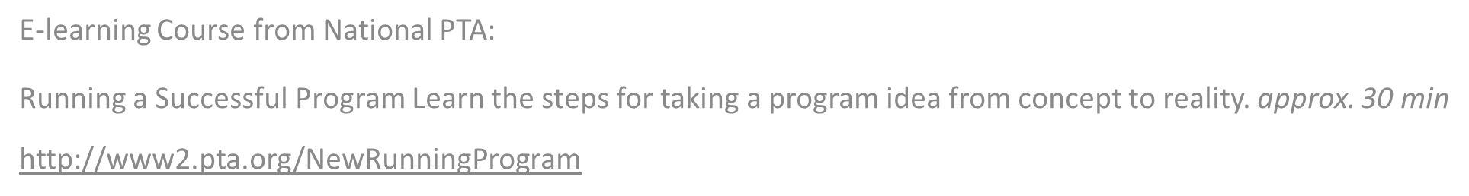
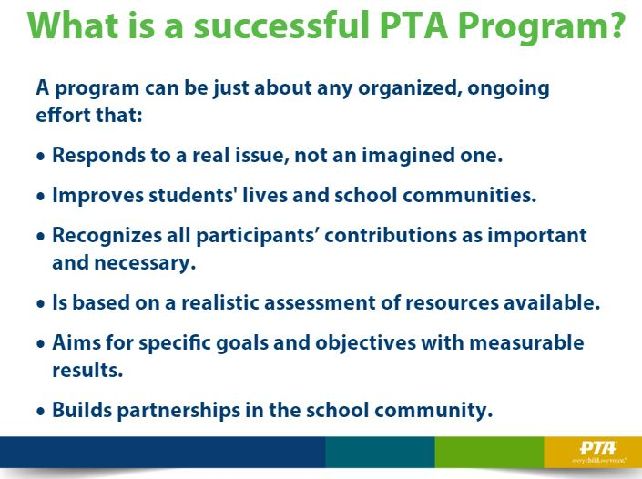

Slide 31
