Slide 1
Reflections

Slide 2
Welcome to Reflections!
Doty Hoffman
Missouri PTA Reflections Chair
dotyh@mopta.org
reflections@mopta.org

Slide 3
National PTA Reflections
The Reflections Program was created in
1969 by Mary Lou Anderson.
It was created to encourage students to explore their talents and express themselves in various forms of art.
Reflections is not a contest or competition, a recognition of the creativity of our Missouri students!

Slide 4
Art Categories
Dance Choreography
Literature
Visual Arts
Film Production
Music Composition
Photography

Slide 5
Grade Divisions
Primary: Pre-K through 2nd Grade
Intermediate: 3rd through 5th Grade
Middle School: 6th through 8th Grade
High School: 9th through 12th Grade
Special Artist: Pre-K through 12th Grade

Slide 6
Reflections: The Basics
Register your local unit over at pta.org
Accept artwork through the Fall
Enter artwork at pta.org by December 1st
State judging results announced early Spring
National winners announced early Summer

Slide 7
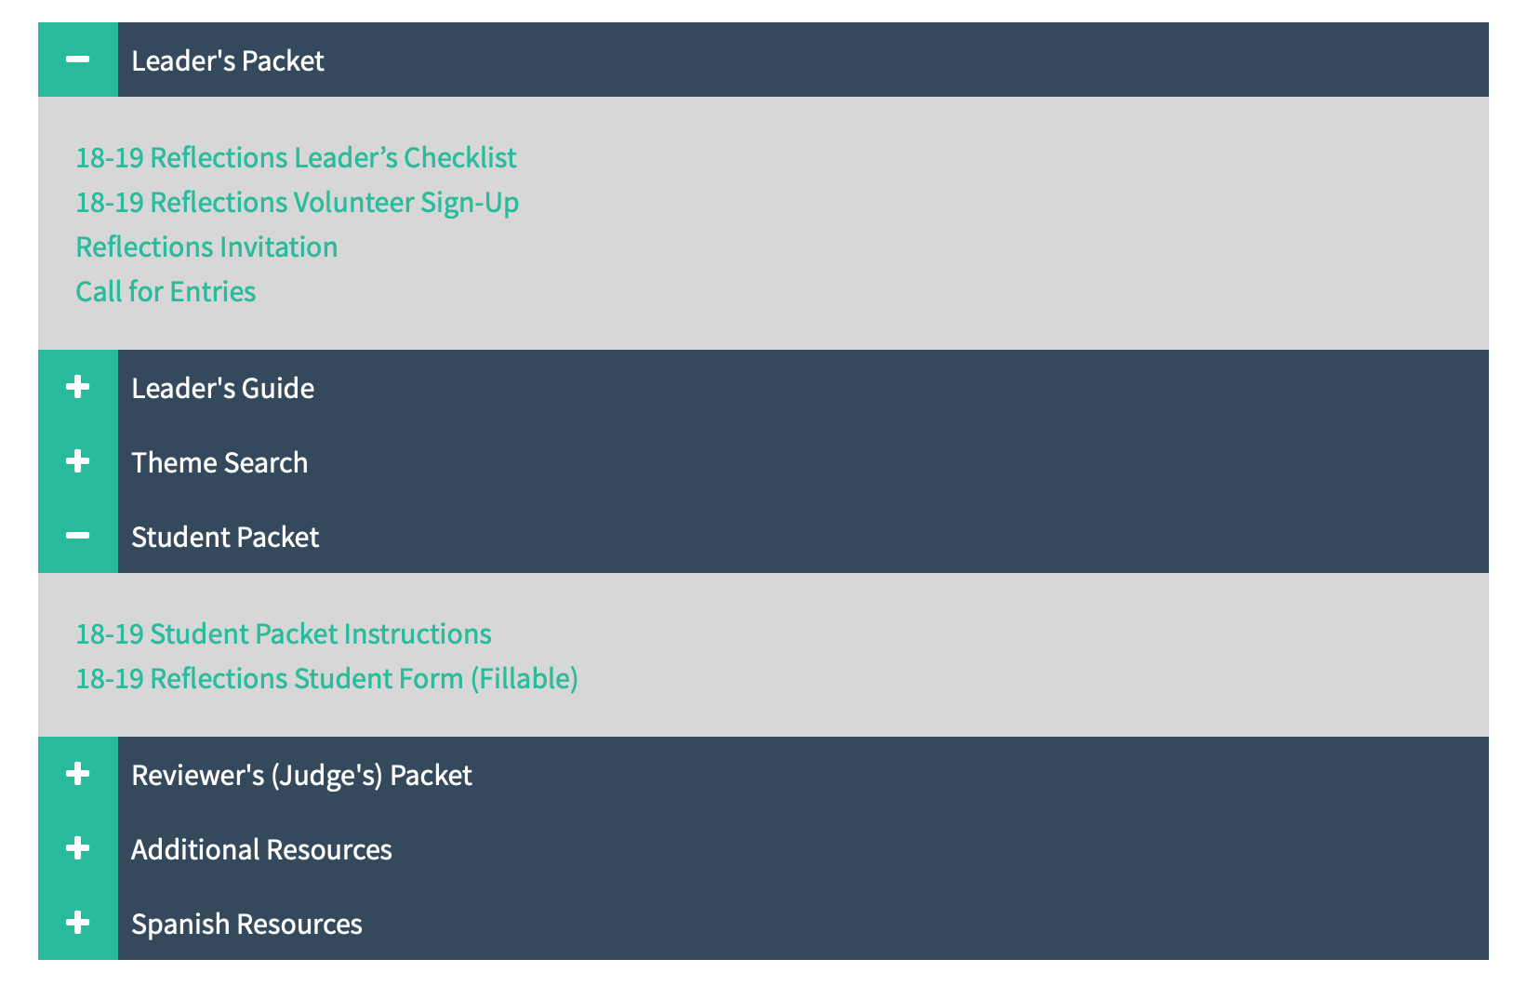
Reflections Resources
Local Leader’s Guide, Student Packet and more available at mopta.org

Slide 8
Artwork in Your Unit
Recruit a Reflections team!
Get the word out! Spread the word about Reflections through principal’s newsletters, in an assembly, on a school bulletin board, through social media, etc. Get the students excited and involved!
Encourage students to enter ALL forms of art in each of the different categories!
Be clear with DEADLINES! Make sure local deadlines align with State deadlines!
Engage school staff! Art teachers, music teachers, literature teachers, counselors!
Display the artwork entries, get creative!

Slide 9
Judging Artwork
Recruit judges! Ask teachers and staff members, PTA parents, other local resources to help judge the artwork.
CELEBRATE THE WINNERS! Certificates! Ribbons! Yearbook photo!
Prepare the artwork to be entered in the State program
Have students complete the Student Entry Form
Take pictures, scan literature, download music files, etc.
Thank your judges!

Slide 10
Entering Artwork at pta.org
Each Local Unit is allowed to enter three entries per category, per grade division
(For example: 3 entries in Visual Arts from Primary, Intermediate, Middle School & High School Grade divisions)
Create Login ID and password, Multiple Chairpersons can have IDs and access
Missouri PTA DOES NOT have access to local leader’s IDs or passwords

Slide 11
IMPORTANT INFORMATION!
A unit MUST be in GOOD STANDING! BEFORE the State deadline!
A unit can find their PTA ID number at pta.org
Make sure to enter the CORRECT information in the Student Portal
Spelling of the student’s name, Chairperson contact information, etc.
Missouri PTA is ALWAYS here to help! Never hesitate to reach out with any questions, ANY questions!

Slide 12
Get Excited for 2019-2020!

