Slide 1

Legislation and Advocacy
Kristina Wilmoth,
VP & Director of Legislation and Advocacy

Slide 2


Take out your phones!
Follow Missouri PTA on social media
@MissouriPTA
Interactions with Elected or Appointed Officials
It is ok to interact with elected officials or members of an executive administration (State and Fed level) with regards to legislation.
Use your unit or state affiliate’s Facebook and Twitter accounts to reach out to your elected officials to support or oppose legislation
Remember, because PTA is a nonprofit organization, you must refrain from interacting with the campaigns of elected officials or repost a message from anyone that has a campaign message for any candidate.

Slide 3
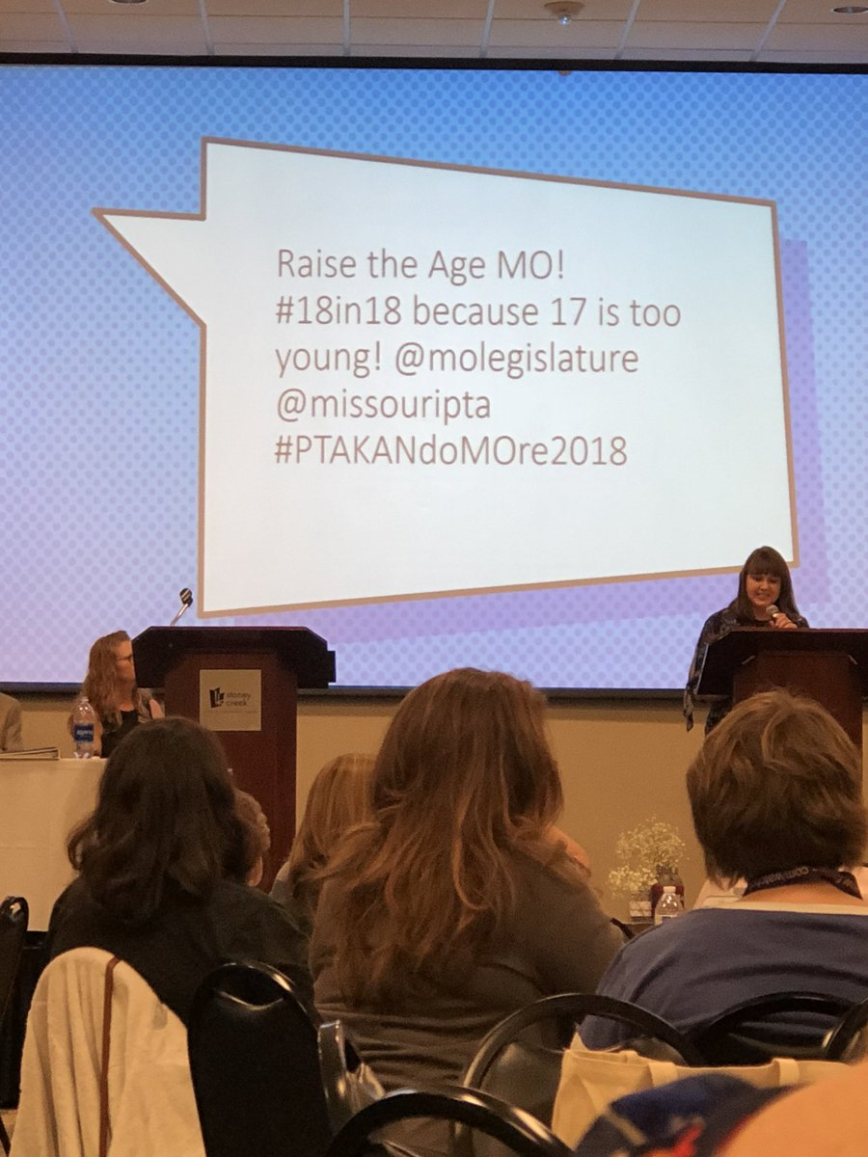
Thank you for being an advocate!
National PTA honored Missouri PTA with its 2019 Outstanding State PTA Advocacy Award for #18in18 Raise the Age Missouri
SB 793 (2018).
National PTA presented Missouri PTA with the award at a reception during the association’s 2019 National PTA Legislative Conference, Wednesday, March 13, 2019, at the Legislative Convention.

Slide 4
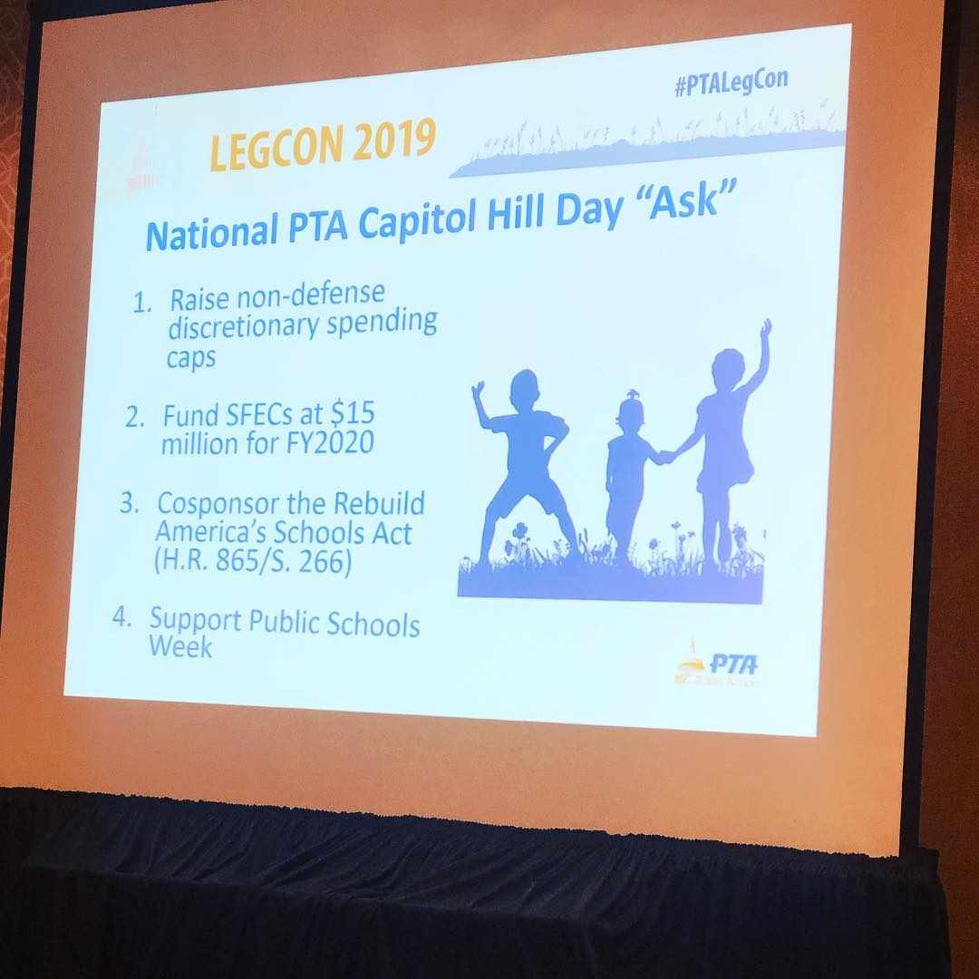
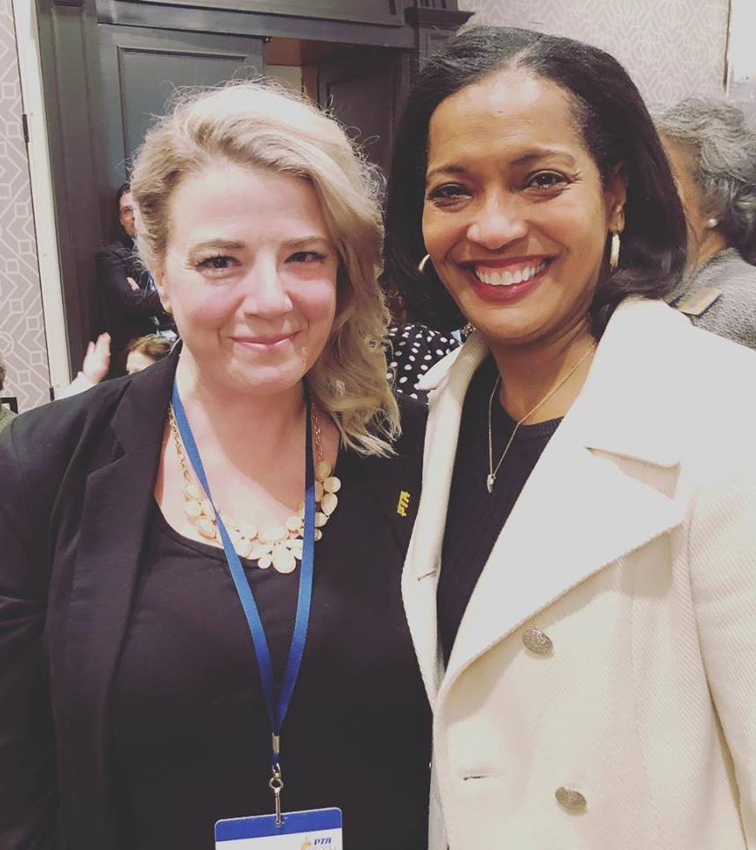
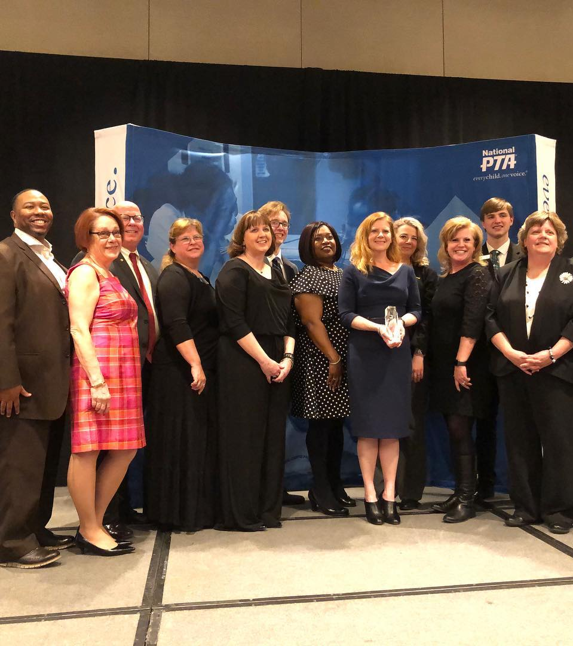
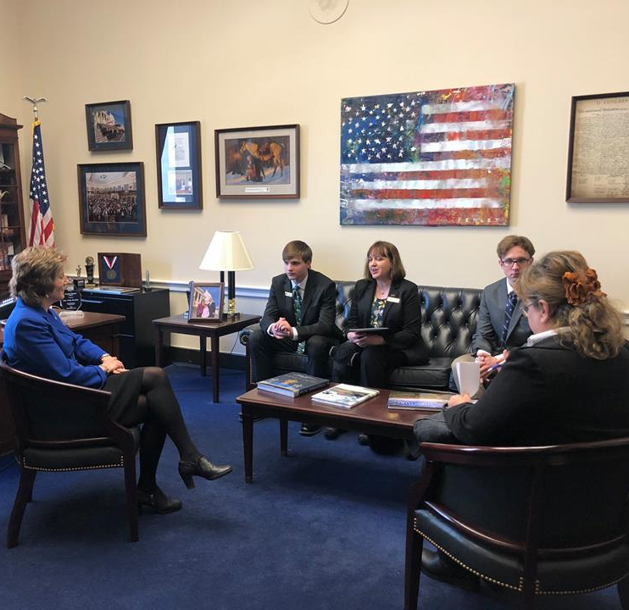
2019 National PTA LegCon

Slide 5
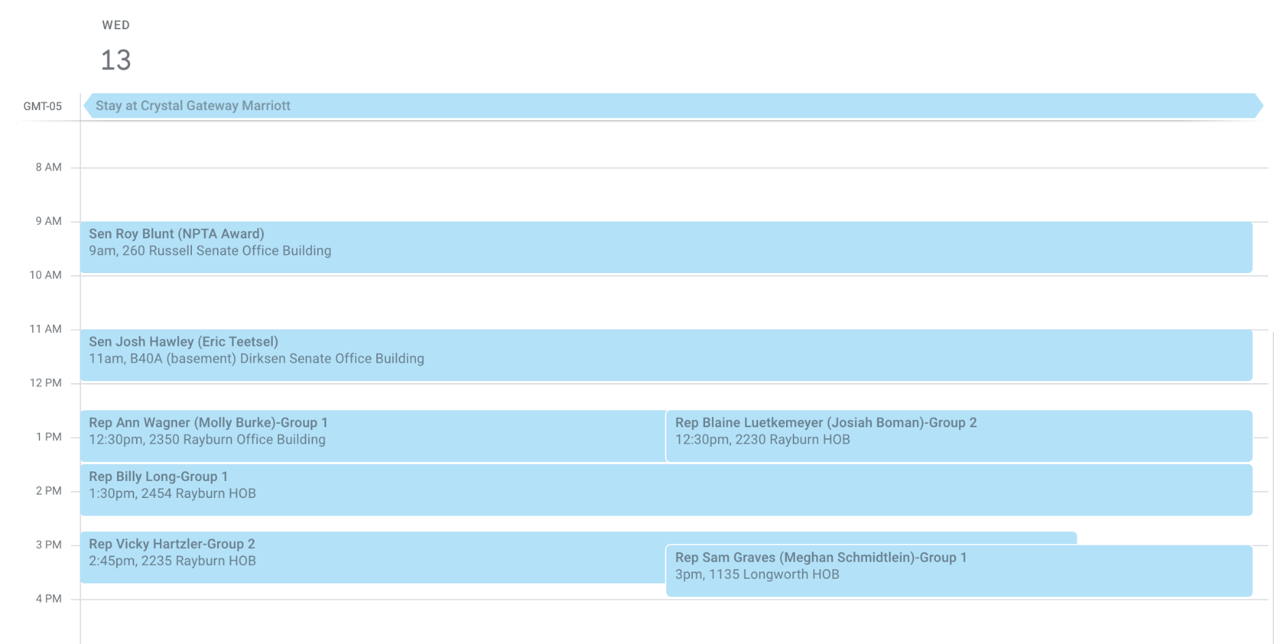
Hill Day 2019

Slide 6






Who Are We Now?
Notes:
6

Slide 7
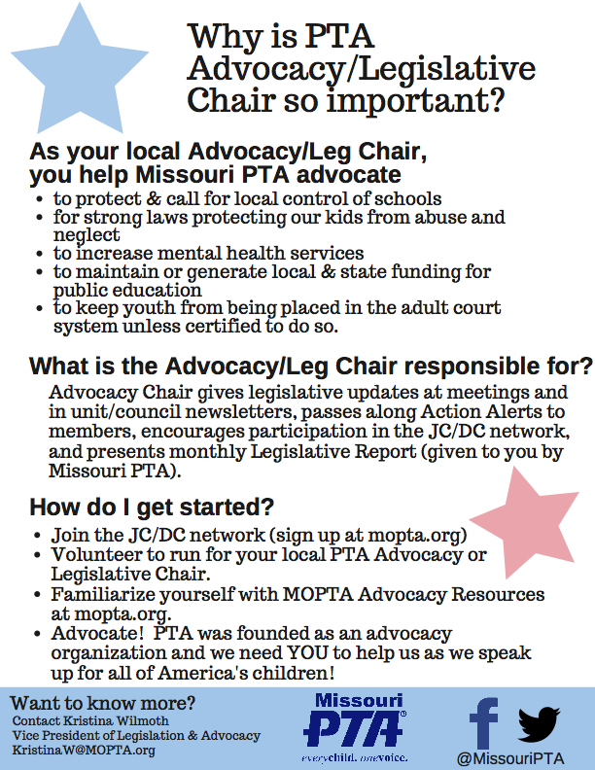

Slide 8
What Have PTA Members Accomplished?
1903
Worked With Policymakers to Create a Juvenile Court System
1911
Successfully Advocated to Establish Public School Kindergarten
1938
Successfully Advocated to Establish Child Labor Laws
1941
Successfully Advocated to Expand Federal School Lunch Program

Slide 9







How National PTA Advocacy Works
Government Affairs Team
Legislation Committee
4 Million PTA Members
54 Federal Legislative Chairs

Slide 10


Advocacy begins with you…
Regularly attend PTA Meetings
Attend school board meetings
Join JC/DC
Ask to receive MO Capitol Chatter (monthly Leg Report) or Kansas Vote Counts
Register to vote and vote
Hold a candidate forum
Contact legislators when Action Alerts are published
Meet candidates for office and ask questions

Slide 11

By becoming and Advocate you..
Keep the interest of PTA on the minds of policy makers.
Engage policy makers in a dialog that benefits PTA.
Effect the change that will benefit our children for generations to come.

Slide 12
Who are PTA Advocates?
PTA advocates speak up for every child to ensure a high-quality public education, no matter the race, ethnicity, disability, gender, income or place of birth.
PTA advocates engage families in schools, communities and all levels of government to protect the rights of all children and families.
YOU! You are a PTA Advocate.

Slide 13

The most important tool you have is to vote!
Consider holding a voter’s registration event.
Provide information on the candidates to our members. How do I learn about issues?
Local school board elections are the best way parents can impact the education of their children.
Post candidate information on your website or newsletters.
MAKE SURE YOU VOTE!!!

Slide 14
Federal Legislation
Quality Education
Elementary and Secondary Education
Special Education
Early Learning and Childhood Education
Post-Secondary Access & Opportunity
Federal Investments in Education

Slide 15
Federal Legislation
Health Safety and Overall Well-Being
Gun Safety & Violence Prevention
Juvenile Justice
Child Health & Safety
Education Technology& Student Data Privacy

Slide 16
Forms of Organizing for Social Change:
Form | Approach
Service | Providing a direct response or program to solve a problem
Education | Researching and raise awareness a problem to generate support for an issue
Speaking Up for Others | Researching and raise awareness a problem to generate support for an issue
Grassroots | Lobbying about an issue on behalf of a community. *Adapted from Midwest Academy with permission

Slide 17


Legislation
Please do not promote any legislation that has not been released by MO PTA without first contacting the office. The bills MO PTA (thus each Council and Unit) supports or opposes must meet either MO PTA or National PTA’s resolutions or position statements!

Slide 18


Things to Remember
You have a voice!
If join your voice with the other 44,000+ MOPTA members voices it they will be to loud to not be heard!
Every call or email counts!

Slide 19

PTA is a 501 (3) (c) organization
There is one basic rule: 501(c)(3)s may not support or oppose any candidate for public office. This means 501(c)(3)s may not endorse candidates, rate candidates, contribute to candidates, or do anything else that might seem intended to help or hurt a candidate.
PTA is a non profit organization, violating the rules could cause you to lose your 501 status. If in doubt contact MO PTA and ask.

Slide 20

What you can do…
PTAs should support issues that are good for children and youth. PTA should oppose issues that are bad for children and youth. That includes state and national legislation, as well as local laws and school district policies. PTA can and should take a stand on bond and levy issues.
PTAs can sponsor public forums (including candidates forums – all candidates must be invited), lectures and debates.
Educate candidates on issues important to PTA.
PTAs can send out questionnaires to all candidates asking in an unbiased way for their positions on issues. The results must be reported accurately and without editorial comment.
PTAs can conduct voter registrations. The registration must be open to anyone, regardless of which party or candidates they want to vote for after registering.
Remind members to vote.

Slide 21

What you cannot do…
Invite only one candidate in an election to come speak to the PTA.
Tell PTA members to only vote for a candidate who supports X position.
Distribute any campaign materials on behalf of a candidate.
Wear campaign buttons or T-shirts during a PTA meeting.
Establish, participate in or support PACs (Political Action Committees).

Slide 22

Communicating Your Message: The Power of PTA’s Voice
PTA media
2. Social media
3. News media
4. Word of mouth

Slide 23

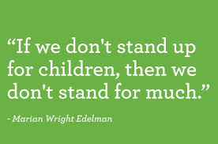
For more information, contact:
Kristina Wilmoth,
VP and Director of Legislation and Advocacy MO PTA
KristinaW@MOPTA.org

