Slide 1
PTA Resources
Workshop
2019 Convention
Springfield, Mo

Slide 2
Let’s start with a few questions
What Resources are you aware of that are available?
What are some of the Resources that you currently use for your PTA?
What are you doing for training within your PTA?
Have you ever reached out to MO PTA or looked at the website for resources?
Have you ever looked at the National PTA website for resources

Slide 3
State PTA Resources

Slide 4
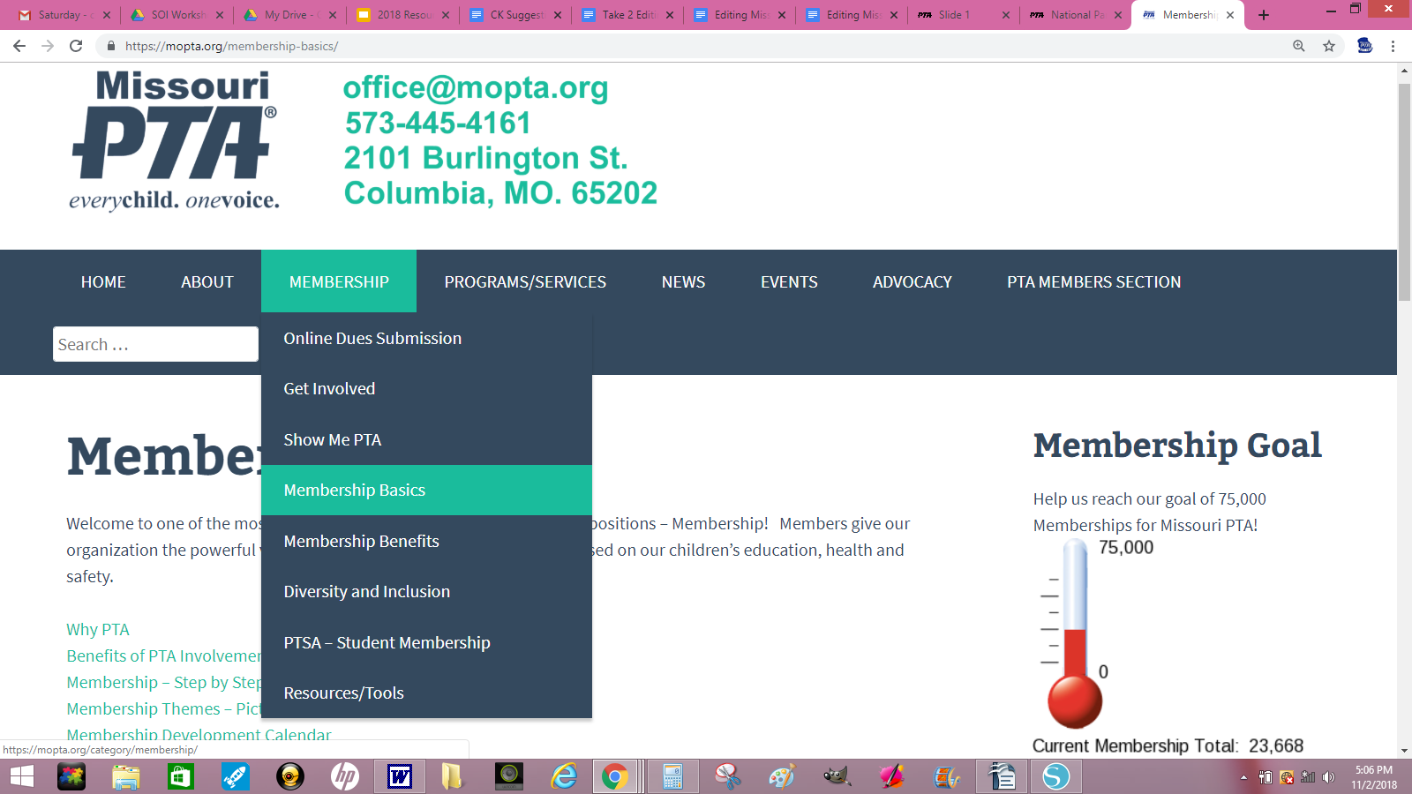
Missouri PTA website
www.mopta.org

Slide 5
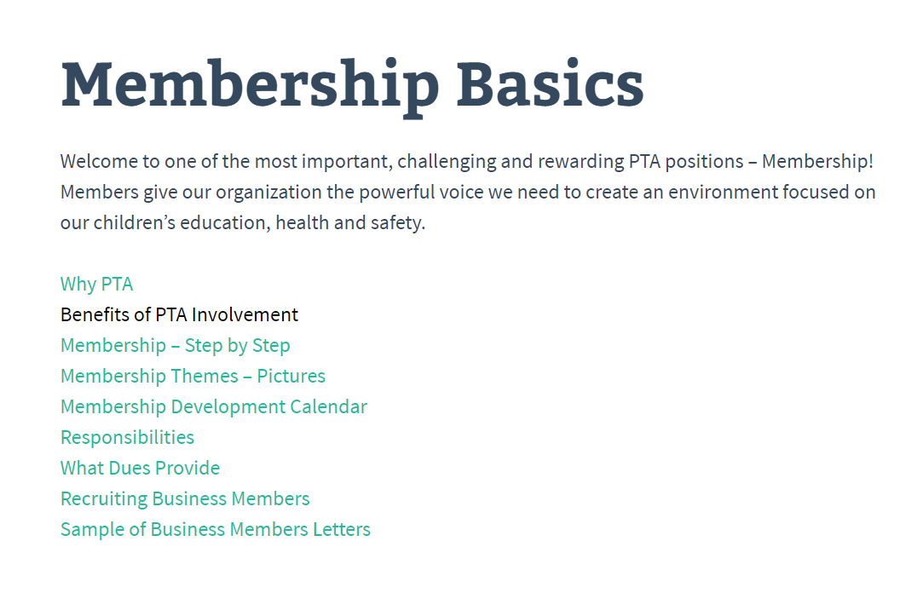

Slide 6
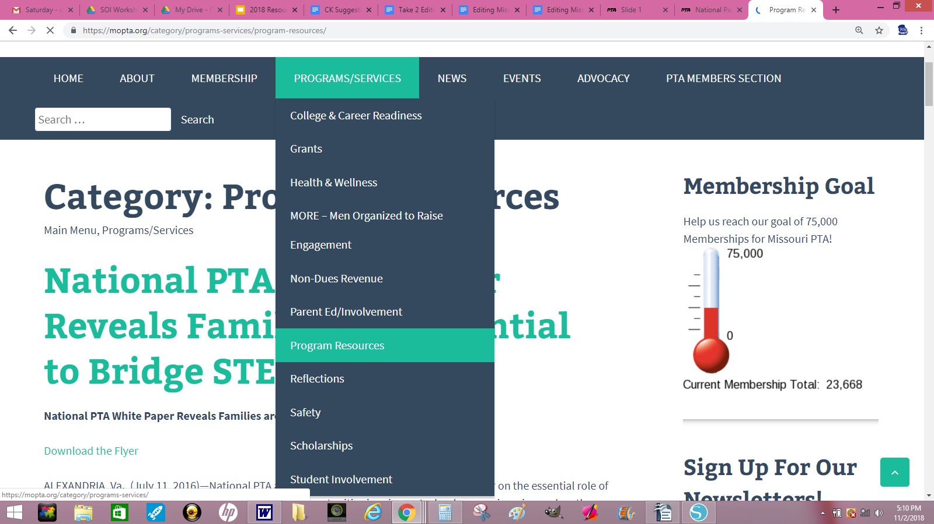
Missouri PTA website
www.mopta.org
Notes:
Non Dues Revenue - Uncle Ben’s, Good Housekeeping, H & R Block

Slide 7
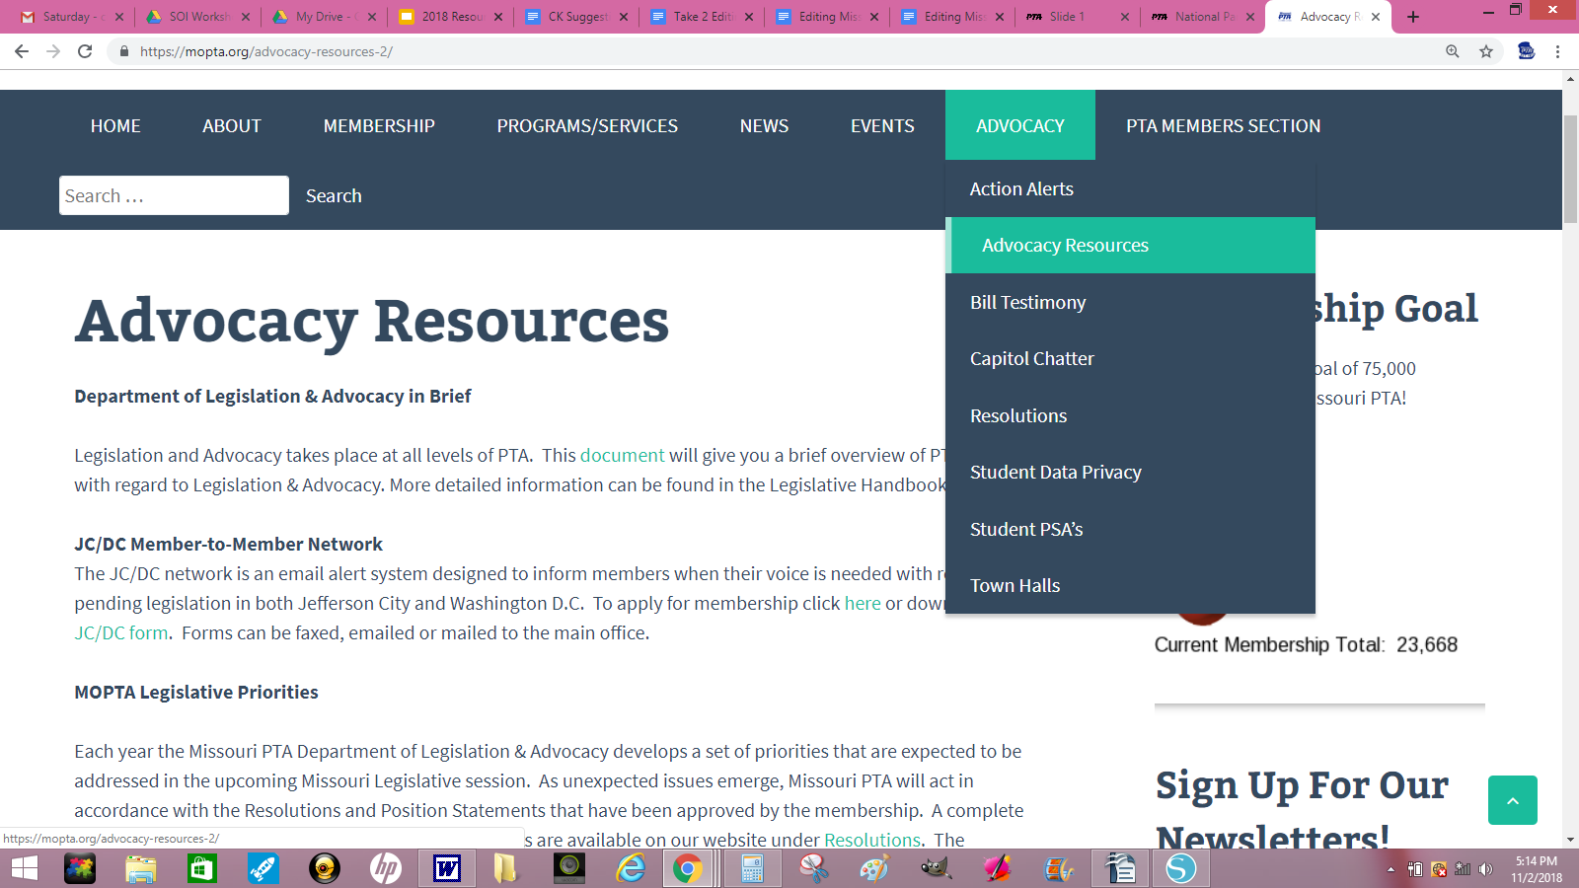
Missouri PTA website
www.mopta.org

Slide 8
Missouri PTA website
www.mopta.org

Slide 9
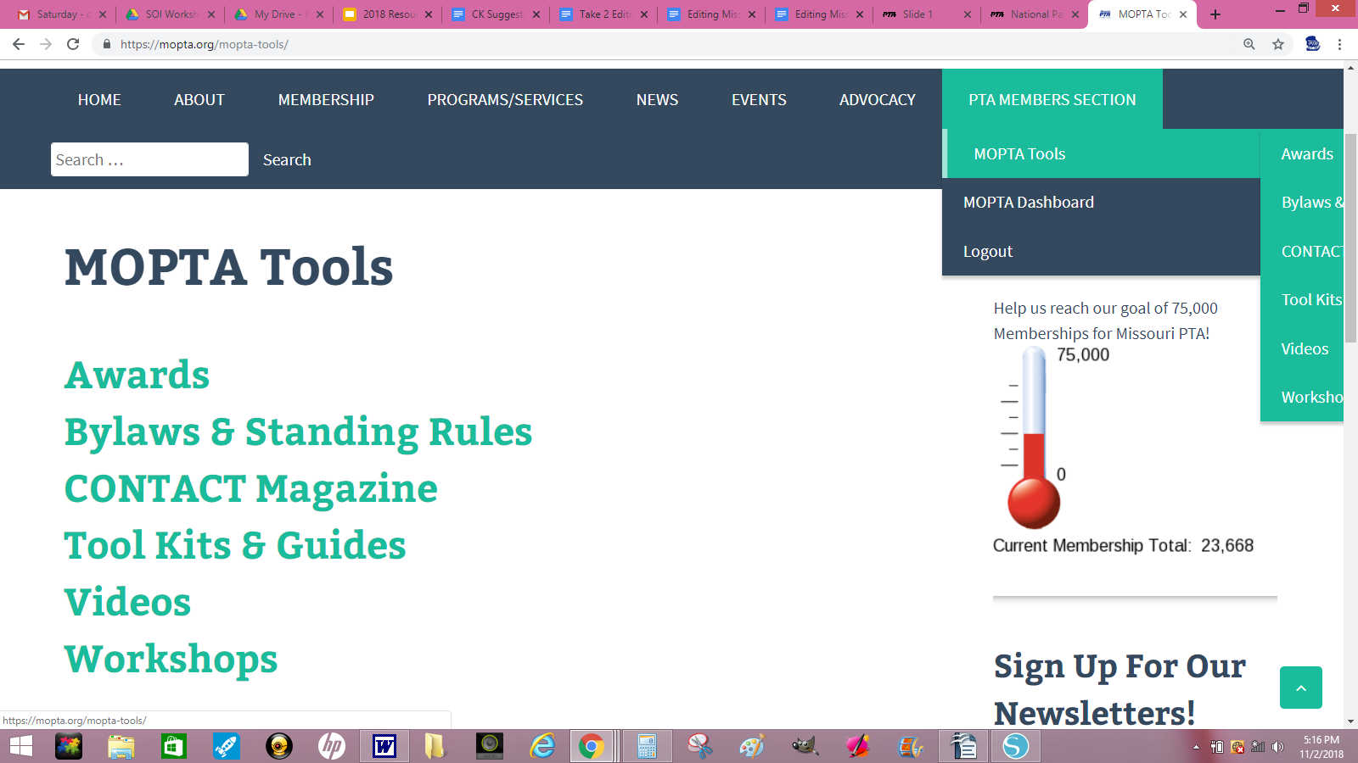
Missouri PTA website
www.mopta.org

Slide 10
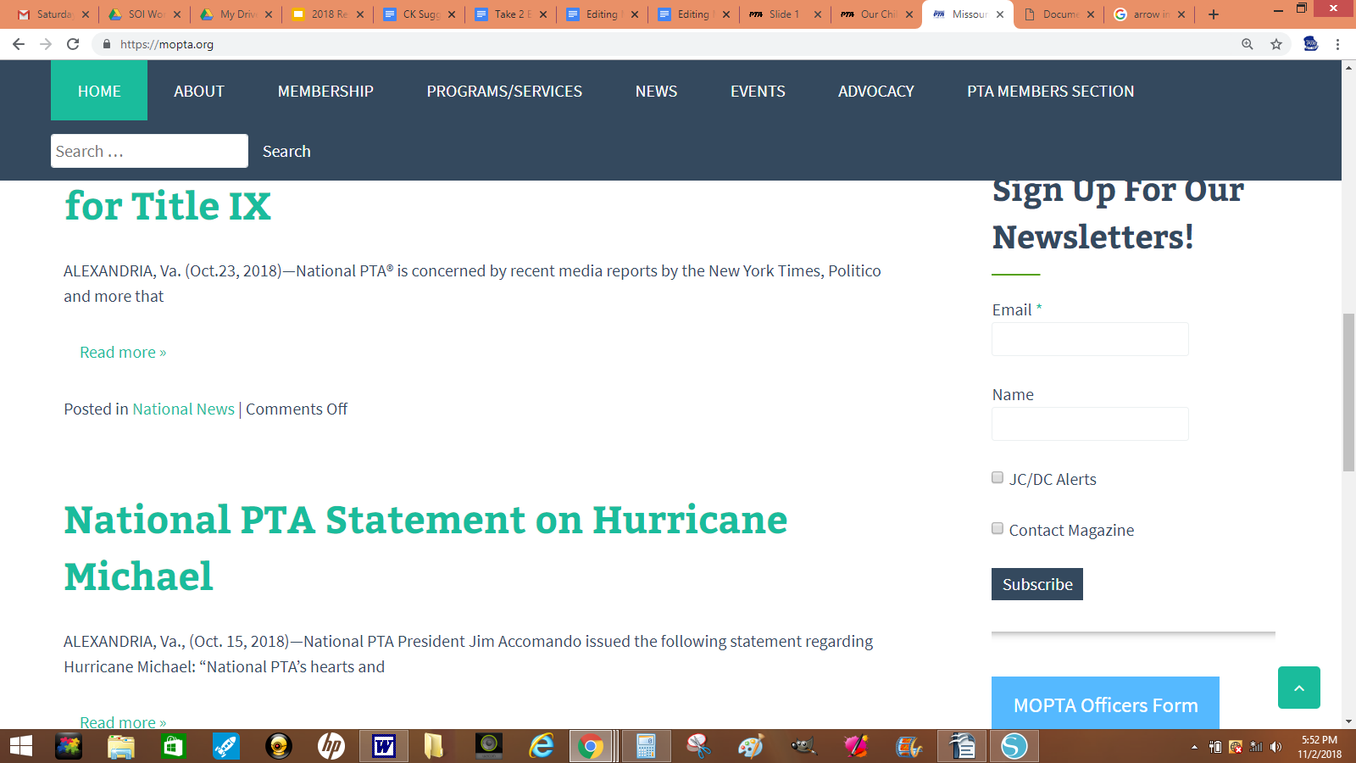
Missouri PTA website
www.mopta.org

Slide 11
National PTA Resources

Slide 12
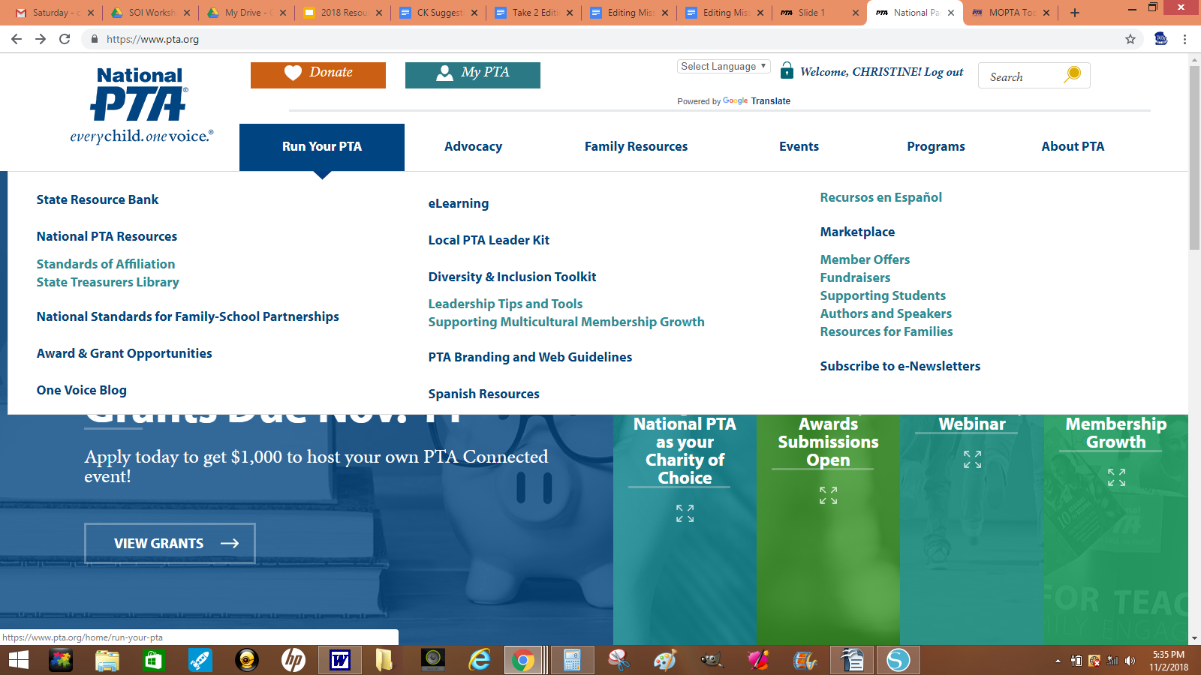
National PTA website
www.pta.org

Slide 13
National PTA website
www.pta.org
National PTA publishes five e-newsletters that reach a combined audience of more than 325,000 PTA leaders, parents, teachers and students.

Slide 14
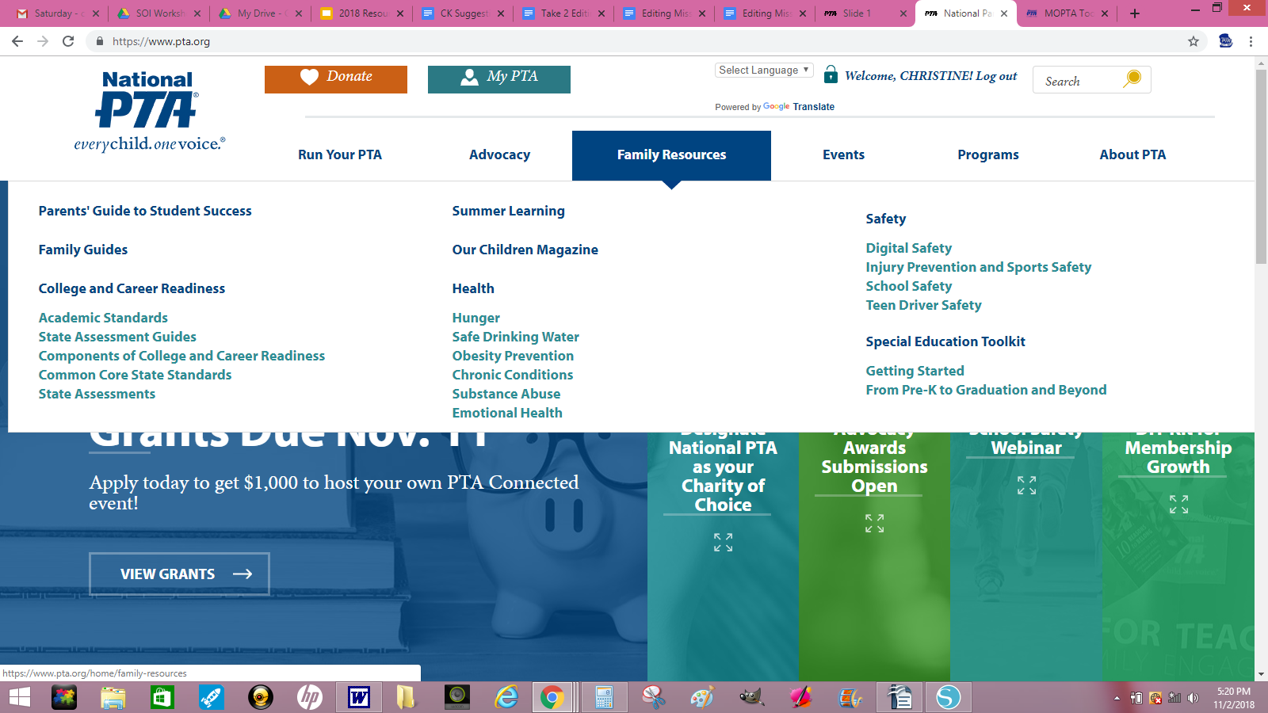
National PTA website
www.pta.org

Slide 15
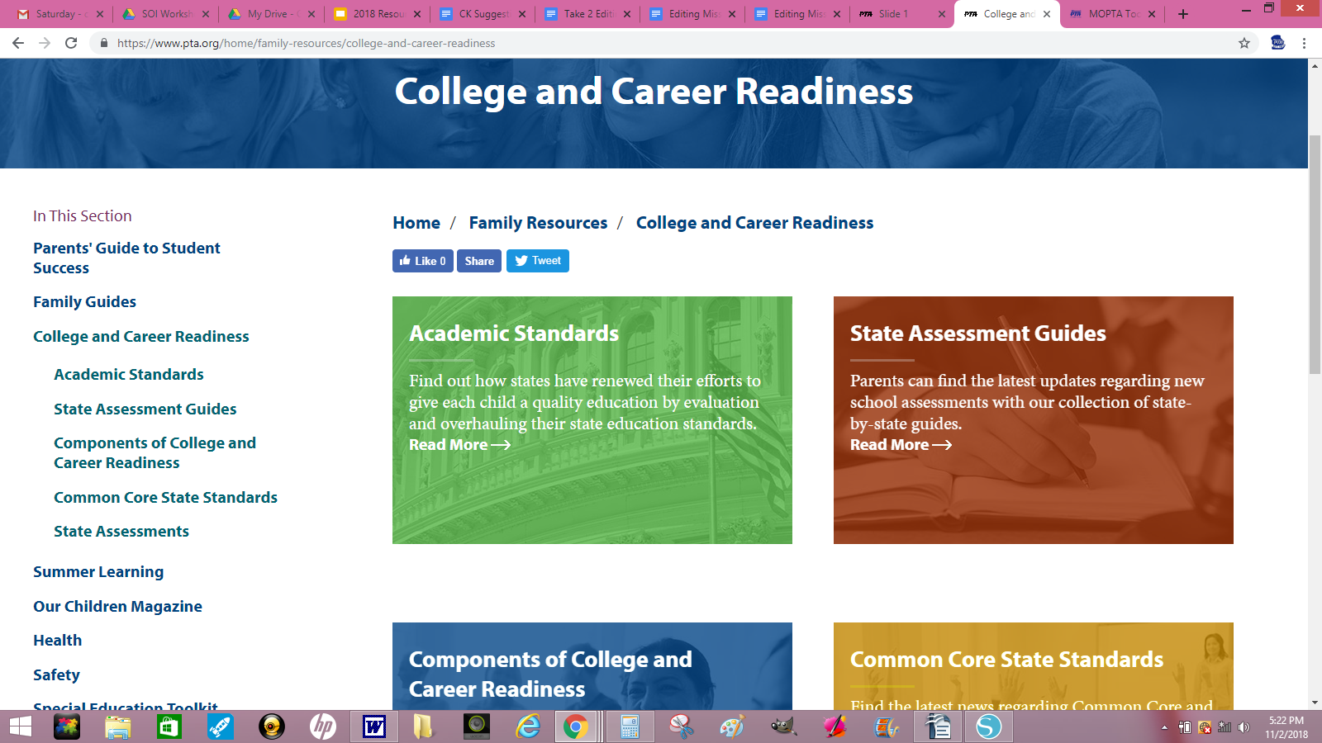
National PTA website
www.pta.org

Slide 16
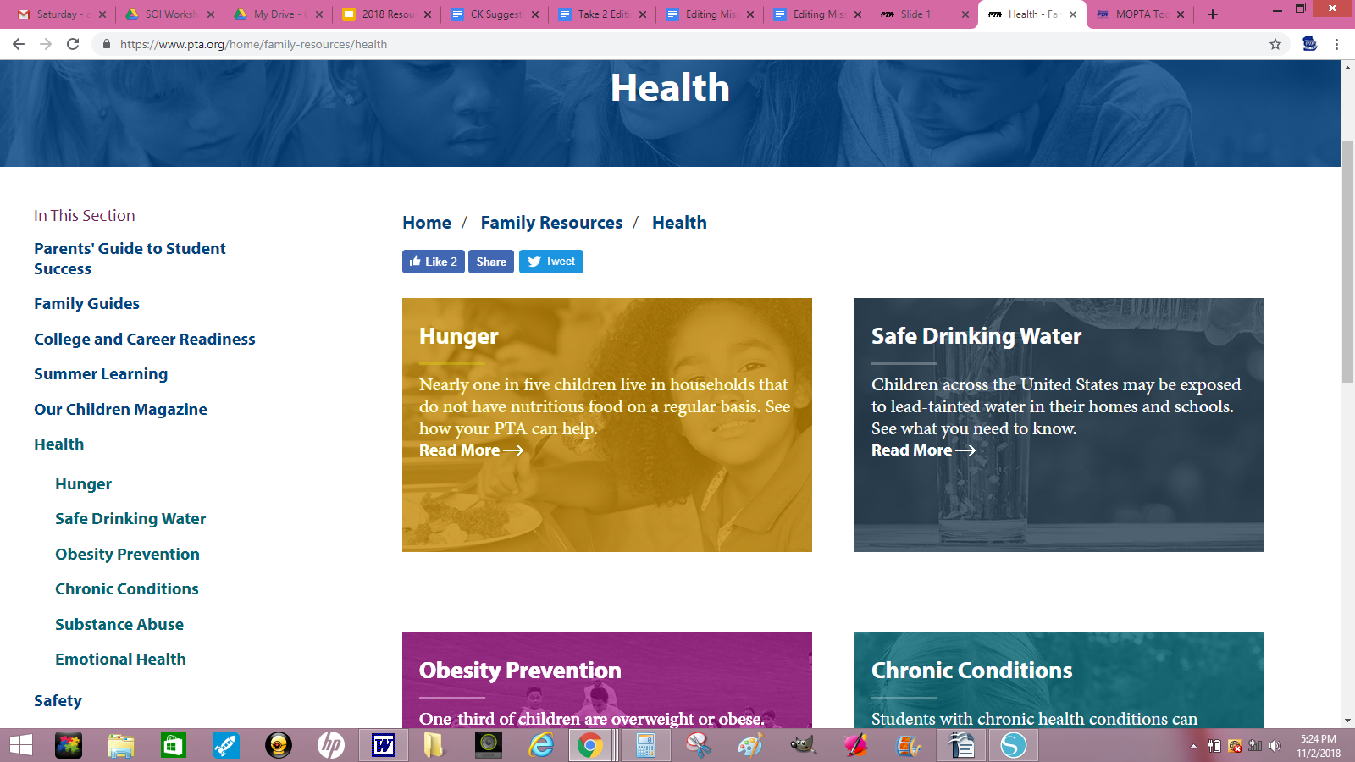
National PTA website
www.pta.org

Slide 17
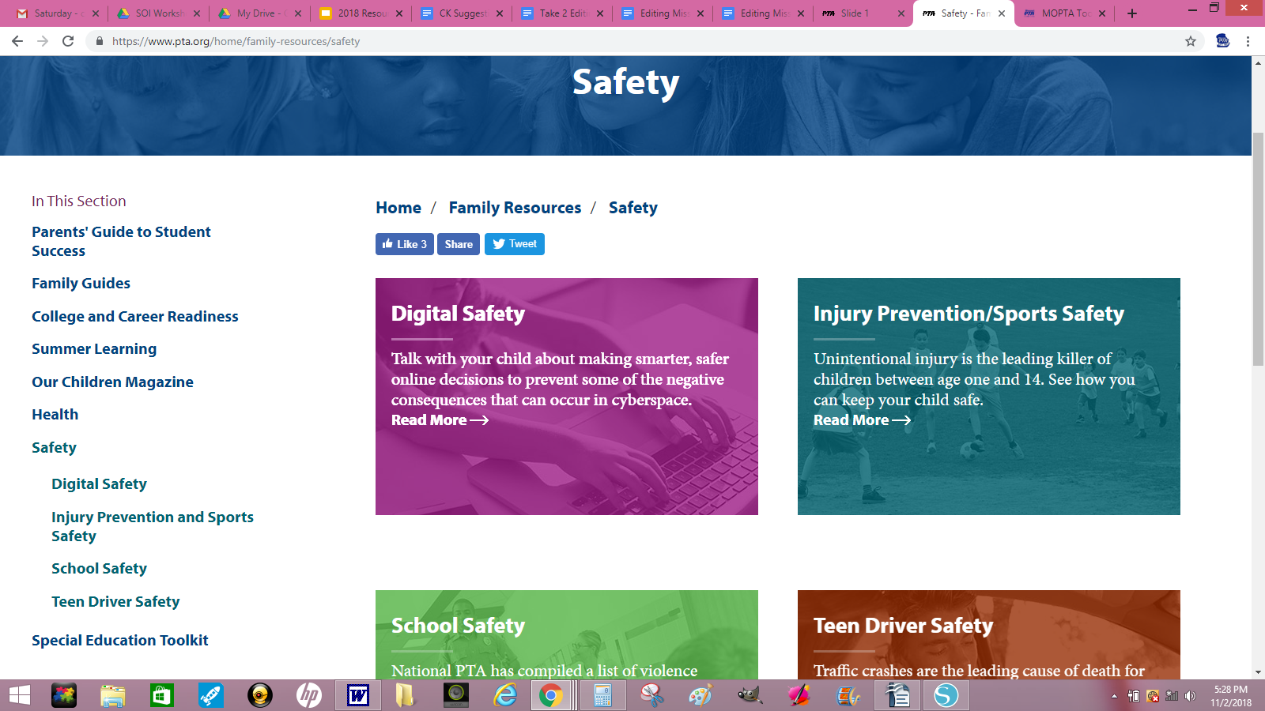
National PTA website
www.pta.org

Slide 18
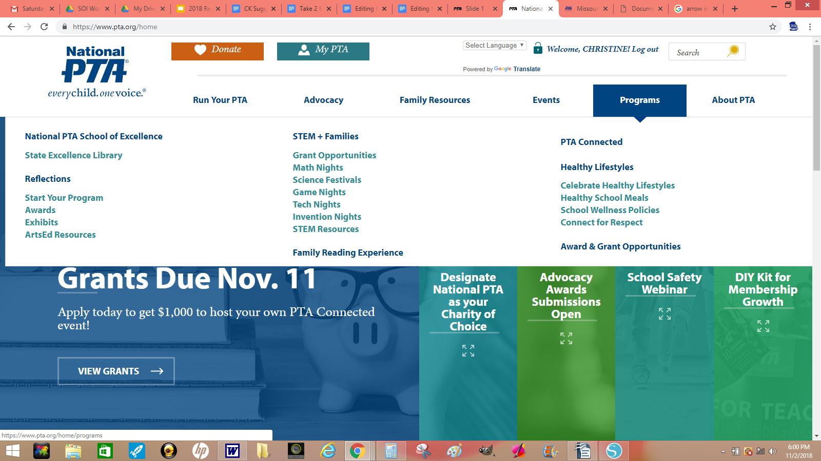
National PTA website
www.pta.org

Slide 19
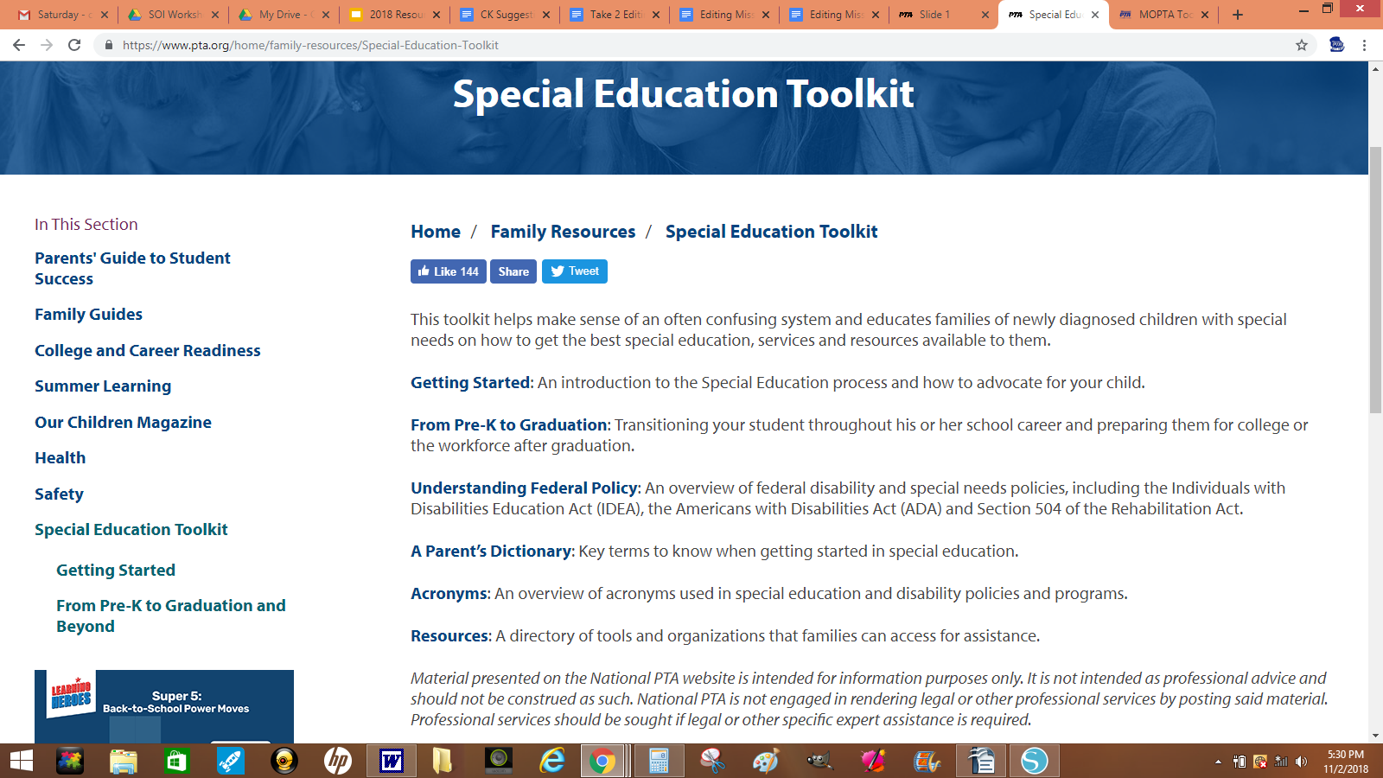
National PTA website
www.pta.org

Slide 20
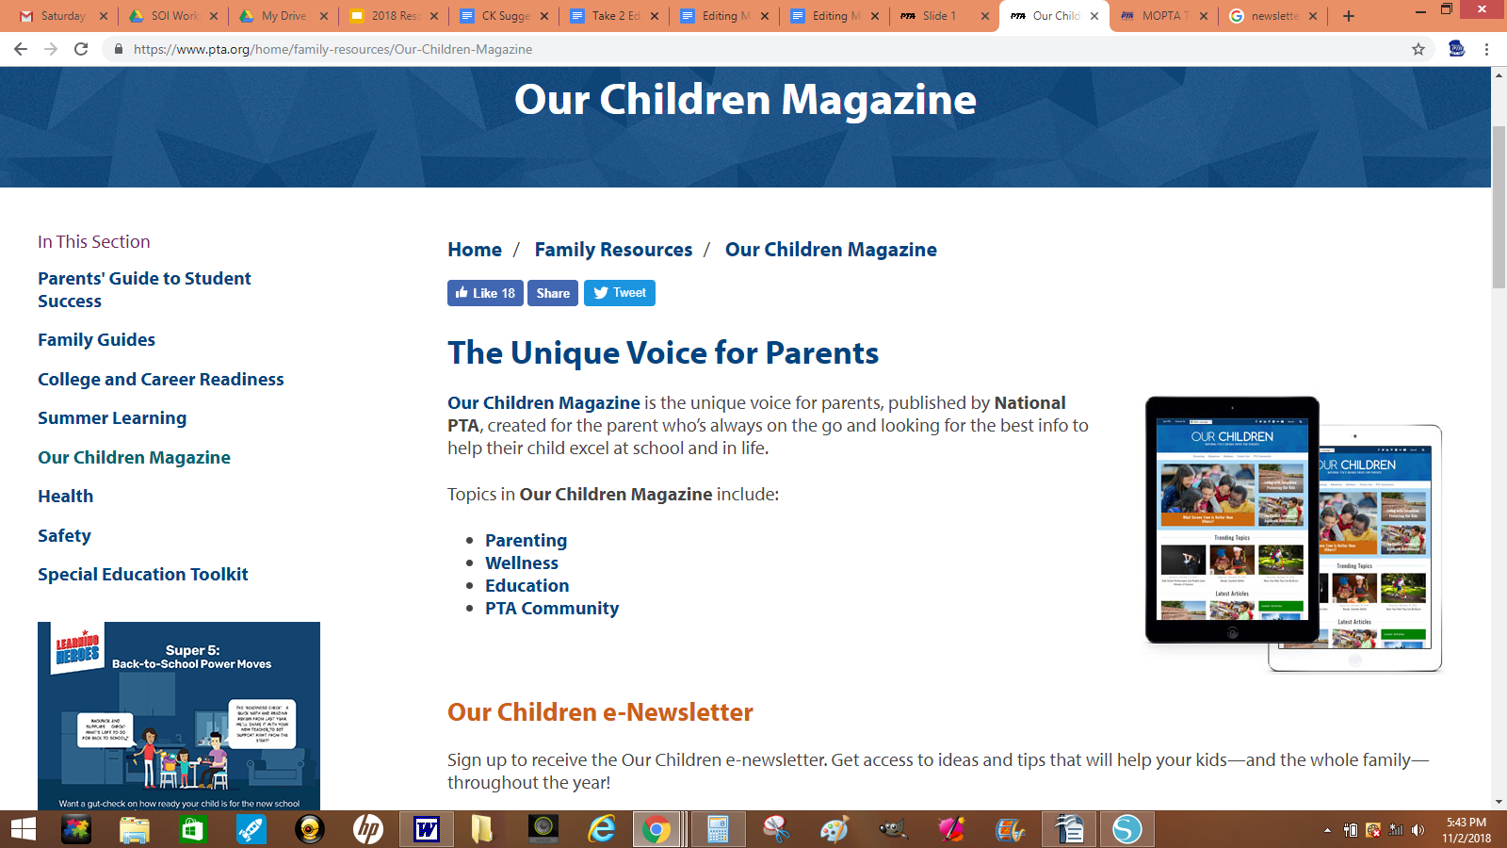
National PTA website
www.pta.org

Slide 21
Other Useful Resources

Slide 22
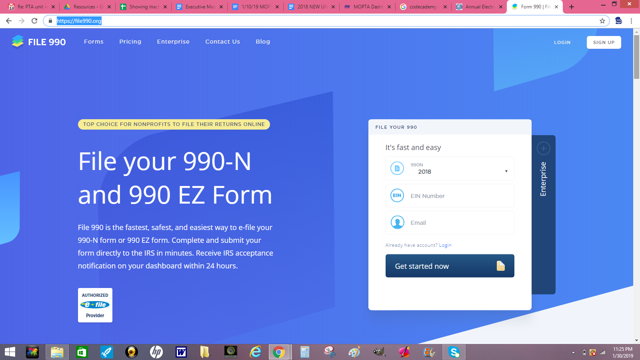

Slide 23
Document Storage & Email:
Google - Google offers access to the G Suite of apps, email, expanded document storage, google calendars and more. https://www.google.com/nonprofits/
Communication with members/board:
Create an email database from memberships and use to send reminders, newsletters, etc.
Remind.com is a service that members can subscribe to, and you can send out reminders or messages
easily from a phone or computer. You can create separate groups for the individual needs of your PTA.
Getting Volunteers:
SignUpGenius.com is BRILLIANT! If you want volunteers, you have to ASK for them. SignUpGenius takes a lot of the work out of managing volunteers. You upload your email database, create your sign up and send it out. People can sign up for time slots, items to bring, etc, and SignUpGenius
will keep track of it all and even send people reminders!

Slide 24
Other PTA Websites
What are other PTA’s doing?

Slide 25
The BEST Resource of all is our VOLUNTEERS!

Slide 26
Thank you,
for all that you do!

