Slide 1
Creative & Captivating Communication
Andrea Battaglia, MoPTA VP Communication
andreab@mopta.org
When you’re good, you’ll tell others about it. When you’re great, others will tell you.
Branding includes the distinctive characteristics that make you extraordinary
It’s what people say about you when you’re not in the room
Communication is how you convey your message.
Select graphics used from Pinterest.com - MackWebSolutions.com

Slide 2
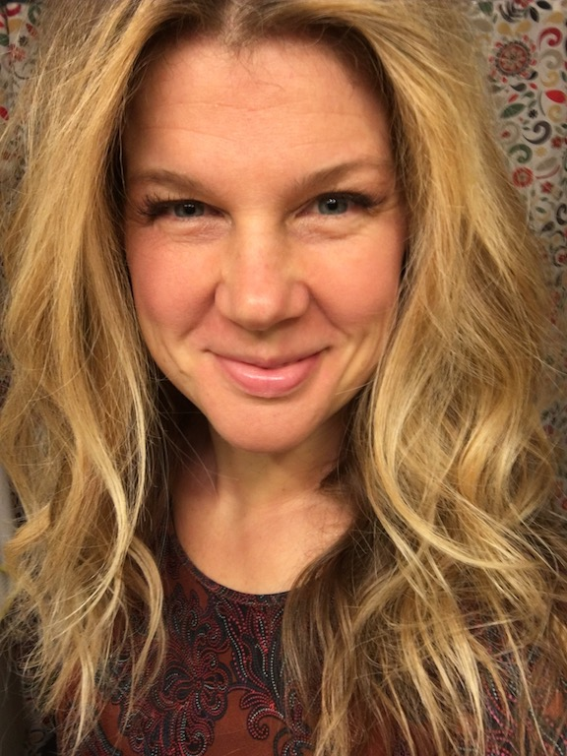
Andrea Battaglia Presenter Information
Work full-time in Fundraising, Marketing & Strategy, helping groups effectively manage communication and brand
Organization Expert & Wellness Advocate, communicate consistent message through personal brand.
Professional Trainer & Facilitator for groups of all sizes and competency levels – develop effective strategy and action plans to improve groups

Slide 3
Define & Elect
Creative & Captivating Communication
Define your goals
What do you want to do?
Why does it matter?
Elect/Select your passionate & committed team
Who are three people that could help you for one hour per month?
What is the best way to involve school administrators?
Who is someone that can take the next step in their leadership development?
Clever
Imaginative
Ingenious
Innovative
Inventive
Original
Gifted
Inspired
Talented
Consistent
Resourceful
Regular
Dependable
Steady
Expected
Informative
Trustworthy
Stable

Slide 4
Develop & Empower
Creative & Captivating Communication
Develop your strategy
How do you want to accomplish your goals?
What action steps will keep your plans going?
Who will be involved?
Empower your team
Set them up for success by addressing concerns, answering questions, and encouraging ideas
Inspire confidence & trust by your responsible, relevant actions
Set priorities and timelines
Clever
Imaginative
Ingenious
Innovative
Inventive
Original
Gifted
Inspired
Talented
Consistent
Resourceful
Regular
Dependable
Steady
Expected
Informative
Trustworthy
Stable

Slide 5
Learn & Create
Creative & Captivating Communication
Learn to be present, available and aware
Meet new people
Remember why you started
Read & utilize resources to stay relevant
Create: Communicate value through consistent, valuable & fun messages
Create Timing Plan (when)
Determine Best Methods (what)
Social Media & Website
Brochures/Posters/Banners
Email/Newsletters
Meetings & Events
Text Message Invites – Remind Me
Personal Recommendations
Teacher Newsletters/School Notes
Clever
Imaginative
Ingenious
Innovative
Inventive
Original
Gifted
Inspired
Talented
Consistent
Resourceful
Regular
Dependable
Steady
Expected
Informative
Trustworthy
Stable

Slide 6
Share & Build
Creative & Captivating Communication
Share your message
Over communicate – keep everyone involved
Follow the 80/20 Pareto Rule
Determine what works best for your people – it will be a multi-channel communication strategy
Person-to-person and personal testimony
Build on your plan and success
Don’t wait for things to happen, make them happen
Be human and available (relatable, reliable, advocate – voice of reason)
Recognize and celebrate awesome
Clever
Imaginative
Ingenious
Innovative
Inventive
Original
Gifted
Inspired
Talented
Consistent
Resourceful
Regular
Dependable
Steady
Expected
Informative
Trustworthy
Stable

Slide 7
Measure
Creative & Captivating Communication
Measure, track progress and make changes
Review events, attendance, participation
Work on needed improvements
Always bring it back to your goals
Clever
Imaginative
Ingenious
Innovative
Inventive
Original
Gifted
Inspired
Talented
Consistent
Resourceful
Regular
Dependable
Steady
Expected
Informative
Trustworthy
Stable

