Slide 1
RETAIN
AND
RECRUIT VOLUNTEERS
PRESENTED BY: SPARKL A. PRUITT

Slide 2
vol·un·teer
As the dictionary defines the word volunteer:
noun
plural noun: volunteers
1. a person who freely offers to take part in an enterprise or undertake a task.
2. a person who voluntarily undertakes or expresses a willingness to undertake a service: such as
a: one who enters into military service voluntarily
B (1): one who renders a service or takes part in a transaction while having no legal concern or interest
intransitive verb
1. to offer oneself as a volunteer

Slide 3
Reasons Why We Don’t Volunteer
No one ever ask
I didn’t know the PTA needed volunteers
To receive personal recognition
The last time I attended an event it seemed very unorganized
Diversity – The PTA does not look like me
I didn’t think I would fit in. The group looked very cliquish
The last time I volunteered, the president rushed through the instructions when he was telling me what I needed to do
The last time I volunteered, no one ever said thank you
I think it takes too much time to volunteer
The PTA doesn’t seem inviting and they act like they don’t need me
I don’t have a high school diploma or the education needed
My children will not be going to this school after this year

Slide 4
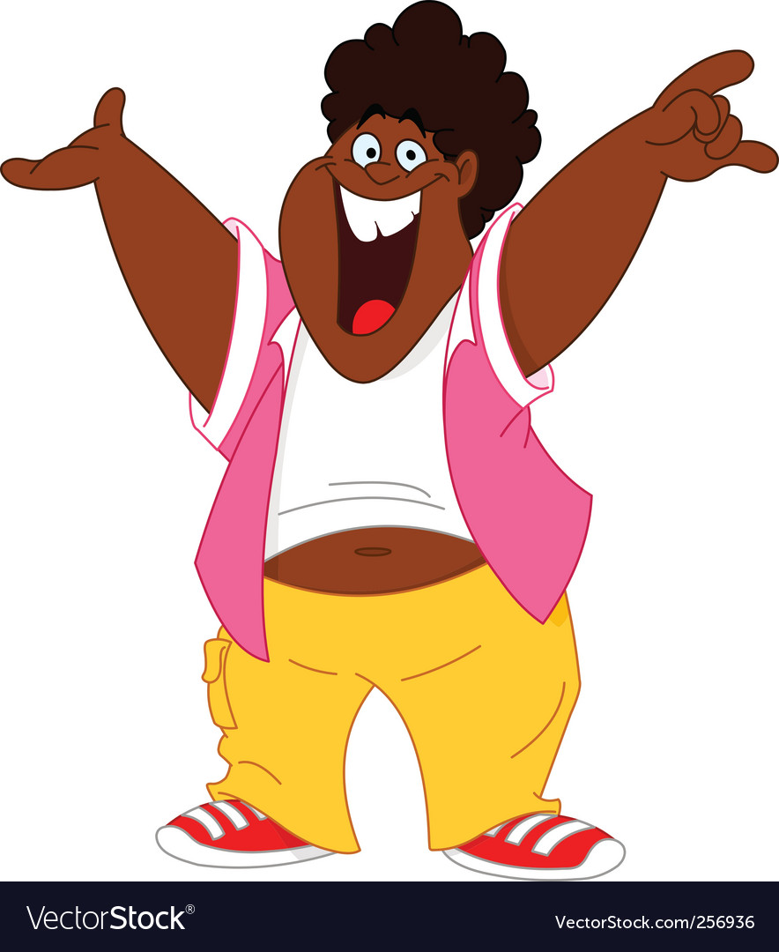
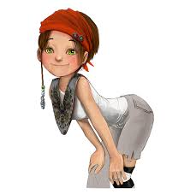
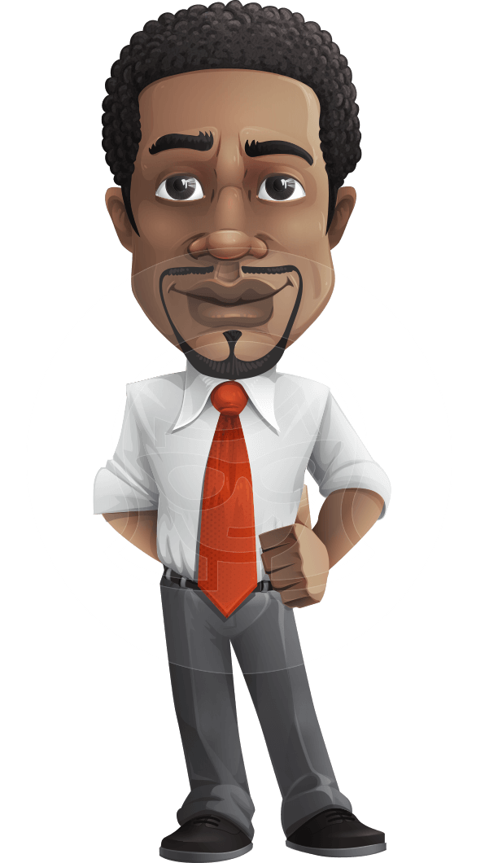
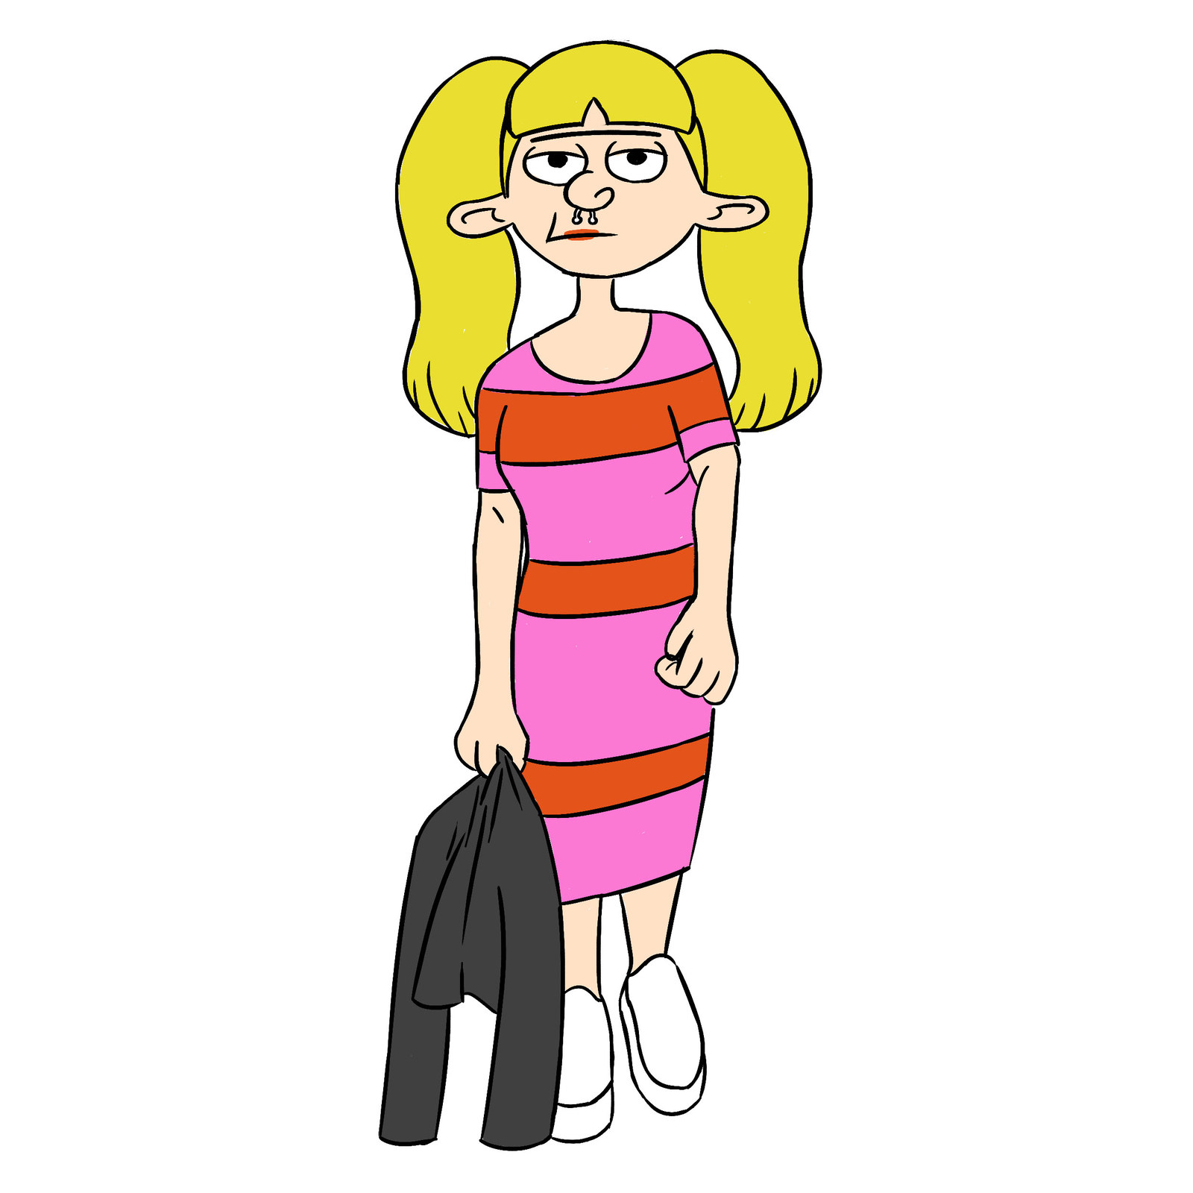
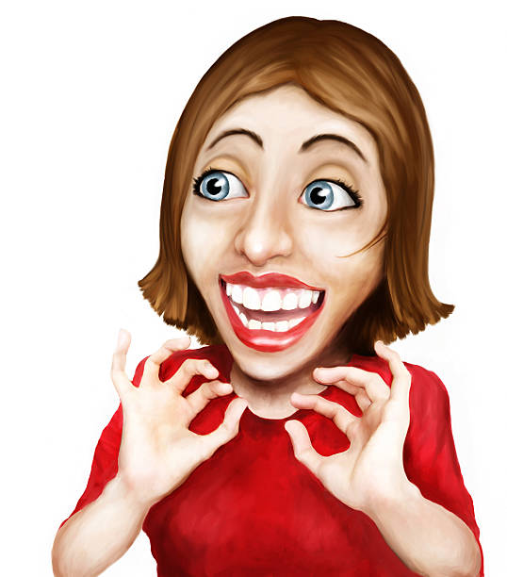
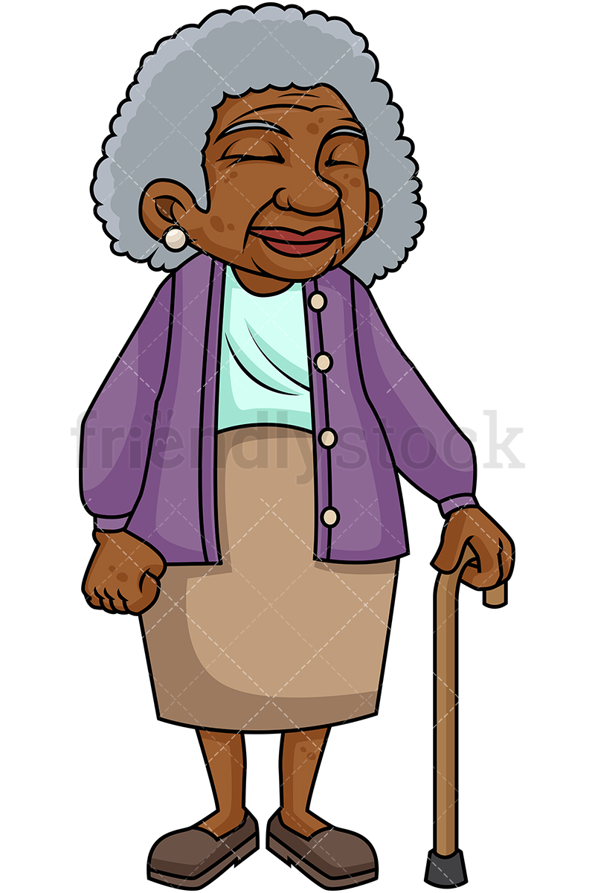
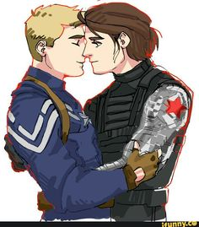
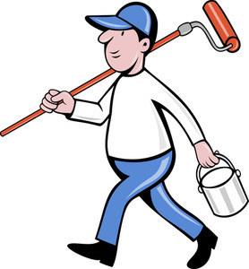
Who Do Volunteers Look Like

Slide 5
Why We Don’t Ask For Volunteers
FEAR
We fear they may take over
Fear that they don’t know what we know and they will mess everything up
We feel they may not be qualified
We don’t like talking to people
Prejudge - We don’t like the way they dress or look
We heard that they are homeless or in transition
We feel they are not dependable
They are not a PTA member
They told me NO before
I really don’t know what I’m doing and I may give the wrong information
Their child is leaving the school next year

Slide 6
Reasons Why People Volunteer
To feel connected to a cause or purpose
They have a personal interest or want to receive personal gratification
To receive personal recognition
They have a need to feel wanted or needed
To have an impact in the community or association
To build their resume or explore a career
To gain leadership skills
To learn something new
To meet new people and/or gain new friends
To feel good or proud
They have a passion for helping others

Slide 7
Where Do We
Get Volunteers
Parents of our students
Open House / Back to School Fair
Teachers from school
PTA members
Local Churches
Senior Assisted Living Homes
Meet them in the line at the grocery store
Local coffee shop
Volunteers Provide:
Information
Talents
Support
Leadership
Manpower
Help
Organization
Details
Vision
Customer Service

Slide 8
Don’ts and Do’s
Don’ts
Do’s
Be negative about PTA or Volunteering
Pre-Judge or assume
Don’t judge the parent based on what you know about their child(ren).
Take on tasks, events, meetings, confrontation, or projects alone
Harbor ill feelings or hold grudges
Get frustrated
Brag about previous or other volunteers
Toot your own horn
Ignore those who are helping
Create or be involved in a cliques or give the impression that PTA is an elite and exclusive group
GOSSIP OR TALK ABOUT THE VOLUNTEERS
If you don’t have anything nice to say don’t say it at all
Don’t give your opinion about someone
Maintain a positive attitude
Be inviting, approachable and welcoming.
Invite everyone to join PTA and volunteer
Be organized and plan events
Be open to new ideas and suggestions
Communicate in several different ways
Email, phone call, text message
Be willing to explain the task several times (in a nice voice tone) if the volunteer does not understand
Be respectful of the volunteers time
Explain the advocacy in PTA and Volunteering
Be the example of a great volunteer
Follow-up after your initial meeting, call and email within 48 hours of obtaining their phone number.
Call them if you haven’t seen them in a few days or if they miss an event.

Slide 9
Ask Someone’s Knowledge
Get to know your volunteers talents.
Ask questions
Get to know your volunteers
Acknowledge Special Kindness
Create name tags for your volunteers. This help others acknowledge volunteers too.
Mention volunteers by name during the welcome of a meeting or event.
Appreciate Specific acts of Kindness
Send thank you notes after a volunteer provides a service or their time.
Provide public Thank you
Send an email thanking them.
for

Slide 10
Specific
Give specific details of what you want your volunteers to do
Possible training prior to your event
Outline details of is required
Shadow
Provide an opportunity for volunteers to shadow someone who may have volunteered in the same position in the past
Show
Show your volunteers how valuable they are to your unit, event, and/or project.
Show them with details what you would like them to do

Slide 11
Kudos
Always give kudos big and small
Possible training prior to your event
Outline details of is required
Knowledge
Everyone has different talents and knowledge which are to be used to have successful events and meetings.
K.I.S.S. – Kiss It Simply Specific
Have a plan of action
Provide as many details as possible
Communicate on a regular basis via email, text message, and phone calls.
Keep your events simple, not complicated.

Slide 12
ASK
SOMEONE’S
KNOWLEDGE

Slide 13
Confidence in Asking
Be confident in asking someone to volunteer
Have a 2 minute and 5 minute elevator speech memorized and ready
Memorize at least 3 benefits to volunteering with PTA
Try not to talk yourself out of asking someone to volunteer
Be willing to continue the conversation
Be willing to ask the same person to volunteer more than one time.
Be willing and ready to build relationships
Be willing to give your phone number to the person you are asking to volunteer.
Be willing to learn something from the person/people you are asking to volunteer
Choose something about the person to remember them when you see them again.

Slide 14
Overcome Objectives
I don’t have time
I totally understand. When I first join PTA, I thought I didn’t have time. Now the joy I get from putting smile on our students faces makes me find time in my busy schedule
I totally understand. The next time you are at the grocery store, do you think you can pick up a large bag of candy and donate it to PTA?
I don’t want to embarrass my child by being at the school
Yes, I thought the same thing. Now, that I have been volunteering, I’ve adopted other students that expect me to assist them with their work. It has actually made my child a little more popular and less shy.
PTA is a clique and I don’t want any part of it.
Many parents have preconceived ideas equating parent groups with cliques. PTAs have to actively reach out to counter the idea that their group is an exclusive club and they are working hard to welcome new volunteers. Personal connections can serve to breakdown cliques.
.

Slide 15
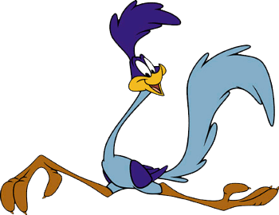
Retain… Don’t Run Them Away
Contact volunteers well before you need them to patriciate or volunteer
Include them in the planning process of your event or meeting
Always give kudos and recognition after your event
Send thank you cards, send an email, post on Facebook
Be willing to apologize if something goes wrong, if you do something wrong or they interpret something wrong
Introduce new volunteers to previous volunteers upon arrival
Introduce volunteers to your executive team
Be respectful of your volunteers time and their availability
Ask teachers and the principal to ask parents to volunteer
Provide incentives for people to volunteer
$5 gift card to Starbuck’s (some restaurants will donate gift cards)
Dress down passes for students when parents volunteer
Make volunteering fun not work

Slide 16
Fun, Laughs & Memories
Volunteers want to participate in something fun
Volunteers want you to BE PREPARED for them
Volunteers want to feel welcomed
Volunteers Want Good Training
Volunteers want to know how much time the task will take
Volunteers want to learn something new
Volunteers want to receive good communication
Capture the memories and post them with their consent
Volunteers want to be appreciated
Volunteers want to do interesting work
Volunteers expect to give, in order to get something back
Volunteers want to be socially connected
Volunteers want to have fun

