Slide 1

Get on Your
By Will Wiese, Advocacy Chair MO PTA

Slide 2
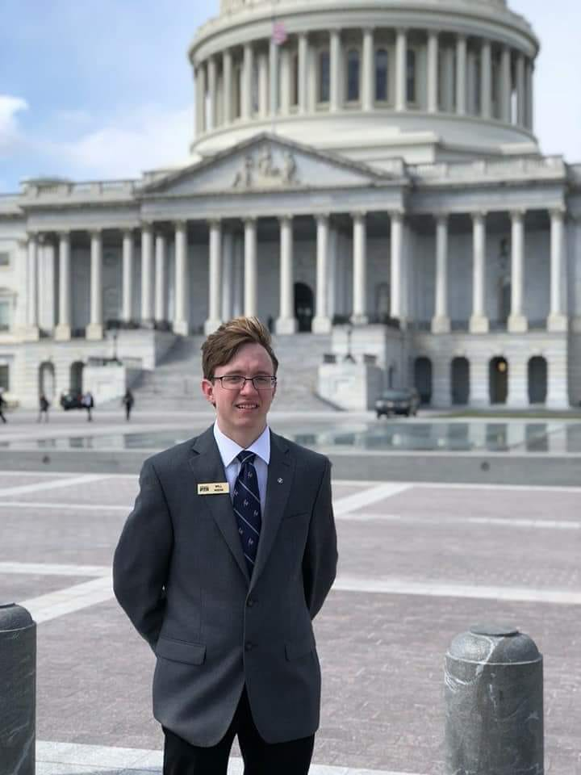
Sophomore St. Charles College Majoring in International Business
MO PTA Student Representative 2 years
MO PTA Advocacy Chair 2 years
Selected to attend National PTA Youth Advocacy Summit
Attended PTA Legislative Conference 2 year, this year was a panel speaker
Implemented the student led campaign for #18in18

Slide 3
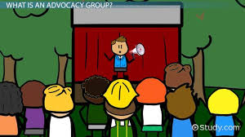

Slide 4


Slide 5
ADVOCACY
The act of supporting an idea or cause.

Slide 6
What is Advocacy?
Advocacy is a process not an event
It happens at all levels- local, regional, state, national and international
It is about achieving specific outcomes
Who can advocate?
Anyone who is passionate about and idea or cause
Do I have to be 18?
Anyone can be an advocate all it takes is a passion for an issue and a desire to make a difference and effect change.

Slide 7

You can’t vote…so what! You have a voice, you know the issues, NOW is the time to take action! Advocacy begins now!
Juvenile Justice
Student Data Privacy
School Safety
School Funding
School Lunches
Late start for High School

Slide 8
How do you get started?
Identify the issue
What are you trying to accomplish?
2. Identify your audience
Who is effected
Is this a local, state or federal issue?
3. Develop an action plan
What is the timeframe for action?
Are there other individuals or groups that will want to join a coalition on the issue
Who will be in charge?
What type of campaign will be effective?

Slide 9
4. Promote your cause
Use social media to take your message to a greater number of people
5. Take your Ask to appropriate officials
Use personal stories to highlight the ask
Give legislators facts
Keep them engaged via follow up and social media
6. Evaluate
Did you accomplish your goal?
If not how can you “change” your action plan?
Do not give up, often it takes numerous years to make legislative changes.

Slide 10
Preparing for Meetings with Legislators/Stakeholders
Email the legislator’s office and request a meeting
Include all who will be attending
Your ask
Any supporting documentation
2. Prepare for you meetings
Most meeting last 30 minutes or less. You want to maximize the amount of time you have.
Remember you are the expert in your subject. Be prepared with facts and follow up information.
Schedule out how your meeting will go including who will talk and about what.
Personal stories are great but keep them brief and relevant.
If you do not know the answer to a question be honest but say you will find out the answer and let the individual know.

Slide 11
3. Dress for success
Dress professional
Women: jacket or sweater with dress, slacks or skirt
Men: suit and tie
4. Arrive at least 10 minutes before the meeting
5. After meeting send “Thank You” note.
6. Follow up with legislators

Slide 12
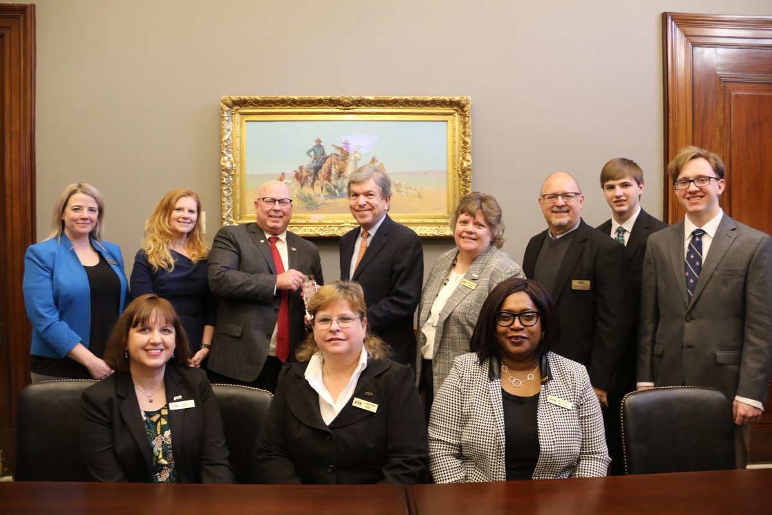

Slide 13
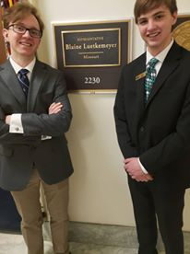
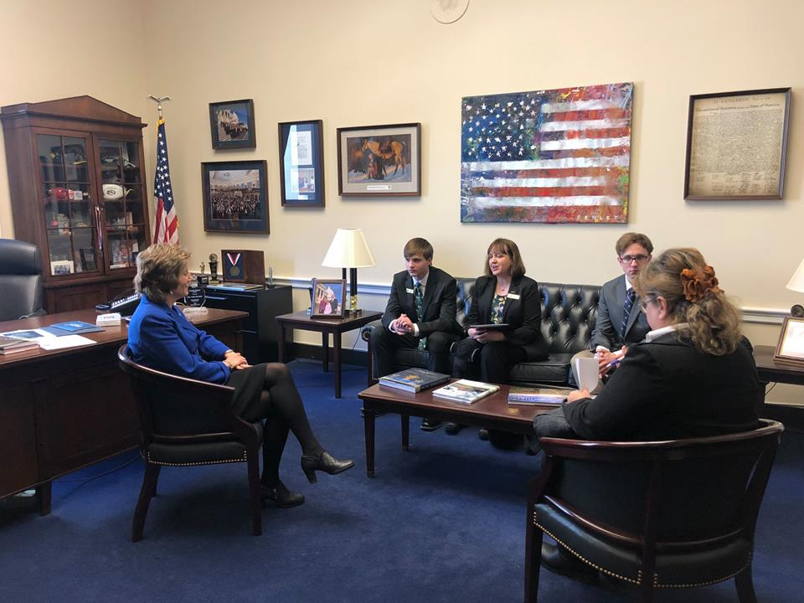

Slide 14
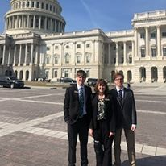

Slide 15
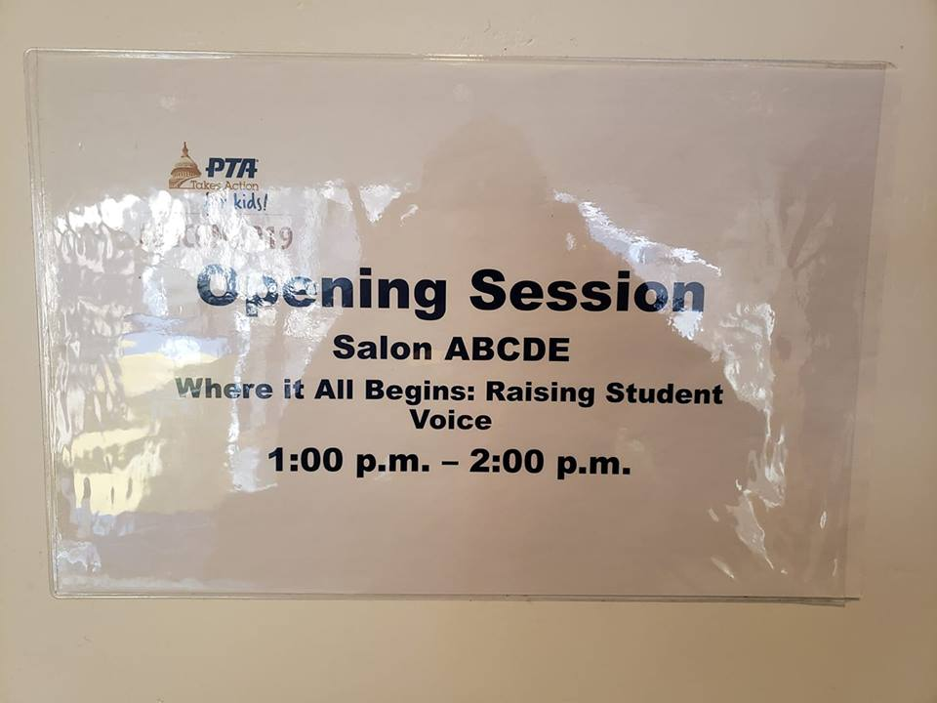

Slide 16
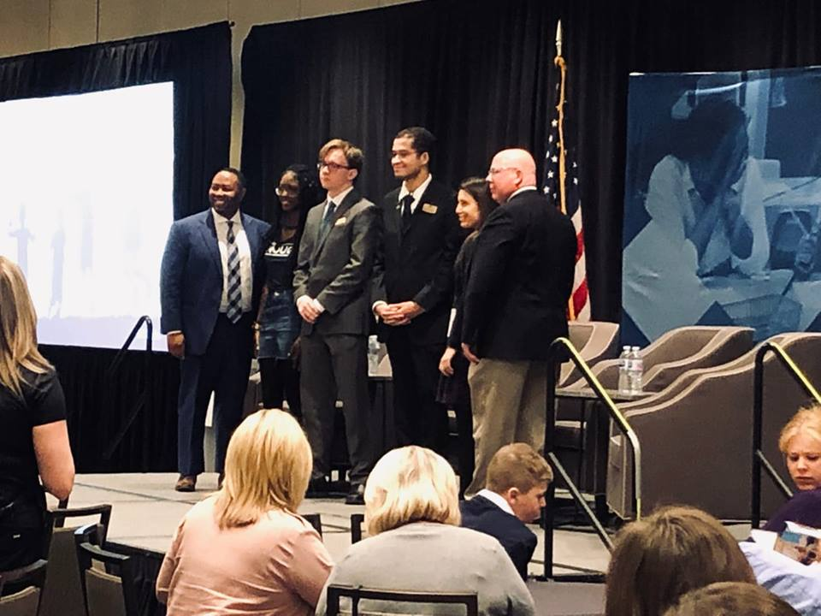

Slide 17
#18in18
Because 18 is to young

Slide 18
Join the Movement...
We cannot vote.
We cannot join the military.
We have not graduated from high school.
We have just begun to think about our future.
We are not adults!
BUT... we can be tried as adults and held in adult prisons.
Join the student led movement NOW to change the way we look at youth offenders. You can begin the conversation by posting the following to social media. #18in18 because 17 is to young. It is time to Raise the Age MO @molegislature @missouripta @raisetheageMO
Did you know Missouri is only one of five states that has not raised the age to 18? Society has labeled 18 as an adult. Why have we not done the same with the justice system. Currently children as young as 12 can be held in adult facilities. We know children do not do well in adult prisons. Not only are they not able to continue with their education but are subject to horrific abuses at the hands of adult offenders. Missouri PTA asks all our Units but especially our student members to join the movement. Often youth do not feel their voice matters, this is an issue that may affect any of our youth. Missouri legislators do listen to what constituents are saying via social media. Students, you can help us work for change by sharing and posting to social media the red post above. Not a student? Your help is just as important. This January join with us as we urge our legislators to Raise the Age and protect the children of Missouri.
For more information contact Will Wiese, Advocacy Chair at willw@mopta.org or Carla Wiese, Vice President of Legislation and Advocacy at carlaw@mopta.org.
Thank you,
Will Wiese
MO PTA Advocacy Chair

Slide 19
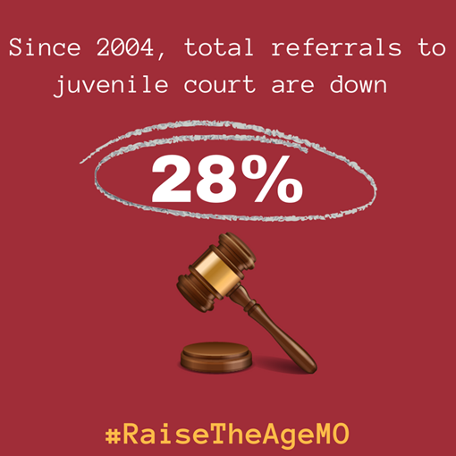

Slide 20


Slide 21


Slide 22
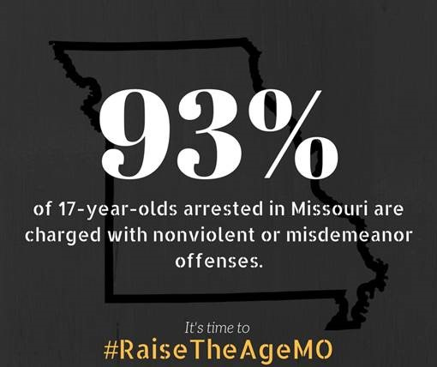

Slide 23
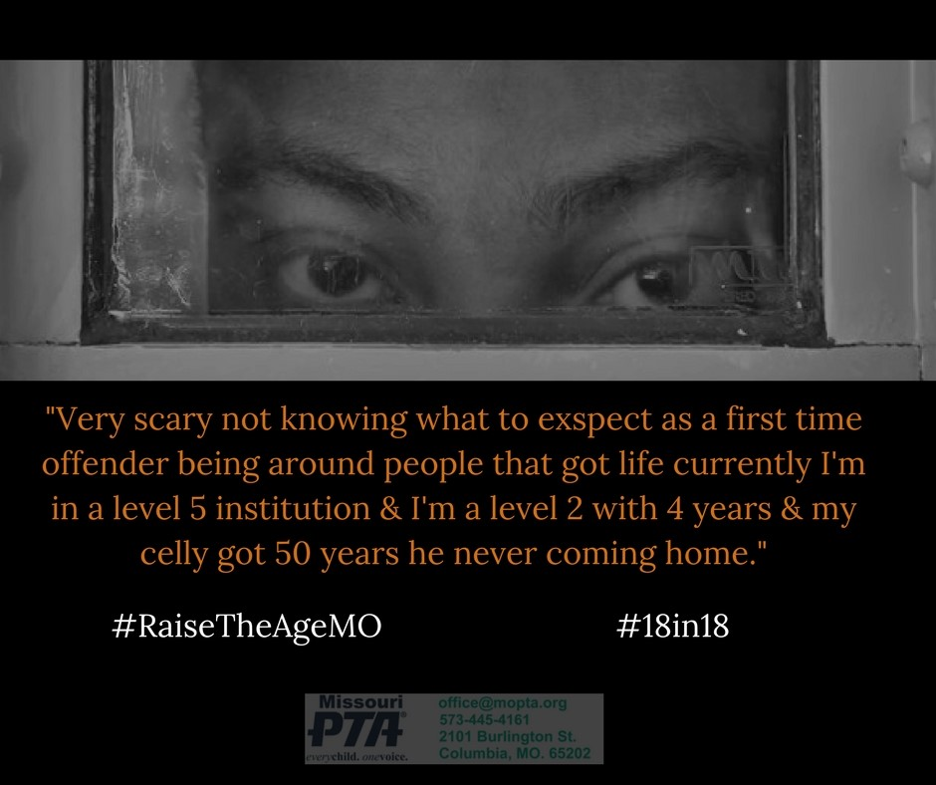

Slide 24

Missouri PTA Outstanding PTA Advocates of the Year

Slide 25


Slide 26
After the Meeting: Keep the Pressure on
@Senator/RepName Thank you for meeting with @mopta please vote to increase budget CAPS #moptaadvocacyinaction
@mopta thanks @senator/rename for meeting with us to discuss increasing the budget CAPS in the FY 2020 budget.

Slide 27
After the Meeting: Keep the Pressure On
Invite your Member of Congress to visit or attend a PTA meeting and/or event
Schedule to meet with the state or district office when you get back to follow up

Slide 28
Any Questions????
Group Activity

Slide 29
Group I
Issue: Counselors in your school do not have the time to adequately help struggling student because they are being assigned to many other duties. This lack of counseling services could be dangerous to the safety of the school.
Distractions: acting as registrars helping students pick classes and fill in substitute teachers.
Ask: How do you alert legislators to the issue and what would a solution?
Group II
Issue: It has been brought to your attention that many juveniles are waiving their right to counsel without having a guardian present.
Problem: This is leading to a much higher rate of incarceration. How can youth sign their rights away if a minor?
Ask: What would you ask legislators to ensure this does not happen?

Slide 30


Slide 31
THANK YOU
Will Wiese, Advocacy Chair
willw@mopta.org

