Slide 1
PTA Awards
Workshop
2019 Convention
Springfield, Mo

Slide 2
Let’s start with a few questions
What Awards are you aware of that are available?
What are some of the Awards that you currently use for your PTA?
Did you know there are also Awards for individual PTA members?

Slide 3
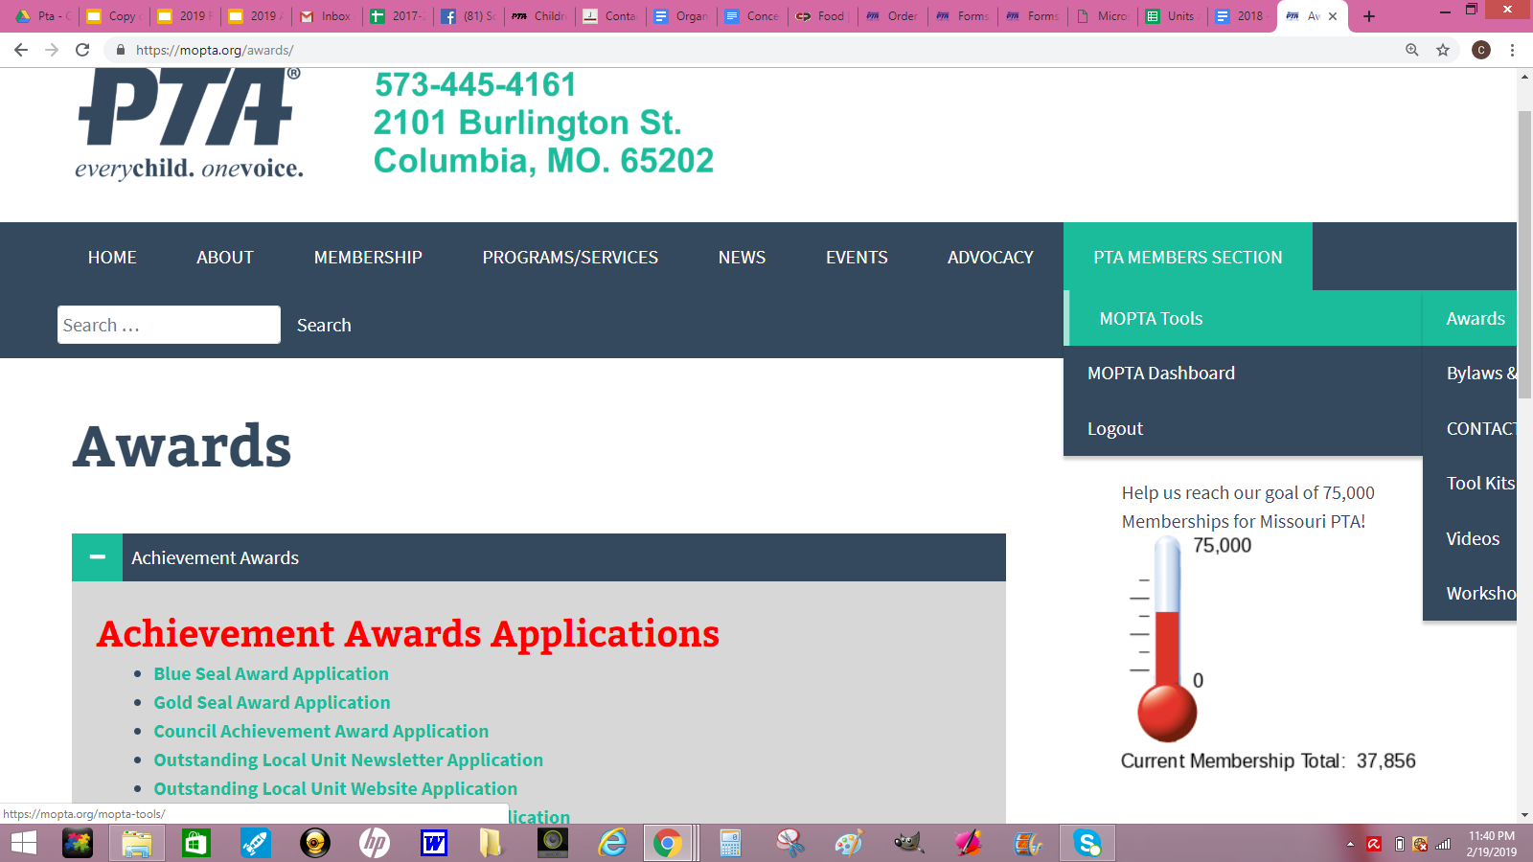
Missouri PTA website
www.mopta.org

Slide 4
Individual PTA Awards

Slide 5
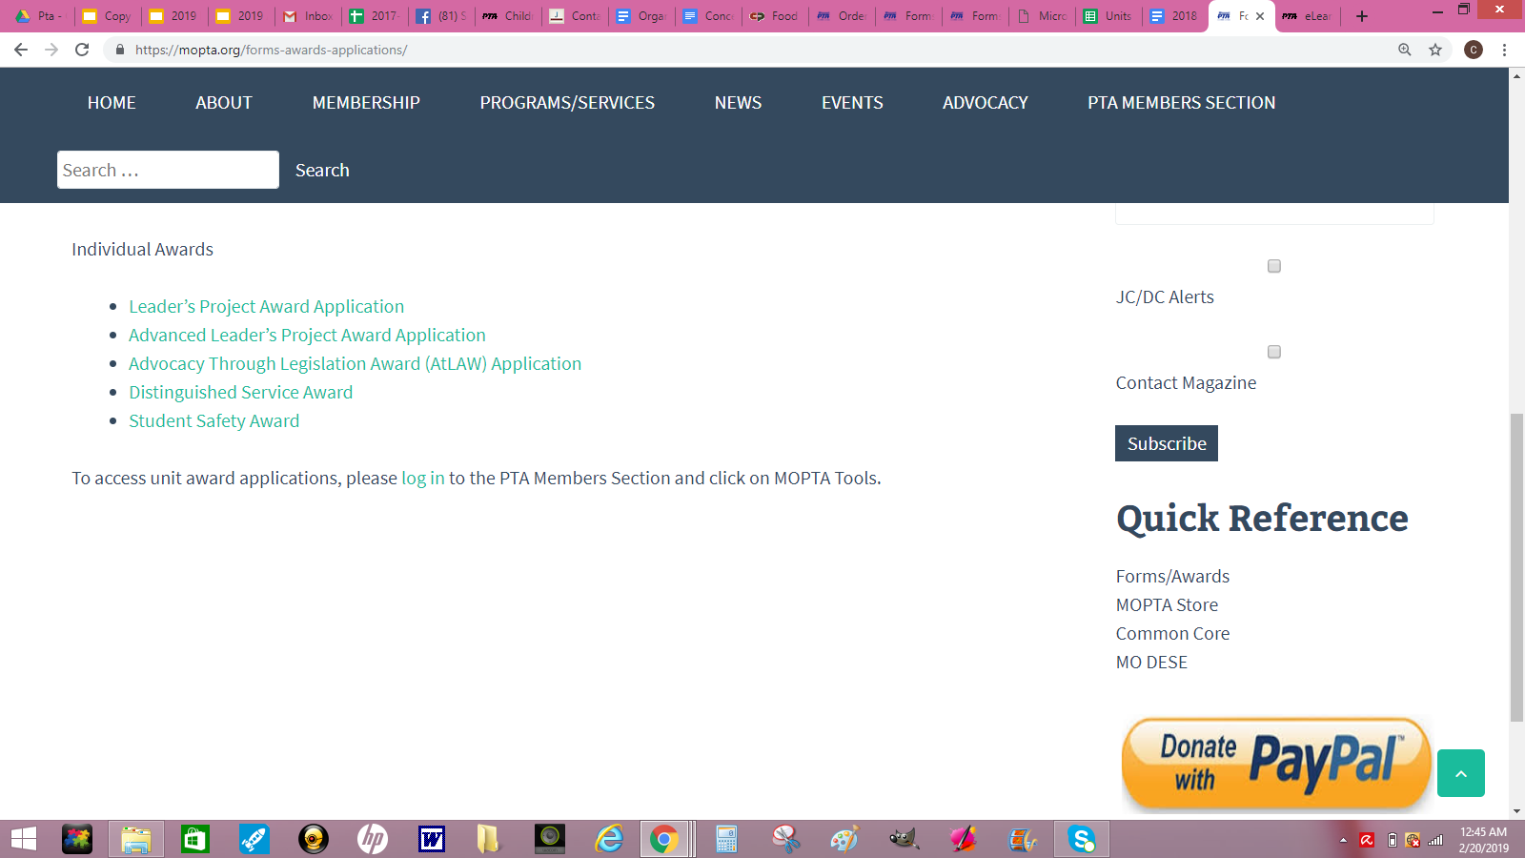

Slide 6
Individual Awards

Slide 7
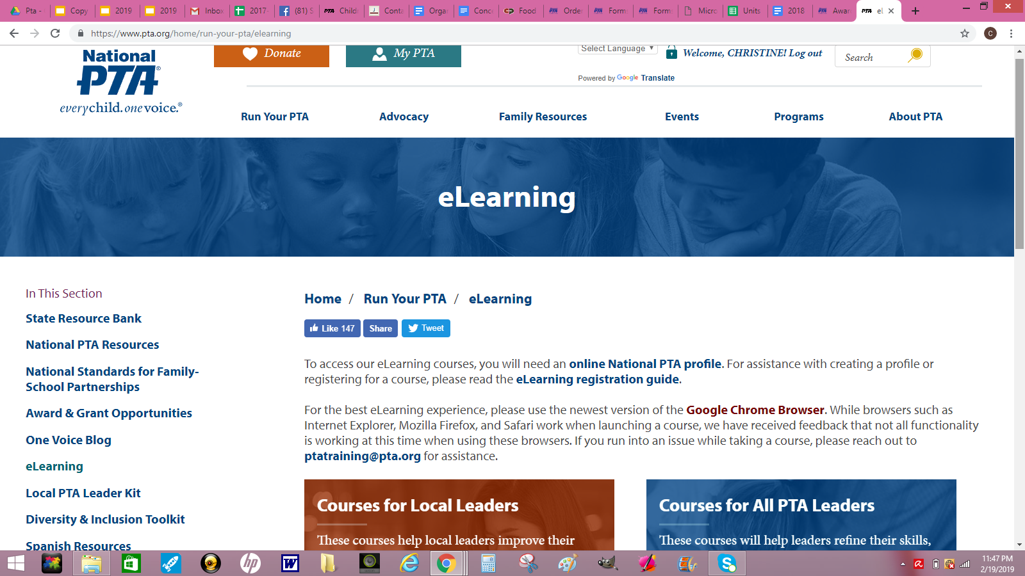
National PTA website
Advanced Leadership Project Award
www.pta.org

Slide 8
Distinguished Service Award
Awarding a Distinguished Service Award is a great way to recognize and honor an extraordinary person for their service and dedication to PTA. This award is a wonderful way to show gratitude and appreciation for a person’s devotion to the children and the purposes of PTA.
Fee applied

Slide 9
Unit PTA Awards

Slide 10
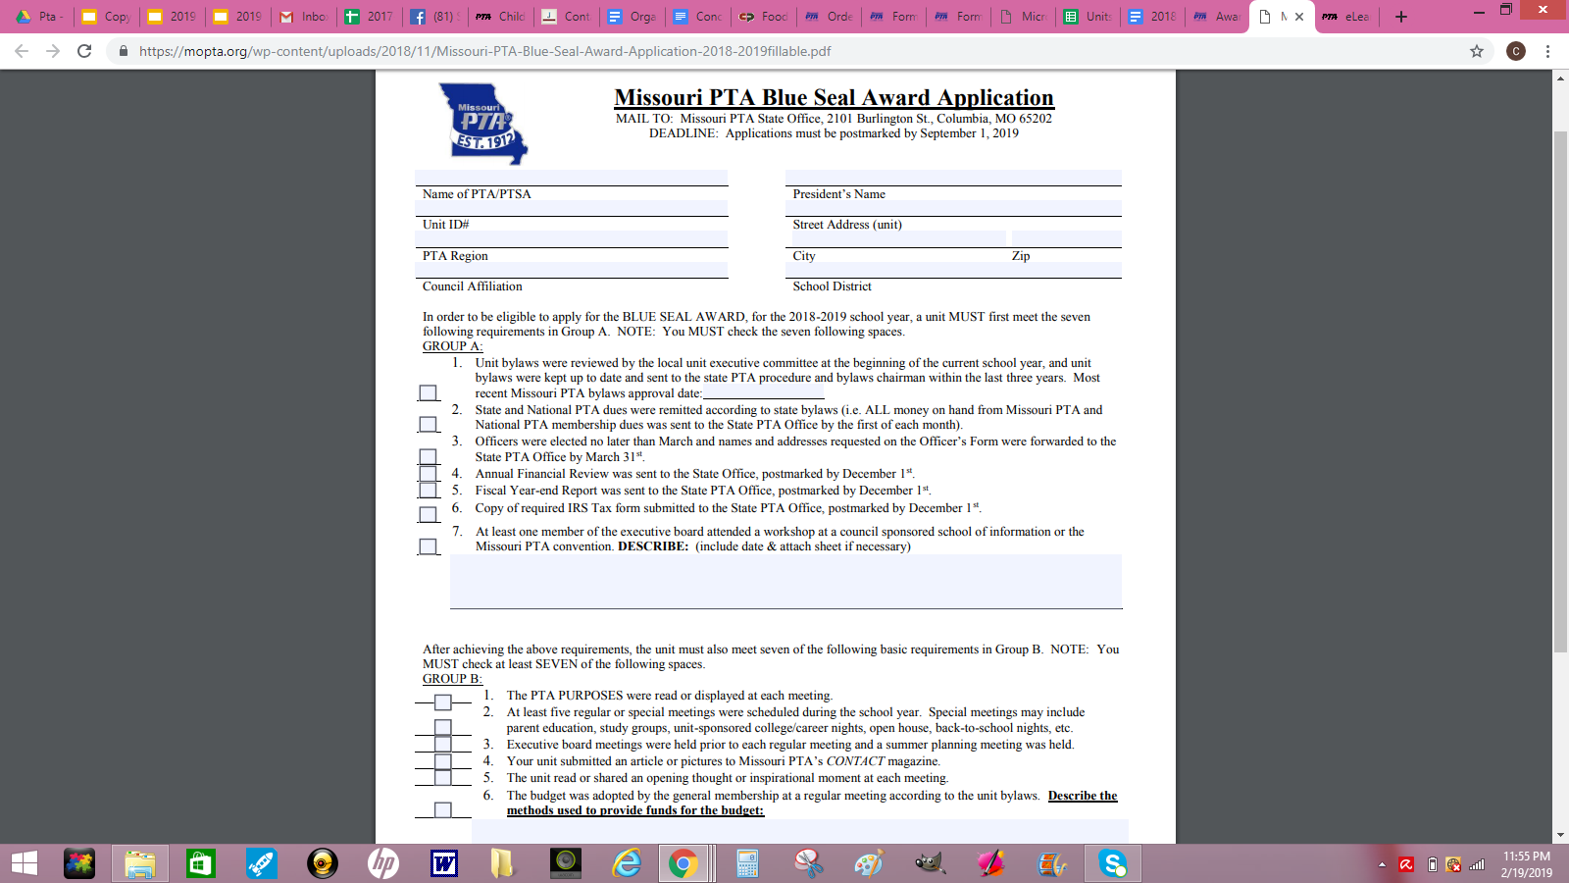
Blue Seal Award
Unit in Good Standing
Membership Dues
Officer Information
Financial Audit
Financial Year End Report
Financial IRS 990 filed
Bylaws Current
NEW - At least one member attended a workshop at Council SOI or state Convention
Notes:
Bare minimum of what a unit should be doing

Slide 11
Gold Seal Award
Beyond Basics
Committees
Education Programs
Community
Awards
Grants
NEW - If used on the Blue Seal Award, may not be duplicated
Notes:
Bare minimum reached, now what?

Slide 12
Unit Newsletter Award
Basics
Unit in Good Standing
PTA pages may be a part of the school newsletter.
Unit Website Award
Notes:
Bare minimum reached, now what?

Slide 13
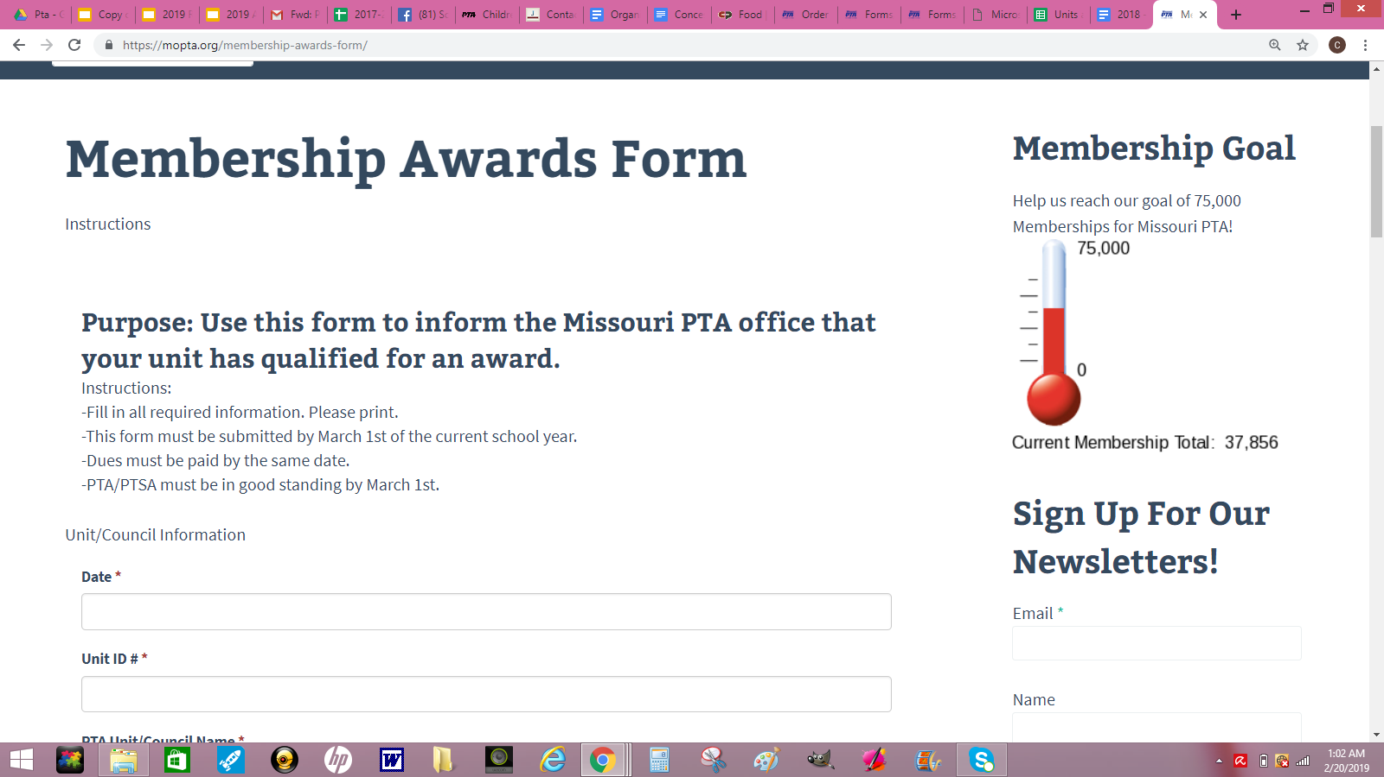
To name a few Unit Membership Awards:
Early Bird Award - First dues payment mailed by August 31st
100% Faculty Award - All full time Certified Staff are paid members
Student Membership Award - 20% increase over previous year of student memberships
Business Partnership Award - 20% increase over previous year of business memberships
Notes:
Bare minimum reached, now what?

Slide 14
Council PTA Awards

Slide 15
Council Achievement Award
Council in Good Standing
Bylaws Current
Service Fees paid
Officer Information
Financial Audit
Financial Year End Report
Financial IRS 990 filed
Pay close attention to due dates

Slide 16
Council Newsletter Award
Council Website Award

Slide 17
Council Achievement Award
Beyond Good Standing
Training
Programs
Awards

Slide 18
Council Membership Awards
Bronze
Silver
Gold
Platinum
Notes:
Bare minimum reached, now what?

Slide 19
Thank you,
for all that you do!

