Slide 2
The Keys to Being President Workshop #201
Susan Rupert
Missouri PTA
President 2018-2020

Slide 3
I have been just elected president!
What does this mean?
What do I have to do?
What are my responsibilities?
Where do I get help?
What did I say yes to?

Slide 4
Don’t panic!
Breath and relax
Keys to Success
Notes:
Don’t panic!
Let’s look at the keys that will help you unlock a successful first year as a council or unit president.
By the end of the workshop you should feel a little more at ease with what it means to be president and the responsibilities that come with that.

Slide 5
Know the organization you are representing
National PTA
Missouri PTA
Council
Local Unit
Who, When & Why
Accomplishments
Goals
Benefits:
Better resource
Connected
Passionate

Slide 6
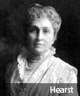
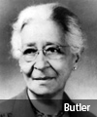
PTA 101 The History of Our Organization
Over 120 years of Advocacy!
Kindergarten classes
Child labor laws
Public health service
Hot and healthy lunch program
Juvenile justice system
Mandatory immunization
Arts in Education
School Safety
“The goal of the organization was to unite the forces of home, school, and community in recognizing the supreme importance of the child."
Notes:
Alice McLellan Birney, Phoebe Apperson Hearst and Selena Butler are recognized as the founders of National PTA. Learning more about them helps us to understand their passion and know more about the history of our organization.
The National Congress of Mothers was founded by Phoebe Apperson Hearst and Alice McLellan Birney on 2/17/1897. Birney said the goal of the organization was …..
The name was changed to National Parents and Teachers Association in 1924.
Selena Sloan Butler organized the first black Parent-Teacher Association in the U.S. at Yonge Street School in Atlanta in 1911(Where Dr. MLK attended elementary school). It was with her help, a group named the National Congress of Colored Parents and Teachers appeared a few years later. This group maintained close contact with the white Parent-Teacher Association and modeled its policies in cooperation with that organization. The two organizations merged in 1970.
The passion and commitment this women must have processed to accomplished this is beyond amazing. Consider the pushback and road blocks we encounter in 2019 when we try something new or different. Think back to your history classes. Women did not have the right to vote and social activism was not popular. The challenges they faced must have been incredible. Two that come immediately to my mind – transportation and communication. They couldn’t jump in the car and drive to the other side of the state in 3 hours for training or fly to DC to advocate on the Hill. They couldn’t contact their members or keep them informed through email, text messages or social media. Think To better the lives of every child in education, health and safety

Slide 7
PTA is the largest & oldest child advocacy organization in the country
PTA

Slide 8
Mission of PTA To make every child’s potential a reality by engaging and empowering families and communities to advocate for all children.
PTA Purposes
To promote the welfare of children and youth in home, school, community, place of worship, and throughout the community.
To raise the standards of home life.
To advocate for laws that further the education, physical and mental health, welfare and safety of children and youth.
To promote the collaboration and engagement of families and educators in the education of children and youth.
To engage the public in united efforts to secure the physical, mental, emotional, spiritual, and social well-being of all children and youth.
To advocate for fiscal responsibility regarding public tax dollars in public education funding.

Slide 9
Since 1897, our social and policy impact has been felt in schools, in school districts, in state assemblies and on Capitol Hill.
We are a vital and relevant resource for family engagement and student programs
Your voice—and your members' voices—are amplified when we join together as one PTA for the good of all children

Slide 10
Missouri PTA
8 Regions
15 Councils
412 Units
FOOTHILLS - 2
GATEWAY - 36
HERITAGE - 41
MARK TWAIN - 3
MERAMEC - 10
OZARK - 83
PONY EXPRESS - 83
THREE TRAILS – 139
“SHOW ME” PTA

Slide 11
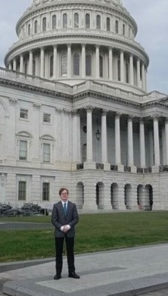
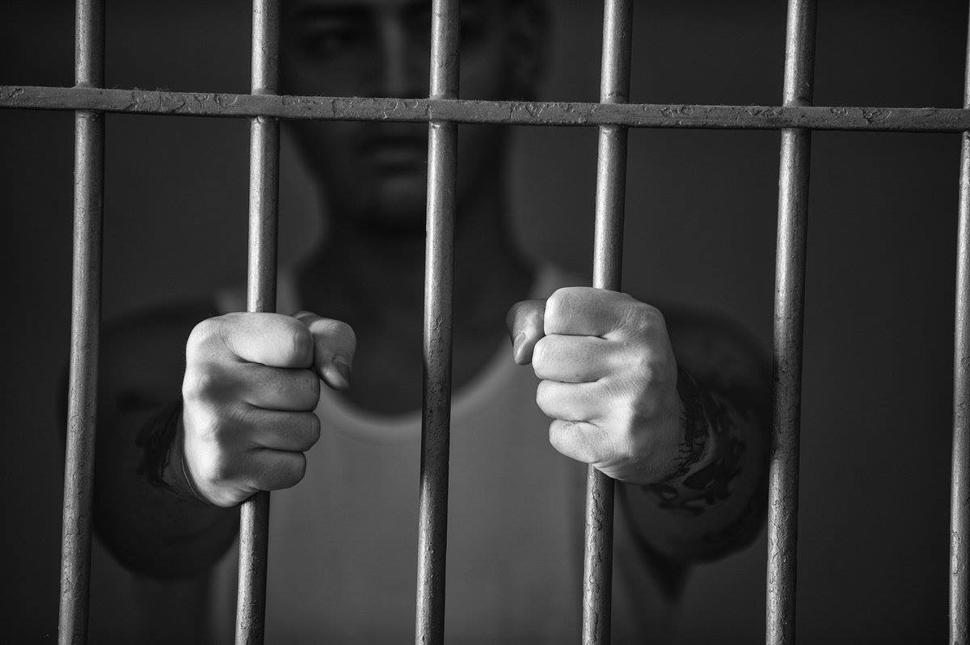
PTA is the key
• Brave Advocates • Big Voice • Bold Purpose
Notes:
Missouri PTA – started in 1912
One of the first state associations to have student serve on the state board.
Our student are very involved in our advocacy.
At the 2013 National Convention our student representatives presented a distracted resolution they drafted. It was adopted by National PTA.
More recently they played a major role in helping the #18in18, 17 is too young initiative signed into law by former Governor Greitens.

Slide 12
National PTA is pleased to announce
2019
Outstanding State PTA Advocacy Award
recipient is
Missouri PTA
PTA is the key
• Brave Advocates • Big Voice • Bold Purpose
Notes:
Prior to Missouri PTA’s advocacy efforts, Missouri was one of only five states that housed juveniles—some as young as nine—in adult facilities, even prior to their conviction. Missouri PTA worked with a coalition to plan and implement an initiative to support legislation that would make sure juveniles involved in the justice system are housed separately from adults. PTA members met with their local legislators, garnered the support of law enforcement and juvenile justice departments, and implemented a robust media campaign on the issue. Last year, after five years of concerted effort, Missouri PTA’s advocacy efforts saw success when SB 793 “Raise the Age” was signed into law. The new law requires that children be prosecuted in juvenile courts and ensures that no person under the age of 18 may be detained in an adult jail unless the person has been certified as an adult.
Missouri PTA was awarded the 2019 Outstanding State PTA Advocacy Award during the 2019 Legislative Conference in March in Washington DC

Slide 13
Did you Know?
Your PTA is an independent nonprofit association – your members get to make the decisions.
Approve your bylaws
Elect your officers
Budget process
Plan of work
Your PTA is an advocacy organization – focus on the mission.
Support student success
Improve school/community for students
Your PTA is connect to approximately 24,000 other PTAs through National PTA
Exist to achieve the mission

Slide 14
Seeing the Big Picture!
When you understand what our organization was founded on and what we continue to stand for, it makes it easier to get on your soapbox to speak up for all children.

Slide 15
The Expectations of the President
Know your role as the President
Definition and Responsibilities
Where to look
unit bylaws
www.pta.org (Run your PTA)
Understand what it means
Benefits:
No surprises
Less frustrating
Fewer misunderstandings
Notes:
Your unit bylaws will outline the responsibilities of the elected officers.
National PTA Official Local Leader Kit also give insight to some responsibilities.

Slide 16
Official responsibilities
ARTICLE VII: DUTIES OF OFFICERS
Section 1. The president shall:
preside at all meetings of this local PTA;
serve as an ex-officio member of all committees except the nominating committee;
coordinate the work of the officers and committees of this local PTA in order that the Purposes may be promoted; and
appoint a parliamentarian, if desired.
Notes:
A description of PTA Officer roles and responsibilities will be listed in your bylaws.

Slide 17
Responsibilities include:
Chairing Board and general meetings;
Overseeing fiscal compliance;
Serving as a liaison with school administration or community partners;
Checking in regularly with officers and committees to ensure the overall plan is on target;
Identifying challenges and inviting solutions;
Familiarizing yourself with all PTA programs and resources;
Representing PTA to the community;
Recruiting and mentoring volunteers and future leaders; and
Volunteering at events, when available
Notes:
Official Local Leader Kit goes into more details and expands on the role of the president.
As President your are expected to chair all board and general meetings. In your absence, the vice president assumes that role.
The treasurer will keep the books, write checks, watch the budget, but it is the president to oversee that this is being done and that steps are being take to ensure fiscal compliance – monthly treasurer reports are reviewed, bank statements are reconciled, the appropriate tax return is filed with the IRS on time. PTA promotes best practices to help you with ensuring fiscal compliance.
As PTA President – you represent your unit or council and you need to lead the charge in building the partnership between the school & PTA and your community & PTA. When the school or community has a PTA question they will be looking to you for the answer.
You are the coach or task master and regular communication with your officers and committees is very important for several reasons. It helps keep everyone on track and in the loop. You need to know the food details for parent/teacher conferences because your principal will ask you. It also shows your team members you are supportive and engaged in their volunteer work.
Just because we have always done it that way doesn’t mean it can’t be improved on. Transitioning positions is a huge challenge for all PTAs. We have implemented Google drive and trained our board on how to use it for document sharing, collaboration and storage.
Being familiar with PTA programs and resources and where to find them – I will come back to this in a few minutes.
It is not uncommon to be called upon to represent PTA in the community.
Recruiting and mentoring volunteers and future leaders is very important to ensure the continued success of your organization no matter what level you serve on. Building your team a KEY.
Volunteers are the lifeblood of our organization. We cannot do what we need to accomplish for children all by ourselves. Do not be the Lone Ranger! Allow others to be coordinate events and volunteer

Slide 18
Building Relationships
PTA – Networking
Other Presidents, MO/National PTA
School – Partnerships
Staff, Principal, Superintendent, School Board
Community - Outreach
Businesses, Service Organizations, Public Officials
Families – Inclusive
New, Established, Grandparents/Caregivers
As PTA President
Your members look to you for leadership in creating partnerships within your community and fostering an environment where family engagement is encouraged and respected.
Notes:
Successful presidents strive to build relationships with others that share PTA’s passion of doing what is right for children.
Take advantage of vast network of PTA knowledge and experience that is available to you. Sharing ideas often eliminates the need to re-invent the wheel, helps to talk with people who have walked in your shoes and speak your language.
It is very important to have a good relationship with our school staff and principal. Your staff needs to know that the PTA can be that foundation for building their relationship with their parents. Finding ways to have parents in the building working beside staff at PTA events is a great way to do that. Like coordinating parent volunteers to help with picture day, or the librarian with the book fair or the PE teacher with field day. Include and invite administrators and sb members to your activities and to join. Principals provide monthly reports to the board about activities in their buildings. Be sure to always give her/him an update to share and include state/national legislative news.
When the school is strong so is the community. Look for ways businesses and organizations can support student success. Invite local law enforcement to be a part of activities that focus on student safety.
PTA needs to have the welcome mat out at all times. Families need to know they are welcome to join and participate. Know what their needs are and strive to meet those needs. For example, several families of seniors need help completing the FAFSA. Coordinate with the HS counselor's office to have a computer lab open and help available.

Slide 19
Training
Engagement
Networking
Longevity
Helps PTAs succeed
Valid expense
Investment in your team
Investment in yourself
Training is an integral part of any organization; it equips individuals with skills required to perform the job.
Notes:
Even though we are a volunteer based organization, there are several parts of what we do that should be viewed as a business.
Training or professional development is one of those.
Training is an integral part of any organization; reduction in errors or defects, enhanced productivity, increased motivation, helps in retaining the talent pool, capacity building, groom the leaders
Training helps in building capacity within an organization, and investing in people is vital

Slide 20
Opportunities
Certified Leaders Project
AtLaw Award
Advanced Leaders Project
State Board Positions
E-Learning Courses
Webinars/Conference Calls
Schools of Information
Regional Training
State Convention
National Convention
Notes:
Even though we are a volunteer based organization, there are several parts of what we do that should be viewed as a business.
Training or professional development is one of those.
When you google Professional Development there are examples of activities that contribute to growth and development:
Continuing Education-Pursuing certificates, accreditations or other credentials
Participation - Attending local, regional, state and national meetings, conferences and workshops
PTA offers many opportunities for volunteers to receive training most is free or minimal in cost.

Slide 21
Yourself
Notes:
The final key to being a successful president is yourself.
The are two ways to categorize the elements that make up the environment of the president’s role. The things you can control and the things you cannot control. Honestly the things you cannot control out weight those you can. I think we would all agree that is the case anytime you are dealing with people and PTA is all about people.
As President, we cannot control if someone drops the ball in their position, decides to resign, doesn’t show up to volunteer or posts a negative comment on social media about the PTA. We cannot change the fact the principal forgot to include meeting details in this week’s newsletter and only 5 parents showed up to hear the superintendent speak on the importance of family engagement.
We also can not control the fact Mother Nature has caused your Valentines Fundraiser to be canceled, the officers election to be postponed for the third time and school is closed again with the Reflections entries locked safely inside.
We cannot control these types of situations but what we can control is how we prepare ourselves for the task ahead and how we respond when we hit that bump in the road. You are the only one that decides how you are going prepare to be president. What kind of leader are you going to be?
You are the one that decides what comes after “I am …”
If you see this year as a chore, that was dumped on you, you were talked into it, do the bare minimum, done and out; or the Lone Ranger, trying to do everything yourself and not involve anyone else because you hate to ask for help; , that is going to set the tone for the entire term and possibly for the unit as well.
The way you approach your term in the role of the president will determine how successful the year will be for the unit and you.

Slide 22
What words will you select to shape your reality as President?
Notes:
You are the one that decides what comes after “I am …”
If you see this year as a chore, that was dumped on you, you were talked into it, do the bare minimum, done and out; or the Lone Ranger, trying to do everything yourself and not involve anyone else because you hate to ask for help; , that is going to set the tone for the entire term and possibly for the unit as well.
The way you approach your term in the role of the president will determine how successful the year will be for you and your unit or council.

Slide 23
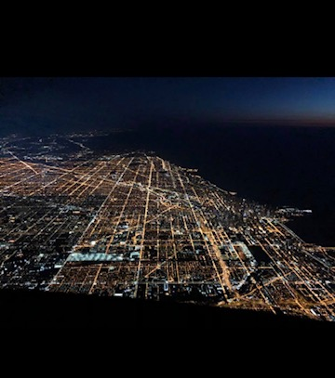
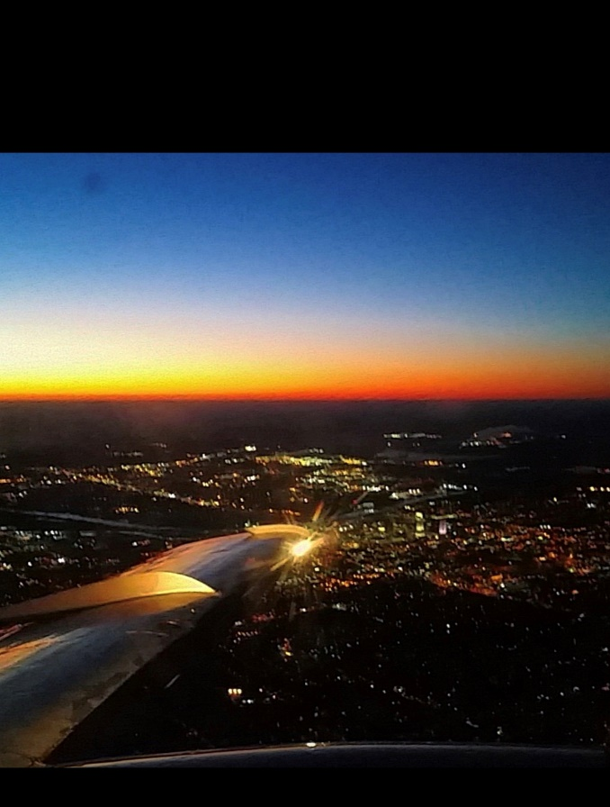
Your Approach
Notes:
When working on this portion of the presentation the word approach was in the forefront of my thoughts. How we decide to prepare, our attitude, our outlook, expectations, fear, excitement There are so many things that can affect our approach to our role then suddenly I thought of a young man I know named Isaac Haahr.
Isaac is in his mid twenties and lives in Nebraska. When you look at his FB posts it is very obviously he has always wanted to fly. After lots of determination, hard work, positive attitude and training he reached his goal. He is a pilot for SkyWest Airlines.
I remember hearing about a part of his training – instrument flight rules and visual flight rules. One you totally rely on the instruments to guide you and the other you have to navigate by using landmarks on the ground, interstates, stars, etc.
I believe Isaac came to my mind because when pilots are getting ready to land or make their approach to the airport they must rely on themselves to remember that training, be calm and confident, and have a clear vision of where they are going.
They also have to be willing to recognize they need to rely on and trust others for guidance and support. Isaac relies on the tower to provide that information on what runaway to use and trust that there are no other planes in that same flight pattern.
He counts on the flight attendants to have the passengers seated and items secured. He has to have confidence the ground crew has done their part in ensuring it is safe for the plane to land. Even though Isaac is the pilot and is in charge of the plane, it takes a whole team to work together to ensure the flight’s success.

Slide 24
Educate Yourself – be the PTA guru!
Unit Bylaws & Standing Rules
Basic Parliamentary Procedure
Meeting Agenda
Good Standing
Local Leader Kit
E-learning courses
Workshops
Websites
Notes:
It’s important to have a positive attitude and an open mind that is ready to learn. It doesn’t matter how long you have been in PTA there is always the opportunity to learn something new and make a difference.
You need to be willing to educate and invest in yourself. You may need to learn new skills. You are going to want to expand your knowledge of PTA, its benefits and resources.
As president, your team is going to look to you for answers and guidance. It’s ok not to know everything and it’s ok to admit that you don’t know everything. The key is to be willing to learn it with them as a team.

Slide 25
Notes:
We promote the important role that family engagement plays in student success. A student who has a family member or members (parent, guardian, grandparent, care giver) engaged in their education is more likely to attend school on a regular basis, have a high level of achievement and be more engaged themselves in their school community.
Your engagement as a PTA leader in the school and community plays a important role in student success and to your unit’s or councils success as well.
Making those connections and building those relationships helps promote what PTA is doing on behalf of children within the four walls at your school, in the buildings of the district, throughout the state and across the country.
If your unit is part of a council be engaged with your council. The council needs to be engaged with each unit. Both need to be engaged with Missouri PTA and National PTA. You as president have to set the example and be engaged yourself. You can’t be the best possible resource to your team, members or school by making yourself a little island out there in xyz Missouri!
It is important to make sure we have your correct email and it’s an email you check.
You should be receiving CONTACT magazine by email – be sure to read it
Join the JC/DC network – respond to legislative alerts. Sign up to receive NPT OC e-newsletter PTA Weekend Update, Advocacy Insider, Leadership Briefing and
Local Leader News

Slide 26
Embrace this time
Important role in your community
Exciting opportunity to make a difference
Help implement PTA’s mission
Every Child. One Voice.
PTA's mission is to make every child’s potential a reality by engaging and empowering families and communities to advocate for all children
Notes:
Embrace this opportunity to make a difference not just for the children in your school but for all children.
Excitement and enthusiasm is infectious.
If you are excited then your team will be excited.

Slide 27
Thank you!!!

