Slide 1
spectacular Social Media Strategies
2018 Missouri PTA Convention
Andrea Battaglia, Missouri PTA Contact Editor andreab@mopta.org
Kristina Wilmoth, Missouri PTA PR chair kristinaw@mopta.org

Slide 2
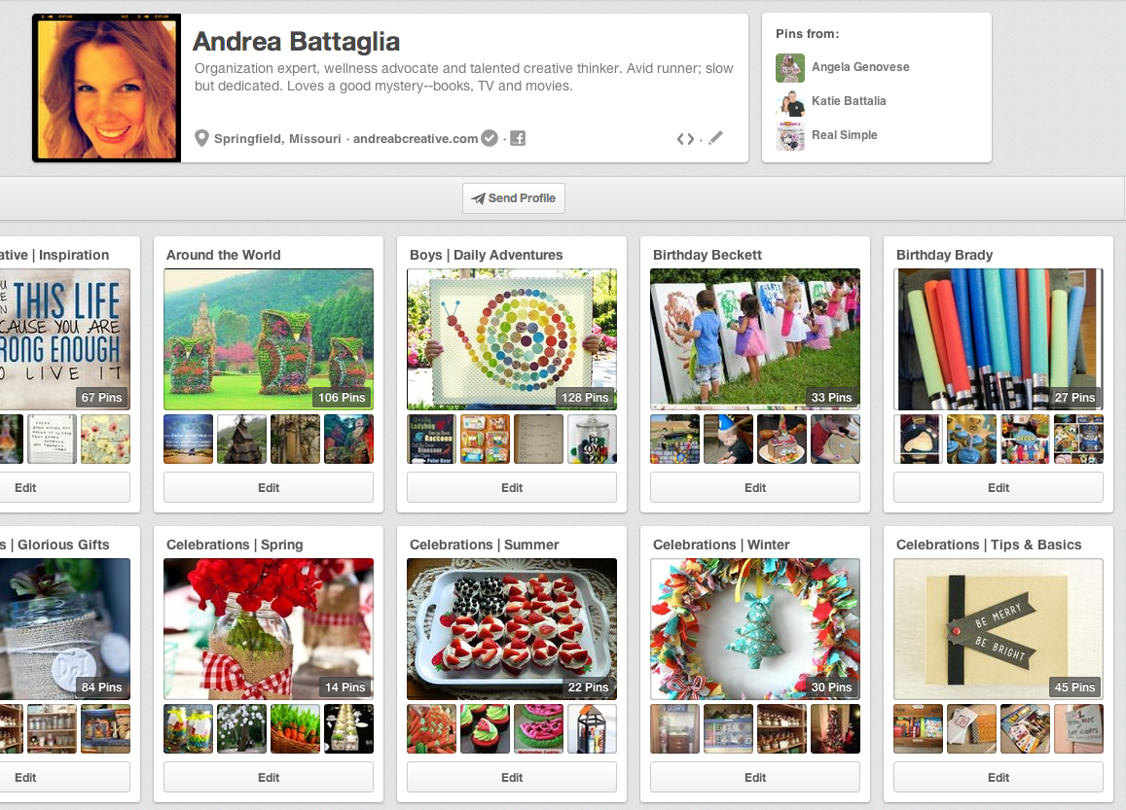
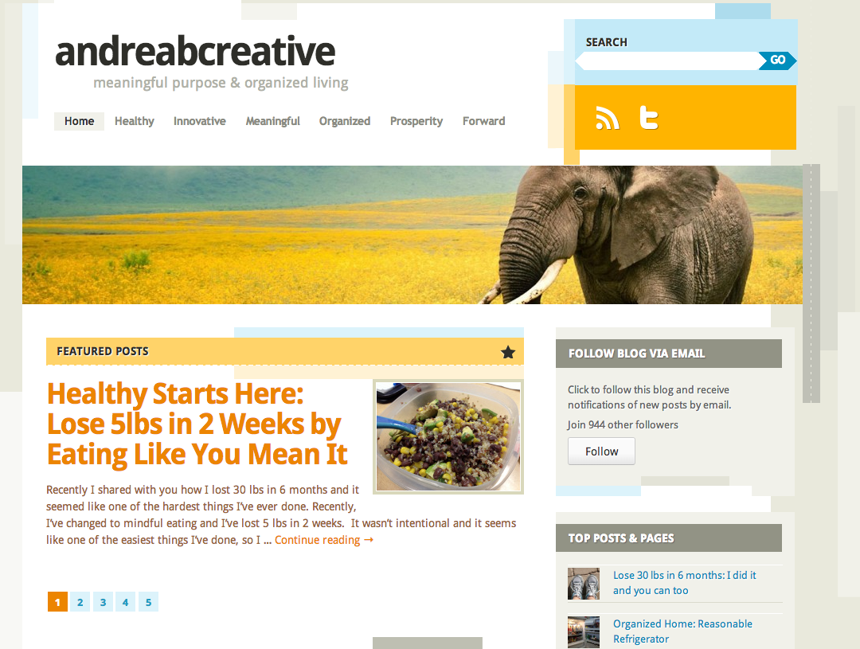
Andrea Battaglia Presenter Information
Work full-time in Fundraising, Marketing & Strategy, helping groups effectively manage communication and brand
Manage 19 social media sites, for professional organizations, volunteer groups and my personal brand www.andreabcreative.com
Organization Expert, Communication Professional and Wellness Advocate, communicate consistent message
Professional Trainer & Facilitator for groups of all sizes and competency levels – develop effective strategy and action plans

Slide 3
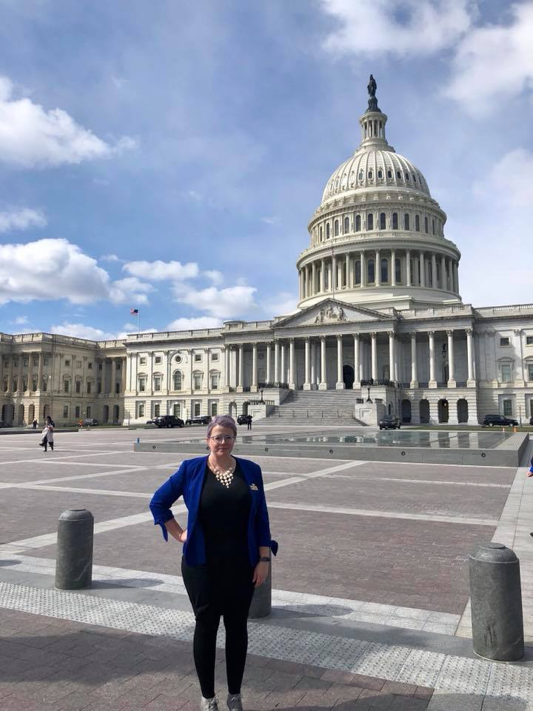
Kristina Wilmoth Presenter Information
Work full-time in Program Management and Recruitment, helping families move from poverty
Manage 18 social media sites, for PTA units, non-profit organizations and Missouri PTA.
Child Abuse Prevention, poverty-reduction, and Health and Wellness Advocate
Professional Facilitator for volunteer teams and train the trainer programs

Slide 4
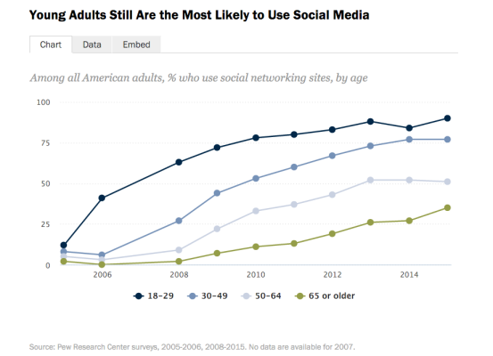
Understanding the value of social media
90% of young adults use social media, with nearly two-thirds of all people using social media (Pew Research)
The average person has five social media accounts and spends around 1 hour and 40 minutes browsing these networks every day, accounting for 28% of the total time spent on the internet Social media sites are used more than any other type of site
What does this mean for your PTA? How can you use social media to communicate your message?
If you are unfamiliar with Social Media and trying to learn, you should:
Plan to spend 1-2 hours per week devoted to social media
After you’ve got a basic idea – ask a student or young professional to train you – and listen to what they say.
You will not learn everything in one day – stay positive as you’re learning.

Slide 5
Social media benefits
People are using social media for
Word-of-mouth recommendations
Learning about other’s experiences
Complimenting brands
Product information
Sharing Incentives
Customer service
How can your PTA provide relevant information to stakeholders?
Is Social Media what you should use?

Slide 6
Your social media brand
Enhancing or Developing your social media brand: Keep it simple – use 1-2 platforms
Facebook (start here)
Twitter
Blog (WordPress), can be used as your website
Pinterest
Instagram
YouTube
Just because it’s available doesn’t mean you need to use it – only choose what is relevant for your stakeholders and what you can manage

Slide 7
Team work makes the dream work
Create Social Media Team
The team should be as small as possible – but all relevant stakeholders should be represented
We recommend 3-4 people: Social Media Manager, Post Scheduler, Event Communicator, “Live” Post Person
Set up a system to collect information
The Social Media team will
Establish goals, guidelines and direction
Determine target audience and appropriate message
Review and approve content

Slide 8
Social Media Manger
You should have one person ultimately responsible for social media content coordination.
This person should be detail-oriented, trustworthy, socially adept, have strong written/verbal communication skills, technical skills and social media experience are a plus
Your Social Media Manager does not need to be a seasoned professional, often new & younger members have great social media expertise – if you don’t have this person, recruit this person (make this your first goal for social media)
This person develops social media calendar, schedules/publishes content to social media accounts, monitors accounts, interacts with followers and fans, provides reporting on progress vs. goals

Slide 9
Social media goals
Document social media goals for each platform using the SMART goals format
Specific
Measurable
Agreed To
Realistic/Relevant
Timed
Early in the process, your social media goals need to be few in number, modest and easily understood

Slide 10
Brand & Communication strategy
Use basic Brand Strategy for social media
Branding includes distinctive characteristics that make you extraordinary
Communication is how you convey your message
Understand Your Message, including tone and content
What are you trying to communicate and how can you keep the message consistent, no matter which member/officer is presenting information
Determine Your Visuals: Logos, custom graphics, font, pictures and color choices
What are your messages going to look like?
Use Available Resources – PTA Communication Branding Kit

Slide 11
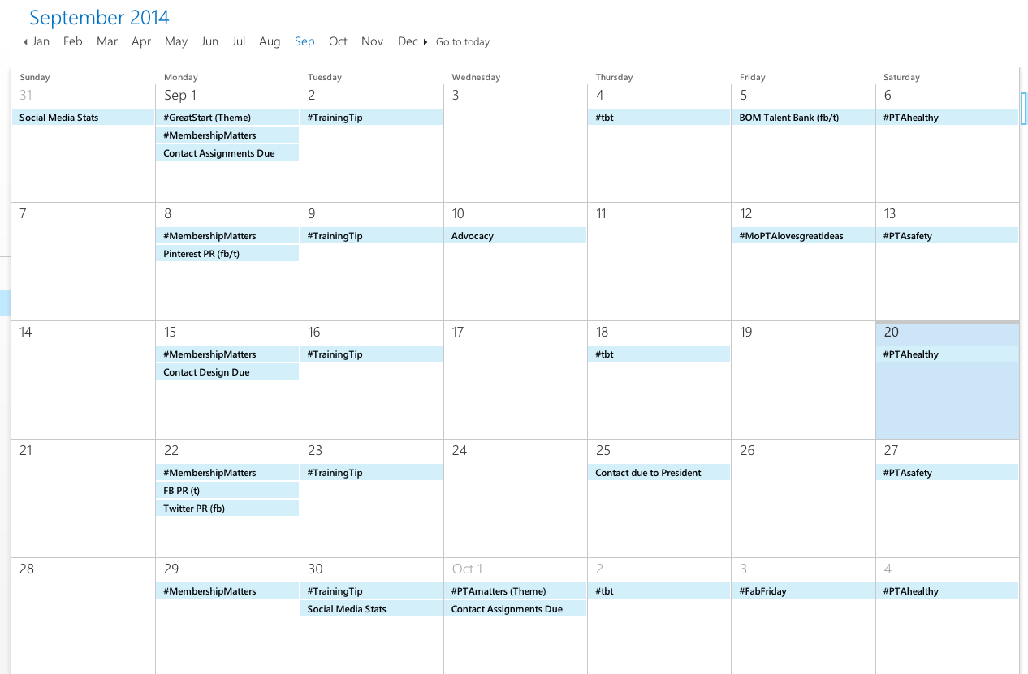
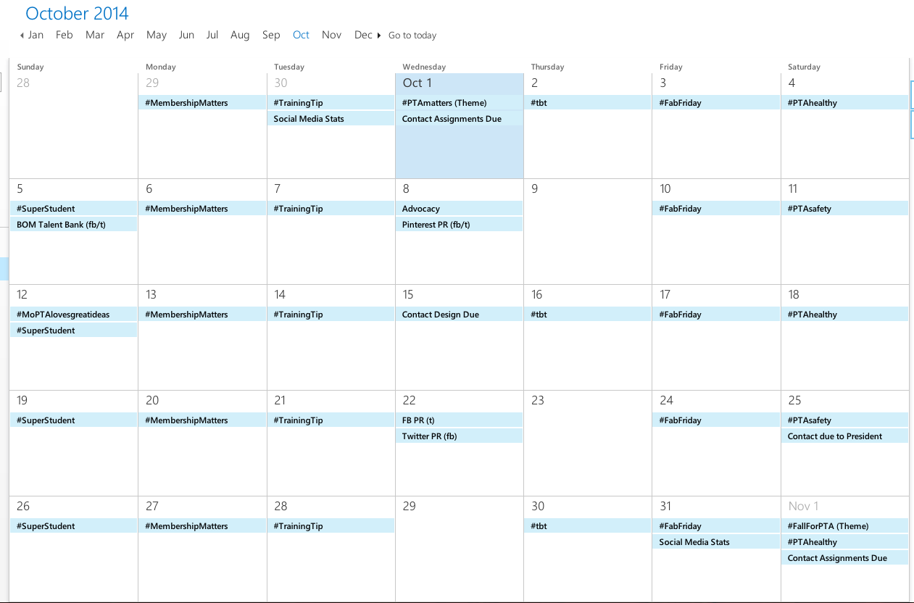
A social media scheduling calendar will save your life
Establish and document repeatable, efficient social media processes and standards regarding how content is developed, approved
Who will develop and review social media calendar?
Who will review and how many revisions are acceptable?
Who is the final approval for all social media content?
Don’t bog content down in the approval process – content should be relevant, responsive and timely
Recommended monthly social media calendar developed by Social Media Manager

Slide 12
Establish successful social media process
Establish and document repeatable, efficient social media processes and standards regarding how content is published, monitored
How often will content be published – Pareto Rule 80/20 split
Who will publish the content – all Social Media Manger or group with approval?
What are posting expectations?
What are response expectations?
Who is the back-up if the Social Media Manager is unavailable?
What are expectations for responses to negative comments?
When are posts deleted?
When are stakeholders banned from the page?
In the event of a PR disaster, who will be in charge of social media accounts and when will they be used?

Slide 13
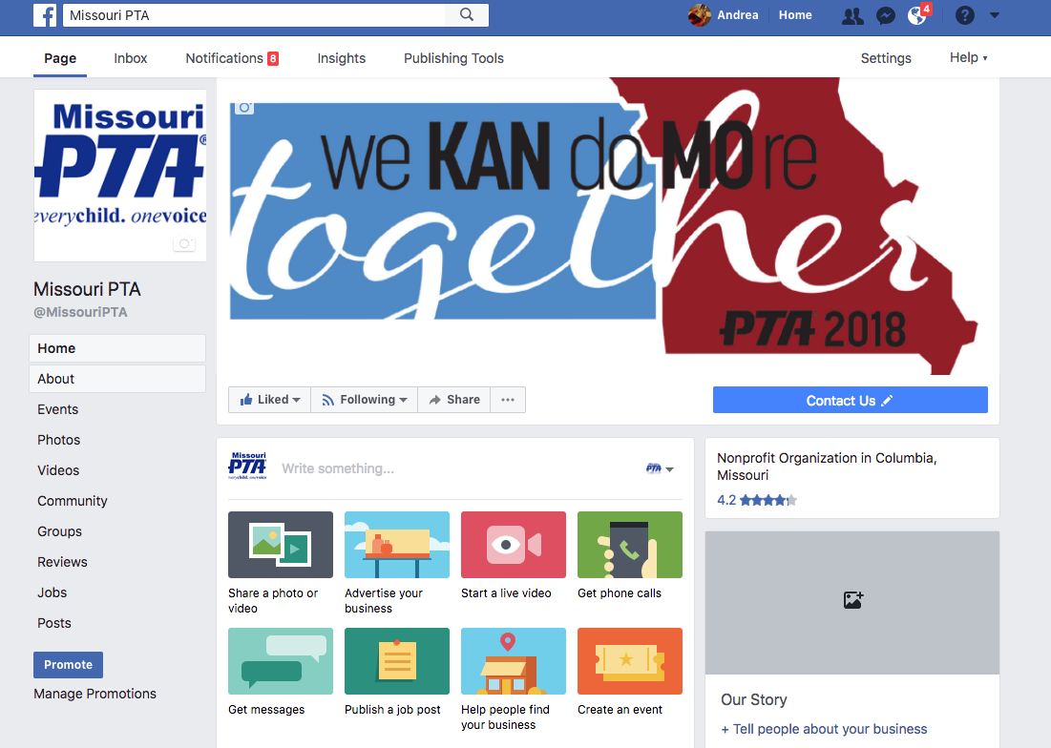
What you should post facebook
Socialize and inform, don’t advertise – think sharing with friends
Quality over quantity – focus on your goals, audience and message.
Only write posts that fit in the message – this isn’t a novel, it’s a quick bit of information.
Pictures are important.
Authentic over automated – be personal, authentic and approachable
Be responsive – respond, listen
Don’t conceal mistakes during a crisis

Slide 14
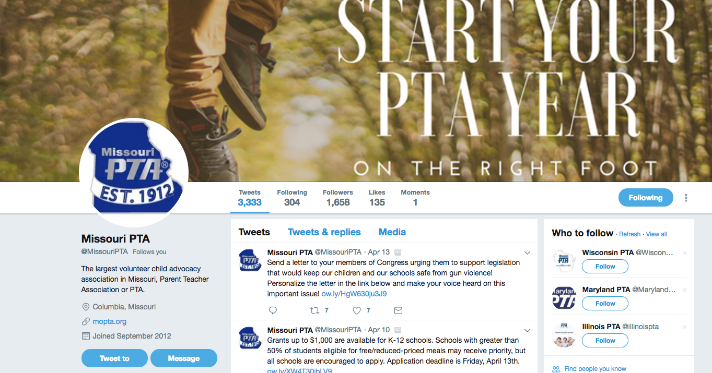
What you should post Twitter
Clever and interesting posts appreciated in this platform
Concise messages are essential. You only have 280 characters.
Hashtags are huge. #BeCreative
Quantity is fine in this platform – focus on your goals, audience and message, provide thought and quality for posts
Authentic over automated – be personal, authentic and approachable
Twitter isn’t where you share tons of information – but you can link to other sites when needed. Do not post a link for more information with every post.

Slide 15
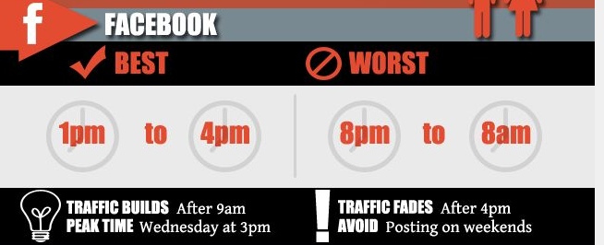
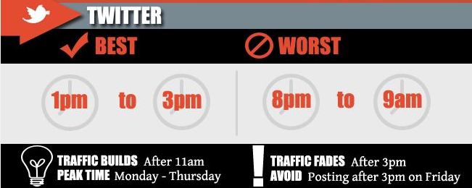
The best & worst times to post
Post to Facebook:
Goal should be 2-3 posts per week – only post if you have relevant information
More posts allowed for special events
Post when your stakeholders are listening
Post to Twitter:
Multiple posts per day are acceptable, a different stakeholder group is on Twitter at 10 am, noon and 7 pm
Multiple posts for same information are fine, consider varying message to increase interest.

Slide 16
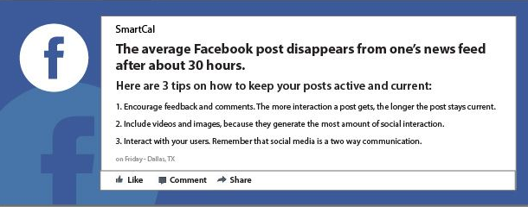
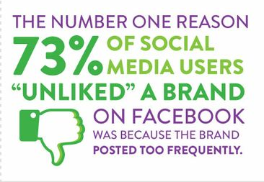
Planning posts matters for facebook
When you develop interesting content and accurately time it, your posts have greater reach – meaning more people see them and your message is more effectively communicated.

Slide 17
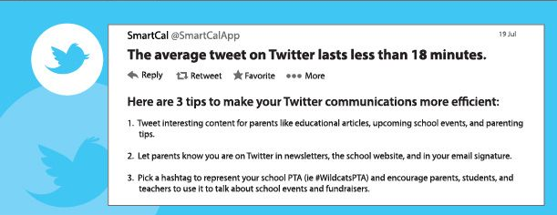
Planning posts for twitter
When you develop clever/interesting content and share it effectively, your posts have greater reach – meaning more people share them and your message reaches a larger audience.

Slide 18
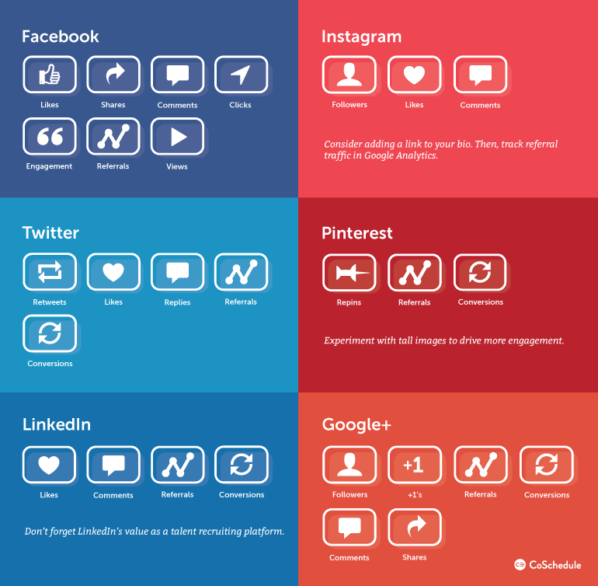
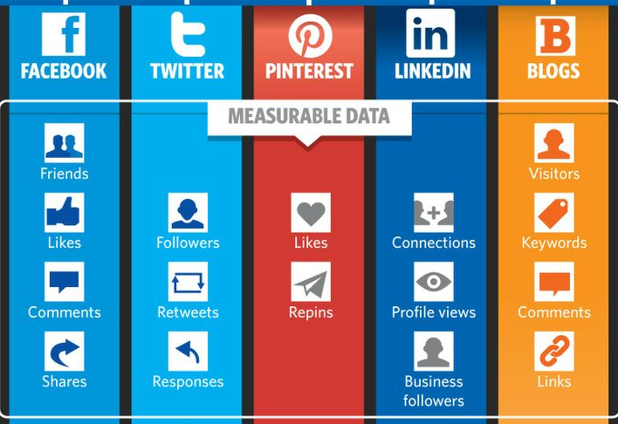
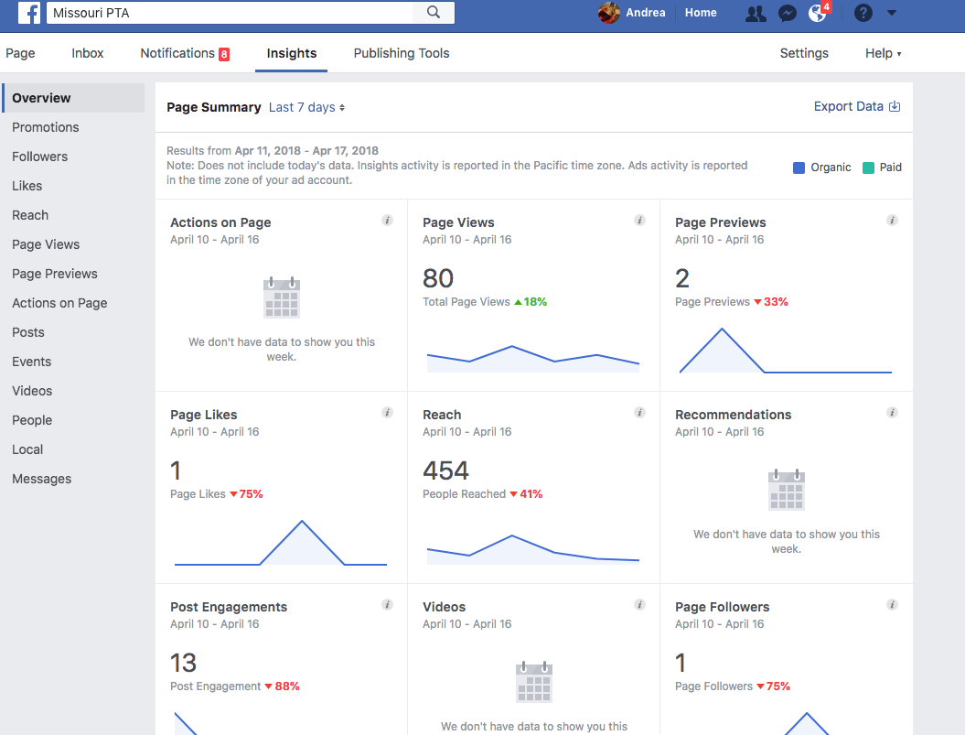
Measure & Evaluate
Check key metrics, you need to know what is working and what isn’t.
Evaluate plan and adjust based on successes and opportunities
Keep trying new things – change is guaranteed and productive

Slide 19
We can help you with your communication
Contact us for assistance with Branding, Communication, PR, Advertising, Social Media
Andrea Battaglia, MoPTA Contact Editor andreab@mopta.org
Kristina Wilmost, MoPTA PR Chair andreab@mopta.org

