Slide 1
Social Media Advanced
Improve Your Social Media
Kristina Wilmoth - Missouri PTA PR Chair
Andrea Battaglia – Missouri PTA Contact Editor

Slide 2
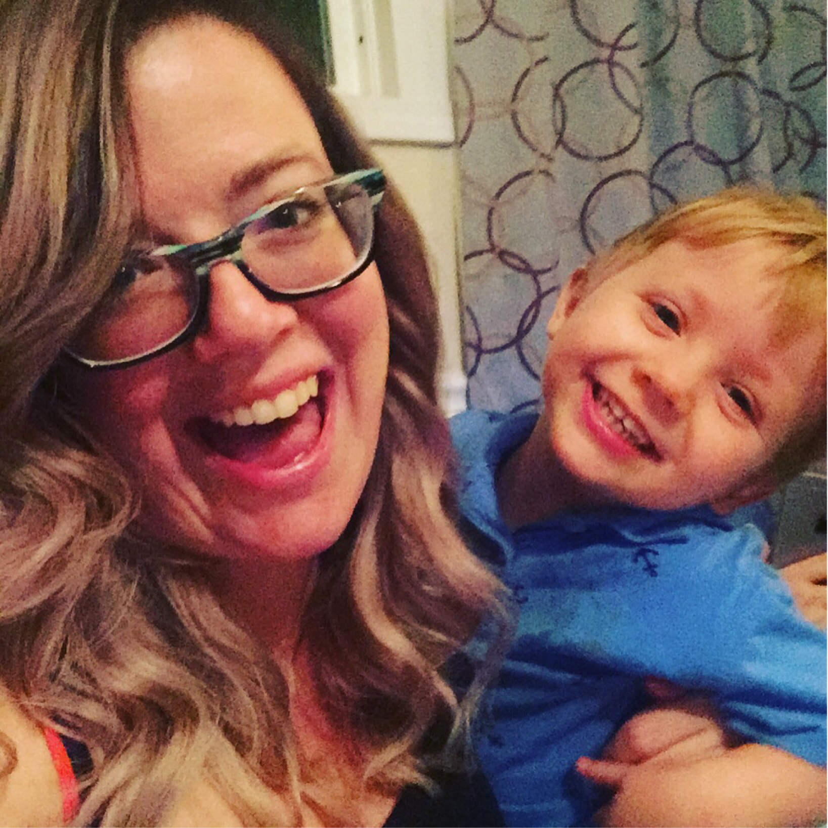
Kristina Wilmoth Presenter Information
Works in Marketing & Strategy, helping non-profits create brand image and maintain constant presence
Manages 12 social media accounts
Full-Time Program manager for a poverty-addressing initiative
Writer and editor for enewsletters and print newsletters for multiple organizations
Bachelor's Degree in Business-Advertising & Promo (MSU)
Master's Degree in Health Promotions & Wellness Mgt (MSU)

Slide 3
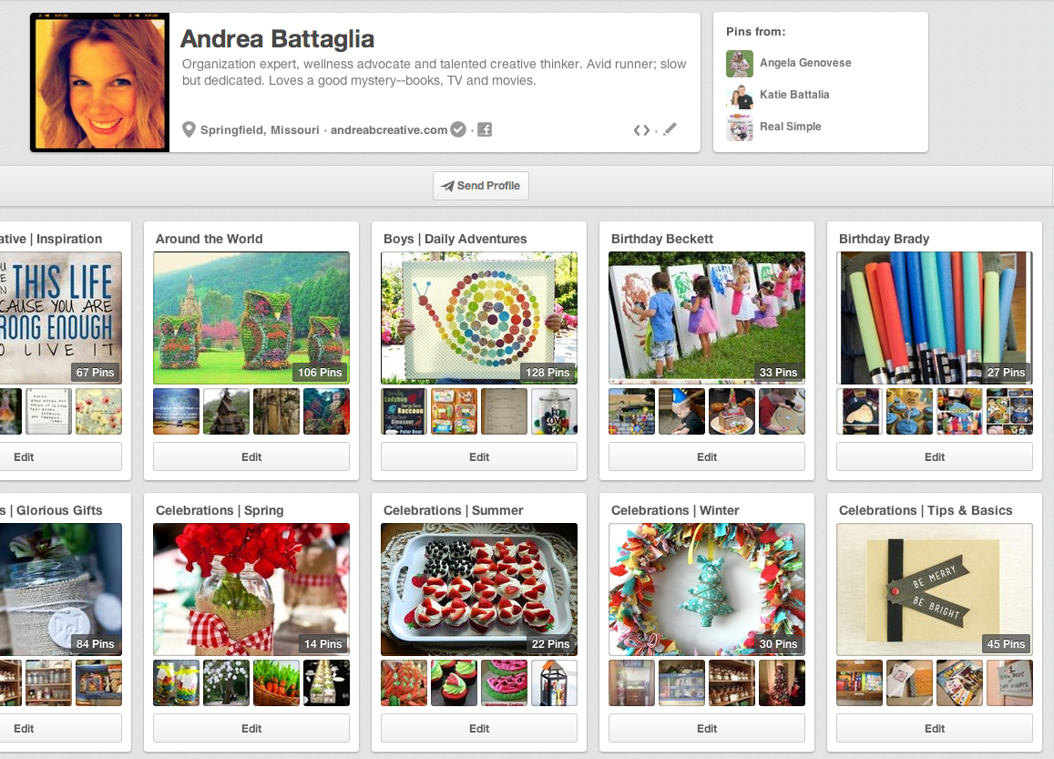
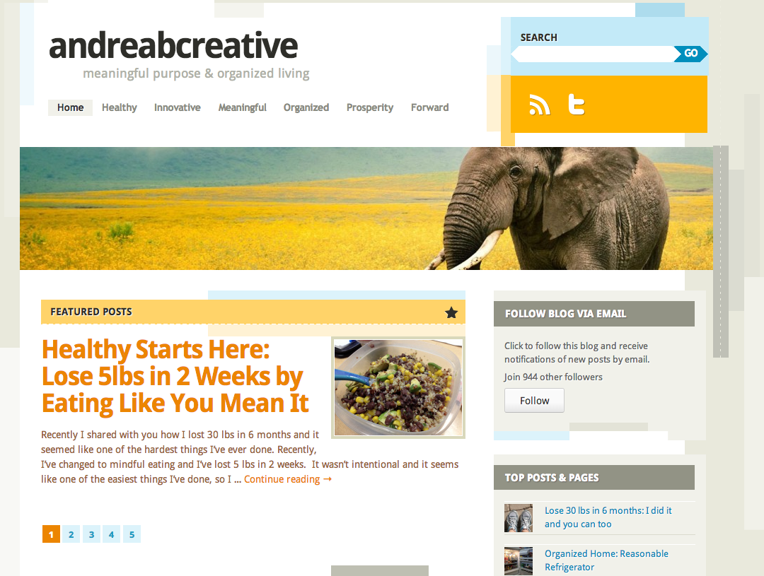
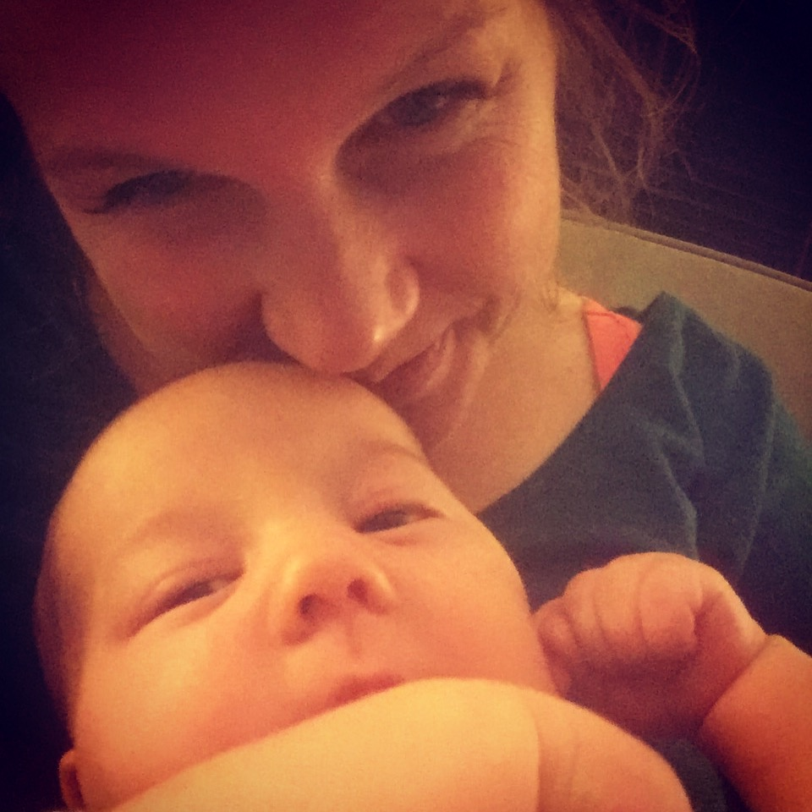
Andrea Battaglia Presenter Information
Work full-time in Marketing & Strategy, helping groups effectively manage communication and brand
Manage multiple social media sites, professional, volunteer and personal including www.andreabcreative.com, my personal brand. Focus is Organized Living & Meaningful Purpose
Organization Expert & Wellness Advocate, communicate consistent message through personal brand.
Professional Trainer & Facilitator for groups of all sizes and competency levels – develop effective strategy and action plans to improve groups

Slide 4
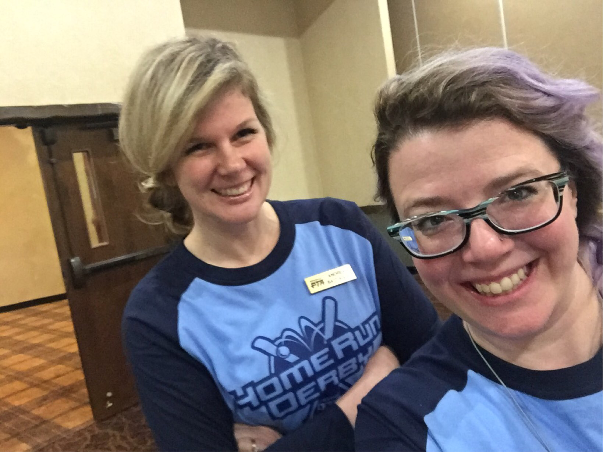
Start with a Strategy
Social Media Team is Vital
Create a team that will be committed to learn and grow together.
The team should be as small as possible – but all relevant stakeholders should be represented.
Set up a system that creates new content, shares relevant content and can collect information sent to one key social media manager

Slide 5
Start with a Strategy
Document social media goals for each platform using the SMART goals format
Specific
Measurable
Agreed To and Attainable
Relevant
Timed
It’s OK if your social media goals are short, few in number, and easily understood
Revisit them frequently as you evaluate how well things are going and what you can do better.

Slide 6
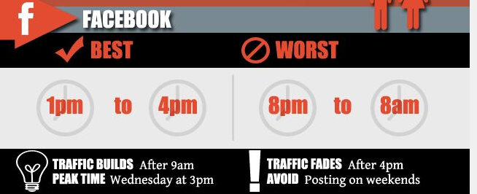
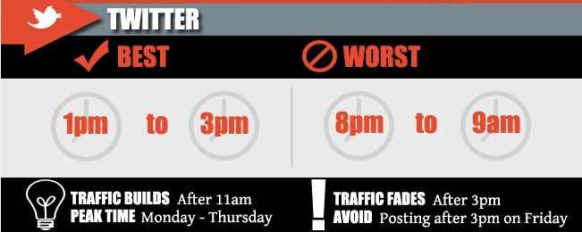
Plan Your Posts
When you should post to Facebook?
Goal should be 2-3 posts per week – only post if you have relevant information
More posts allowed for special events
Post when your stakeholders are listening
When you should post to Twitter?
Multiple posts per day are acceptable, a different stakeholder group is on Twitter at 10 am, noon and 7 pm
Multiple posts for same information are fine, consider varying message to increase interest.

Slide 7
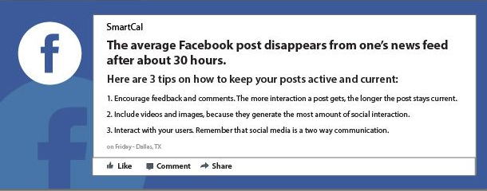
Plan Your Posts
Why planning posts matter for Facebook
When you develop interesting content and time it effectively, your posts have greater reach – meaning more people see them and your message is more effectively communicated.

Slide 8
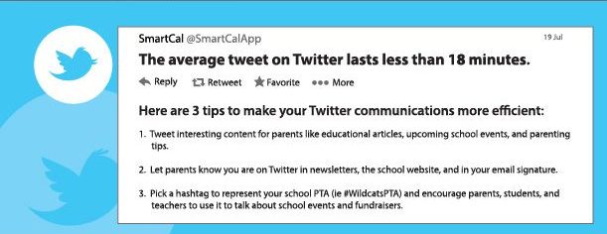
Plan Your Posts
Why planning posts matter for Twitter
When you develop creative content and repeat it effectively, your posts have greater reach – meaning more people share them and your message is more effectively communicated.

Slide 9
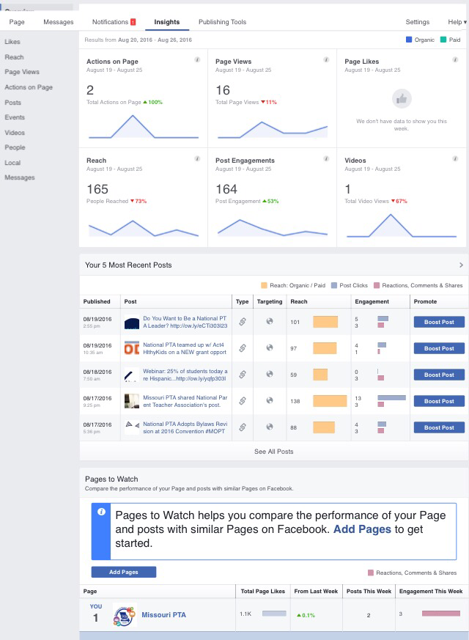
Measure & Evaluate Your Posts
Check key metrics, you need to know what is working and what isn’t.
Evaluate plan and adjust based on successes and opportunities
Keep trying new things – change is guaranteed and productive

Slide 10
Measure & Evaluate Your Posts
Use the tips and tricks given on social media platforms.
Read blogs, how-to articles, and books
Ask young members, friends, and kids for advice and help

Slide 11
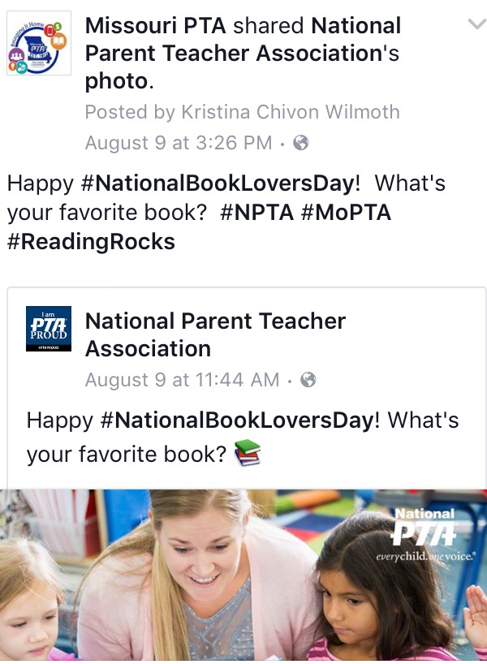
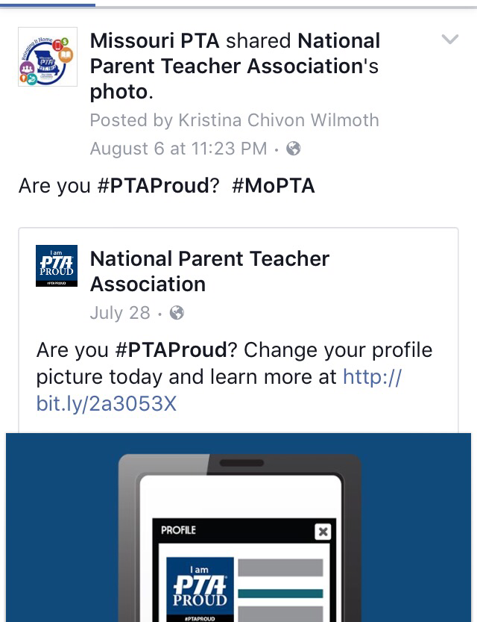
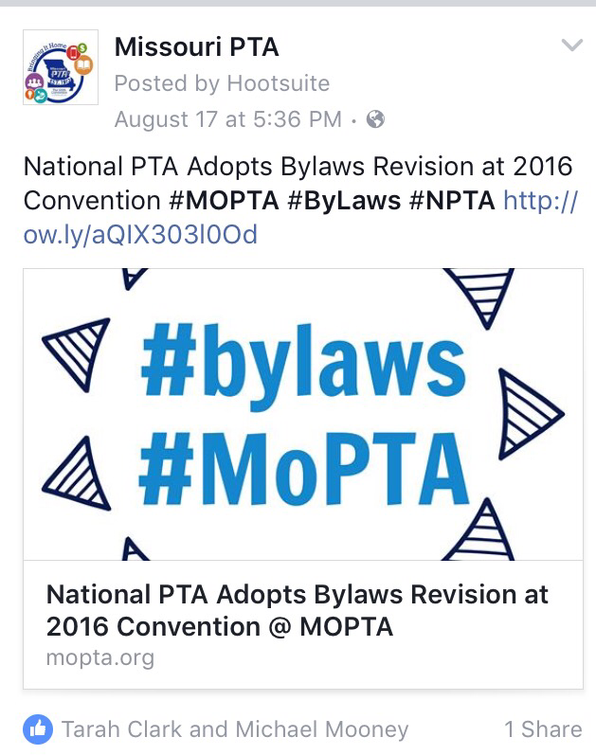
Intensely Important Interruptions
Planning is great, but sometimes postings are not planned ahead of time and that's great, too!

Slide 12
Activity
Break into groups of 3-5
Your group is a new Social Media Team. Create roles and job descriptions (bullet points) for each of you. Write out the process for approval of social media posts.
Create a FB and twitter post for this email and tell us about the approval process. (MOPTA emails and National PTA posts).
What was the Call To Action?
Hashtags? Tagged? Check in?
Is this a continuous post or a one-time post?
What time of day, date, etc will the post be?
Did you use a picture? Where did it come from?

Slide 13
Thank You & Contact
Kristina Wilmoth Missouri PTA PR Chair
kristinaw@mopta.org
Andrea Battaglia Missouri PTA Contact Editor
andreab@mopta.org

