Slide 1
Family Reading Experience
A National PTA Program

Slide 2

The National PTA Family Reading Experience was developed to help families get more involved in their children’s reading and enhance their emerging interest in books.
This is not a reading program – we are not teaching children to read. This is a family engagement program.
All the tools necessary are available for a PTA to host this fun filled family engagement program.
Notes:
Recommend if utilizing spanish have an interpreter available for the evening
Recommend hosting K-2 and 3-5 on separate nights or in different areas to avoid confusion – this depends on your volunteer force. The activities are designed to be developmentally appropriate for those grades.

Slide 3
There are two different kits:
Grades K-2
Grades 3-5
Both are available in English and Spanish
Notes:
Recommend if utilizing spanish have an interpreter available for the evening
Recommend hosting K-2 and 3-5 on separate nights or in different areas to avoid confusion – this depends on your volunteer force. The activities are designed to be developmentally appropriate for those grades.

Slide 4
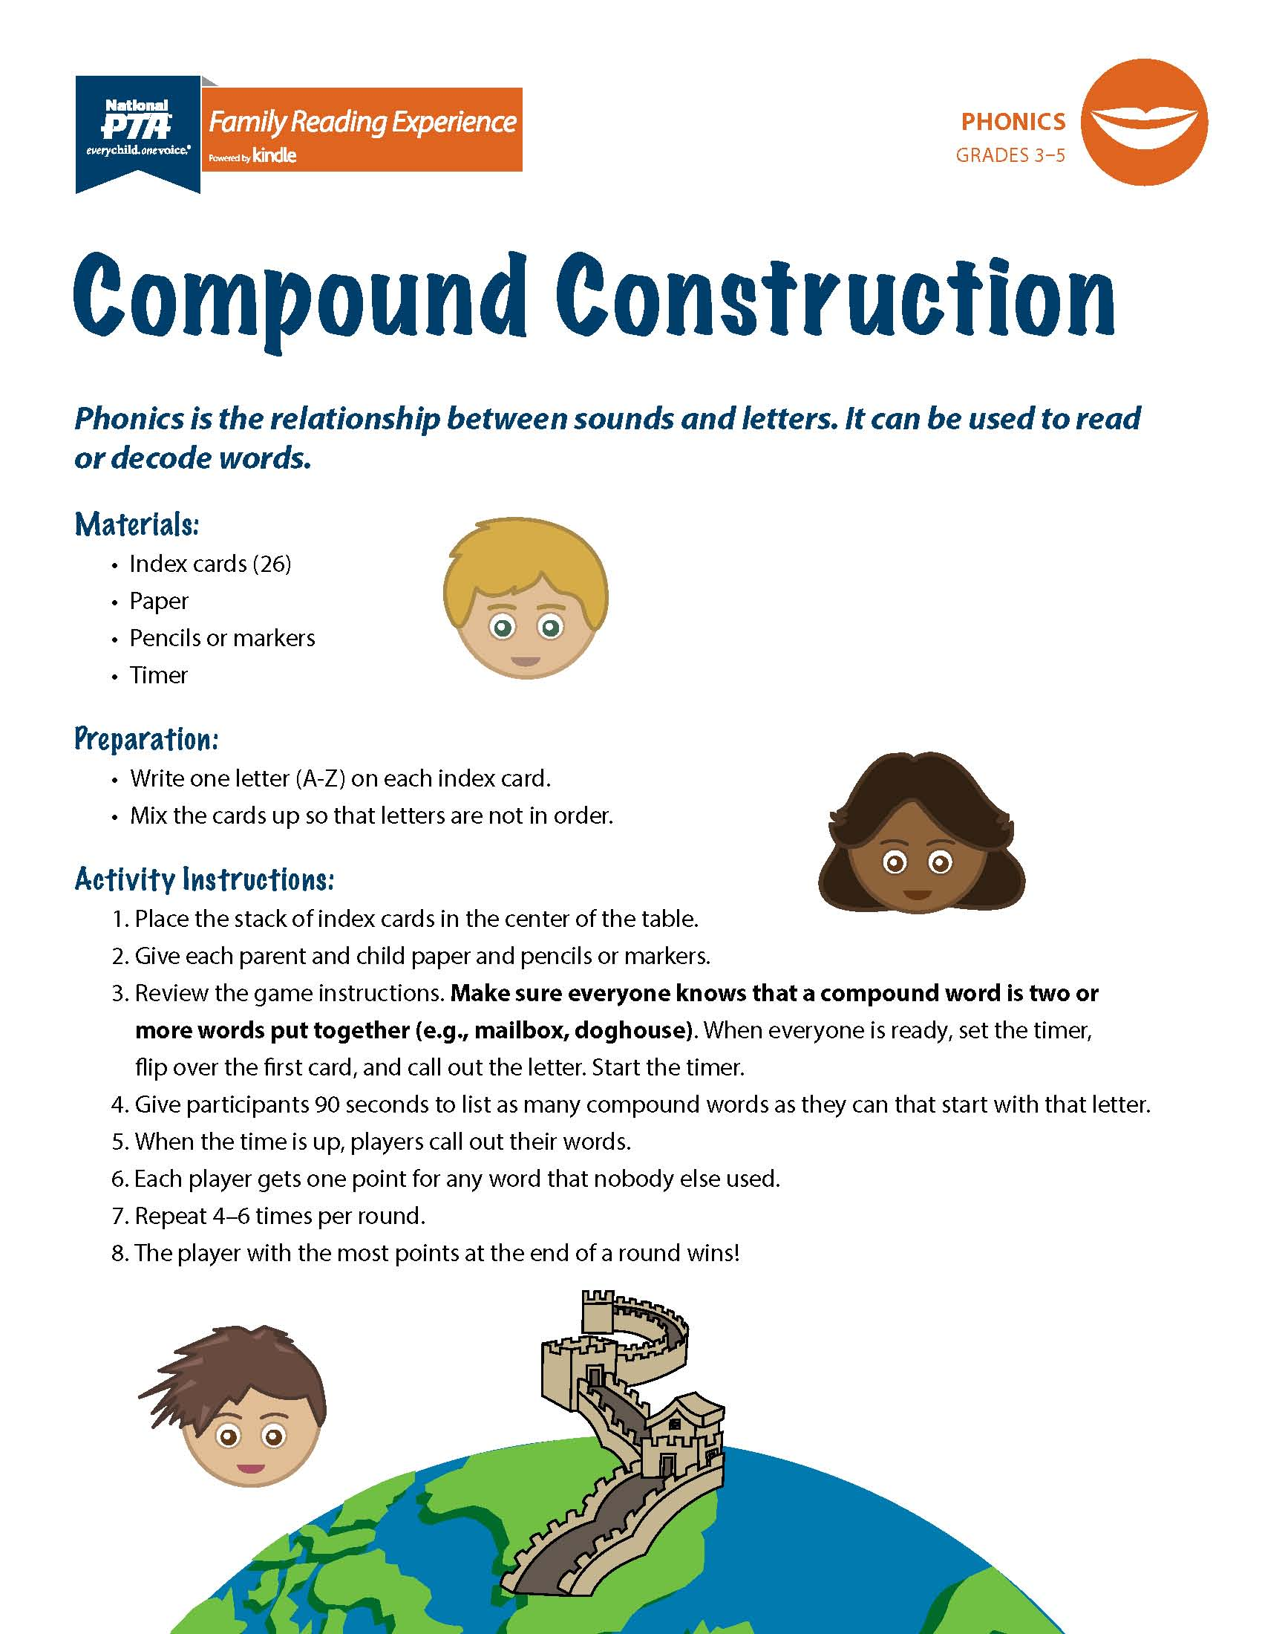
The kits come in four themes:
On Safari
Under the Sea
Out of this World
Around the World
Notes:
Different themes allows you to conduct multiple events in a school year
Varity of promotional materials to go with each theme

Slide 5
Promotional Tools available at pta.org
Key messages and sample social media messages
Flyers
Sample letter to families
Sample morning announcements
Sample media advisories and
newsletter articles
Notes:
Customizable tools

Slide 6
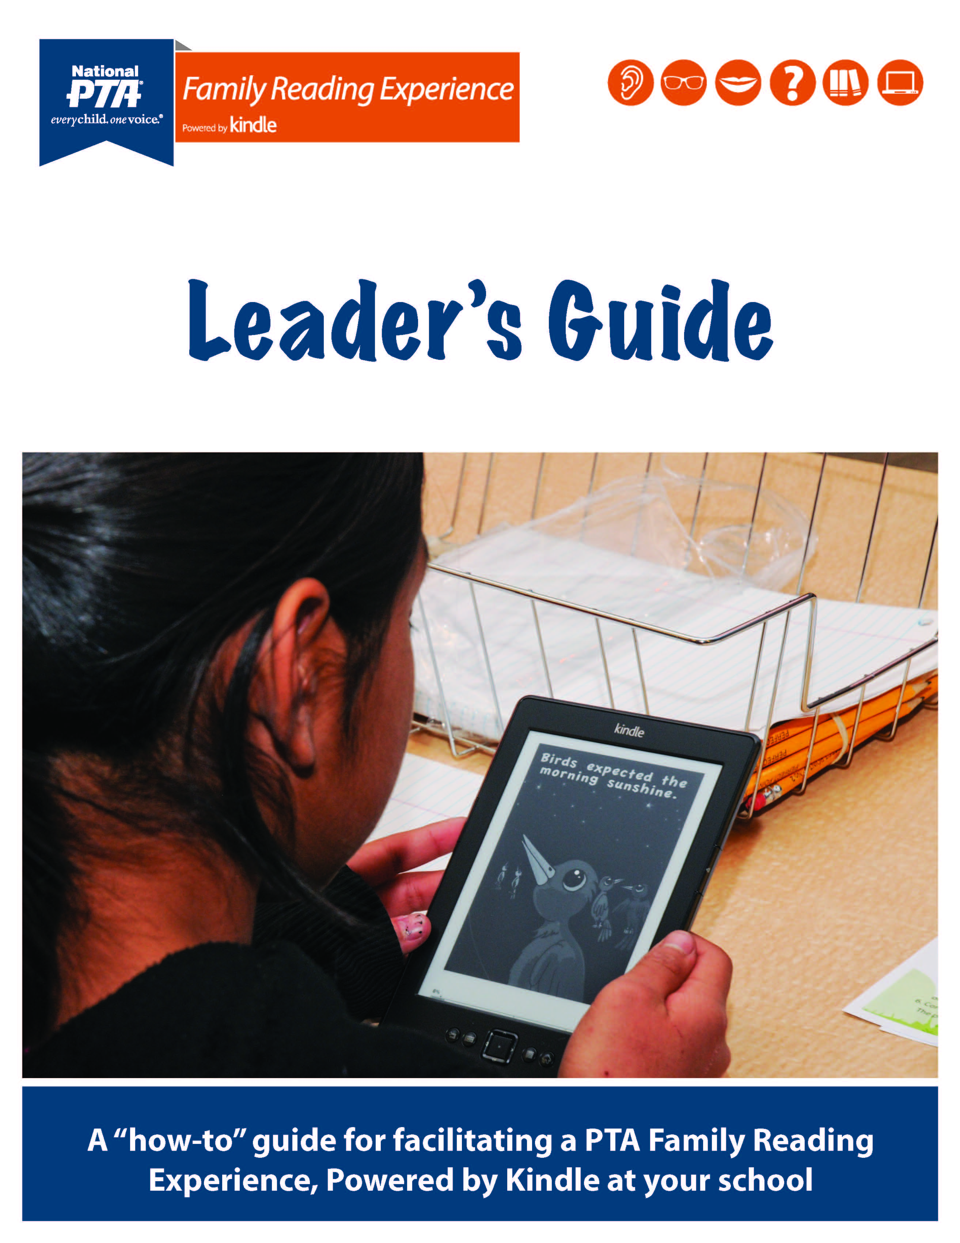
How to Host an Experience:
Utilize the Leader’s Guide
  This will help you host the experience from beginning to end.
  PTA.org/familyreading
Six stations – Phonemic awareness, fluency, phonics, comprehension, vocabulary, technology.
Notes:
Recruting volunteers, how to promote, gather materials, organize by station, and evaluate your efforts
Do not have to include the technology station – is there because of the growing amount of material available in electronic format and the unique ways electronic devices can assist with reading.
Have arrive in one location - dinner or light refreshments – explain how the program works traveling to each station. Make sure you allow 5 minutes at least for each station and about 5 minutes travel time between stations. Have a way to alert people when it’s time to move.

Slide 7
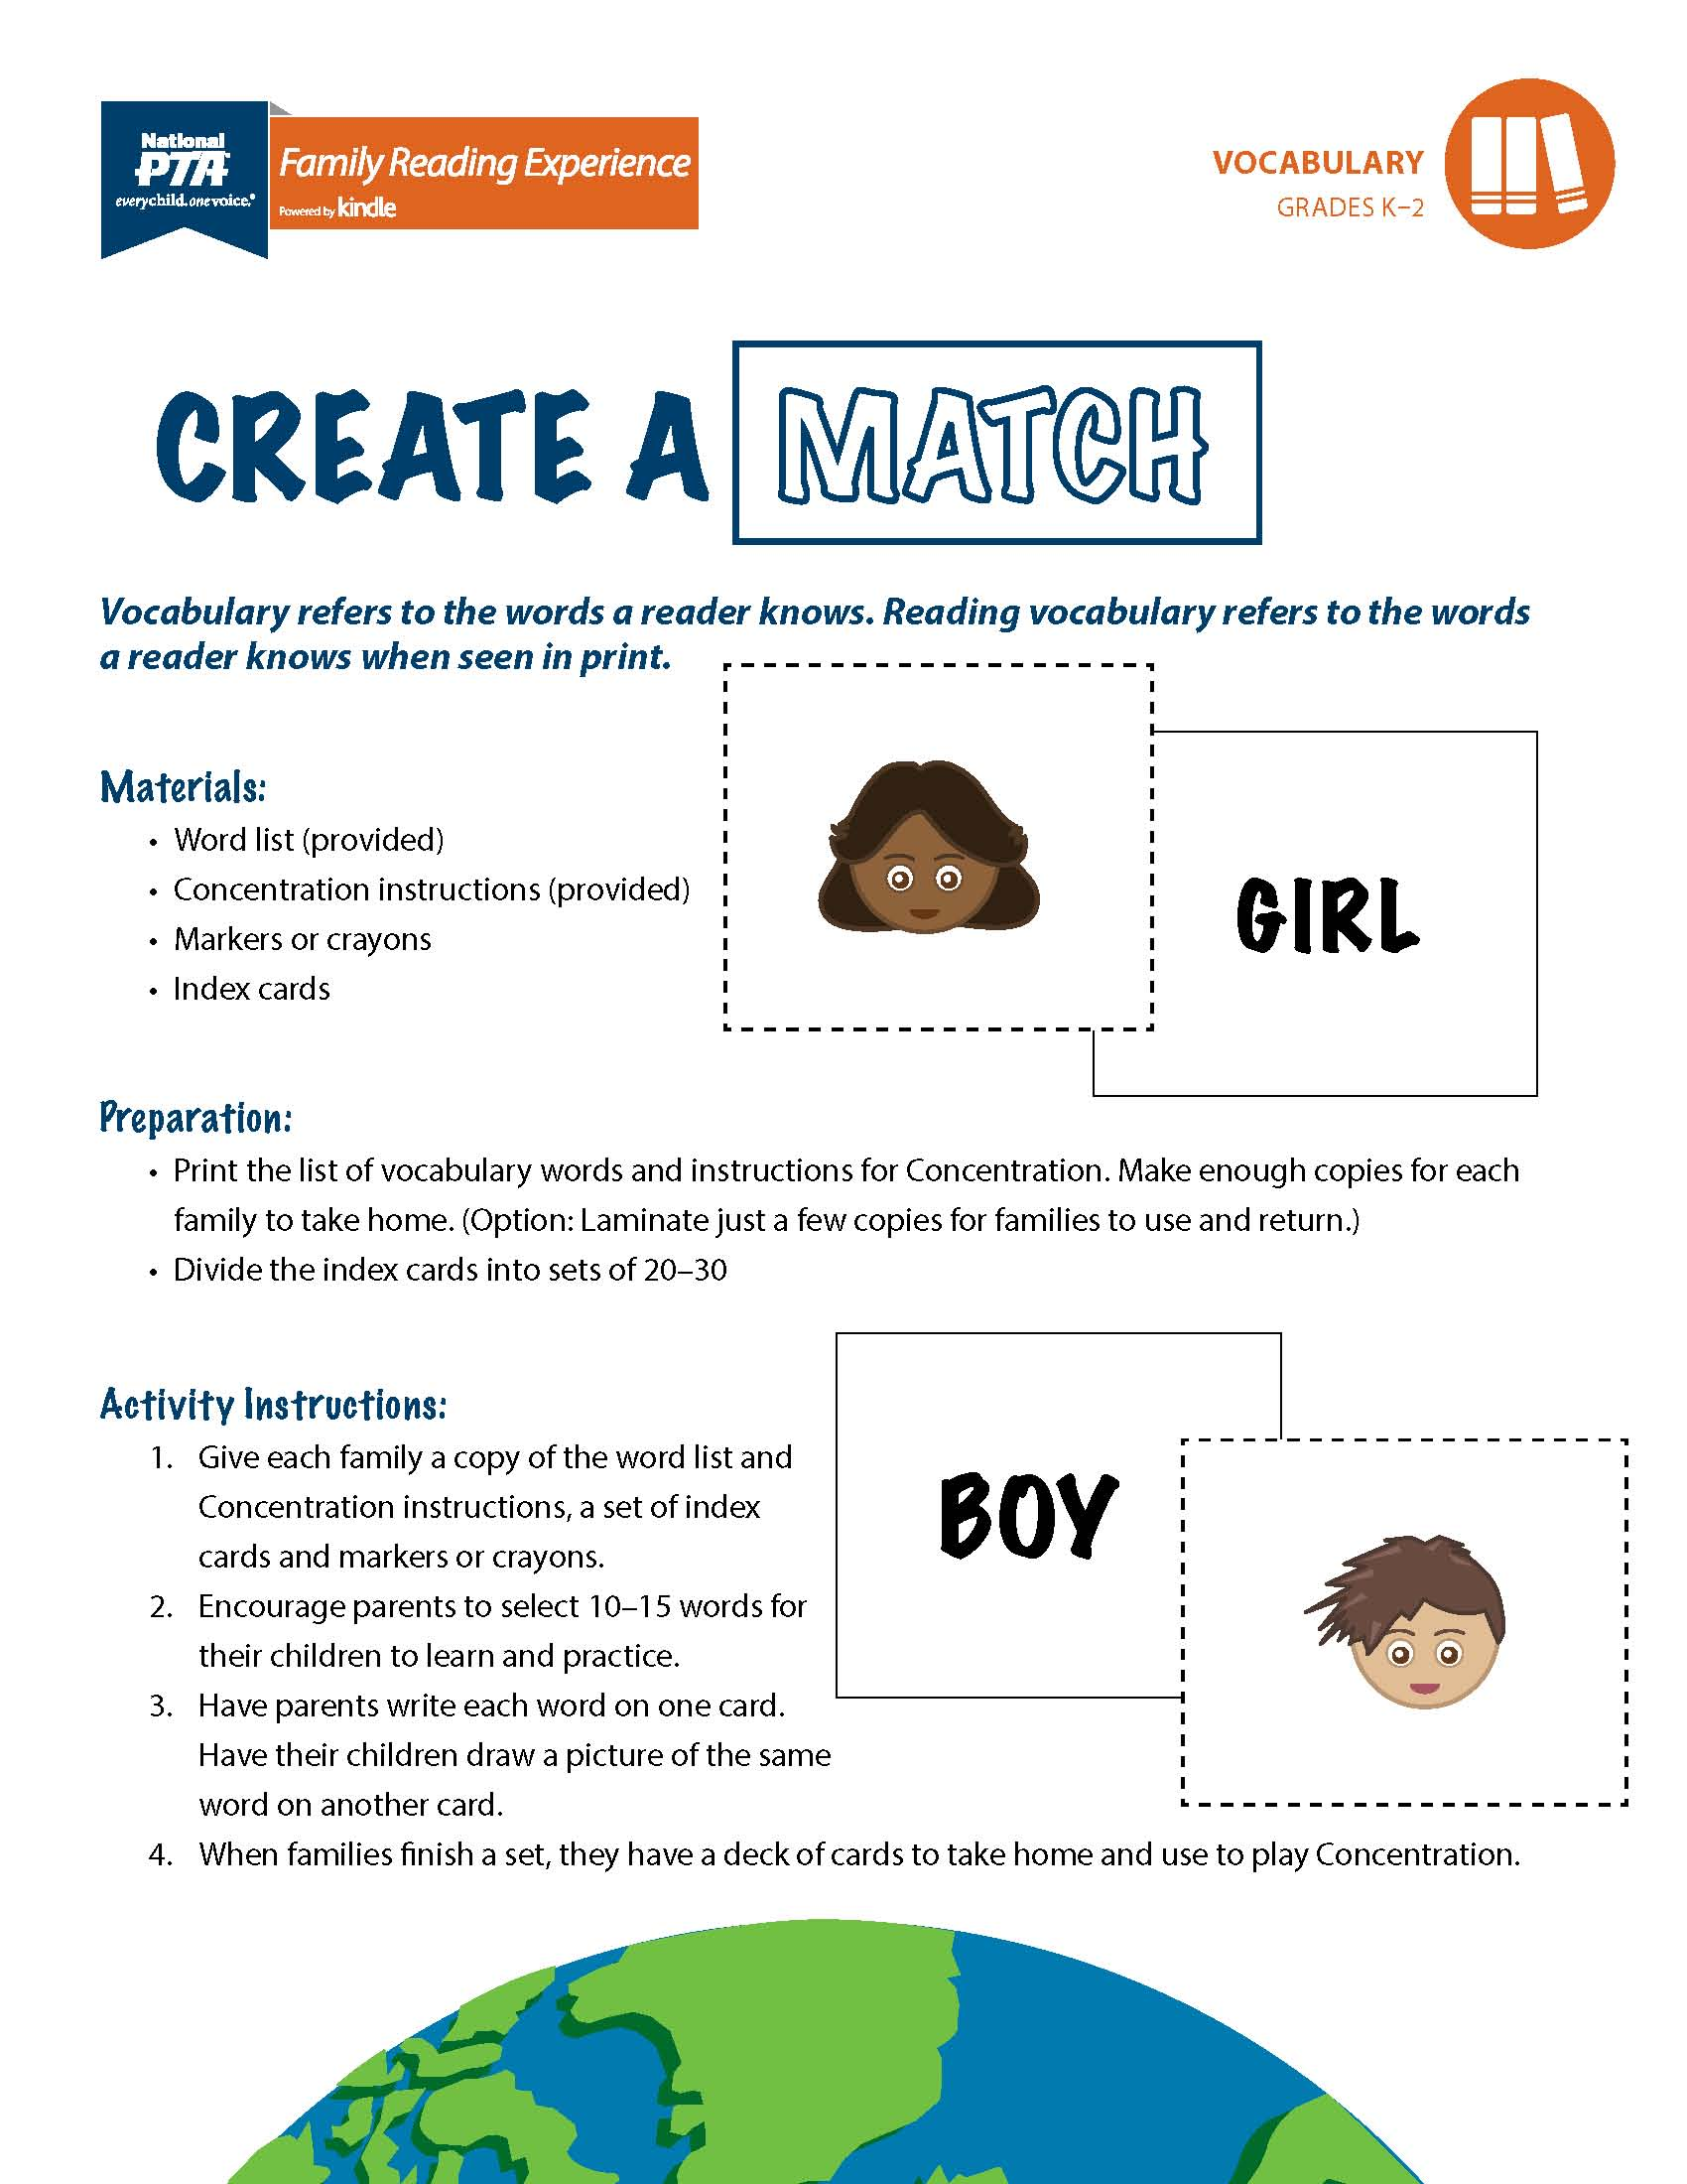
Setting up your stations:
Print materials
Gather other supplies
Train your volunteers
Notes:
Consider laminating printouts so they are more durable and can be used again
Volunteers should be familiar with how the station works and focus on making sure the parents are engaged during the event.

Slide 8
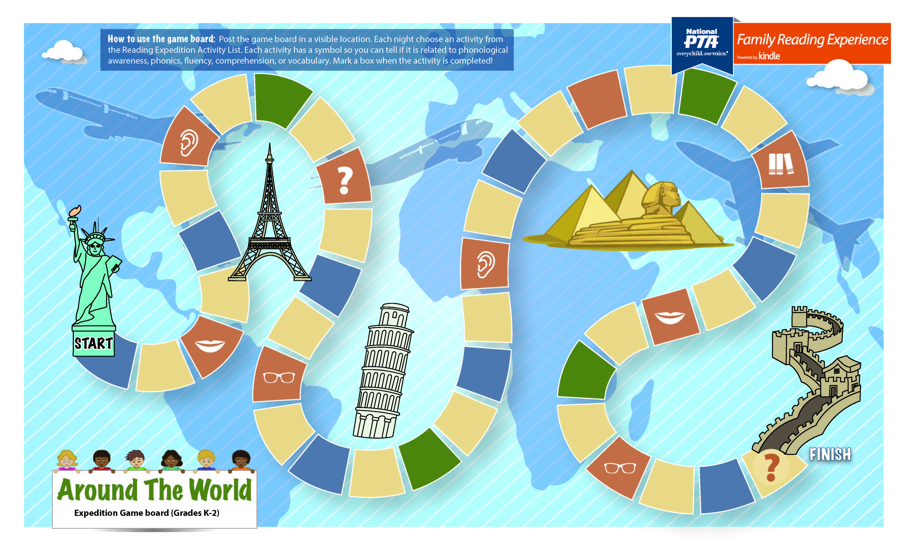
Ending your experience:
Take home activity
Evaluate
Notes:
Two sided – one for the children and info on the back for the parents
Find out what worked and didn’t work

