Slide 1
Awards 2
Achievement Awards
And
Unit Awards

Slide 2
Achievement Awards AA
Blue Seal
Gold Seal
Council Achievement
Outstanding Newsletter
Outstanding Website
AtLaw Awards (Advocacy through Legislation).

Slide 3
Unit Awards
Male Engagement Award
Parent Education and Involvement Award
Health, Wellness and Safety Award

Slide 4
Blue Seal Award
 |  | The PTA PURPOSES were read or displayed at each meeting.
 |  | At least five regular or special meetings were scheduled during the school year. Special meetings may include parent education, study groups, unit-sponsored college/career nights, open house, back-to-school nights, etc.
 |  | Executive board meetings were held prior to each regular meeting and a summer planning meeting was held.
 |  | Your unit submitted an article or pictures to CONTACT magazine.
 |  | The unit read or shared an opening thought or inspirational moment at each meeting.
 |  | The budget was adopted by the general membership at a regular meeting according to the unit bylaws. Describe the methods used to provide funds for the budget:
 |  | The unit had a Founders Day observance.
 |  | A Founders Day contribution was made to the State PTA Office postmarked by April 1st.
 |  | At least one member of the executive board attended a workshop at a council sponsored school of information or the Missouri PTA convention.
 |  | The unit has developed Standing Rules in accordance with the bylaws.
 |  | For units that are part of a council, attend at least one council meeting.
 |  | Your unit has an Advocacy Chair that reports regularly to the unit.
must meet seven of the 12 basic requirements
Deadline:
September 1st for the previous school year.

Slide 6
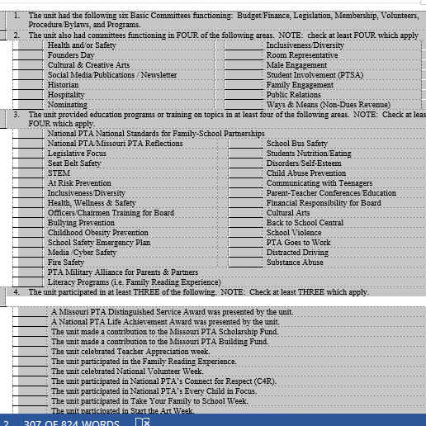
Gold Seal
Must meet requirements of the Blue Seal plus
3 of 4 in this group.

Slide 7
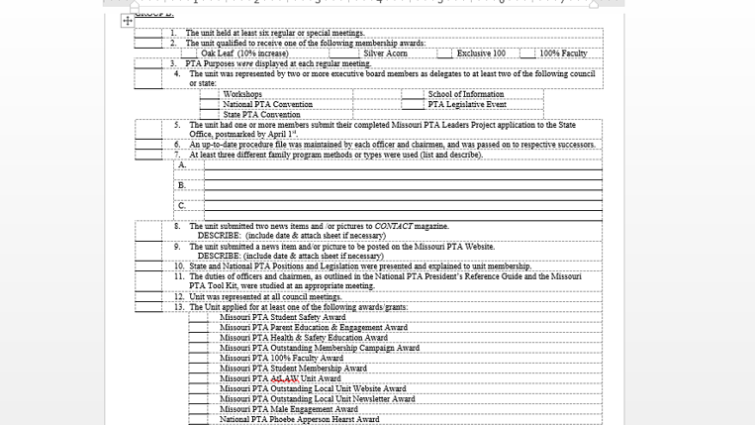
Gold Seal Award
Seven of 13 in Group B and submitted to the office by September 1st for the previous school year.

Slide 8
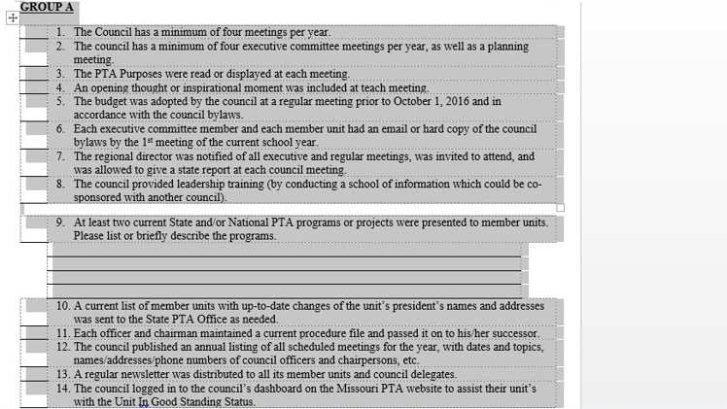
Council Achievement Award
Must be in good standing for that year and meet all of these requirements.
Plus ……

Slide 9
Council Achievement Award
Plus:
Seven of 14 of Group B
and submitted to the office by September 1st for the previous school year.

Slide 10
Outstanding Newsletter Award
NEWSLETTER AWARD CRITERIA:
PTA pages may be a part of the school newsletter. Other Information is secondary.
Judging criteria will be on content (unit, state & National PTA information), attractiveness, design and use of graphics
Includes PTA Officer(s) contact information.
At least three different newsletters from the current year should be submitted with this form.
Entries must be identical to those distributed to readers.
Entering units must be a PTA/PTSA units in good standing
Your completed application and newsletters should be sent to the MISSOURI STATE PTA OFFICE (POSTMARKED NO LATER THAN September 1, 2017).

Slide 11
Outstanding Website Award
WEBSITE AWARD CRITERIA:
A site must include the PTA/PTSA contact information, calendar, mission, purpose and goals.
A site must include links to both Missouri and National PTA websites.
A site must include PTA/PTSA information.
A site must have current, accurate information.
A site must use correct grammar and spelling and text is in an easy to read format.
A site must avoid empty pages.
A site must be user-friendly and appealing.
Entering units must be PTA/PTSA units in good standing,
A PTA/PTSA website may be part of a school district website, an education-based commercial site offering free web space such as “Myschoolonline,” or a parent website.
Your completed application should be sent to the MISSOURI STATE PTA OFFICE (POSTMARKED NO LATER THAN September 1, 2017).

Slide 12
Advocacy Through Legislation Award
Unit or Council Award
Hosting legislative events, educating others about PTA resolutions, encouraging members to actively participate in legislative endeavors, and promoting PTA issues all work towards helping your unit or council achieve the points required for the Missouri PTA Advocacy through Legislation Outstanding Unit or Council Award.
To earn the Award, units and councils must show their commitment to advocating for children through legislation by earning 200 points or more during the specified time frame, which starts April 1st and continues to March 31st of the following year. Some items are worth a set number of points while others have a point multiplier value. For example emailing out a JC/DC alert has a point multiplier value of x10. The unit or council would multiple by 10 each time they email a different JC/DC alert issued by either Missouri or National PTA.

Slide 13
Advocacy Through Legislation Award
Mandatory requirements for this award.
Councils must host a Missouri PTA Kids First Town Hall Meeting held between the dates of April 1st 2016 and March 31st 2017. **please note this requirement is only mandatory for councils.
A Legislative Chairperson for the unit or council must be appointed. The name and contact information including name, phone and email must be to the MOPTA office by September 1st, 2016.
The completed application form with supporting documentation (newsletters, programs, minutes, letters, copies of e-mails) must be to the MOPTA office and postmarked on or before April 1, 2017.

Slide 14
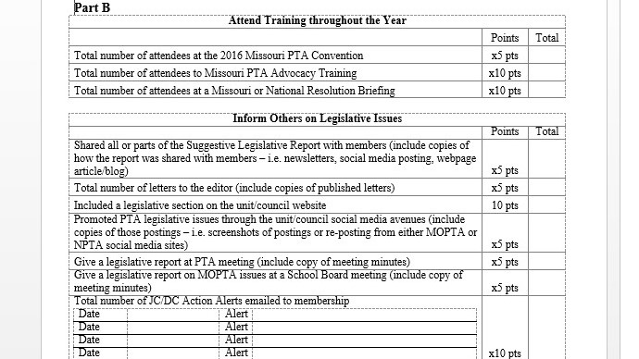
Advocacy Through Legislation Award

Slide 15
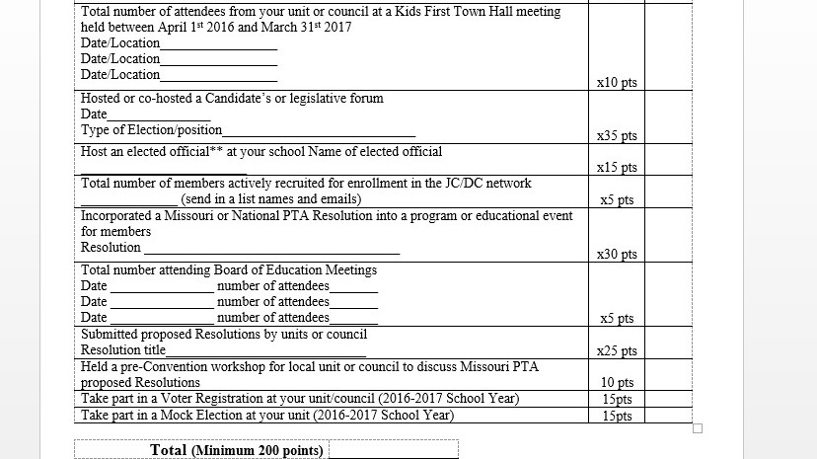
Advocacy Through Legislation Award

Slide 16
Advocacy Through Legislation Award
*Elected officials include any state or federal elected position, e.g.: State Representative or Senator, U.S. Congressman or Senator, Governor, etc.
NOTE:
Subject matter must pertain to issues important to children and youth.
The applicant in any communication/contact, whether written or oral, must take the position held by National PTA and Missouri PTA.
The completed application form with supporting documentation (newsletters, programs, minutes, letters, and copies of e-mails) must be to the MOPTA office and postmarked on or before April 1 2018.

Slide 17
Male Engagement Award
The Male Engagement Award promotes your PTA unit’s efforts to increase Male Membership and Male Participation in schools and communities and to help nurture children’s intellectual, physical and social development.
The PTA Unit being honored will receive a certificate of recognition, a check for $150 and be announced at the Annual Awards Ceremony at the Missouri PTA Convention.
Dues must be postmarked on or before September 1, 2018, for this award

Slide 18
Male Engagement Award
Increased male participation by using at least two of the following strategies:
Host at least one male participation event;
Host an event with a National PTA MORE Alliance partner;
Implemented a male participation program involving students;
Began a community partnership with a local fatherhood or other male initiative program.
Encourage an active male engagement committee that planned and implemented male participation activities.
Reduced or eliminated barriers to promote male involvement and engagement in PTA, school or community.
Explain how your unit accomplished each of the items qualifying you for this award.
Submit supporting documents of your programs, such as flyers, photographs, final reporting minutes of program outcome, etc.

Slide 19
Parent Education & Engagement Award
DEADLINE: Application must be postmarked on or before September 1, 2018
The Parent Education and Engagement Award is awarded to local and/or council units in the state of Missouri who effectively organize, plan and hold a program, project, specific workshop, or event which educates and/or celebrates parent engagement in the school.*
Programs, workshops or events held may be educational and/or social in setting while focusing on bringing parents together to participate in a school activity. The program may have been successfully held during the 2016-2017 school year or scheduled to be held during the 2017-2018 school year. Units may submit award applications for more than one event if desired.
To be considered for the award, your unit must be “a unit in good standing”

Slide 20
Parent Education & Engagement Award
The following MUST be submitted to be considered:
Brief description and summary of your workshop/program/event
List of your goals and objectives in holding the activity
Budget indicating how award funds will be used or will reimburse event expenses (preferably itemized)
Method of evaluating your activity post-event. How did you or will you determine your program’s success?
In addition, you may include any other materials that further explain your activity and show how families, students, committee members, school staff, and / or your community were or will be involved.

Slide 21
Health, Wellness & Safety Award
DEADLINE: Application must be postmarked no later than September 1, 2018
This award is given to a unit or council that hosted a program, activity or project that promoted an awareness of health and/or safety related information.
One (1) PTA unit or council will be recognized with a certificate of recognition, a check in the amount of $150.00 (one hundred and fifty dollars) and be announced at the Annual Award Ceremony at the Missouri PTA Convention.
Also, the unit or council will be given the opportunity at convention, to be a part of a Programs Workshop outlining their awarded program.

Slide 22
Health, Wellness & Safety Award
The program may have been successfully held during the 2016-2017 school year or scheduled to be held during the 2017-2018 school year. A selection committee composed of Missouri PTA Board of Managers members will review all applications.
Application must be submitted by unit/council in good standing.
Did your program make an effort to involve all parents in your school community, or your entire community? (please specify one or both)
Submit a brief summary of your program/activity/project.
Submit a budget for this program
Provide any material, worksheets and other documentation to support your program.

Slide 23
Awards 2
Questions ?

