Slide 1
STUDENT INVOLVEMENT

Slide 2
What does Student Involvement mean to PTA/PTSA?
Student Involvement could mean many things:
Answering surveys
Evaluate event results - Pros & Cons
Passing out programs for an event
Decorations/Posters or Set up/clean up crew
Greeters or Guides - “Welcomers”
Being on a committee/committee chairman
Student Representative on Local PTSA board
Student Representative on State PTA board

Slide 3
Students can sometimes say it better...
Notes:
I would like to show you a video on just what i mean by that…….

Slide 4
What adults can learn from kids | Adora Svitak
Notes:
Stop video after applause!!!!!!!!!!!!!! (About 9 min)

Slide 5
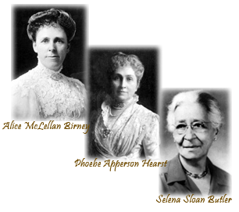
Our founders represented women of imagination and courage.
WOW!
Notes:
What a leader she is and will be!
If only I had as much imagination and courage as Adora.
Our founders of PTA, had a simple idea—to improve the lives and future of all children. They understood the power of individual action, worked beyond the accepted barriers of their day, and took action to change the world for all children.

Slide 6
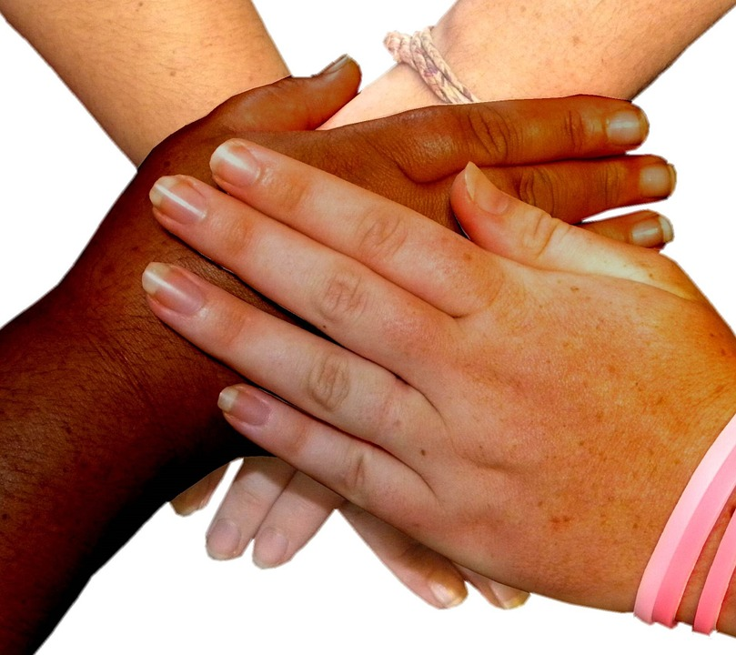
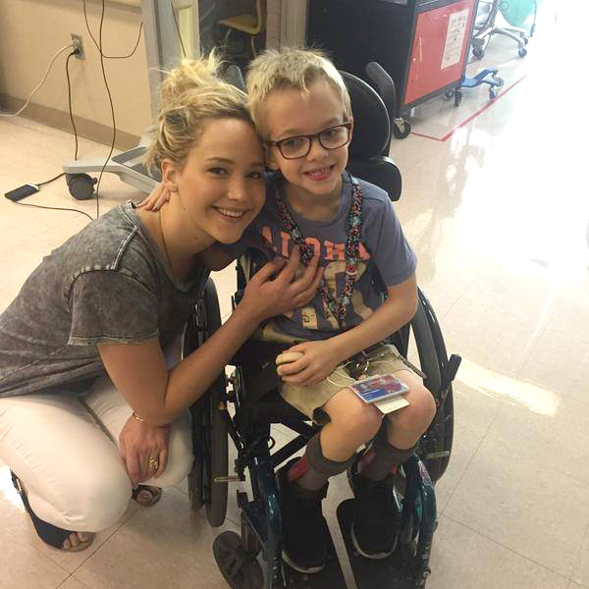
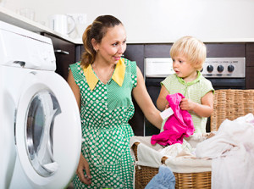
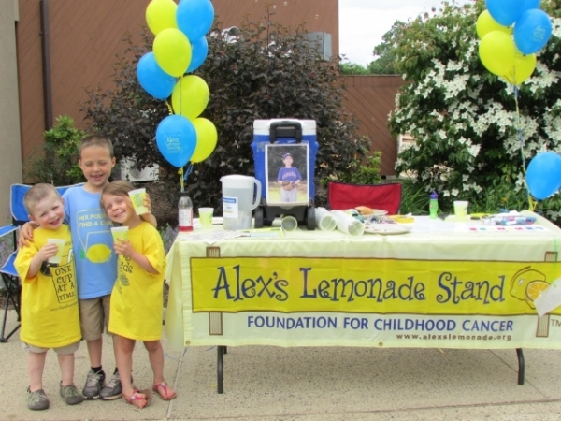
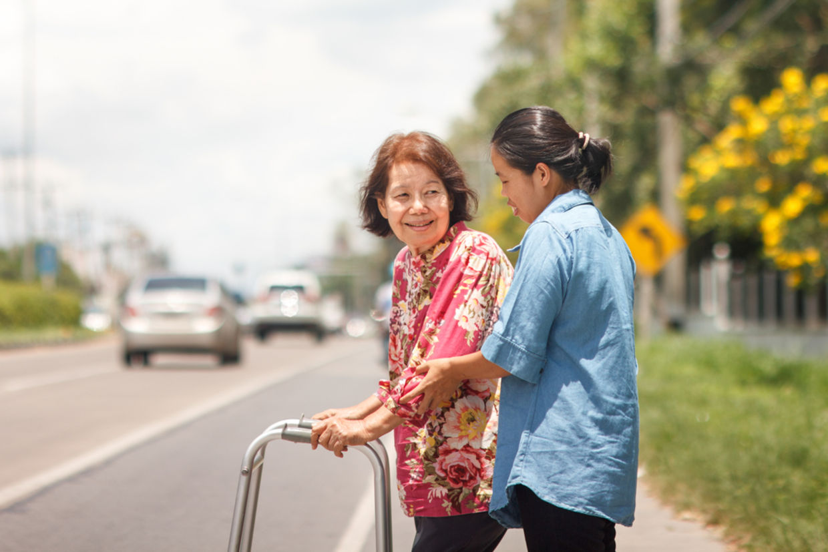
FRIENDS
COMMUNITY
FAMILY
Notes:
Students can and have contributed so much to those around them already.
For their friends, families, schools and communities.

Slide 7
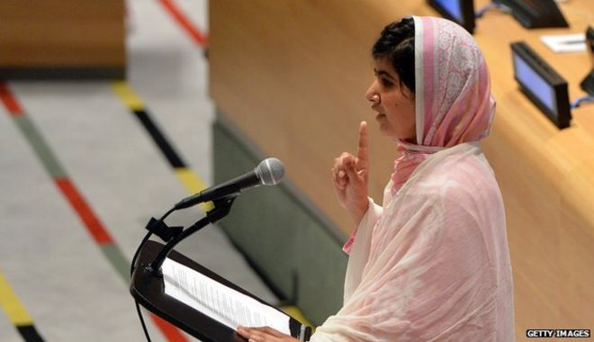
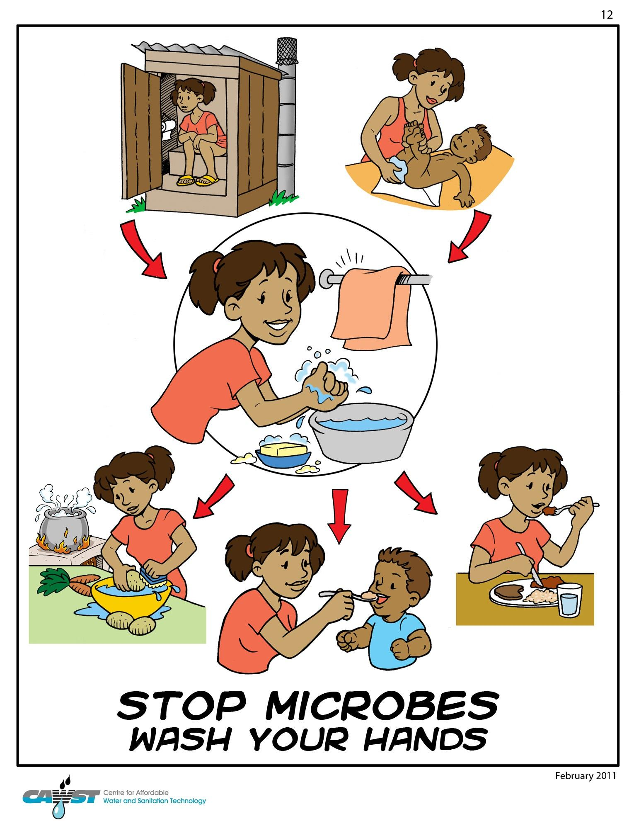
“Simple Idea”
Hanging/Making Posters
Providing leadership roles
Taking surveys
Notes:
Continuing the founder’s initial“simple idea”, we can add to their original agenda by including and involving students first hand in our PTAs.
Providing leadership roles and opportunities for them to contribute towards their own surroundings. Take part in surveys. Who better than getting first hand information than from the individuals you are trying to do things for? For example, if you have a winter party coming up, send out surveys to students and let them have a voice in what will happen. Follow up surveys are another great tool. What worked, what didn’t.

Slide 8
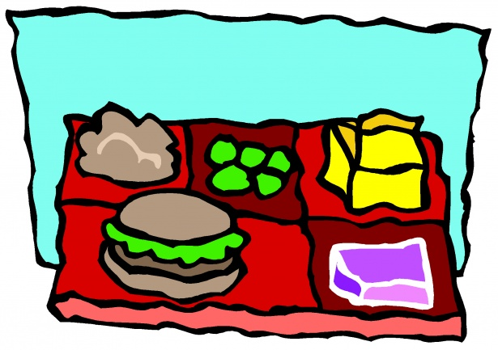
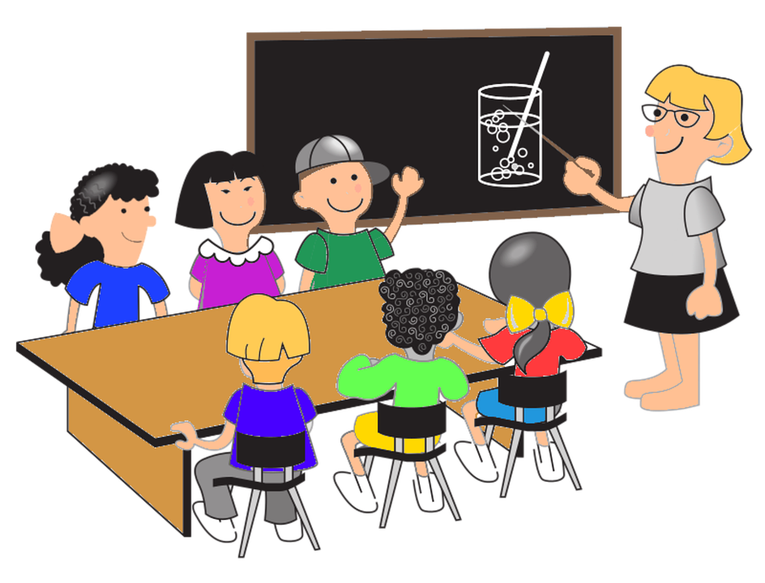
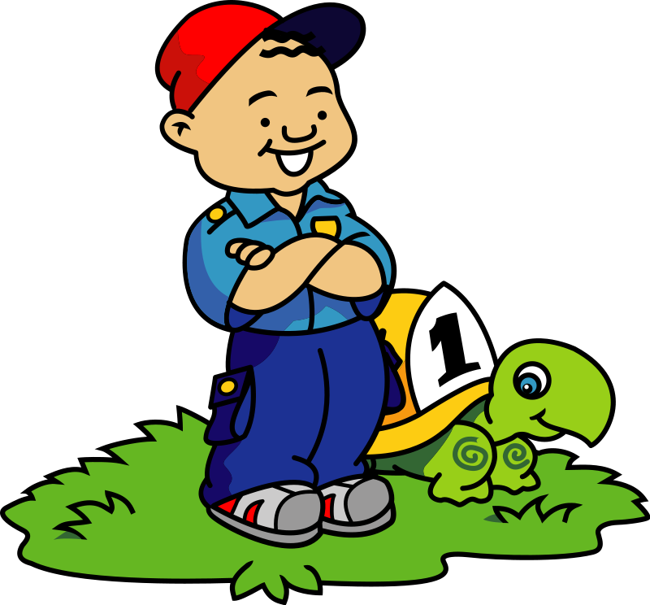
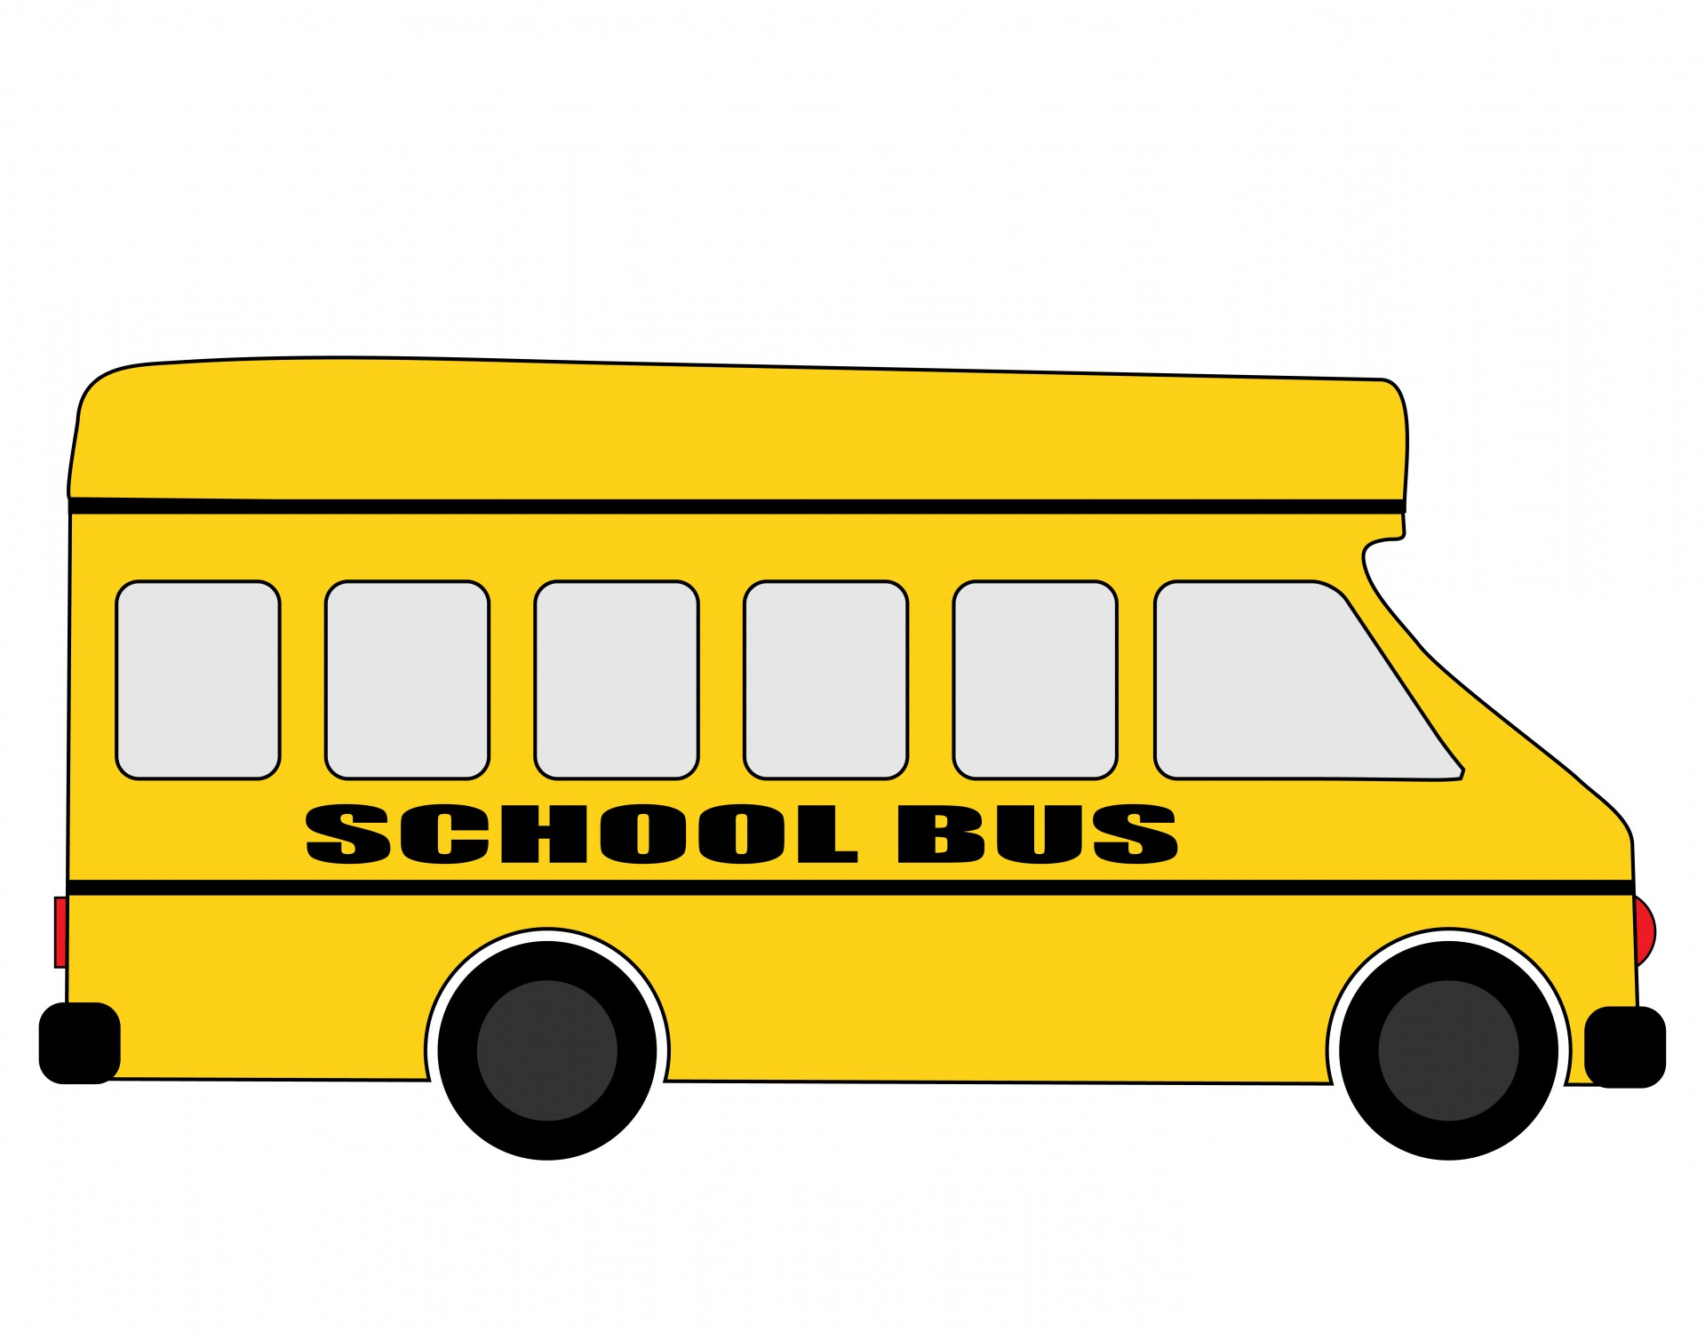
EDUCATION
HEALTH
SAFETY
Notes:
Students know first hand what is happening in their school and are uniquely qualified to determine how their education, health and safety can be improved.

Slide 9
COMMUNITIES & SCHOOLS
SAFETY AT HOME AND AT PLAY
HEALTHY LIFESTYLES
FAMILY READING EXPERIENCE
CONNECT FOR RESPECT
REFLECTIONS
SCHOOL OF EXCELLENCE
Notes:
Students can make a difference in our communities and schools through involvement in PTA/PTSA programs that address issues such as safety, health concerns, reading and bullying to name a few. Also, bring awareness to the arts and help collaborate to improve their parent/teacher/student relationships.

Slide 10
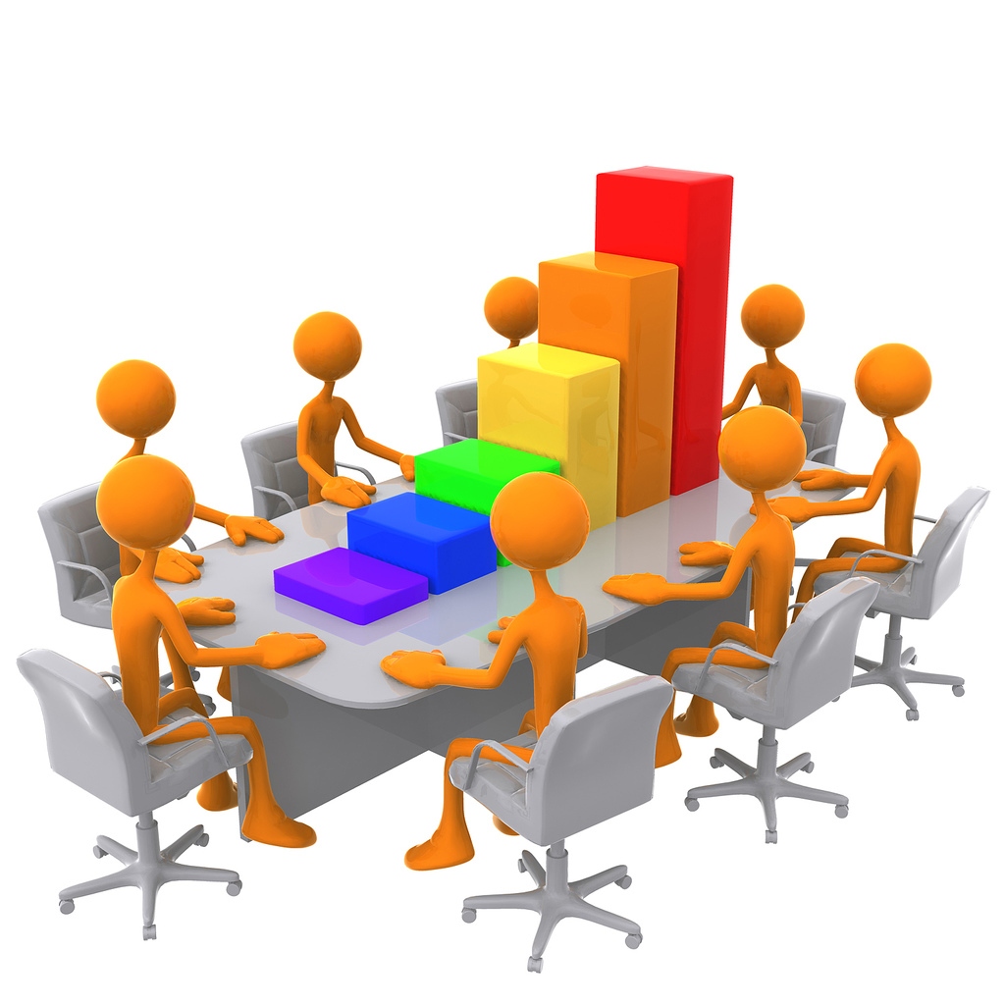
COMMUNITY
SUPPORT
Notes:
Students can attend school board meetings with members of your unit, become an expert on issues of education and legislation, and help gather community support. They can gain an understanding of public education and how it works. The operations of state and local governments. Students can learn about the legislation process and its impact on school funding and services.

Slide 11
PTA/PTSA involvement helps students gain leadership skills such as goal setting and conflict resolution.
Students can learn how to run a meeting according to parliamentary procedures, strengthening their decision making skills and speaking in public-comfortably.

Slide 12
A PTA/PTSA membership entitles students to the same rights and privileges as an adult membership.
Students can become a leader in their local unit
by serving as a chairperson of a committee.
Many of the contacts made in the community during PTA/PTSA work may also prove useful after graduation (e.g. college recommendation letters, scholarship opportunities and job prospects).

Slide 13
STUDENT INVOLVEMENT
I believe that it is the student who will continue the legacy of the original founders. With education and guidance, become the great leaders of tomorrow.

Slide 14
Thank you!
Missouri PTA Department of Membership
Christine Kent | Missouri PTA VP Membership
christinek@mopta.org
816-838-2179
I choose to surround myself with people who inspire possibility.

