Slide 1
Navigating PTA Webpages
Stephanie Wade – Missouri PTA IT Chair

Slide 2
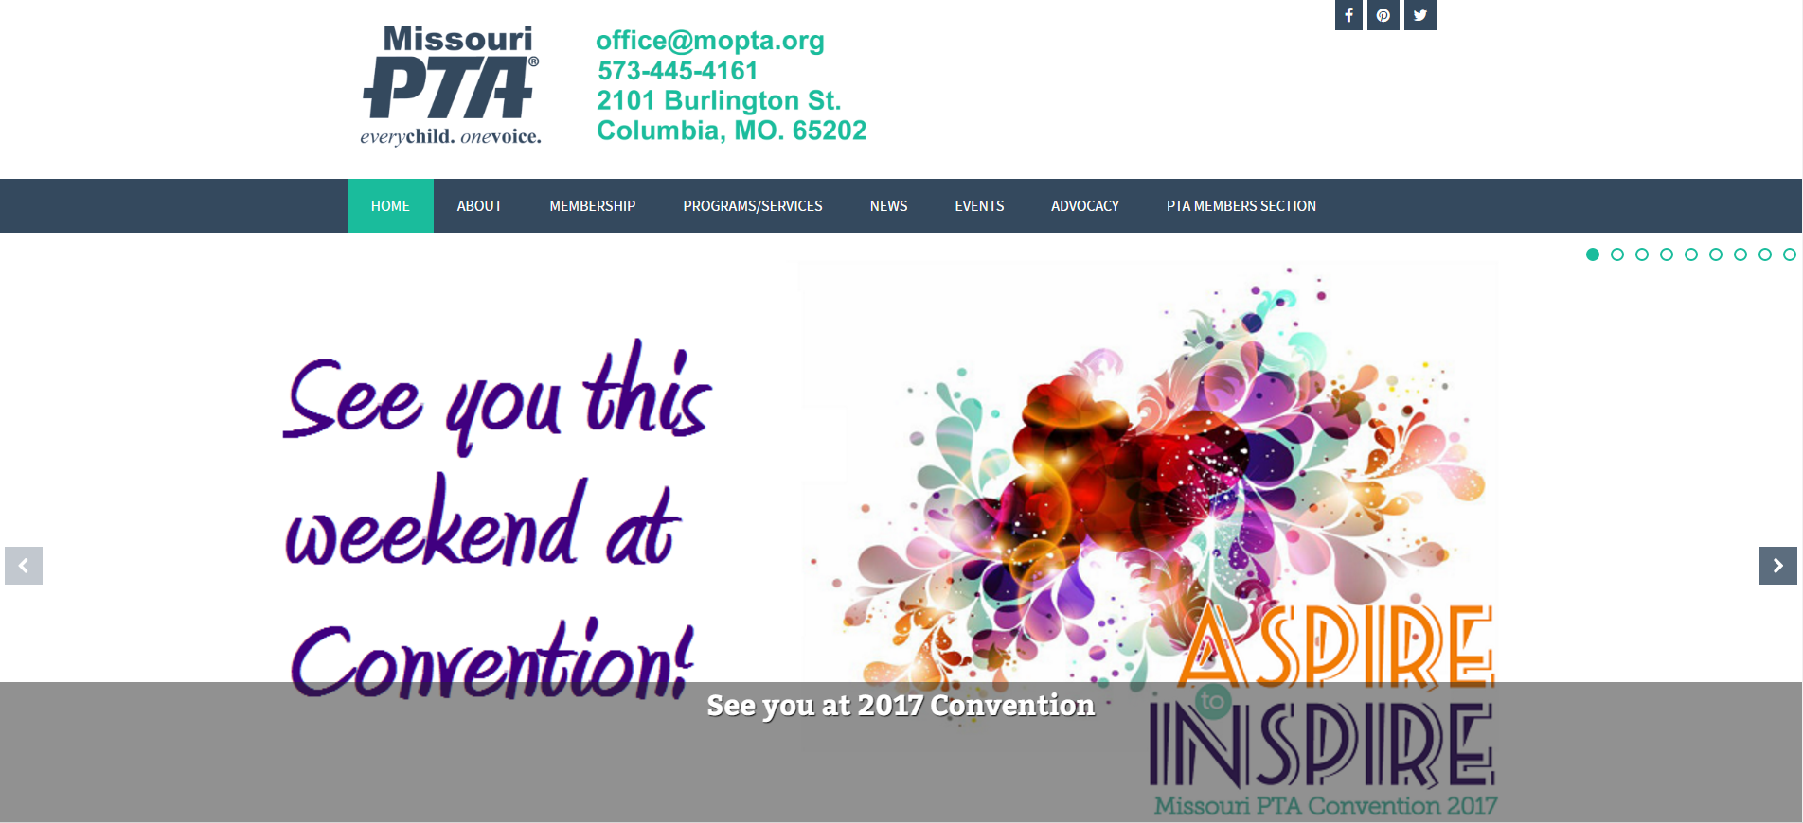
Missouri PTA Website
Notes:
This is the redesigned MOPTA website. We have updated it with a new theme, which has lots of new features. We’re going to walk through this a little bit and show you where important information is located.

Slide 3
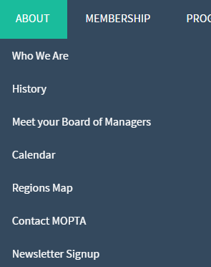
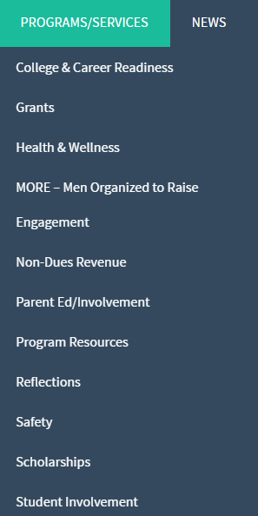
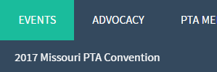
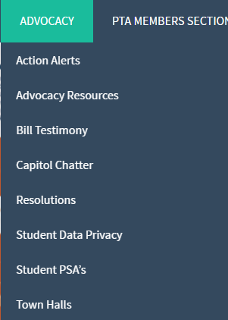
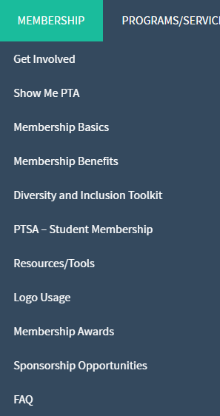
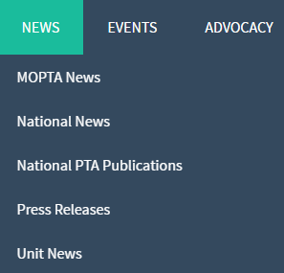
Menu Items
Notes:
These are the drop down menus when you hover over a main menu item.

Slide 4
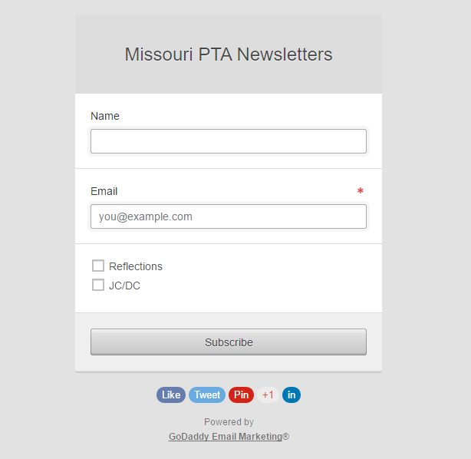
Newsletter Signup
Notes:
Receiving our Newsletters are a great way to keep up with what is happening with MOPTA. President’s are automatically signed up to receive all newsletters, and certain positions are automatically signed up as well. For example, your Reflections chair will automatically get all Reflections information sent to them, and your Legislative chair will get all the JC/DC and legislative information sent to them. You should encourage your board members to sign up for these newsletters as well though, minimally the JC/DC network emails. Mostly these emails are the action alerts where we are asking you to contact your legislators about an important advocacy piece happening soon.

Slide 5
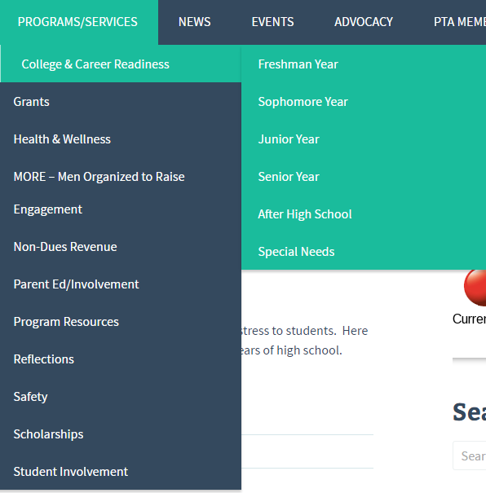
Menu Items
Notes:
We have a section on College & Career Readiness. This is separated by grade-level/special needs. This is updated as frequently as possible as new information comes out. Be sure to browse this section in your spare time!
Anytime we receive information on grants that are available to units, we post it in this section.
Anytime we receive information on programs that are available to units, we post it in this section.

Slide 6
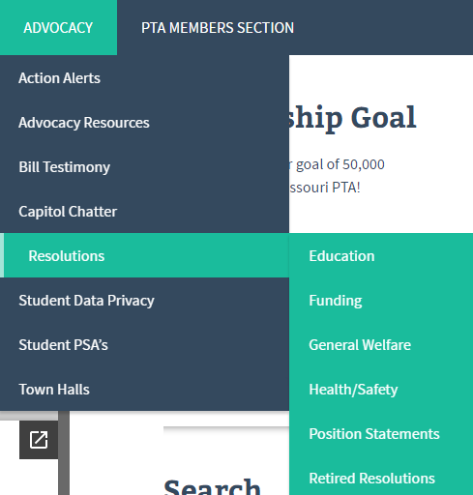
Menu Items
Action Alerts are notifications of upcoming legislation that require action from our members. They are:
-posted to the website,
-posted to Facebook and
-emailed out to all JC/DC subscribers.
They are compiled in this section of the website.
Under this section is where you will find all of Missouri PTA’s Resolutions. A resolution is a proposal that something is done, or that something is the wish, opinion or sense of the assembly. These are what give us our voice and permission from our membership to act on certain issues in a certain way.
This area gives you information on Student Data privacy laws, how student data is used and great tools with regard to student data privacy.
We live in a digital age, protecting our student’s data is imperative!
Notes:
Under this section is where you will find all of Missouri PTA’s Resolutions. A resolution is a proposal that something is done, or that something is the wish, opinion or sense of the assembly. These are what give us our voice and permission from our membership to act on certain issues in a certain way.

Slide 7
Menu Items
-Department of Legislation & Advocacy in Brief - a brief overview of PTA’s role
-JC/DC Member-to-Member Network – links to sign up
-MOPTA Legislative Priorities
-Legislative Handbook
-2016 National PTA Federal Public Policy Agenda
-National PTA Election Guide
-How To Be A Legislative Chair – this guide provides new and seasoned Legislative chairs with an outline of what the position entails and prominent events during the year.
-Legislative Chair report template and monthly report suggestions
-Corresponding with Representatives – template and sample letter
-Tips for Meeting with Your Legislator
-The National PTA Online Advocacy Toolkit
-School Board Candidate Forums and Questionnaires
This step-by-step “How To” guide was created to assist our units and councils who would like to host School Board Candidate forums or conduct candidate questionnaires.
-Town Hall Planning Resources
Download electronic copies to use in your Town Hall planning the entire step-by-step guide is located in the Legislative Handbook.
-Town Hall check off sheet
-Legislator information sheet
-Table top name card template
-PTA Takes Action Update e-Newsletter – sign up to receive this valuable
e-Newsletter and keep informed of legislation news at the national level.
-Resolution Handbook
Download the Resolutions guide to direct the Missouri PTA voice on issues. The Resolution Handbook gives an overall explanation of how the Resolution process is structured and provides tools for drafting and submitting a resolution.
Customizable word document resolution worksheets will assist members with construction of a resolution for submission.
-Resolution handbook
-Resolution worksheets
Notes:
This page is ESSENTIAL for your Legislative chair. Make sure they are aware of this page and read it thoroughly! You too!!
Department of Legislation & Advocacy in Brief - a brief overview of PTA’s role with regard to Legislation & Advocacy.
JC/DC Member-to-Member Network – links to sign up
MOPTA Legislative Priorities
Legislative Handbook
2016 National PTA Federal Public Policy Agenda
National PTA Election Guide
How To Be A Legislative Chair – this guide provides new and seasoned Legislative chairs with an outline of what the position entails and prominent events during the year.
Legislative Chair report template and monthly report suggestions
Legislative Chair Report Template
Legislative Chair Report Suggestions – January 2017
Legislative Chair Report Suggestions – February 2017
Legislative Chair Report Suggestions – March 2017
Corresponding with Representatives – template and sample letter
Representative Sample Letter
Tips for Meeting with Your Legislator
The National PTA Online Advocacy Toolkit
School Board Candidate Forums and Questionnaires
This step-by-step “How To” guide was created to assist our units and councils who would like to host School Board Candidate forums or conduct candidate questionnaires. School Board Questionnaires And Forums.pdf
Town Hall Planning Resources
Download electronic copies to use in your Town Hall planning the entire step-by-step guide is located in the Legislative Handbook.
Town Hall check off sheet
Legislator information sheet
Table top name card template
PTA Takes Action Update e-Newsletter – sign up to receive this valuable e-Newsletter and keep informed of legislation news at the national level.
Resolution Handbook
Download the Resolutions guide to direct the Missouri PTA voice on issues. The Resolution Handbook gives an overall explanation of how the Resolution process is structured and provides tools for drafting and submitting a resolution. Customizable word document resolution worksheets will assist members with construction of a resolution for submission.
Resolution handbook
Resolution worksheets

Slide 8
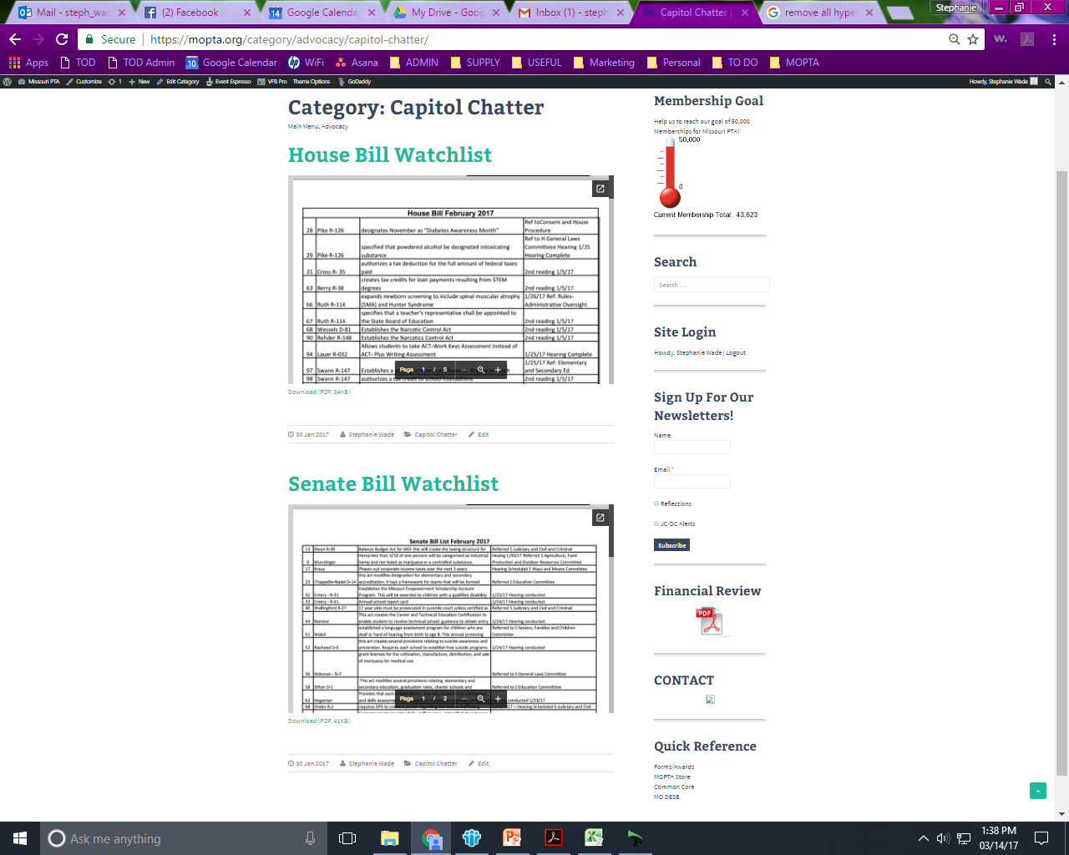
Menu Items
Notes:
This is where we post our Bill Watchlists. These are bills that are being brought forth to the house and senate that we are watching very closely. If they move to voting, that is usually when we send out action alerts to contact your officials to either vote yes or no for the bill, depending on our stance. You are able to download these documents and keep track of them your self.

Slide 9
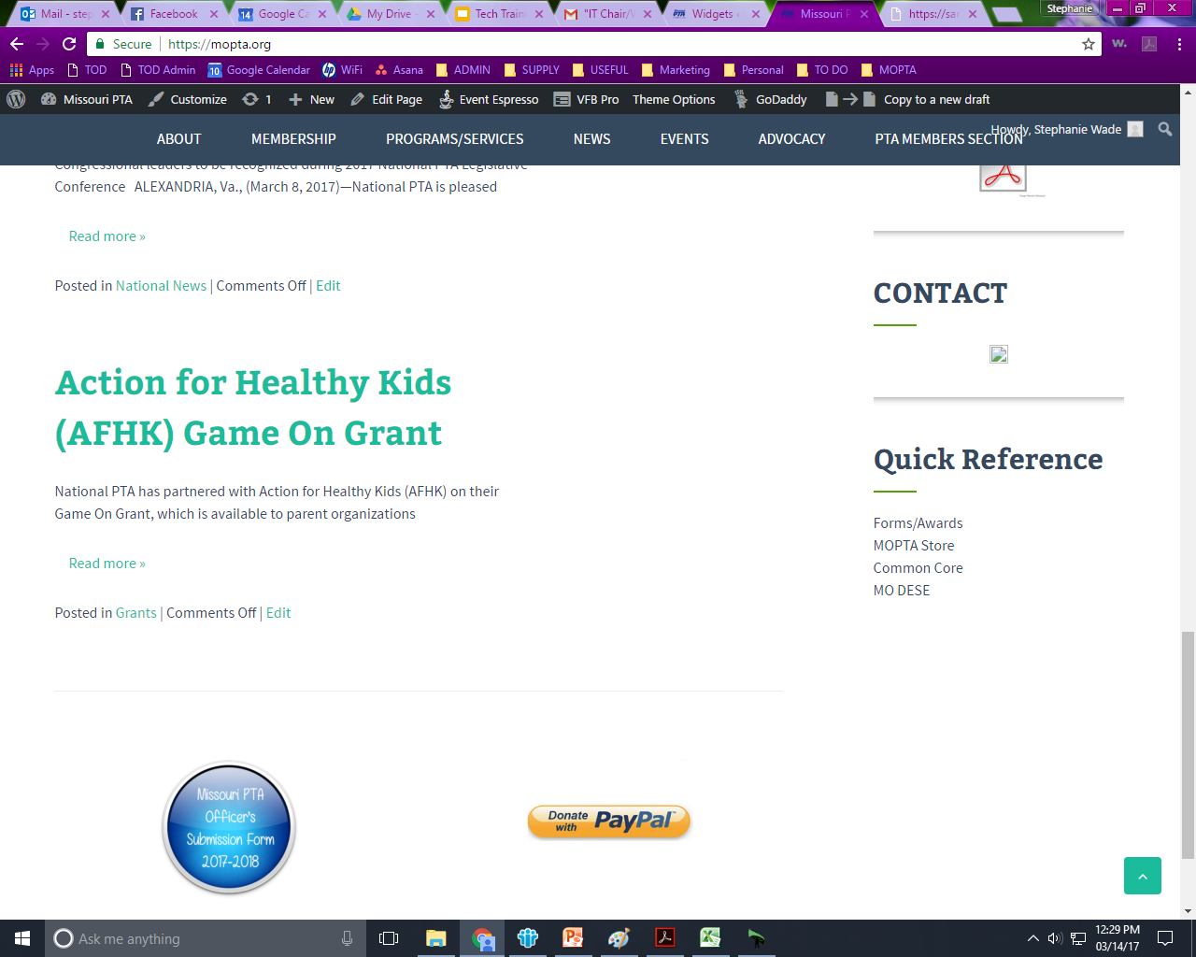
Finding Forms on the MOPTA Website 1st Place to look – sidebar:
Side bar of just about any page

Slide 10
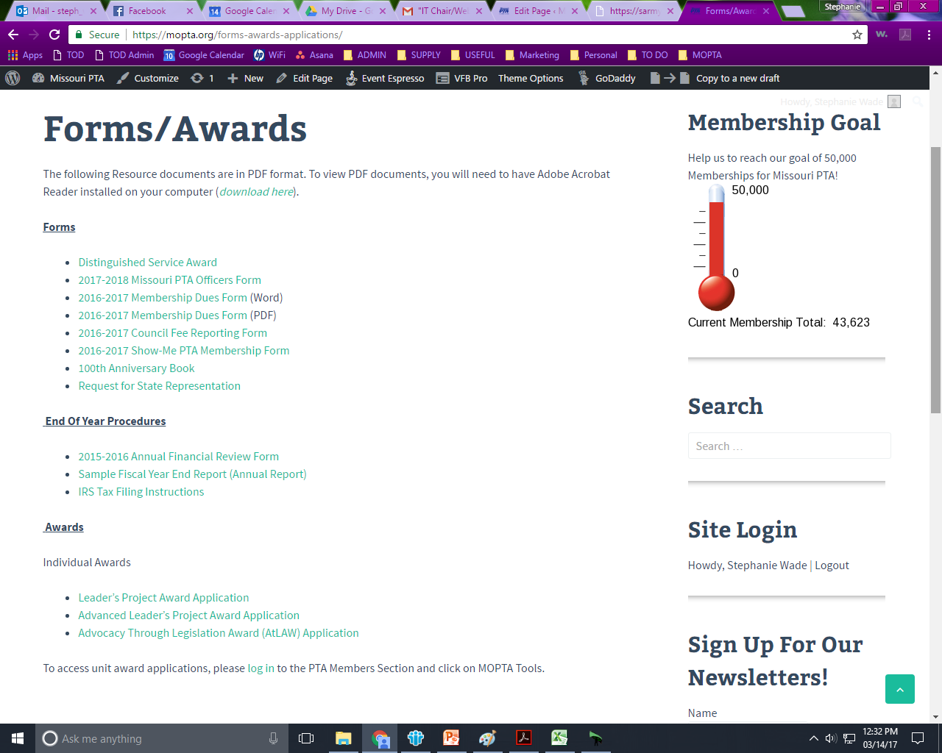
Notes:
These are forms you can access without being logged in by using the link on the sidebar of just about any page.

Slide 11
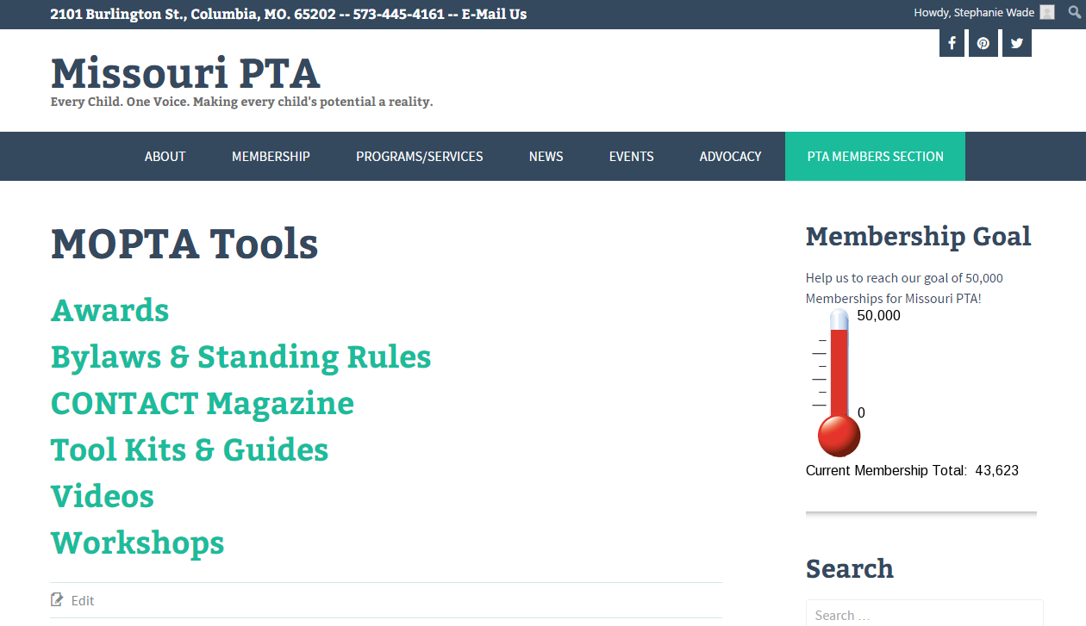
Finding Forms on the MOPTA Website
2nd Place to look – Members Section:
Notes:
After you are logged into the website, which we will cover how to do in a moment, “PTA Members Section” will appear on the menu. If you hover over this, a drop down menu will appear where you will find MOPTA Tools. A pop out menu appears where you can select any of these categories, or you can click on MOPTA Tools and this page will appear.
Awards – applications for all awards
Bylaws & Standing Rules – suggested unit/council bylaws, cover page, amendment form, suggested standing rules, instructions for the bylaws
chairman.
CONTACT Magazine – all CONTACT magazine articles from 2007-current
Tool Kits & Guides – Resources for running your PTA and for all your board members. VERY IMPORTANT section! When you have a question about PTA and how things should be done, this is probably where you will find the answer.
Videos – a video series on parliamentary procedure
Workshops – Past Convention Workshops are in this section and organized by Convention year.

Slide 12
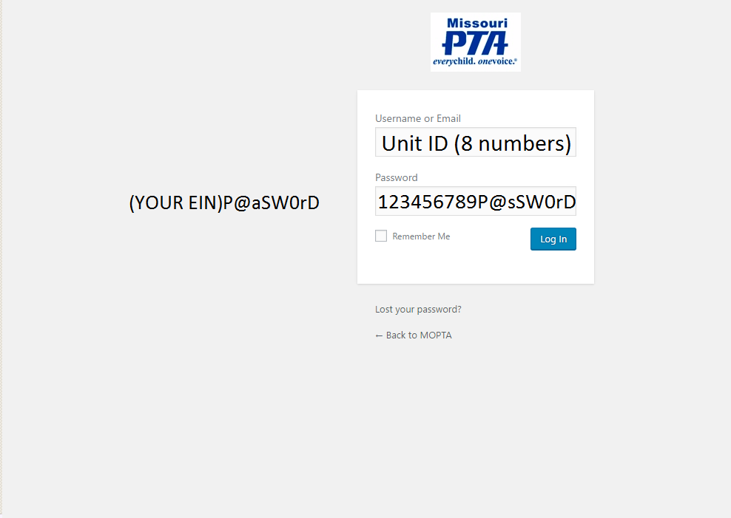
Logging in to the MOPTA Website
If you cannot login with the generic password, someone changed the password for your unit.
Contact website@mopta.org to have your login reset.

Slide 13
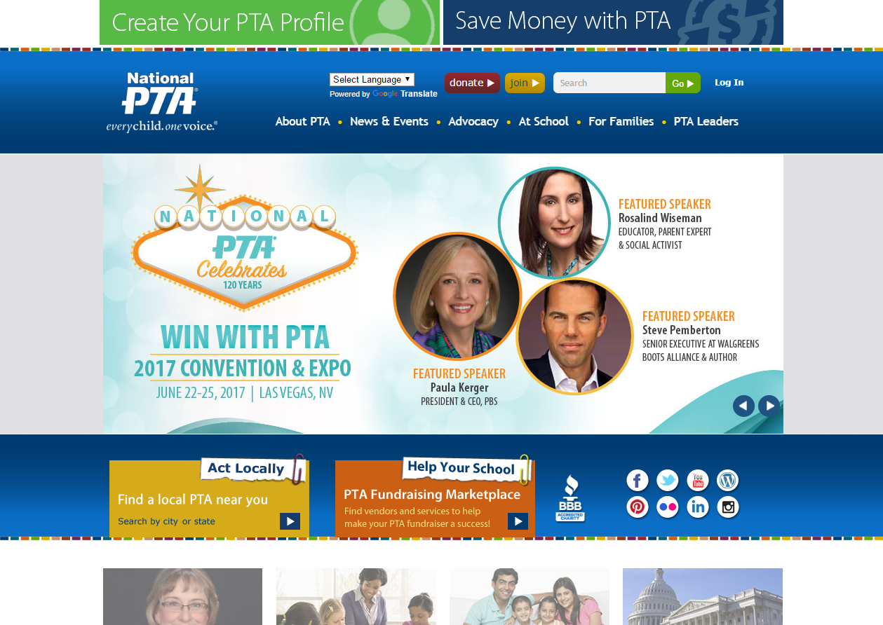
National PTA Website
Notes:
This is the homepage for the National PTA Website

Slide 14
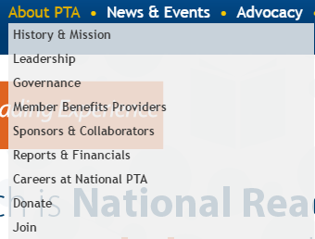
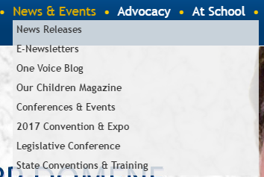
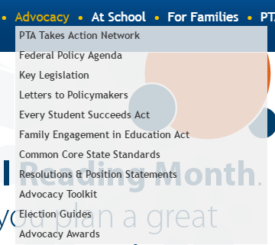
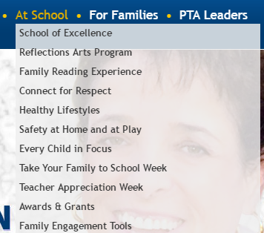
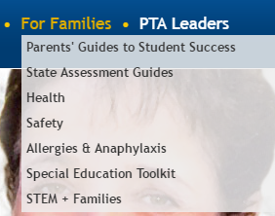
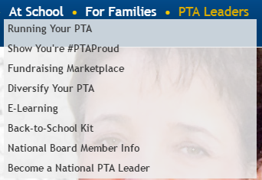
National PTA Menu Items
Notes:
These are the drop down menus when you hover over a main menu item.

Slide 15
National PTA Programs
Notes:
Information on National PTA Programs are located under the “At School” section. Each link will lead you to a page all about that specific program with resources to implement these programs at your school.

Slide 16
National PTA Advocacy Resources
Notes:
PTA Takes Action Network is a resource to easily contact your national legislators about current issues.
Passed PTA Resolutions and Position Statements are in this section.
Information on ESSA is located here, as well as Common Core information, the Federal Policy Agenda and Key Legislation information.

Slide 17
National PTA Newsletters
Notes:
Make sure you are receiving all PTA newsletters by using this link and signing up. National PTA’s One Voice Blog is located under this section, as well as current and past issues of their Our Children Magazine. This is where you find information about National PTA events as well.

Slide 18
National PTA Tool Kit
Notes:
There is a separate website for the Back-To-School-Kit (www.ptakit.org), which is fully digital now, but you can find the link to get there under “PTA Leaders”.

Slide 19
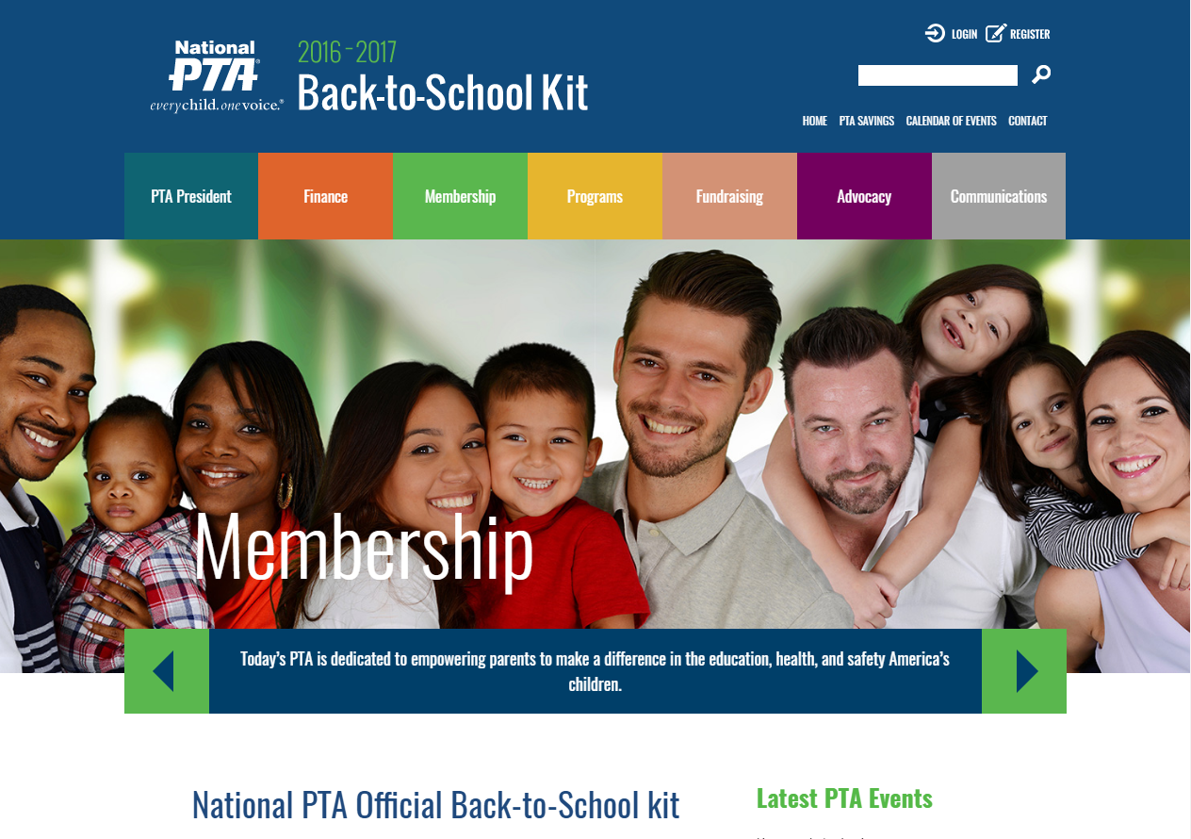
Notes:
You do have to register to have access to the Back-To-School Kit. There are great resources here. Under each section, you can click on Additional Resources, and there is a PDF file in there that will download that entire section, so you could download each one and email it to the corresponding board member.

Slide 20
National PTA E-Learning
Notes:
National PTA E-Learning courses allow you to gain the knowledge and skills needed to effectively serve your community. Here are some additional benefits of National PTA E-Learning:
As a PTA member, you have access to a wide selection of online learning courses that allow you to develop the skills that matter most to you.
Each online course includes interactive activities and assessments to make the learning process more engaging.
With easy online access 24/7, members can develop and hone leadership skills when, where, and as they need them.
National PTA E-Learning courses cover a wide range of PTA-related topics that help you be a better leader. Check out our full course offerings at PTA.org/elearning.

Slide 21
Stephanie Wade
Missouri PTA IT CHAIR
The
End!
stephaniew@mopta.org
217-254-8952 (cell)

