Slide 1
Reflections II: Conquering the Portal-Together!
Susan Rupert
Missouri PTA President-Elect

Slide 2
Do not let the online submission process intimidate you …

Slide 3
Our Quest Today
To learn more about
Opportunities for additional recognition
Eligibility requirements
Preparing entries for advancement
Advancement process
Notes:
Learn more about the recognition opportunities on the state and national level.
Know and understand the requirements that an unit must meet in order to participate in these Reflections rounds
How to prepare student’s entries for submission to the state level
Learn what the advancement process is and how to breeze through it

Slide 4
Be the Jedi Master
Conquer the Online Portal!

Slide 5
So far in our Reflections story …
Our hero/heroin aka Local Unit Reflections Chair has formed a Reflections committee. Together they have planned, budgeted, promoted, recruited volunteer judges/reviewers, collected entries from students, provided the judges with the rules and guidelines, prepared the artwork for judging and turned it over to the judges. Celebration plans have been made. Recognition awards are all ready. The entries have been judged, the placings have been determined and the final results are in the hands of our hero/heroin aka Local Unit Reflections Chair…

Slide 6
Don’t Stop There! Let’s continue our story…
Advance those entries to the state round!
Show off your students’ talent to the rest of the state and perhaps the nation!
Notes:
Did you know there was state and national levels?
So many units will hold their local program and submit the entries to the city or council event but do not advance their entries to the state round for consideration.
You have already done the hard work of planning, promoting and running your local program. This part is pretty simple compared to all of that.

Slide 7
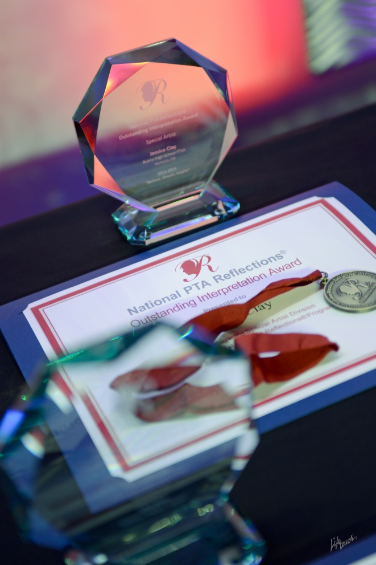
Opportunity for Additional Recognition
Missouri PTA State Round of Reflections
Your Unit may advance:
3 student entries per awards category – i.e. 3 primary visual arts entries
State round recognition is announced at the beginning of March via email & website
1st thru 5th place recognized and up to 6 honorable mentions
1st place entries advance to National
Annual Student Showcase
Photo Credit: LifeTouch
Notes:
Units may advance up to 3 entries per awards category. So for example you can advance 3 primary entries in visual arts, 3 primary entries in photography, etc
Missouri PTA will conduct the state level judging and announce those that placed in the state round by email to the unit presidents and reflections chairs. The information will also be posted on our website.
We usually recognize 1st through 6th placed and up to 6 honourable mentions.
1st place entries in each award category advance to the national round.
Missouri PTA hosts the annual Student Showcase event which recognizes all the students that placed on the state level. Typically this event is held in April

Slide 8
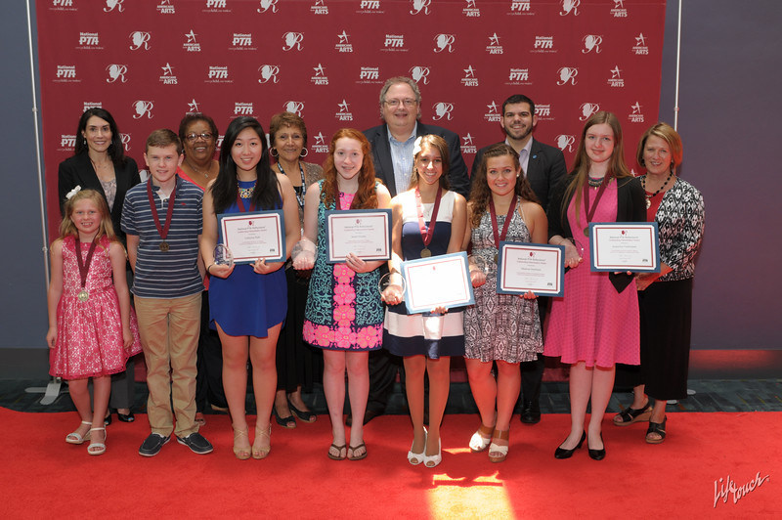
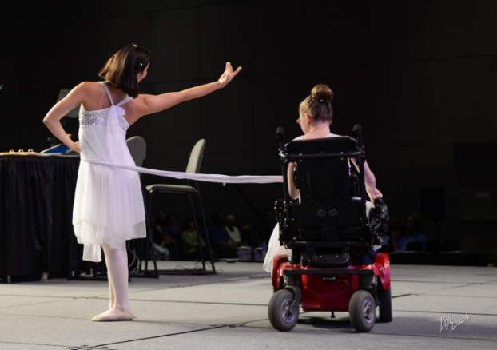
National Awards Announcement May 2017 PTA.org/Reflections National Awards Celebration June 2017 Annual National PTA Convention Las Vegas, NV National Art Exhibit Opening January 2018 U.S. Department of Education Washington, DC
2016-2017 PTA Reflections Program
National Awards & Events
PTA.org/Reflections
Notes:
National award winning works are celebrated in person throughout the following year and online at PTA.org/Reflections .
National PTA’s student showcase is held in during the National Convention each year.
Winning art work is displayed at the U.S. Dept of Education in DC
The complete list of National awards can be found at PTA.org/Reflections

Slide 9
Submitting to the State Round
Key points to know before you start
Unit must be in Good Standing
No physical artwork is mailed or delivered.
Entries are advanced to MO PTA in digital form by using National PTA’s online submission portal
Deadline is December 16th
Notes:
These are key points to know about advancing artwork to the state round. Over the next several slides we will go into more details about these points.
Your unit must be in Good Standing with Missouri PTA in order to participate in the state and national rounds
Several years ago the actual artwork had to be submitted in order to be judged. Artwork would be damaged or lost in the mail or delivered past the deadline. Then we had the task organizing all the artwork, getting it the judges then returning it to the local units. It was super labor intensive. When National PTA developed and offered the online submission process as a trial, Missouri PTA was all in and has been instrumental in fine tuning the process.
The portal is located on the national PTA website. You set up the unit’s account when you register, then you will enter the student’s entry form information and upload the digital file of the artwork.
The deadline for Missouri is December 16th . Each state establishes it’s own deadline. We like the December deadline for several reasons. These include quicker response time on the website when you, the local chairs are uploading entries. Our deadline to advance entries to National PTA is March 1st. The December deadline allows us to verify good standing, organize the digital files for the state judges who are professionals in the art fields and have to fit the judging into their schedules. We also like to have a little cushion for the incidentals like the weather, technological issues and there have been a couple instances we had to find a substitute judge in late February. Once we get results from the judges we start preparing the winners list to be announced, mail letters to those students and order & prepared awards then get ready for Showcase.

Slide 10
Be in a Unit in Good Standing (UIGS)
Names and addresses of officers by March 31st
Bylaws have been approved by Missouri PTA in the last 3 years or are in the process of being reviewed by the State Bylaws Chair.
Remit dues to the by the 1st of each month
A copy of the unit’s fiscal year end report December 1st of each year
A copy of the unit’s annual financial review (formerly known as the audit) by December 1st of each year;
A copy of the required IRS tax form by December 1st of each year and
All are sent to Missouri PTA
Notes:
Verifying the unit is in good standing is one of the first tasks. You as the Reflections Chair are probably going to have to ask the President about the unit’s status.
If you attended the Reflections I workshop you will recall we talked about the Theme Search Contest which has a deadline by 10/31. A unit has to be in good standing to participate.
Over the summer or by August I would be asking about the bylaws review date. If they are coming up for review I would push for getting that committee appointed. It can be a lengthy process which is a whole different workshop.
So by 10/31 the unit needs to have submitted the contact information of the current officers to the state office. These were actually due 3/31. Make sure your name was submitted also so that you the Reflections information directly when we send it out. The other requirement at this point would be the submission of dues. By 10/31 every unit should have sold memberships and mailed in the state & national portions to Missouri PTA at least once and hopefully 2 or 3 times. Dues should be mailed monthly.
For discussion purposes lets say its now November. I would ask your unit President the question again – Are we in good standing? By 12/1 the rest of these items need to be submitted to the state office. Most units complete all of these tasks but forget to forward a copy to Columbia to be filed in the unit’s records.
Usually if a unit is not in good standing it is because these 3 documents or maybe just 1 of them has not been sent to us.

Slide 11
Why should I care about UIGS?
The Kids …………….
Notes:
It would be really easy to say, “You know what, I’m not the president so being in good standing is not my responsibility”, “I’m not the secretary ,it’s not my job to send in those officers’ names and phone numbers”, “Last time I checked I wasn’t elected as treasurer or membership chair and my name isn’t on that checking account”. “Bylaws Review? I have no idea what that means and I don’t want either”
It would be so easy to take this view point, but obviously we really don’t feel that way. Because we would not have agreed to take on the Reflections Chair position or be here today if we did not care about the kids and helping them reach their potential.
We care or we will care about UIGS because the kids have put their heart and time into their art piece. We care because the volunteers on our Reflections Committee and the judges have given their time because of the kids.
If we don’t care about UIGS then the unit can’t participate on the state round and the time you have put in to make sure the entries are in the correct format, set up the student’s information and up loaded to advance those entries will have been all for nothing.
We are all volunteers, we have the best intentions but sometimes life happens and things do not go according to the plan or the script. As a member of the unit’s board you share in the responsibility to make sure the unit is doing what it is suppose to be doing to follow the purposes of PTA and guidelines of a non-profit which includes UIGS

Slide 12
The Easy Steps to Online Submitting
Grab your resources & entries
Register your unit (if you haven’t already)
Report participation
Prepare the artwork (if necessary)
Enter the Student’s info and upload artwork
Notes:
So you will want to have your procedure book which should have all your toolkit materials in it, i.e. Missouri PTA Local Leaders Guide, rules, the entries & their entry forms
If you haven’t registered your unit yet we will do that
If you have artwork that was not submitted digitally we will prepare it
Then we enter student information and upload their artwork.

Slide 13
Go to
www.mopta.org/Reflections
Click on
Reflections Tool Kit
Official Rules
Guide for Online Portals
Notes:
In your procedure book we will be working with the Official Rules and the Online Instructions Guide.
If you don’t already have these printed off you can find them at www.mopta.org/reflections

Slide 14
Step 1: Register Your Unit
July 1 – December 1
Use the Guide for Online Portals
You will need to know your unit’s 8-digit ID#
Have the information listed on guide ready
Go to www.pta.org to register
Notes:
The Registration period opens July 1st. Some chairs will register during the summer months or right after school starts. Others will wait to do this part the same night they are uploading their entries. It is to your benefit to do this earlier than later because you will receive updates and helpful information throughout the program year.
Also by registering earlier your unit will appear on our state report. That’s what we use to check UIGS for participating units starting in November. If see that you are missing something i.e. the copy of the 990 then we will contact you so that the situation can be resolved in plenty of time rather than DQ entries. But if we don’t know you are participating until the night before the deadline it is much more stressful to notify the president who calls the treasurer who then has to find the paperwork.
The Online Instructions sheet is probably your #1 resource for advancing entries to the state round. That is why I have given you a copy today. It will walk you through the steps. It is also on our website with the reflections toolkit materials
If you don’t know the unit’s 8-digit ID# the president and treasurer will have that information. You can also email the state office at office@mopta.org
The information you are going to need is the basic contact details for you and the unit. If you are the chair your are the PTA Leader. The president’s info can be entered in the additional contacts spot
Your building principal, food service directory or central office will have the Title 1 and free/reduce information. It’s ok to ask because it is public information.

Slide 15
Notes:
When you get the National PTA Website to find Reflections you will click on “AT SCHOOL” on the menu across the top of the page. This will bring up a drop down box and you will click Reflections.
This is the Reflection page on the national website.
This is where you will come to register your unit, report your success which is your participation numbers and submit the entries you want to be considered on the state level.
There is a lot of good information accessible from this page as well.
You just click on a tab and it will take you to the task you are wanting to accomplish or to the resource you are looking for.

Slide 16
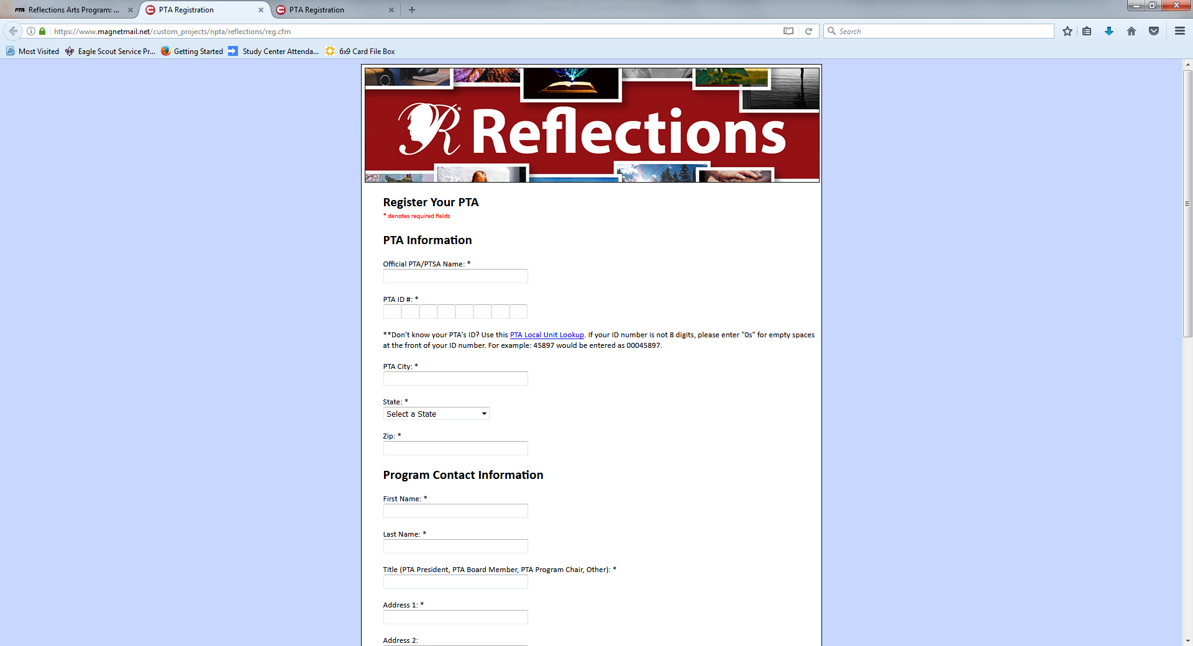
Notes:
When you click on register your unit this page will open. Once you have entered all the information into it click submit and it’s done!
You should get a confirmation email.
Does the unit have to be re-registered each year – YES
At first I didn’t understand why we needed to register every year but if you think of it in terms of a program year it make more sense. A unit might participate this year but not for the next three. The data is collected each program year. This information is used to develop new resources, opportunities and help us advocate for arts in education.

Slide 17
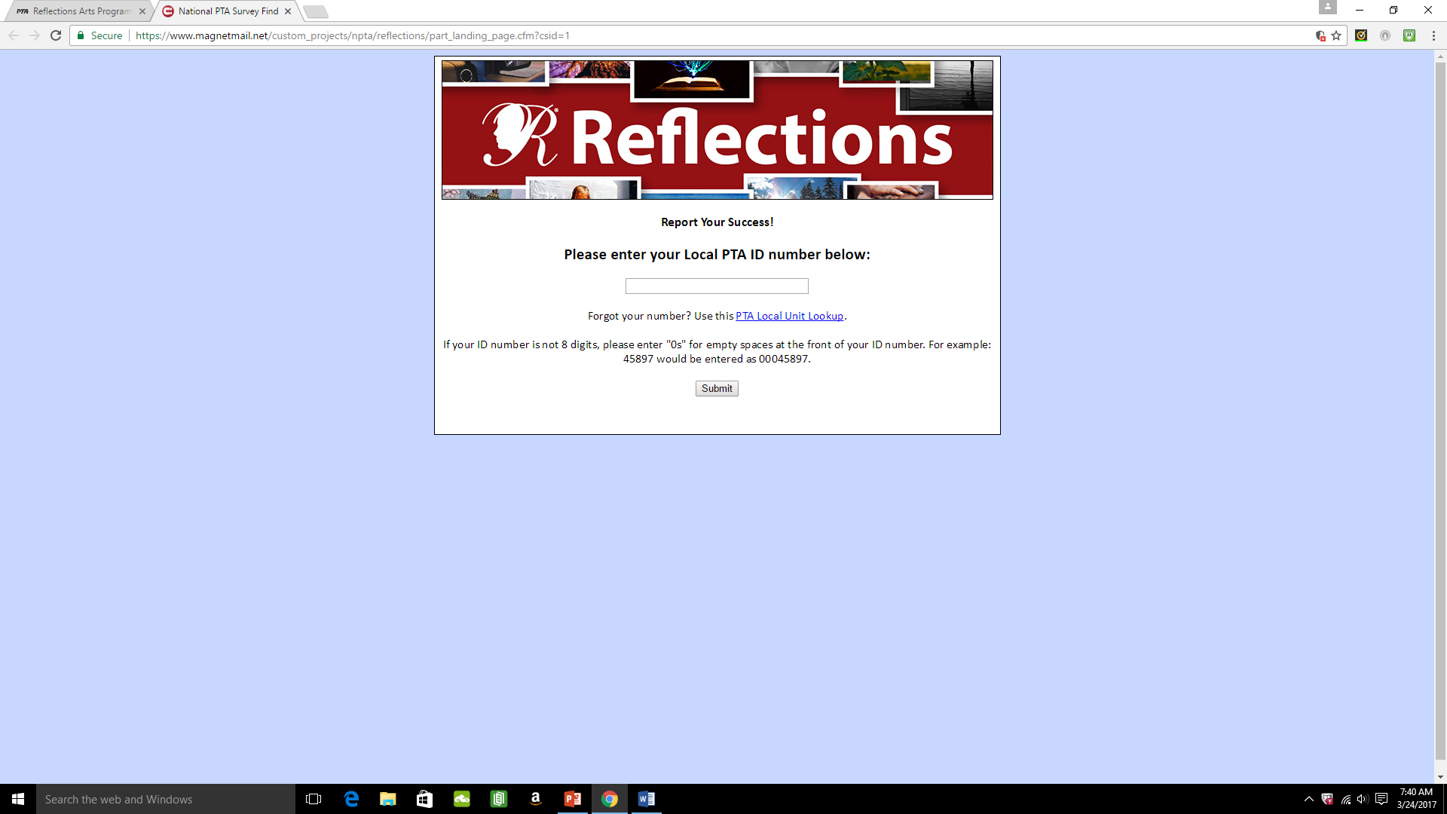
Unit ID#
How many students participated in each category by age group
Notes:
Registering the unit and reporting your participation needs to be done by everyone even if you are not going to advance any entries to the state round.
The data is collected each program year. This information is used to develop new resources, opportunities and help us advocate for arts in education.

Slide 18
Step 2: Prepare Art Work
Review the specific art category rules for the acceptable file format
Verify existing digital files (dance, film production & music composition) are correct format
Create digital files if needed
i.e. scan literature, take pictures of photography or visual arts
Label files correctly by renaming & saving
TURNEY PTSA.MUSIC COMP.HS.JOHN RUPERT
Notes:
If the artwork was submitted to you in both physical and digital formats then it is important to verify that the digital format meets the requirements for file format and size
For film production, music composition and dance choreography it is important that the copy of the entry you have is in the correct format and size. If it is not, the online submission system will not accept the file.
If it is the wrong file format the digital file is going to have to be changed. Either return it to the student to convert or there on conversion programs. Zamzar.com is free and does a pretty good job. If it is not the correct file size you are probably going to have to return it to the student to correct.
For photography, visual arts and literature entries if the student didn’t include a digital file then one can be easily be made either with your cell phone or a copier with scanning capability.
If the student didn’t include a digital format then one will have to be made before the artwork can be advanced to the state round.

Slide 19
Is it 2D or 3D?
Notes:
A quick recap Visual Arts
Do you know the difference between 2D and 3D ?
Do you know which is 2D and which is 3D?

Slide 20
Visual Arts Forms
2D Forms: Architectural drawing, collages, photographic collages, computer-generated image, drawing, painting, printmaking.
Dimensions must not exceed 24x30 inches, including matting.
Paper entries must be mounted on sturdy material.
1 digital file uploaded
3D Forms: Architectural model, carpentry, ceramics, design, dioramas, fiber work, jewelry, kites, metal etching/punch work, mobiles, sculpture and wind chimes.
Artwork must be able to move for display purposes.
Must include packaging materials and 3 photos of the entry (a combination of angles must be provided) for judging, ID and exhibition purposes (entries that require assembling/repairing from transporting will be disqualified).
When labeling the files include view1, view2, view3
Notes:
Most of this information is used when the judges are ranking the entries
Keep in mind 1 digital file is updated for 2D visual arts and 3-D artwork requires 3 pictures of the files to be upload with the entry

Slide 21
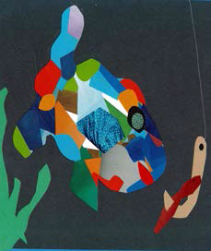
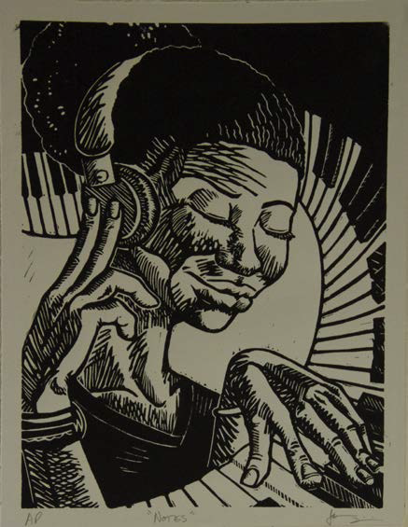
If you guessed 2D – you are correct !

Slide 22
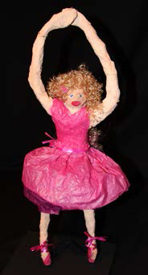
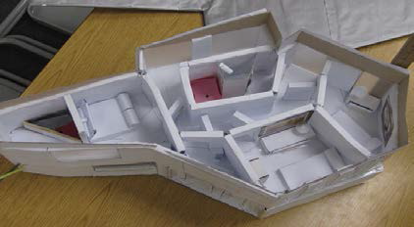
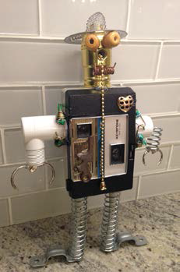
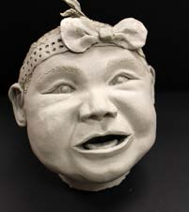
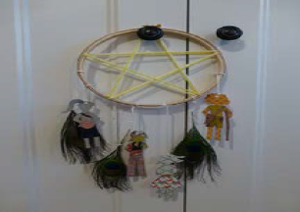
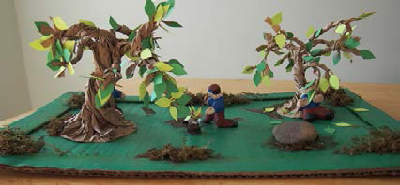
3D Artwork

Slide 23
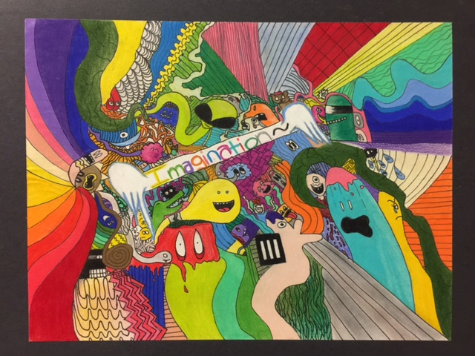
Notes:
If you have to make a digital file of a visual arts entry first make sure the artwork is mounted because that is going to make the picture look better.
Try to find a flat service to either lay it down or hang it up. I like to use painters tape and hang it on a wall. It is easier to avoid glare from lights in the room.
I crop out any background “clutter” like the wall
Then save the file and name it so it correlates to our unit i.e. Turney PTSA.VA.HS.Jones.Zoe

Slide 24
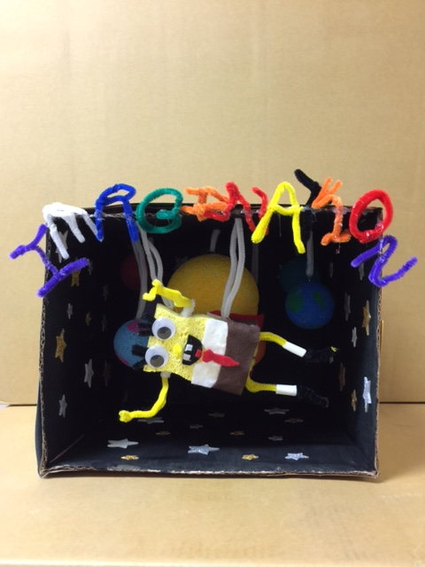
Notes:
This is an example of 3-D visual arts and three picture.

Slide 25
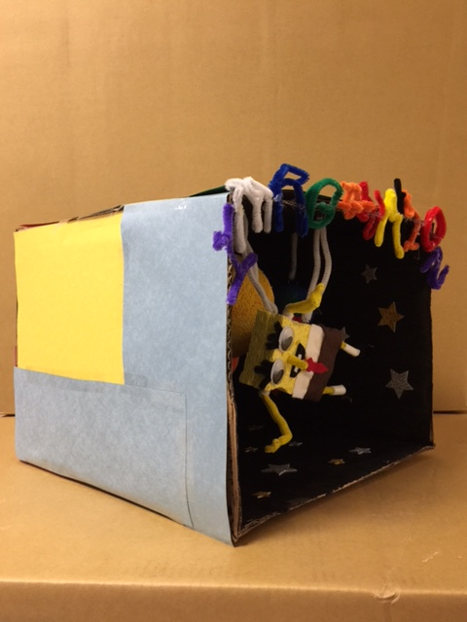

Slide 26
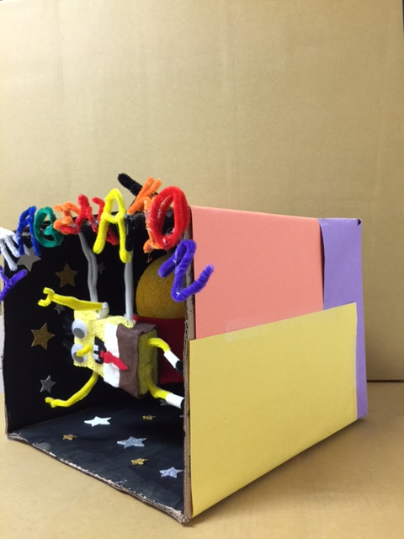

Slide 27
Ready to Upload!
Follow the Student Entry Portal Instructions on the Guide to the Online Portals
Create an account
Submit the entries by December 16th
Confirm each student’s submission status

Slide 28
Notes:
Go to PTA.org/reflections
Click “Submit Student Entry”

Slide 29
1. Create an Account
Click “sign up” and enter YOUR NAME, YOUR EMAIL & create a password
Write the password down ☺
Click “register”
Check your email for the confirmation email
Click the unique link in the email to activate your account

Slide 30
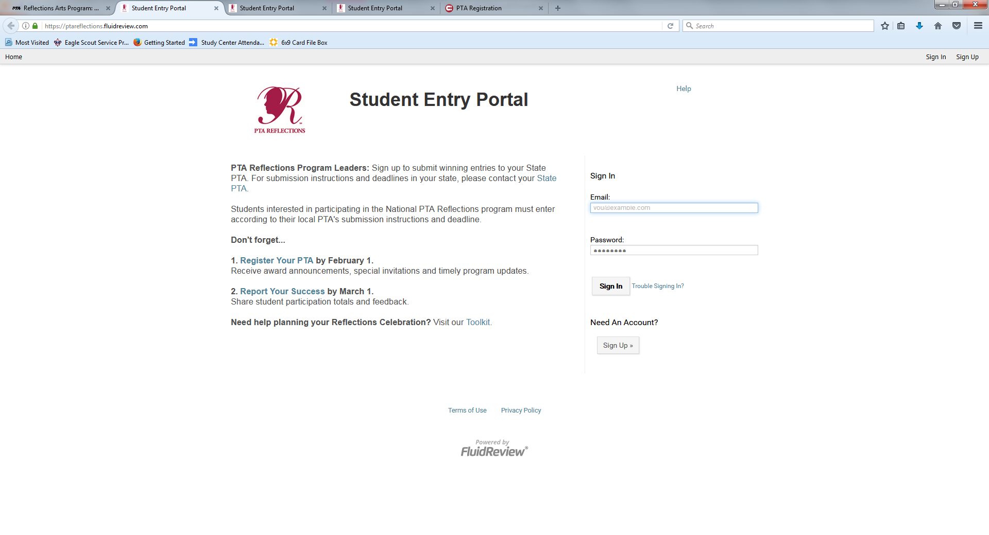
Notes:
You have registered your unit and reported your participation now you need to set up an account to submit the entries online.
Why? Think of it as two separate parts of the program. Registering the unit and reporting your participation needs to be done by everyone even if you are not going to advance any entries to the state round.
Create an Account by clicking on he “Submit Student Entry” Button on the Reflections page.
It brings you to this screen.
There are 3 options here
Sign in if you already have an account from last year and know the password
Trouble Signing in - Sometimes chairs run into a snag here because they don’t remember the password from last year or someone else was the chair.
Need an account? -first time the unit has participated
Click “sign up” and enter YOUR NAME, YOUR EMAIL & create a password (write the password down ☺)
Click “register”
Check your email for the confirmation email
Click the unique link in the email to activate your account

Slide 31
That Was Easy!

Slide 32
2. Submit Advancing Entries
Go to your account’s “home page”
Click “create a submission”
Click “Student Entry Form” and enter the information from the hard copy of the student’s entry form
Click “Upload Artwork” to upload the digital file of the artwork. You will get that “browse” option to go to doc file, click on it then upload
Click “Submit your student entry”

Slide 33
Looking Good!!!

Slide 34
3. Confirm Student Submission Status
Go to your account’s “home page”
You can view the list of the created submissions
Confirmed submissions will show a status of “Submitted”

Slide 35
But what if …..
I didn’t use the right file format?
I uploaded the wrong student file and submitted it?
I need to edit the entry form?
I’m not sure if this uploaded?
How do I know you got it?
I really do not understand what I am doing!

Slide 36
Take a deep breath
Stay calm and drink a Pepsi
Just notify Missouri PTA at reflections@mopta.org .
We are here to help you!

Slide 37
You did it!
Now relax and enjoy the holidays.
Watch for results to be announced by email and on the Missouri PTA website

Slide 38
Thank you for spending the weekend with us and for all you do to help our children succeed.

