Slide 1
Social Media Basics
What you need to know
Kristina Wilmoth - Missouri PTA PR Chair
Andrea Battaglia – Missouri PTA Contact Editor

Slide 2
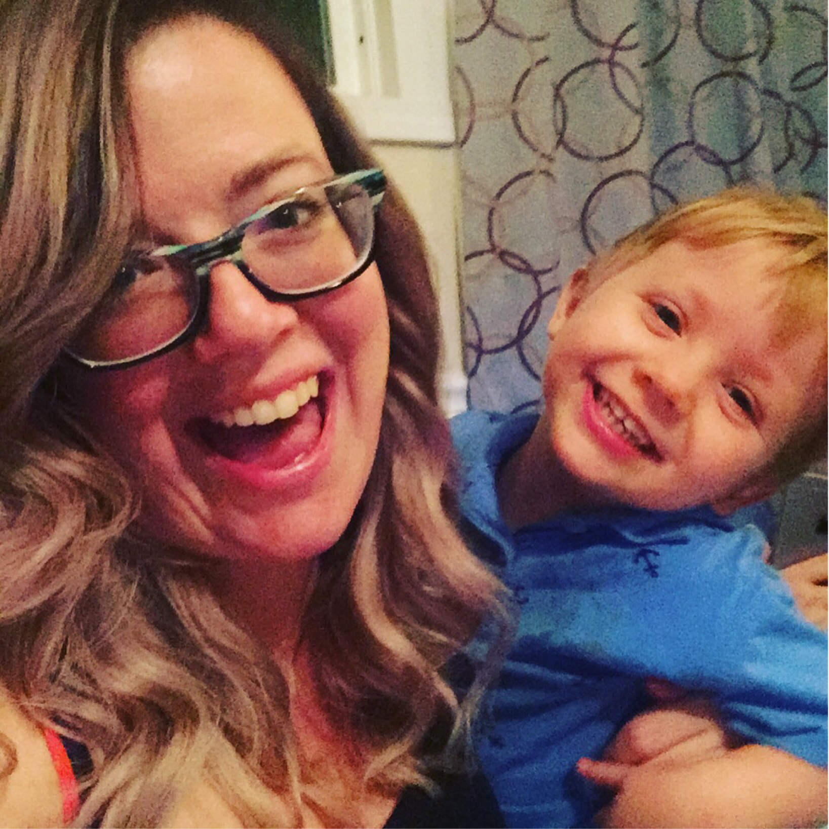
Kristina Wilmoth Presenter Information
Works in Marketing & Strategy, helping non-profits create brand image and maintain constant presence
Manages 12 social media accounts
Full-Time Program manager for a poverty-addressing initiative
Writer and editor for enewsletters and print newsletters for multiple organizations
Bachelor's Degree in Business-Advertising & Promo (MSU)
Master's Degree in Health Promotions & Wellness Mgt (MSU)

Slide 3
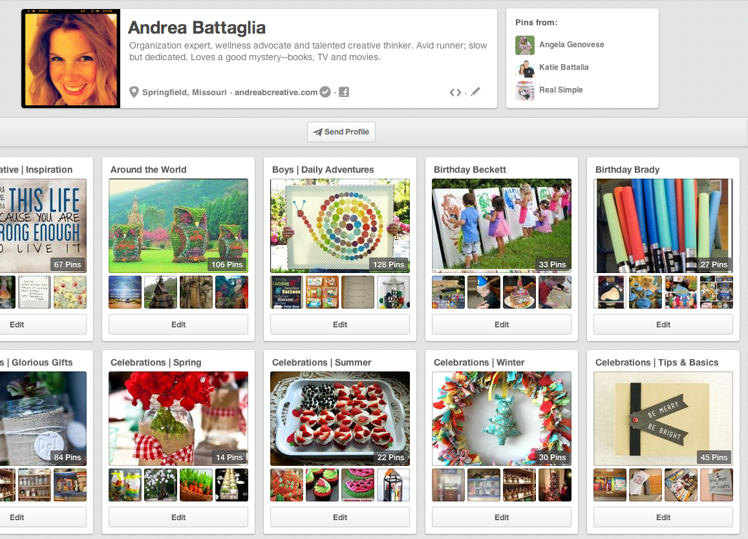
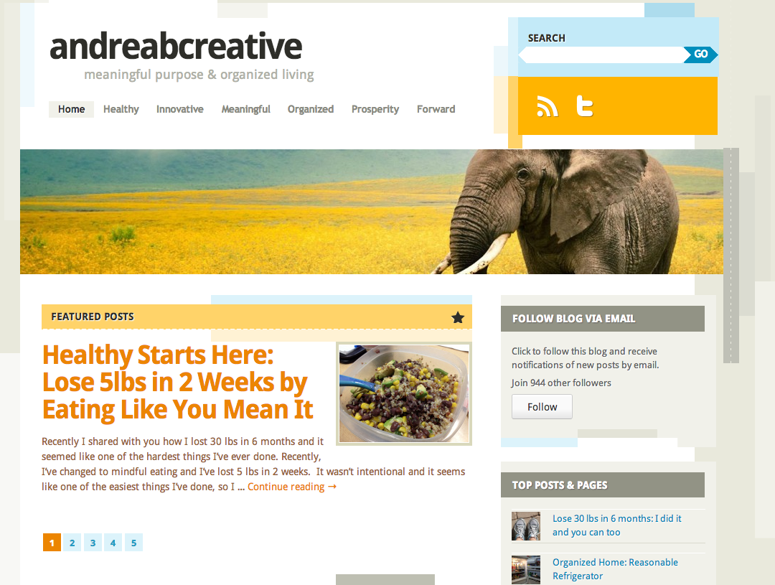
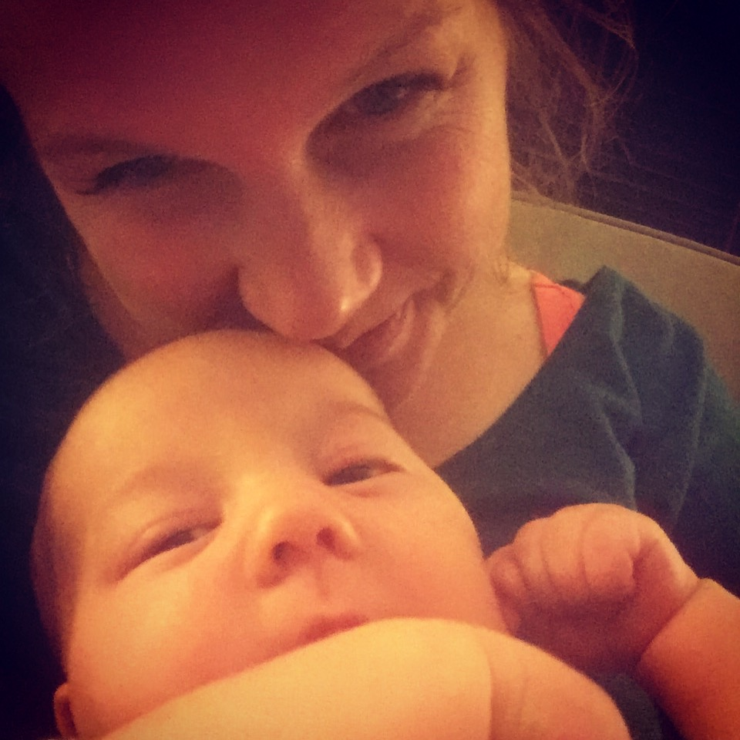
Andrea Battaglia Presenter Information
Work full-time in Marketing & Strategy, helping groups effectively manage communication and brand
Manage multiple social media sites, professional, volunteer and personal including www.andreabcreative.com, my personal brand. Focus is Organized Living & Meaningful Purpose
Organization Expert & Wellness Advocate, communicate consistent message through personal brand.
Professional Trainer & Facilitator for groups of all sizes and competency levels – develop effective strategy and action plans to improve groups

Slide 4
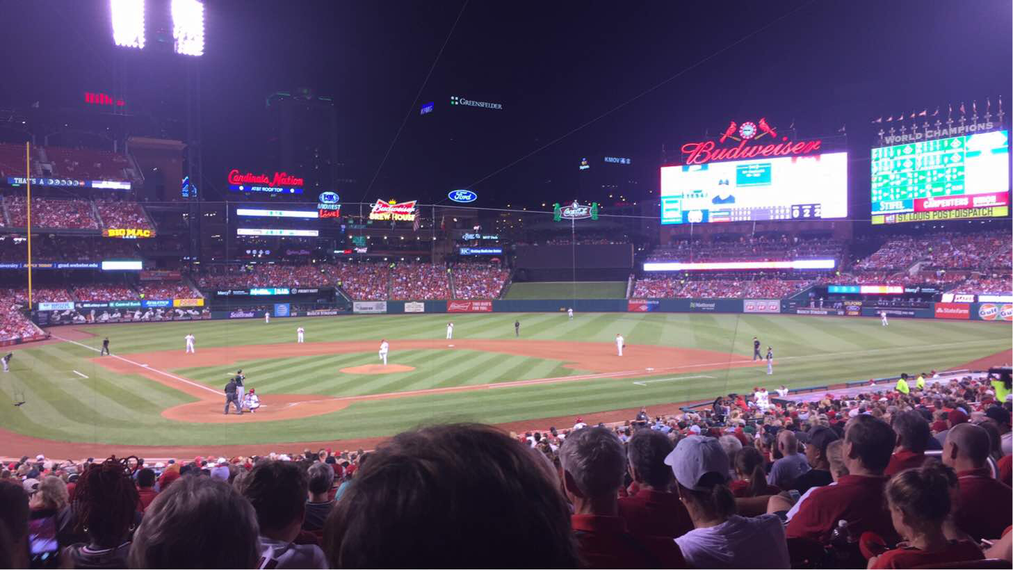
Start with a Strategy
Understanding the value of Social Media
72% of adults use social media
21% of internet time is spent on social media sites
Social media sites are used more than any other type of site

Slide 5
Start with a Strategy
Developing your social media brand: Keep it simple – use 1-2 platforms
Facebook (start here)
Twitter
Blog (WordPress), can be used as your website
Pinterest
Instagram
YouTube
Just because it’s available doesn’t mean you need to use it – only choose what is relevant for your stakeholders and what you can manage

Slide 6
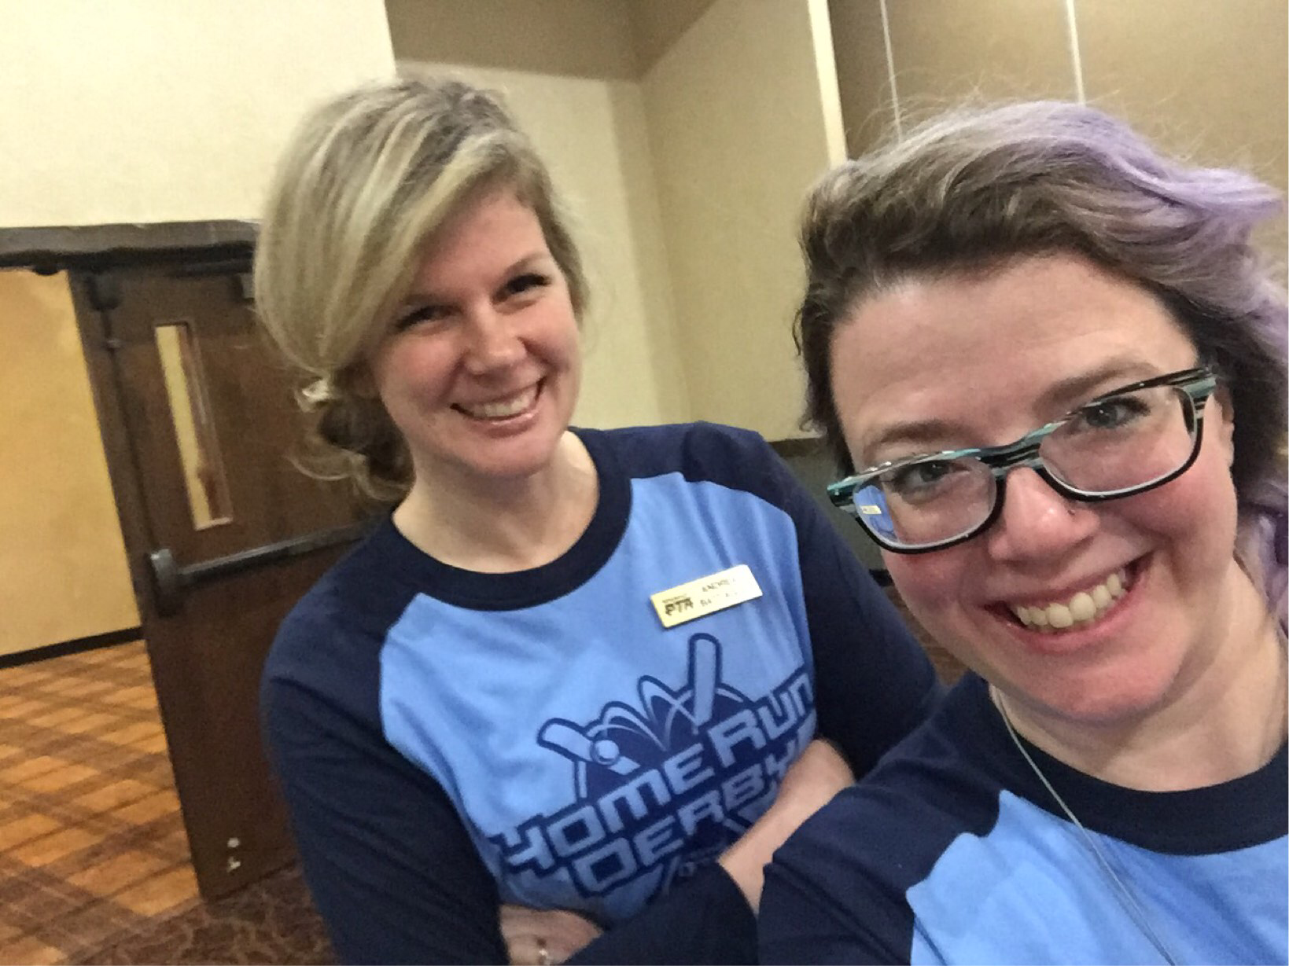
Start with a Strategy
Create Social Media Team
The team should be as small as possible – but all relevant stakeholders should be represented
Set up a system to collect information sent to one key social media manager
The Social Media team will
Establish goals, guidelines and direction
Determine target audience and appropriate message
Review and approve content

Slide 7
Start with a Strategy
Set up a system to collect information and send it to one social media manager
Example: Legislative Alert comes via email. Forward to Social Media Manager. They create a post (after approval channel) and post. Communication is key! If you don’t know what to say or when to post, ask those that do.
Social media team will:
establish goals, guidelines
direction of the campaigns.
Determine target audience and appropriate messages.
Review and approve content.

Slide 8
Perfectly Planned Posts
Develop interesting content and time it effectively. Research similar organizations and follow/like all of their social media pages.
What are they doing well? What isn’t working?
Check with your audience to ensure your message is effectively communicated.
Utilize tools including new hashtags, established hashtags, tagging members or community members, checking in, etc.

Slide 9
Be Responsive
It’s an ever-changing field and we have to be timely with everything from new posts (especially in the political climate we are experiencing) to direct messages and inquiries from the audience.
Stay on top of things, but don’t let it run your life.

Slide 10
Use your Resources Don’t Reinvent the Wheel
Retweets, shares, and reposts - In short, do this! And do it a lot. Your content should include over ½ reposts, shares, and retweets:
from organizations like your own
news postings that relate to your organizations
from a parent organization.
Show how your unit is an extension of the big picture.
This engages more people (extends your reach) while also adding to your credibility as a unit.

Slide 11
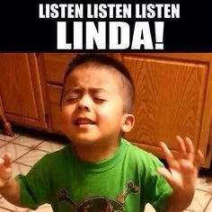
Use Visuals
Use pictures, or create your own (there are tons of photo editing or graphic-creating apps for phones).
This catches attention and is more likely to be a post others interact with.

Slide 12
Activity
You receive this document (approved for social media sharing) and have to create a FB and twitter post for the content.
Get in groups of 2-3 and create posts using tools like hashtags, tagging, etc. and we will share your posts with the group. (file: Leg alert email)

Slide 13
Thank You & Contact
Kristina Wilmoth Missouri PTA PR Chair
kristinaw@mopta.org
Andrea Battaglia Missouri PTA Contact Editor
andreab@mopta.org

