Slide 1
Membership Basics Workshop - Convention 2017
Notes:
Our workshop today is designed to be a guide for membership chairs & units as they plan and implement their membership campaign.
The goal is to provide the basic information you will need to have a successful membership year in a format that is easy to follow, helps you stay on track and is flexible enough to meet the individual needs of the chair or unit.
Membership steps are not really one fits all, it needs to fit each individual chair and unit.
There is a lot of room for creativity.
To be successful in membership, you need to be committed to the task, have good planning, be organized and don’t do it alone. You also need to stay current and informed.

Slide 2
Membership is the key!
The PURPOSES
● To promote the welfare of children and youth in home, school, places of worship, and throughout the community;
● To raise the standards of home life.
● To adequate for laws that further the education, physical and mental health, welfare, and safety of children and youth;
● To promote the collaboration and engagement of families and educators in the education 18 of children and youth;
● To engage the public in united efforts to secure the physical, mental, emotional, spiritual, 20 and social well-being of all children and youth; and
● To advocate for fiscal responsibility regarding public tax dollars in public education funding.
MISSION STATEMENT
● A powerful voice for all children,
● A relevant resource for families and communities, and
● A strong advocate for the education and well-being of every child.
VISION
● Making every child’s potential a reality.
Notes:
How many of you are returning membership chairs?
We are so glad you are here and hope you will take away something new & exciting today.
How many are brand new membership chairs?
Welcome to one of the most important, challenging and rewarding PTA positions.
Membership is the key that unlocks the door to all the possibilities that PTA holds.
Just look at our Purposes revised June 30, 2016 (pause to allow attendees to read)
Listen to our Mission Statement (read all together)
Say the PTA Vision with me and we are going to say it loud & proud! (say it out loud)
Membership is what makes it happen!

Slide 3
Responsibilities
Coordinate & lead the unit’s membership program
Believe in the Mission of the PTA
Attend scheduled meetings
Work with the state membership chair to reach membership goals
Distribute membership cards and encourage members to sign up for e-newsletters
Collection, processing and remittance of dues
Maintain accurate membership records including procedure book
Attend leadership and membership training
Notes:
Know your role and expectations as your unit’s membership chair.
Are there committees you are automatically a part of?
IE the back to school committee or the budget committee
What meetings are you expected to attend?
officer/executive or just board meetings in addition to general meetings.
Attend meetings and be ready to give a report or give a “Membership Minute”
What is the “Membership Minute” - brief summary of #members, introduce new
member benefits, http://www.pta.org/newsevents/signup.cfm?ItemNumber=3304
Remember the state membership chair has the same goals as you do; recruiting & retaining
The more members you have on the local level the more influence your PTA will have
within your school & community.
The more members we have within the state of Missouri, the more advocating power we have in
Jefferson City and the louder PTA’s voice will be in Washington D.C.
Overseeing the distribution of membership cards to your local members
and the collection & remittance of dues is a big part of the membership chair’s fiduciary responsibilities .
We will go into more detail in just a moment.
It is important to keep an accurate list of your members. Some of the Membership Awards are based on details
Updated lists need to be provided to the secretary on a regular basis.
This membership roster is what will be referred to if there is ever a question
regarding eligibility for voting or to hold an office.
A good procedure book will help you stay organized.
It will also help those that follow you start off on the right track.
Recommendations about procedure books can be found in the Tool Kit in the Leadership section.
Members can access the Tool Kit and many other resources on the MO PTA website at www.mopta.org
Take advantage of any & all leadership and membership training for your committee and yourself.
There is always something new & different as well as the great networking opportunity.
Committees work best when they meet often and each member has the information they need
to do their jobs and is trained.

Slide 4
Membership Cards
Cards can be requested via www.MOPTA.org cut or by sheet, ask for around the same # of members as the previous year.
More can be requested through the state office or you can print your own
Has a place for the Member’s Name, Unit PTA ID # & Unit Name
Every individual paid member gets a card; >>>>>>>1 name - 1 card - 1 vote<<<<<<<<<<<
Business memberships; >>>>>>1 card - 1 vote<<<<<<<
Councils do not sell memberships
Notes:
Number sent is based on last year’s membership total
Additional cards can be requested on the dues remittance form
Telephone and email requests are not preferred, but ok in emergencies
Each PTA unit has an ID number.
It can be found on the unit mailing label from Nat. PTA or can be obtained from State office.
This number needs to be filled in on the membership card
PTA Name (the Unit’s Name) and the members’ name also need to be completed
On National’s website there is a template that can be used to print this information on cards.
Everyone gets a card because it represents their voting privileges and their ability to benefit from the National Providers. Issued to individuals only, never Mr. & Mrs. or family
Business memberships are issued in the name of the business and receive a certificate & emblem, these are mailed to the unit president
Only local PTA units join a PTA council, not businesses or individuals.
They become official PTA members when they pay their dues locally and the unit remits the dues to the state office. Their membership is not dependent upon activation.

Slide 5
The PTA Membership Card
Sign up for e-newsletters and more www.pta.org/newsevents/signup
To create your PTA profile, login to www.PTA.org/Profile
Notes:
The new PTA card was launched last year
It feels & looks different. More professional & durable.
Activation is requested but not mandatory.
It helps to provide “proof” to our sponsors & legislators the size of our membership
Activation without aggravation!
See webinar available through National PTA.
The whole process is painless and takes about 3 minutes.
You will need your new PTA membership card in hand before you start.
Locate your unique ID number located in the top right corner of your membership card.
Access to the internet, the website address in on the card
If you don’t have access to the internet, a 800# is also printed on the card.

Slide 6
The Dues Details
Report dues accurately using the
Dues Remittance Form
Mail to the State Office by the 1st of each month
A portion of all membership dues collected goes towards state and national.
$4.25 for Individual memberships
$5.50 for business memberships
Notes:
It is important to keep track of the membership cards your unit has received and sells.
If your unit receives 100 cards and sells 100 memberships, then cards need to be issued to those 100 members and dues for 100 memberships turned into the state office.
Mistakes happen – let us know about any damaged or unusable cards.
Work closely with the treasurer to set up a process to turn in money when memberships are sold and to ensure dues are mailed to the state office each month.
This is part of being an unit in good standing and could affect your unit’s eligibility for awards or reflections.
What you charge for memberships is set in your unit’s bylaws.
$4.25 for individual memberships and $5.50 for business memberships must be sent to the MO PTA office . This covers the State & National part of the dues.
Use the Dues Remittance form when sending dues in.
An example is in your handout.
Make sure it is filled out completely & accurately
Many local units have similar names and it is important that the proper unit gets the credit.
Accuracy can be ensured when the information in the state office is current and it matches information on the form. (correct officer information)
Include a check from the treasurer – do not send cash
When sending in business memberships remember to fill out the requested information on the form regarding the business.
The state office will mail the business certificates and emblems to the unit’s President.
It is important to make sure these get distributed to your business members.
Don’t let them get lost in a stack of papers in someone’s kitchen.

Slide 7
At the beginning:
To Do List:
Previous chair’s records
Read your bylaws
Attend training
Contact your principal
Introduce yourself to Administrators
The treasurer – a “BFF”
Form your committee (if you haven’t already)
Notes:
If you are the new membership chair, ask the previous chair for their procedure book as well as any membership information they may have received from MO PTA or National PTA.
There should be a copy of the unit’s bylaws in the procedure book.
If there is not, ask your president for a copy.
Your bylaws are going to provide valuable information about membership for your unit including when your membership year begins & ends, cost of individual memberships, if business memberships available and cost, if you are a PTSA there will be details about student membership.
Your bylaws need to be followed. For example, if it states the cost of an individual membership is $5 you can not charge $7. This would require a bylaws amendment and those procedures need to be followed.
Attend training whenever possible. Schools of information, regional trainings, & convention provide the opportunity to receive details about membership and to network with other PTA leaders.
Contact your principal before school is out and before they are out of the office for the summer.
Introduce yourself and form a partnership Administrators are already making plans for next year.
Get his/her commitment to support PTA.
Sometimes the principal will be willing to participate in contests.
It is important to communicate frequently with the principal and obtain support/approval when planning activities.
A good working relationship will be very beneficial to your membership efforts and your unit.
Meet with the treasurer , a new BFF – “Best Friend Forever” (at least for the next 12 months)
Work out a process with the treasurer for the collection and deposit of dues.
Have a clear understanding between the two of you about who is going to mail dues to the state office each month.
Determine who is willing to be on the membership committee. Have a meeting to start planning for next year.

Slide 8
What next:
To Do List:
Work with your committee
Set realistic & measurable goals 10% higher? 20%?
Select marketing strategies that promote relevance.
Create marketing plan
Adopt a membership theme
The Membership Chair and Committee
Notes:
Setting goals is a good way to channel your membership efforts.
Setting an overall goal as well as a specific goal works well .
2-5% growth is a good target.
So if you had 125 members last year, a 2% growth would be 25 more this year or a total of 150 members. A 5% growth would be an increase of about 63 members.
Maybe you want to focus on a particular segment of potential members
Increase male membership by 10 members/ Grow student membership by 20 members
100% of all K thru 4th grade classroom teachers / All school board members
Your goal could be to have all your unit’s membership cards activated
Pick an award to work towards.
There are several to choose from. They are listed on the state website
Create a marketing plan that uses strategies to promote your PTA’s value & relevance.
Maybe create a “Top 10 Reasons to Join ABC PTA” that highlights accomplishments of your unit as well as MO PTA and National PTA.
Attract new members and motivate current members to renew by reminding them about the impact PTA has on the community, school and families
People will join your PTA if they find value in what you do
Always promote the member benefit providers
Having a membership theme can sometimes help put creativity and life in the campaign.
Your unit can develop one of it’s own. Maybe it goes along with an event that is happening in the building or district. It could center around the school’s mascot.
You could choose to use the state membership theme

Slide 9
Monthly Theme Ideas
All year Membership Themes:
“Unleash the Power of PTA!”
Put Yourself in the PTA Picture…Join Today!
There’s No Place like _____PTA! or Fun in the Sun at _______PTA!
“Join the PTA T.E.A.M. – Together Everyone Achieves More!” / “Join the Winning Team – PTA”
Space theme: We’re Soaring to New Heights…Join PTA Today! / “Blast into the Future with PTA!” or ‘Space” Rockets (classes) race toward the moon
Tree theme: “Come Grow With Us” / “Branch Out to Students” / “An Apple A Day Makes A Great PTA” leaves or apples added to tree for each membership
Western theme: “Blazing New Trails” or “Sign up for the Wagon Trail to Success”
“New Year - New Opportunities”
Valentines Day - Hearts
“Be Lucky” - Shamrocks
“Spring into PTA” - Flowers
“March with PTA”
Notes:
Write other theme possibilities on flip chart

Slide 10
Your Membership Plan
It is a year – round activity
You are marketing & selling a product
Memberships help make our PTA voice stronger as we all speak for the wellness & education for all children
PAST - PRESENT - FUTURE
Re-invite past members
Charish present members
Campaign future members
Notes:
As you are developing your membership plan it is important to keep two things in mind.
1st – remember that membership is a year – round activity.
It isn’t just at back to school time and it doesn’t stop in October.
A successful membership plan keeps membership in the forefront all year long .
Units that continue their membership efforts on the average will have 20% more members. Nationwide 18% of PTA members join in January & February. This is second only to the traditional, back-to-school campaign period.
2nd – treat membership like you are marketing & selling a product that your customers do not realize they can’t live without.
There are two ways to accomplish this
One is thru what is referred to as the “60 second elevator speech”
Everyone on the membership committee & board should have one
It is a consistent message with specific talking points
2-3 successes from last year
2-3 goals that can be achieved with more members
Practice & role play

Slide 11
To Do List:
Continued
Prepare budget request
Review Membership Form
Visit Businesses or ask members to invite their place of business to join
The Secretary – a “BFF”
Check out resources
Notes:
Think of your plan of work as an agenda or a timeline that tells the what, when, where & who of a membership activity.
For example: Membership Table
Varsity Home Football Game, October 4th, 6:30 p.m., Dragon’s stadium
Beth & Susan
supplies - take banner, pens, membership forms & cards, money bag
Have a membership table at all school functions. Be sure to include information about PTA’s programs, activities, legislative positions, advocacy efforts and members benefits.
Utilize the school calendar to help plan these events & remember to get permission from the school administration to set up.
When you prepare the budget request it is important to make sure you are requesting enough funds to cover the expenses you may have to run your membership campaign. This may include copy paper or printing fees, supplies for posters or banners, prizes for contests.
Check with your treasurer or president about any guidelines (i.e. in the standing rules) that might be in place regarding budget requests.
This would also be a good time to ask about expense reimbursement procedures.
Your membership form can be plain & simple
It can be fancy with lots of graphics that highlight your membership theme.
It needs to fit your unit’s needs and include basic information like name, address, phone number, email address and their student(s) name(s).
You can design your own or “borrow” one and change it.
Start approaching local businesses to join as PTA Business Members. Sometimes this is the beginning of a partnership that leads to further support of other activities.
Contact the secretary to find our in what format (electronic or paper) and when he/she would like to receive the membership list to ensure it is ready for meetings.
There are a lot of resources available with information and ideas about membership.

Slide 12
Resources
Utilize the MO PTA State Board members
Missouri PTA Website: www.mopta.org
Tool Kit
National PTA Website: www.pta.org
Running a PTA/Marketing Tools
Search Internet: PTA Membership, PTA Membership Campaigns, PTA Membership Ideas, etc. Look at other State or unit PTA Websites and newsletters on-line.
Notes:
You do not have to reinvent the wheel.
It is ok to borrow an idea.
If it wasn’t, it would be available for you to see.
That is the benefit of networking or “internetworking” – the sharing of ideas.

Slide 13
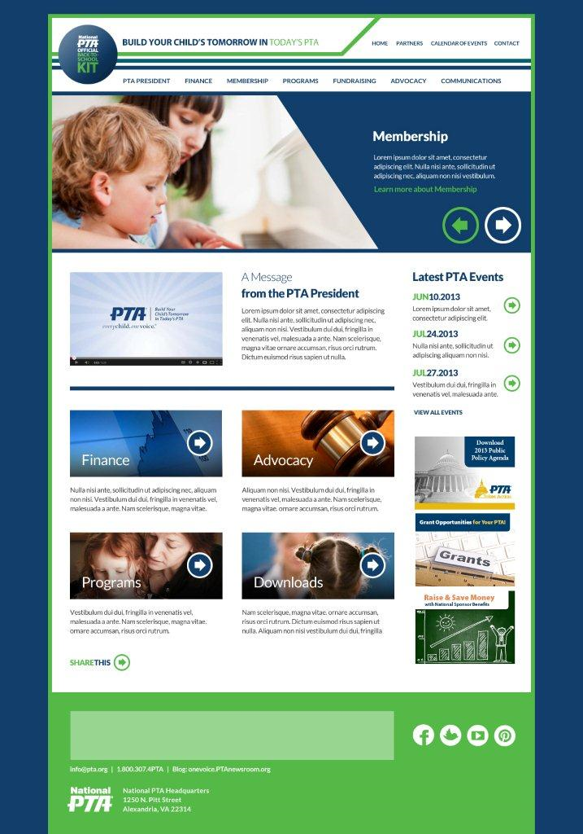
Official Back to School Kit
http://www.ptakit.org/
Customizable
Marketing Tools
Posters, Fliers, Letters
Everyday scripts for handling objections
Monthly Membership Engagement Activities
Communications and Other Resources
Notes:
There are many resources also available from National PTA to help guide you and promote your membership campaign.
The official back to school kit that includes the membership quick reference guide. Find this online at http://www.ptakit.org/
Follow the Membership Tab. Also check other tabs for useful information such as the Communications Tab for logo use, social media tips and sample press releases.

Slide 14
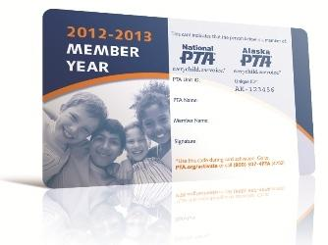
Notes:
Here are some examples of the promotional items that are available.

Slide 15
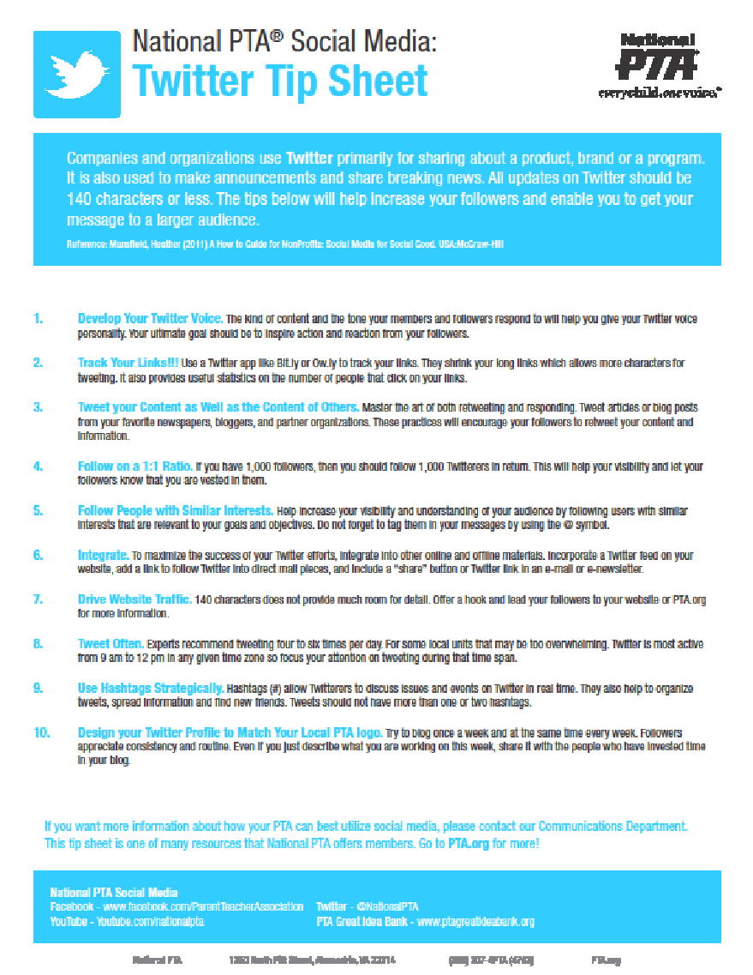
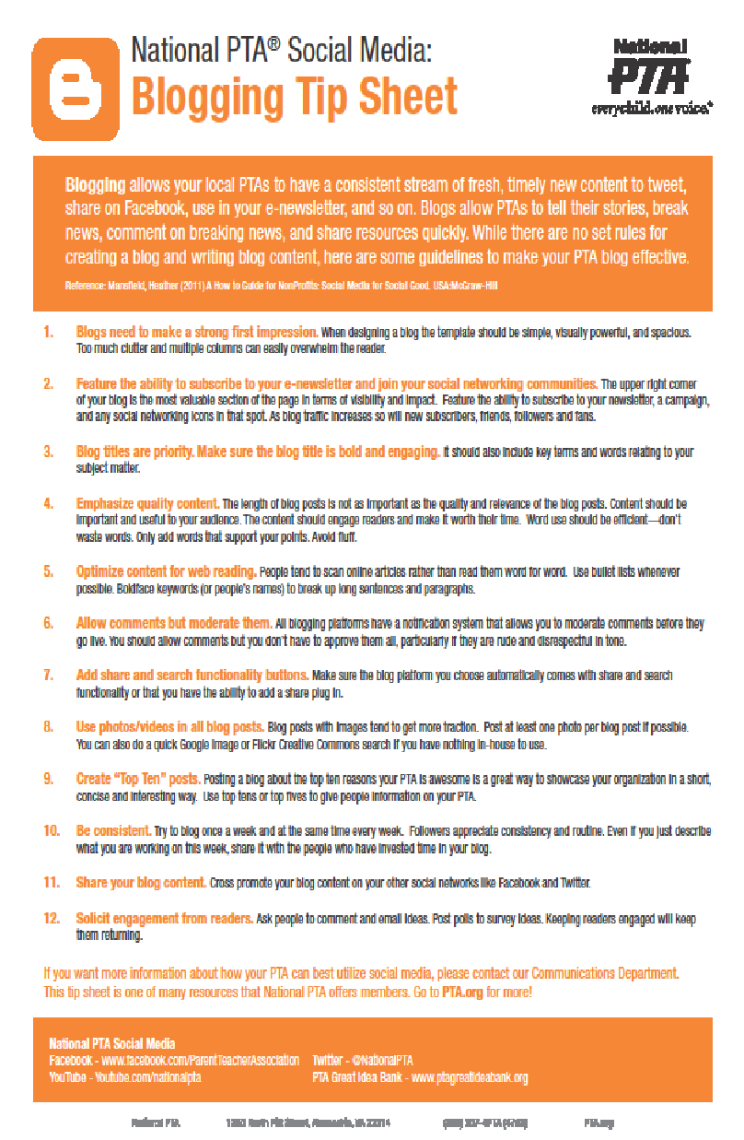
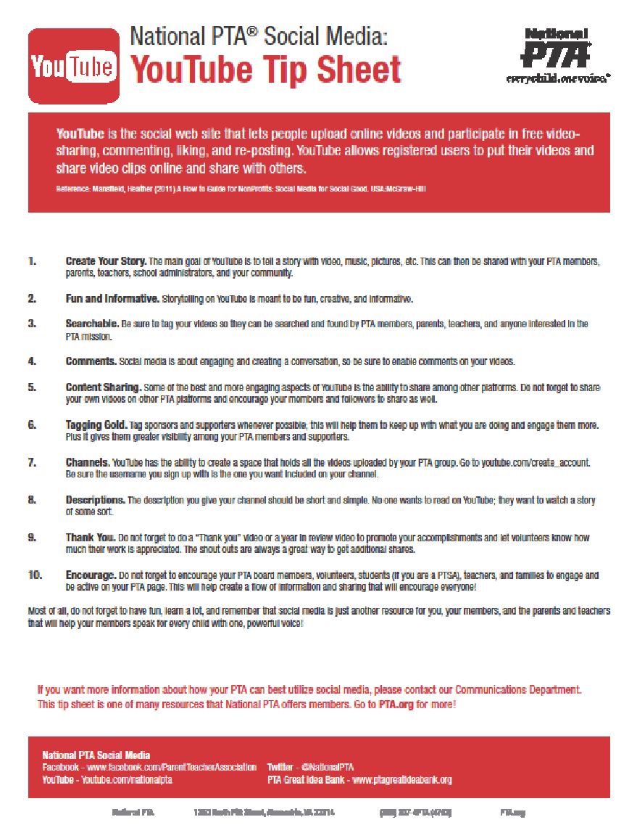
Notes:
There are also social media tip sheets available about blogging, Facebook, Twitter, and YouTube.

Slide 16
First Meeting:
To Do List:
PTA board members (this should be collected before you do any other business)
Membership plan approved
Plan for:
Kindergarten Orientation
New Student Welcome packs
Open House
Membership contest Kick off
Notes:
Make sure all officers and chairmen are members. It is required by your bylaws. This needs to be take care of before the board starts decision making/voting. Can’t vote unless you are a member!
Present the membership committee’s plan of work to the board for their approval. This will help everyone take ownership and feel responsible to implement it.
Get permission from the principal/superintendent about being a part of the building’s/district’s in-service for the staff. Here your chance to get on your “soap box” and let them know why joining PTA is the right thing to do. If you are having a membership contest that involves competition between teachers – this is a great time to announce it especially if it involves the principal & maybe pies. Have your membership cards ready!
Also ask to have membership tables at all back to school activities like open house, meet the teacher night, registrations, volunteer meetings.
Make sure to have the membership table supplies ready to go; membership cards, copies of membership forms, money bag, other information to hand out.
Order or make banners and posters that say “Join Today”
Advertise on marquees at school and local businesses
Plan an event for kindergarten registration in the spring, donate snacks, coffee, etc. This is a great opportunity to meet new parents and invite them to join PTA. Might even find some volunteers.
Make up “Welcome to Our School” packets that include items like a local map, merchant coupons, a school year calendar and of course, how to join PTA information. Give these to your school secretary to have on hand for those families that move in after registration time or after school starts.
Each month you need to take care of business. That means getting with your BFFs, (treasurer & secretary).
Record how many memberships have been sold.
Make sure this number agrees with the amount of money that has been collected.
Work with the treasurer to complete the dues form and it is mailed to the state office by the first of each month.
Keep a copy of the completed form in your procedure book
Update the membership roster and give a new copy to the secretary each month.

Slide 17
Ongoing To Do List:
Continue to contact local businesses
Utilize local media
“BFF” time
Treasurer:
money collected = memberships sold
dues mailed by the 1st
Secretary:
updated membership roster
Notes:
Work with your local newspaper and other media to publicize it is time to join PTA. Include information about accomplishments, goals, members benefits. Always included details about how to join.
Share membership opportunities with local businesses.
Maybe they would like to offer a member benefit, i.e. “Show your membership card and receive $1 off of a movie rental.” “$3.50 discount off of a hammer when you show your membership card”. “BOGO free admission at the movie theater with your membership card”.
A great way to bring in the memberships is to have a friendly competition between classrooms. One very successful contest allowed the teacher of the class with the most PTA memberships gets to “slime” the principal. Highly visible posters were hung in the hallway to track the progress of the contest. The kids loved it, the teacher loved it and the principal did his part in promoting PTA membership.
Turn in your membership dues by September 9, 2013 and you will have the opportunity to earn the Missouri PTA Early award. Details are in the tool kit or on the Missouri PTA website, www.mopta.org
Take care of business just like last month!
Be sure to register for convention to take advantage of further training and networking with PTA members from across the state.

Slide 18
To Do List:
Fall Sports
Totals so Far!
Goal Status
“Hello” School Board Members & Faculty
OCTOBER
Notes:
Make sure membership tables are “manned” at all fall sporting events (not just football).
It is a great opportunity to ask community members and extended family members to join.
Different crowds attend different sports. Soccer fan are not necessarily at football or softball games.
Coordinate membership sales with spirit wear sales.
Summing up the Kick-Off contest or campaign
Your initial membership drive/contest is probably about to end.
Publicize the results (winners, memberships received, how close to overall goal).
Thank/acknowledge those who have joined/volunteered so far. This can be done in a newsletter or a wall of fame in the school.
Plan to have another contest or membership drive during November & December.
Check last year’s membership list and contact those who have not joined this year.
Have you been to a school board meeting?
Check with the district office to find out when the next one is.
Ask if you could have a minute on the agenda or be a part of the public comment portion.
Take the unit president with you and share the wonderful things PTA is doing in your district and extend the invitation to join. Have membership forms & cards in hand.
At Convention. Be ready to listen, learn and share ideas with PTA members from around MO.
Do you know the song “Taking Care of Business”? Remember to sing it every month.

Slide 19
To Do List:
Show & Share
Say “thanks” with a gift of PTA
Special Events
Are you in good standing?
NOVEMBER
Notes:
Share the great training and ideas you gathered at the Missouri PTA Convention with your committee and board.
Develop a gift membership
Use a “Give Thanks” theme.
“Thank someone who works hard for children – buy their PTA membership for them.”
Make sure to have membership tables at special events like concerts and plays.
Sponsor a special event (like a patriotic concert) that promotes community service and PTA membership.
Ask the band and/or choir to sing theme appropriate songs.
Ask the local paper and radio station to publicize it
Include a short video clip about PTA (& why it is important to join). One with children in it is always good!
Announce the Reflection Arts competition and display winning work from last year.
Invite the public and ask them to bring a canned good for the local food pantry
Have the membership table manned & ready
There are several requirements that must be met by 12/1 for a unit to be in good standing.
These are list in the Tool Kit and on the MO PTA website
Double check with the president/ treasurer to make sure your unit is in compliance. It will make a difference when applying for membership awards.
Sing your song!

Slide 20
To Do List:
Who is on your shopping list?
Plan 2nd push
Are you in good standing?
Take a break!
DECEMBER
Notes:
Develop a gift membership with the theme of
“Give the gift that keeps on giving, a PTA Membership”
Just right for those who are hard to buy for.
Ideal for those who have everything they need.
Maybe they are in the service or work overseas and want to support their niece or nephew’s school.
Perfect for those who would like to help out by volunteering, but are unable to .
Remember membership isn’t over!
Plan an activity for January to kick off the second half of your membership drive.
Add a new member benefit from a local merchant
Watch for announcements about membership challenges from
the state & national PTA.
Sing your song with your BFFs then take a break for the holidays.
You deserve it. The membership committee has worked very hard this year.
Rest up and come back fresh for the New Year!

Slide 21
To Do List: (Now that you have had a break, Back to work)
New families
Bring a friend
Kindergarten Round-Up
Preschool Screening
Winter Sports events
School Board Forum
“Never too late to join” ads
Founders Day (Feb. 17th)
Continue to search internet for new ideas
Final month for dues to count toward awards – 3/1 deadline
Mail award applications
January
February
March
Notes:
There is a lot of change in enrollment after New Years.
Make sure to contact new families to your school
Issue a challenge to your members to bring a non-member friend to the January meeting.
When (not if) they join, both names are put into a prize drawing.
Have a membership table at Kindergarten & preschool enrollment events
Winter brings a whole new set of sports and fans!
Host a school board forum.
Use the opportunity to educate the crowd about PTA’s advocacy history & power
Have a membership table and make sure the candidates are members
Send a postcard to those parents that have not yet joined. Maybe they forgot!
Launch a “It’s Never Too Late to Join” campaign by utilizing yard signs, flyers and the local media.
Founders Day is a great opportunity to reflect back on the accomplishments of PTA.
Host a dessert night and invite past unit presidents, school staff, community leaders and parents.
Have a membership table and extend the invitation to join. They won’t be able to resist when they see what all PTA does for the children.
Do a web search for new membership themes.
Dues must be postmarked 3/1 to count toward awards
Sing, Sing, Sing!

Slide 22
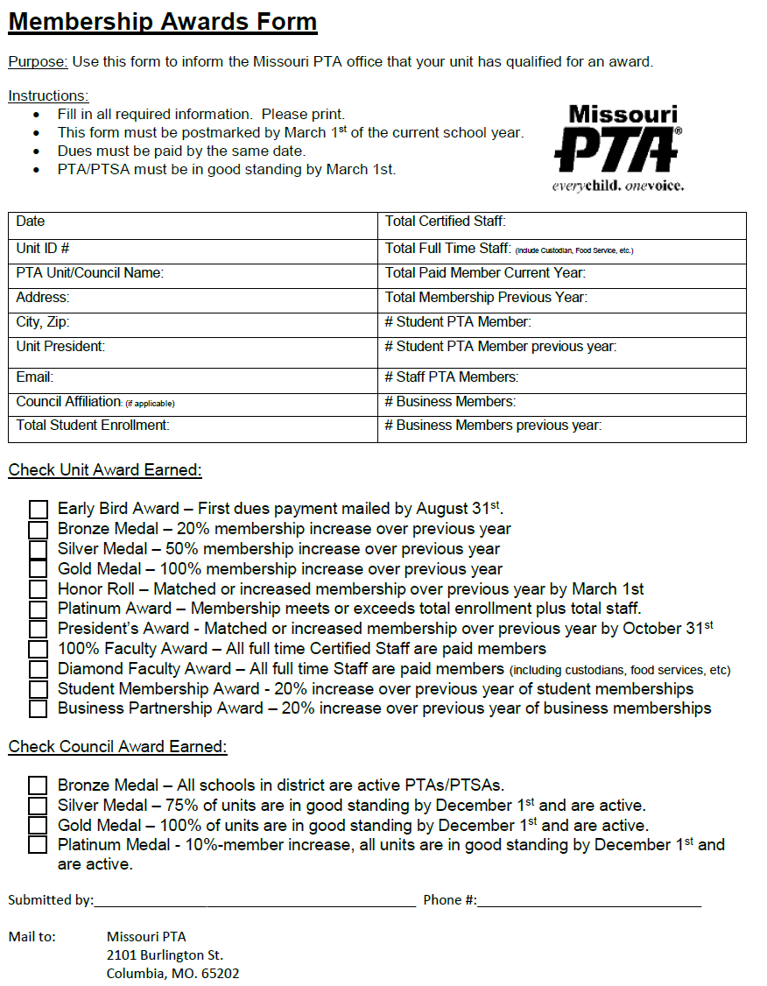
NEW 2017
MEMBERSHIP AWARDS FORM

Slide 23
To Do List:
Update membership records & procedure book for next year
Evaluate your successes
Celebrate the accomplishments
Thank your committee
Prepare & give final membership report
April . . .
The final month
Notes:
Membership award applications must be filled out correctly and completely to be considered.
Applications must be postmarked on or before April 1st.
Check ahead to see what day of the week the deadline falls on.
Do the final update on the membership records and procedure book.
Have it in good shape for you or your successor to start the next year
Include your final membership roster and number, the original goal, awards applied for, roster of committee members, evaluation of the membership year, recommendations and important materials used/needed.
Celebrate! You and your committee did a great job. Be sure to thank them personally and publicly for their hard work.
Your final membership report should summarize the year’s work and accomplishments. This is usually read at the final (annual) meeting of the unit. Provide a copy to the secretary and keep a copy in the procedure book.

Slide 24
GOOD AND BAD “MANAGER” TRAITS
BAD “MANAGER” TRAITS (SOME THINGS WE MAY BE DOING THAT SEND GOOD PEOPLE PACKING)
Overwork people. - It’s tempting to work your best people hard.
Don’t recognize contributions and reward good work. - Everyone likes kudos! And rewards!
Failure to develop people’s skills. - Good managers manage, pay attention and constantly listen and give feedback.
Don’t care about the volunteers. - Balance between being professional with being human.
Don’t honor your commitments. - Trustworthy and honorable, do what you say you will do.
Failure to engage creativity. - Allow change, improvements and creativity.
Don’t challenge people intellectually. - Find out what volunteers want to do, if it’s boring or too much. Match volunteers to their own comfort zone.
Notes:
It’s pretty incredible how often we hear chairs commenting on how they are left with doing everything by themselves. How they may have individuals say they will help and never show up or how they get help at first and then no repeat help.
Sometimes, we have to take a long look at what we are doing to encourage and keep our volunteers. Most individuals don’t leave the job they may be leaving the leader.
Let’s take a closer look…..with a new perspective and some extra effort on the chair’s part.

Slide 25
GOOD AND BAD “MANAGER” TRAITS
GOOD SIGNS THAT YOU CARE
Communication - Regular, create an open environment to communicate, give suggestions and feedback.
Encourage - Give opportunities for challenge or the next step up.
Connect - Help others connect to the right people to complete tasks.
Training - School of Information, E-training, Convention Workshops, etc.
Credit - You are only the head, keep it attached to the body (volunteers).
Notes:
Make the most of any new challenges, training and development opportunities that you take on or pass on.

Slide 26
That’s it!
Thank you for volunteering and being here to educate yourself and your unit!!!!!!!
Christine Kent - MOPTA VP of Membership
christinek@mopta.org
OR
membership@mopta.org
OR
816-838-2179

