Slide 1
Key Role PTAs Play to
Align and Amplify Efforts to Change The Future of Childhood Obesity

Slide 2
WELCOME!
Weight Management Clinics
Research
Weighing In
Group Weight Management Programs
Children’s Mercy & KUMC
Center for Children’s
Healthy Lifestyles & Nutrition

Slide 3

Healthy Schools
Healthy Lifestyles Initiative
Treatment
Early Childhood
Weighing In
Notes:
This is where the HLI- Administrative support is housed but the work is done by collaborating with community organizations!

Slide 4
Objectives
Review childhood obesity’s causes and problems.
Highlight the Missouri Children’s Services Commission prevention and treatment recommendations.
Review statewide actions to align efforts on these recommendations.
Focus on school health and wellness recommendation.
Describe critical role of PTAs, parents and families.

Slide 5
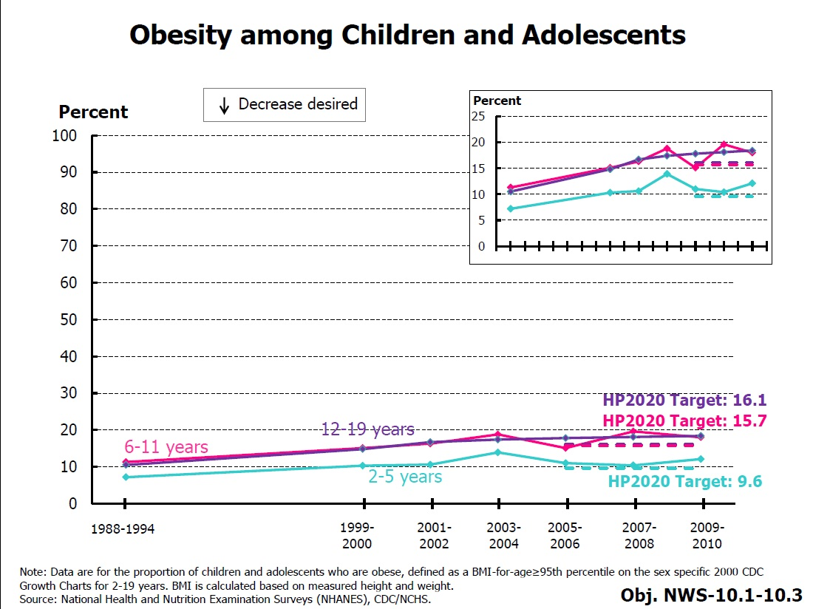
Collective Goal!
Notes:
Greater than 95th percentile BMI for age
2009-2010 HP 2020
2-5 year olds 12.1 9.6
6-11 18.0 15.7
12-19 18.4 16.1

Slide 6
Rates of Overweight and Obesity
Age group | National rate | CM FY 2013 n=15,728 | CM FY 2014 n=17,140
2-5 years | 22.8% | 27.54% | 27.28%
6-11 years | 34.2% | 39.58% | 40.31%
12-19 years | 34.5% | 44.37% | 45.1%
Children’s Mercy (CM) Primary Care Clinics, Kansas City, Missouri

Slide 7
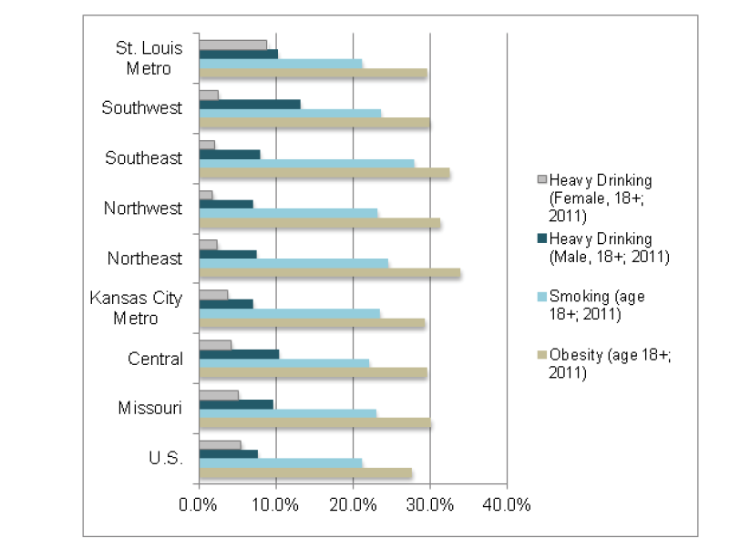
What do we know about Missouri’s modifiable risks?
Missouri Health Assessment Report, http://health.mo.gov/data/index.php
Notes:
Social norms and food and fitness environments increase risk for obesity and chronic diseases
29 % of low-income children are overweight and obese. (CDC-2012)
30.4% of adults are obese (CDC-2013)
http://health.mo.gov/data/mohealthassess/pdf/assessment.pdf
Cost of inaction
Missed prevention opportunities
Missed treatment opportunities

Slide 8
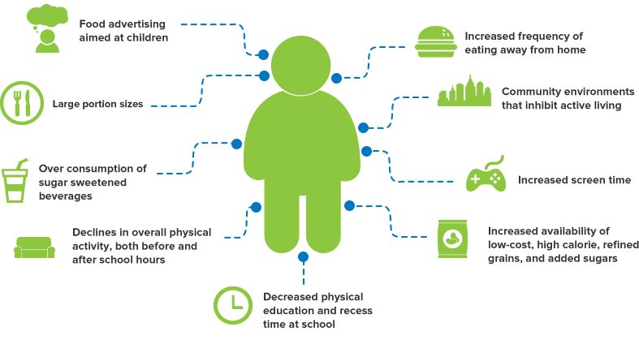
Multitude of Causes
”
Graphic courtesy of

Slide 9

What’s the Problem?
Obesity epidemic is fueling…
…Serious health, social, & economic problems.
Health problems
  Diabetes
  High Blood Pressure
  Cardiovascular Disease
Social Problems
Weight bias
Bullying
Annual cost of being obese per year:
$4,879 for an obese woman
$2,646 for an obese man
This is the first generation in US history that could live sicker and die younger than their parents’ generation
Notes:
At Children’s Mercy
--Only 16% of obese children have been told by the primary care provider that they had a weight issue
--82% of children who appear in weight management clinics have a co-morbid condition
--increasing proportion of our patients have fatty livers
--Children with obesity have a healthy quality of life that is similar to a patient with cancer
This is largely preventatable

Slide 10
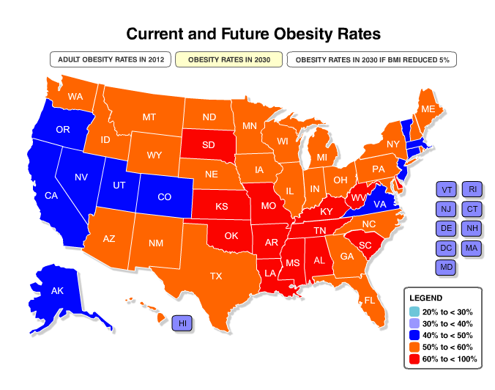
What’s the Problem? 2030 Projection
If current trends continue, Missouri will spend $12 B annually on obesity-related health care by 2030
F as in Fat: How Obesity Threatens America’s Future 2013
Notes:
Projecting 60 % of adults in MO as Obese
In 2012,
Missouri is 17th Most Obese State in Nation with 29.6% of adults being obese
2011 data
In both KS & MO 12-13% of 2-4 years olds in low- income families are obese.

Slide 11

Flood tide of obesogenic factors
Notes:
Children, like adults, face a “veritable flood tide of obesogenic factors on a daily basis.” Any single intervention, in any setting, intended to combat these influences is rather like a single sandbag intended to contain the rising waters of an actual flood. No matter how robust, a single sandbag… a single intervention cannot be expected to oppose the obesogenic flood tide.” The aggregation of interventions must be applied to the containment, control, and prevention of childhood obesity (12) and is the approach being used by WI and BHH

Slide 12
Missouri Children’s Services Commission
Recommended Actions
for Childhood Obesity Prevention and Treatment
results of research, planning and community forums
Subcommittee on Childhood Obesity
State of Missouri Children’s Services Commission

Slide 13
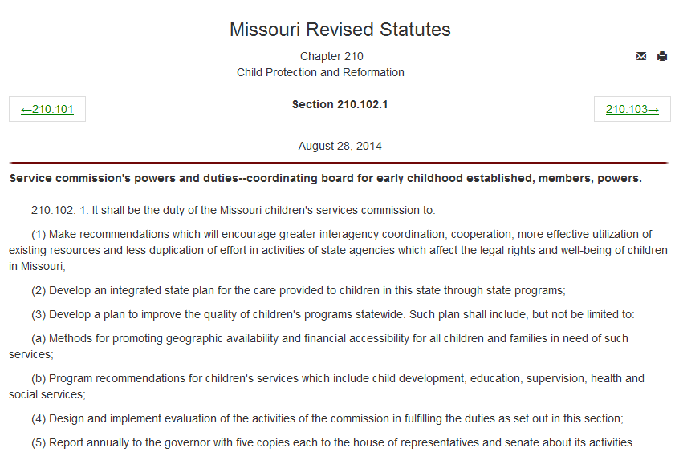
http://www.moga.mo.gov/mostatutes/stathtml/21000001021.html

Slide 14

Subcommittee Purpose
Subcommittee on Childhood Obesity
State of Missouri Children’s Services Commission
Review the issue of childhood obesity, the evidence for effective approaches to prevent and treat, Missouri's current approaches, and the gaps in services and resources.
Compile recommendations to create a comprehensive approach that includes access to treatment in Missouri that will fill identified gaps and decrease prevalence of obesity.
Present the report and recommendations to the Missouri Children's Service Commission which will in turn, inform the Governor and General Assembly.

Slide 15
subcommittee members
Graciela Couchonnal, PhD
Health Care Foundation of Greater Kansas City
Ann Davis, PhD, MPH, ABPP
Center for Children’s Healthy Lifestyles and Nutrition
University of Kansas Medical Center
Dawnavan Davis, PhD
KC Blue Cross Blue Shield
Johanna B. Derda
American Academy of Pediatrics, Missouri Chapter
Meredith Dreyer Gillette, PhD
Children’s Mercy Hospitals and Clinics, Kansas City
Janet E. Farmer, PhD
University of Missouri School of Health Professions
Sarah Hampl, MD, FAAP, Co-Chair
Children’s Mercy Hospitals and Clinics, Kansas City
Megan Klenke, MSW
Child Care Aware of Missouri, St. Louis
Timothy Kling, MD, FACOG
Missouri HealthNet
Missouri Department of Social Services
Deborah Markenson, MS, RD
Weighing In, Children’s Mercy Hospitals and Clinics, Kansas City
Ann McCormack, MPH, RD
Bureau of Community Food and Nutrition Assistance
Missouri Department of Health and Senior Services
Donna Mehrle, MPH, RD, LD
Missouri Council for Activity & Nutrition (MOCAN)
University of Missouri Extension
Samar Muzaffar, MD, MPH
Missouri HealthNet
Missouri Department of Social Services
L. Carol Scott, PhD
Child Care Aware of Missouri, St. Louis
Member of Children’s Services Commission
Pat Simmons, MS, RD, LD
Missouri Department of Health and Senior Services
Amy Stringer Hessel, MSW
Missouri Foundation for Health
Aneesh Tosh, MD
University of Missouri School of Medicine
Denise Wilfley, PhD, Co-Chair
Washington University in Saint Louis
project staff
Eric S. Armbrecht, PhD
Angela Lima, MBA, RD, LD
Emily Meissen-Sebelius, MSW
Stephanie Seger
Allison Yee, MPH

Slide 17
Types of Recommended Actions
Subcommittee on Childhood Obesity
State of Missouri Children’s Services Commission
Prevention
Treatment
Infrastructure

Slide 18

State of Missouri Children’s Services Commission
Subcommittee on Childhood Obesity
Recommended Actions for Childhood Obesity Prevention and Treatment
prevention early childhood
Update child care licensing rules to align with the latest evidence on nutrition, physical activity, and screen time.
Train and support child care professionals
to meet new standards.
Children’s Services Commission | December 1, 2014 | Jefferson City, MO
Notes:
Children who are overweight or obese as preschoolers (2-5 year olds) are 5 x more likely to be overweight or obese at 12 years old when compared to their normal weight peers.
MO child care licensin regulation for nutrition and PA have not been updated since 1993
Current regulations meet only 5 of the 47 nationally recommended standards for preventing childhood obesity
Nutrition
Feeding practices
PA
Screen time
Update child care licensing standards in collaborative effort—DHSS, child care providers, early childhood supports
Provide training and support for child care providers to meet new standards

Slide 19

State of Missouri Children’s Services Commission
Subcommittee on Childhood Obesity
Recommended Actions for Childhood Obesity Prevention and Treatment
treatment reimbursement
Reimburse licensed professionals with specialized training in evidence-based multi-component, family centered weight reduction programs through all Medicaid plans. Reimburse services provided in health care or community settings for children with a body mass index (BMI) at or above the 85th percentile.
Children’s Services Commission | December 1, 2014 | Jefferson City, MO
Notes:
60 % of children who were overweight or obese had one risk factor for heart disease and 25% had two or more risk factors
Type 2 diabetes accounts for as many as half of all new cases in children.
Experts recommend multi-component evidence-based treatment—this entails 26 hours of intensive treatment to cover the broad array of element: nutrition , physical activity , behavior change, partenting...

Slide 20

State of Missouri Children’s Services Commission
Subcommittee on Childhood Obesity
Recommended Actions for Childhood Obesity Prevention and Treatment
infrastructure centers of excellence
Establish Centers of Excellence across Missouri to provide evidence-based weight management services; coordinate access to treatment; train health care providers, school staff,
and others about screening,
treatment options, and referral
coordination; and train health
care and community agencies
on prevention strategies.
Children’s Services Commission | December 1, 2014 | Jefferson City, MO
Notes:
Provide infrastructure and capacity-building, so that children and their families across the state can access evidence-based prevention and treatment services.
Provide treatment
Build capacity in communities to provide treatment—training and technical assistance
Build capacity in communities to implement prevention strategies
Coordinate regional approach

Slide 21

State of Missouri Children’s Services Commission
Subcommittee on Childhood Obesity
Recommended Actions for Childhood Obesity Prevention and Treatment
infrastructure commission on child health and wellness
Establish a commission to oversee implementation of the Subcommittee’s recommendations, study effectiveness of obesity prevention strategies, and provide an ongoing
forum for education and future actions.
Children’s Services Commission | December 1, 2014 | Jefferson City, MO

Slide 22

State of Missouri Children’s Services Commission
Subcommittee on Childhood Obesity
Recommended Actions for Childhood Obesity Prevention and Treatment
prevention schools
Establish an Office for Student Wellness to maintain expectations for health and physical education curricula.
Modify school accreditation by creating and
maintaining a health and wellness component.
Train and support school staff to implement
best practices and school wellness policies
related to nutrition, physical activity and
physical education.
Children’s Services Commission | December 1, 2014 | Jefferson City, MO
Notes:
Rates of obesity jump when children enter school
70-80% of overweight and obese children will be obese adults

Slide 23
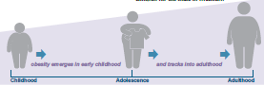
Support and Rationale
Children with obesity emerge in in early childhood
Rates of obesity increase during school years
For those who are obese:
  Miss more school
  Perform more poorly
  Have lower self-esteem
  Are targets of bullying
Childhood obesity tracks into adulthood

Slide 24

Support and Rationale
Schools are natural hubs for prevention
  888,000 children attend daily in Missouri
  Impart knowledge
  School policies and environments impact behaviors
  Connect with families and community

Slide 25
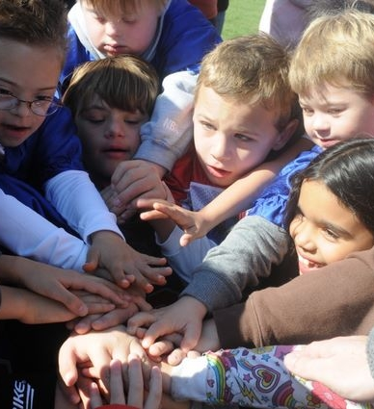
Support and Rationale
DESE’s goal: top 10 by 2020
Healthy children perform better academically
Health builds on healthy behaviors modeled and taught in schools

Slide 26
School Based Prevention Recommendation
Student Wellness Office
Health & PE curricula
Accreditation Scoring Guide
Health and wellness standards
Training & TA
Implement best practices & policies (nutrition, PA, PE, family engagement)
Notes:
recommend that an Office of Student Wellness be created
to assure adequate staff to provide guidance on health and PE Curricula,
set accreditation health and wellness standards
Provide training and technical assistance

Slide 27
1. Incorporate health and wellness component as part of school accreditation
Modify scoring guide to include a health and wellness component
Provide incentive for schools to voluntarily implement healthy lifestyle-obesity prevention strategies

Slide 28
2. Provide up-to date grade level expectations for health and physical education curricula.
Ever-evolving subject areas
Equip students with the knowledge, attitudes & skills to support life-long health practices

Slide 29
Resources provided to health education teachers is significantly declining
Missouri School Health Profiles 2014 http://dese.mo.gov/sites/default/files/HPE_Missouri_2014_School_Health_Profiles_Report_0.pdf

Slide 30
Demand for Health Education Training by Teachers
Missouri School Health Profiles 2014 http://dese.mo.gov/sites/default/files/HPE_Missouri_2014_School_Health_Profiles_Report_0.pdf

Slide 31
3. Provide training and technical assistance-best practices and school wellness policies
Collaboration between DESE and DHSS
Areas of focus:
  Nutrition
  Physical Activity
  Physical Education
  Family engagement

Slide 32
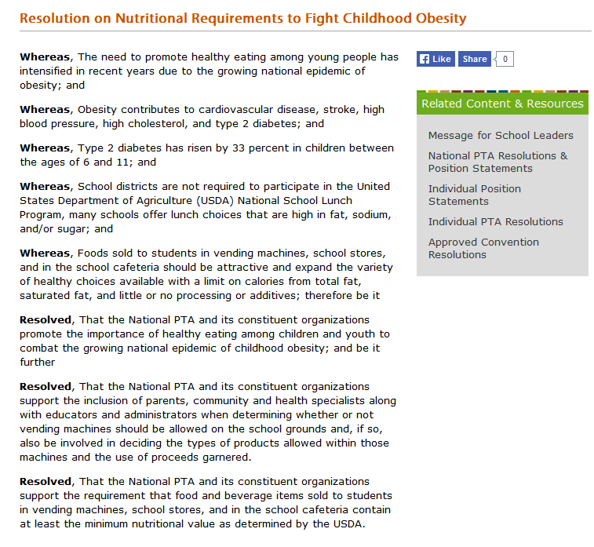
National PTA
continued…

Slide 33
continued…
National PTA: http://www.pta.org/about/content.cfm?ItemNumber=3442

Slide 34
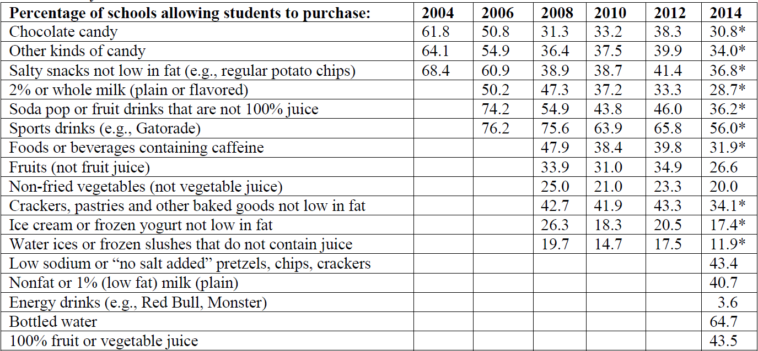
Better Standards=
Better Practices
Missouri School Health Profiles 2014 http://dese.mo.gov/sites/default/files/HPE_Missouri_2014_School_Health_Profiles_Report_0.pdf

Slide 35
Sugar-added Drinks or Non-diet Soda Consumption 1+ Times per Day*, Missouri 2007-2013
Prevalence (%)
* In the past 7 days, YRBS, DHSS

Slide 36
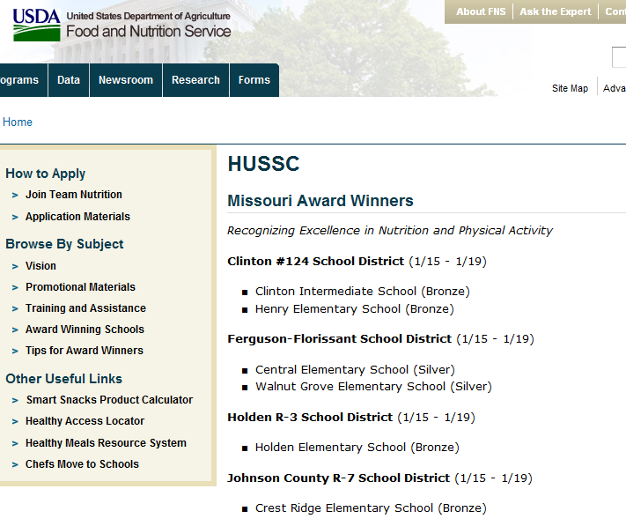
We are making progress

Slide 37

What’s a parent to do?

Slide 38

Rate Yourself
On a typical day, how many minutes do you (does your child) spend in active play/exercise?
(breathing harder or sweating)
Notes:
Goal: Be active 60 minutes or more each day. Staying active can help you keep your energy up and reach or stay at a healthy weight.

Slide 39
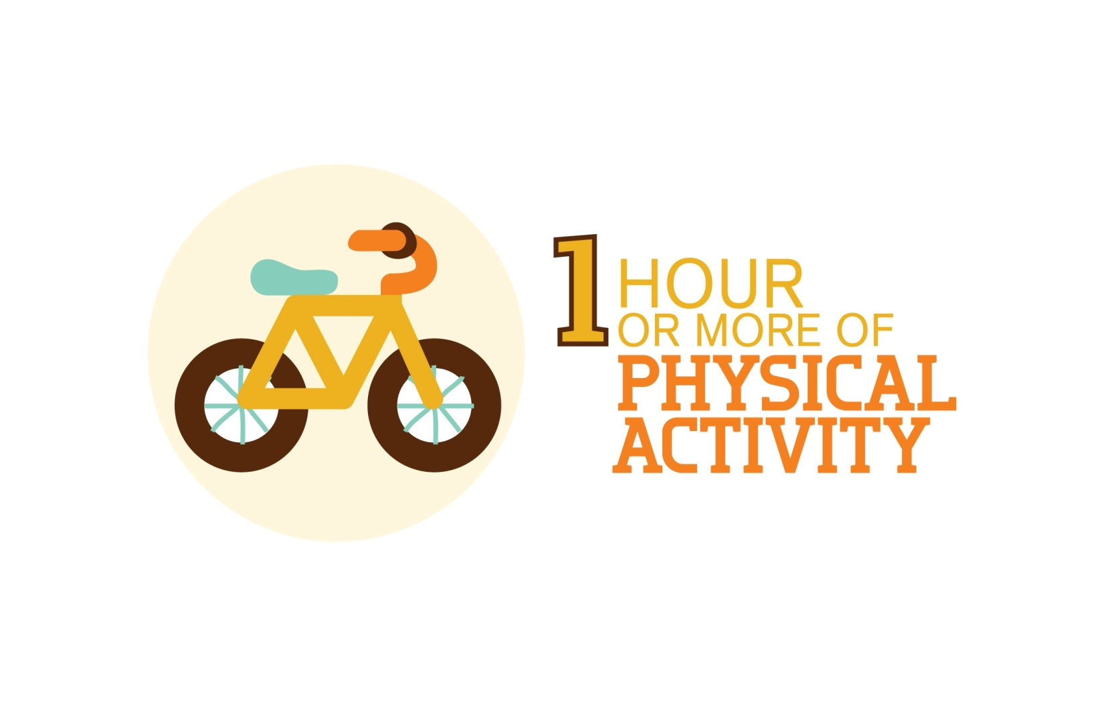
Notes:
How close are you to the 1 hour mark?

Slide 40

What’s A Parent to Do?
Become a Healthy Role Model
Make gradual changes
You don’t have to do it all at once
Start Walking
Keep it social
Benefit Keep your energy up, reach and stay at a healthy weight
Notes:
Make gradual changes. Walk 10 minutes longer every week.
You don’t have to get 60 minutes in all at one. Cut down one less indulgent food or drink every week.
Balance bad habits with good ones. Watch TV while you’re on the treadmill. And don’t go cold turkey on your favorite foods—it’s ok to have an occasional treat. You’ll be more likely to stick to your commitment if you don’t feel that you are depriving yourself.
Start walking. Take the stairs instead of the escalator. Park at the back of the parking lot and walk Drink more water and less soda. You can’t expect your kids to cut back on soda if you won’t.
Keep it social: Physical activity can be a great way to make new friends. Kids are more likely to stick with an activity if friends are involved. Encourage your kids to invite friends for active play-dates, such as bike riding and touch football games.
Just say no to "exercise"! Don’t present being physically active as exercise—kids may interpret that as a punishment.. Encourage everyone in your family to try different activities and find one that suits everyone. Keep it fun!
What are some other ideas you have for walking?

Slide 41
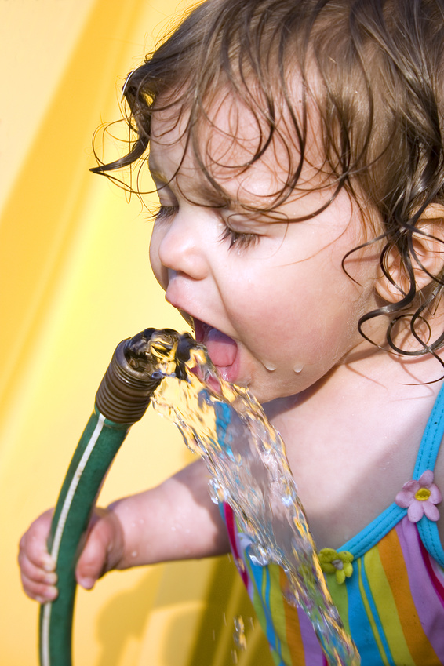
Rate Yourself
On a typical day, how many times do you (does your child) drink plain water?
  1 time
  2 times
  3 times
  Many times >4
  None
What other beverages do you drink in a typical day?
Juice (100%)
Regular Soda
Fruitade (Sunny Delight, Kool-aid)
Sports drink
Diet soda
How many times?
1 time
2 times
3 times
Many times >4
None

Slide 42
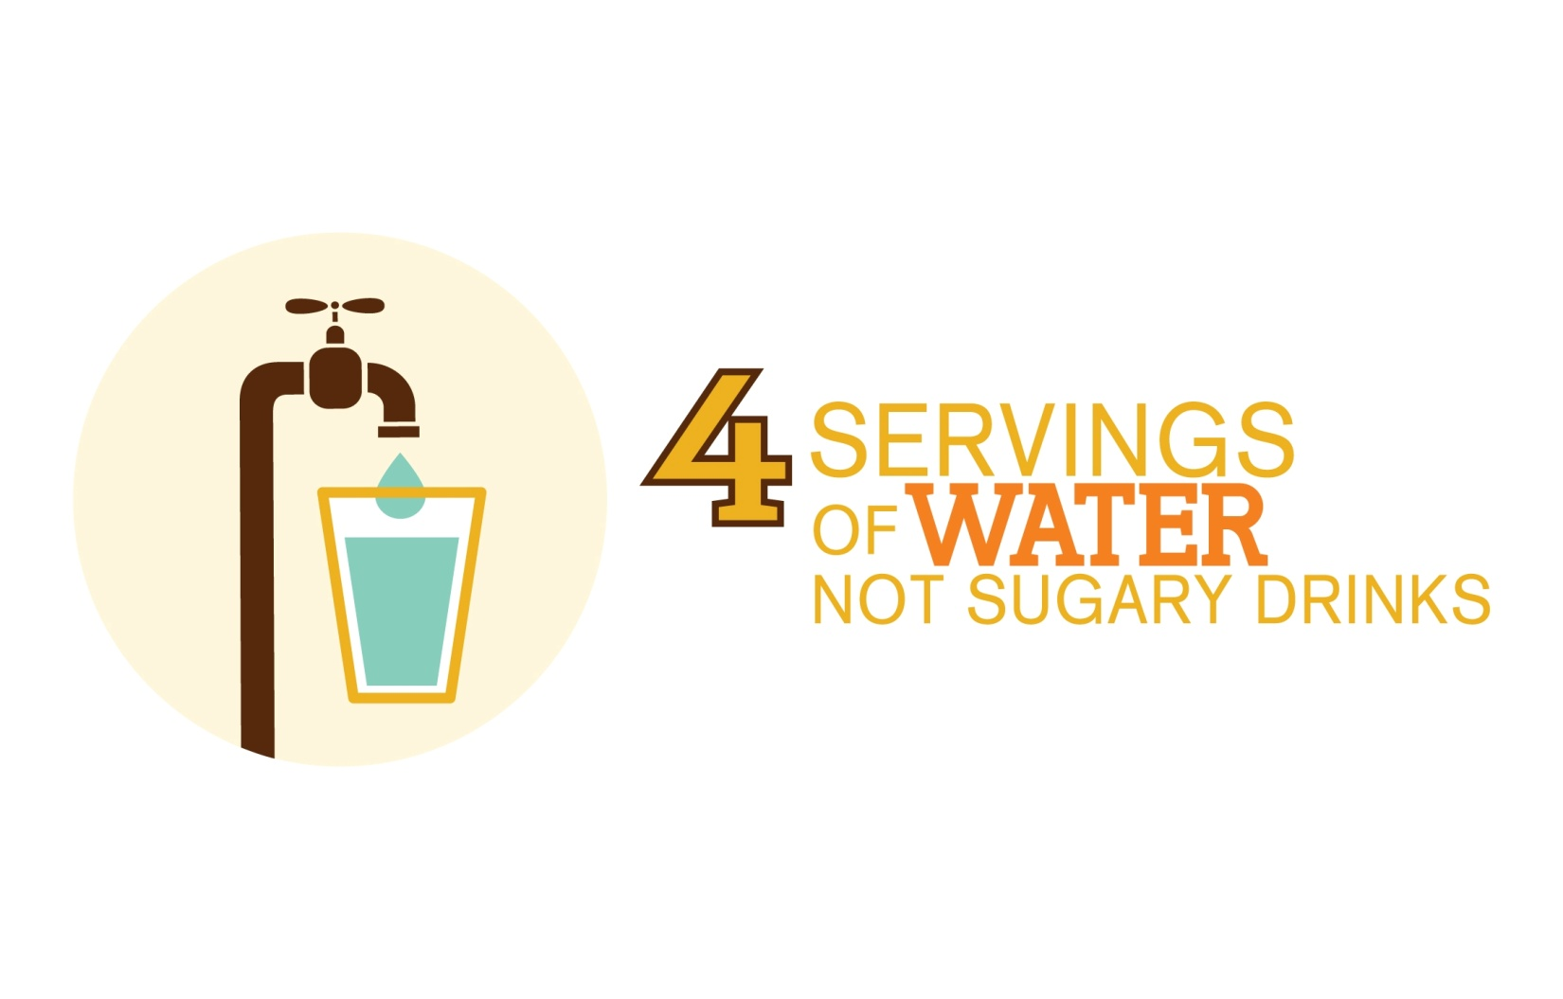

Slide 43

What’s a Parent to Do?
Drink more water, not sugary drinks
Serve water between meals instead of sugary drinks
Drink a cup when you brush your teeth in the morning
Keep a pitcher in the fridge
Add slice of orange or lemon
Benefits: Keeps your body running well. Quench your children’s thirst with water, not sugary drinks to avoid weight gain and risk for dental decay.
Notes:
Drink more water and less soda. You can’t expect your kids to cut back on soda if you won’t.
Sugary Drinks
How many gallons of soda the average person drinks per year (answer: 55 gallons a year). Convert to calories and pounds. This is an opportunity to tie into math skills. 55 gallons = 7040 fl oz (128 fl oz in 1 gallon). There are about 12.5 calories per ounce of soda so there are about 88,000 calories in 55 gallons of soda. It takes about 3500 calories to gain one pound. So, if you are consuming an extra 88,000 calories per year, this would result in a 25 pound weight gain.
Review there is no real need for sugary drinks. We choose to drink them because they taste good. Review negative effects of sugary drinks:
Excessive calorie intake leading to weight gain.
Cavities.
Replace other nutritious drinks that contain vitamins and minerals our bodies need like milk and water.
Discuss barriers to reducing intake of sugared drinks.
Calorie contribution from sugared drinks:
Take different size beverage containers of the same drink (i.e. different sizes of Coke – 8oz can, 12oz can, 16.9oz bottle, and/or 20oz bottle; different size drink pouches small vs big Capri Sun; etc.).
Review the label and serving size listed on the label. Have students figure out how many servings are in each container and how much sugar they would be getting in the different size containers.

Slide 44
What’s A Parent To Do?
Ways to get involved at HOME:
Add healthy foods when you can
Help them learn
Keep healthy snacks on hand
Make healthy foods and meals enjoyable
Talk to your child about their food and physical activity at school
Notes:
Get them excited about healthy food: Let them smell, touch, taste, ask questions and try fruits, veggies, yogurts and other healthy foods in the kitchen. Ask them what they think of the foods and let them know their opinions count.
Get them involved in the kitchen: Let them help you with small, kid-safe jobs in the kitchen such as mixing ingredients. Be sure to thank them for their help.
Give them a say in what they eat: Help your kids make the right food and drink choices from an early age. If they have a say in decisions, they will be more excited about what they eat. It's a great way to get them to take charge of their health.
Take them grocery shopping with you: Get your kids involved in shopping decisions. It may take a little more time in the supermarket, but it is likely to lead to less tantrums at meals.
Keep the junk food out of the house: Your kids can't eat unhealthy snacks if you don't buy them. Kids will moan at first, but soon they will get hungry and reach for the apple instead of the chips.
Add healthy food when you can: Find ways to add healthy foods into foods your child already likes. You can put blueberries in pancakes, chopped fruit on cereal or small pieces of broccoli in macaroni and cheese.
Help them learn: Encourage your kids to draw or doodle pictures of healthy foods or write a poem. Post it on the fridge and make sure they know you are proud.
Sit down together: Try to set aside your meals as family time. Turn off the TV and enjoy eating together. Great time to role model
Keep healthy snacks on hand: Bring healthy snacks when you pick them up from school, after sports practice and at other times when you know their stomachs will be grumbling.
Make healthy food and meals fun: Try cutting up food into fun shapes or making faces out of fruit and vegetables. Putting healthy snacks such as oatmeal cookies or dried fruit into a fun bag can turn healthy foods into a cool snack for your child.

Slide 45

What’s a Parent to Do?
Talking healthy with your kids-concern about weight?
Don’t focus on weight
Talk to your doctor
Make it relevant
“Diet” is a four letter word
Food is not a reward
Make it a family affair
Make it relevant
Notes:
It’s not about weight: Weight is just one indicator of health and often an extremely sensitive subject for kids. Emphasize how important it is to eat right and be physically active instead of just losing pounds. You don’t want to hurt their confidence or self-image.
Talk to your doctor: Your doctor is a great resource when talking with your child about their weight. You can work with the doctor, a nurse or dietitian to help start the conversation. Most healthcare practitioners will be happy to help if you ask. Tips for talking to your Child’s Doctor or Nurse
Make it a family affair: Talk about how everyone in the family is going to work together to get healthier. Children should not be the only ones making changes.
Make it relevant: Explain why being healthy is important in a way that kids will understand. Kids don’t care that being healthy now will prevent their risk of disease in the future—kids care about the here and now.
Treat "diet" like a four letter word: Adults don’t stick to diets, so why would kids? Teaching your children to eat and drink in moderation (including an occasional treat) will ensure they get the balanced meals they need.
Food is not a reward: Saying you can have ice cream after you finish your carrots makes eating carrots a chore and ice cream the reward—the exact opposite effect you were going for.

Slide 46
What’s a Parent to Do?
Ways to get involved at school:
PTA
School Website
Talk to other families
Talk to your teacher
Talk to the principal, food service director, +
Support school wellness policies

Slide 47
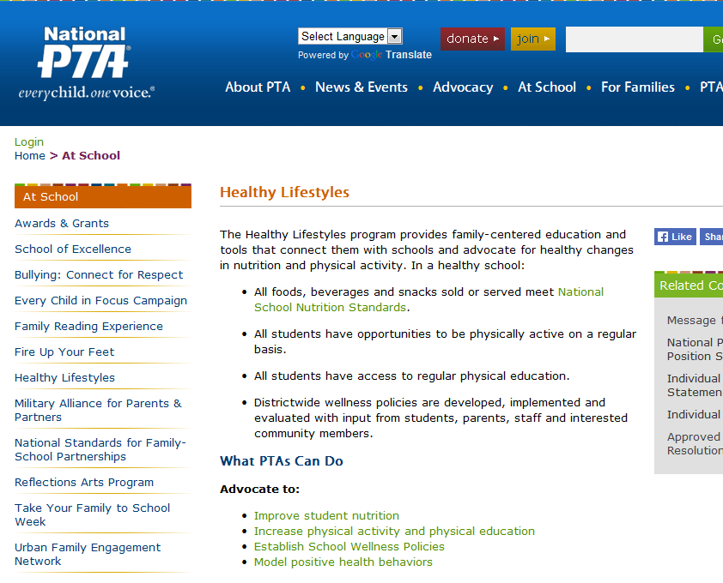
What’s a PTA to do?
http://www.pta.org/programs/content.cfm?ItemNumber=4280
Notes:
http://www.pta.org/programs/content.cfm?ItemNumber=4280

Slide 48
School Wellness Policies
School Wellness Policies are an important tool for parents and school districts in promoting student wellness, preventing and reducing childhood obesity, and assuring that school meals meet federal requirements.
Notes:
Requirements
Healthy Hunger Free Kids Act
How many are familiar with your school’s wellness policies? How many of you have participated in advisory boards?

Slide 49
Impact of school wellness policies
Controlling classroom parties makes a big difference in total calorie intake!
HP Goal
  ⬇149 kcal/day
  for 6-11 year olds
  ⬇177 kcal/day
  for 12-19 year olds
1st graders ate 550+ more calories from foods brought by parents for one party
Notes:
2020 Goal: reduce childhood obesity 10% lower than the 2005-2008 goal.
Reduce daily calories to reach the goal:
⬇149 kcal/day in 6-11 year olds’ diet
⬇177 kcal/day in 12-19 year olds’ diets
60 minutes of physical activity/day—make them breath hard, break a sweat

Slide 50
Physically Active for 60+ Minutes per Day on 5+ Days of the Past 7 Days, Missouri 2005-2013
Prevalence (%)
*
Moderate physical activity for 60+ minutes on 5 or more days of past 7 days
YRBS, DHSS

Slide 51
Change School Practices
POLICY: staff incorporate regular physical activity breaks for students during classroom time (in addition to PE)
Does your school have this policy or practice?

Slide 52
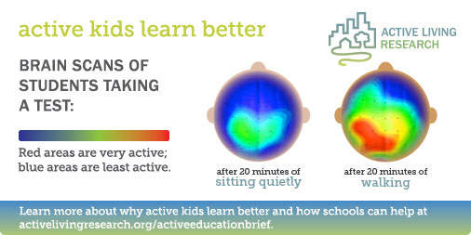

Slide 53
It’s a partnership
State
School
Community
Parents & Families
Students
PTA

Slide 54
Next Steps
Talk to your school wellness coordinator or school nurse about needs.
Build on what is going well.
What is one area that you as a PTA might choose to work on with school health and wellness advisory committee?
Advocate for increased supports for DESE & local school districts to meet best practices and provide health, nutrition and physical education.

Slide 55
Thank You

