Slide 1

ADVOCACY BOOT CAMP:
Empowering Insights and Tips
for Effective Activism
Missouri PTA Spring Into Action Conference
April 18, 2015

Slide 2

Founders:
Jonathan Freiden
U.S. Toy/Constructive Play Things
Tyler Nottberg
U.S. Engineering Company
David Oliver
Berkowitz Oliver Williams Shaw & Eisenbrandt LLP
Supporters:

Slide 3
Budget
Foundation Formula
Early Childhood Special Ed
Missouri Preschool Project
First Steps
Parents as Teachers
Child Care Assistance

Slide 4
How Do We Make Children A Priority?
Other Priorities
Children/Youth

Slide 5

VOTE
Register to vote:
http://www.sos.mo.gov/

Slide 6
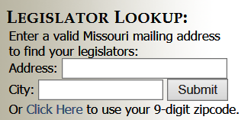
Build Relationships
Find your Legislators:
http://www.senate.mo.gov/

Slide 7
UNIFY
Testify at hearings
In-District Meetings
Invite Legislators to See Programs
Capitol Lobby Visits
Organize a public rally or an event with a key speaker
Develop region-specific fact sheets
Earned media
Phone calls/Letters/Emails

Slide 8



RAISE YOUR HAND FOR KIDS

Slide 9
Formula for
Kindergarten
Readiness
School Readiness
Health Screenings:
Hearing
Vision
Dental
Behavioral
Quality Pre-K
Home
Visitation & Parent Education

Slide 10
Benefits of Investing in Early Childhood Development
STRENGTHENS
Our
current
workforce
BUILDS
Our
future
workforce
CREATES
New
Missouri
jobs

Slide 11

How Do We Fund It?
Tobacco Tax Increase
Why Tobacco Tax?
Keeps Kids from Starting Smoking
Sin Tax
MO Has Lowest in Nation
Politically Feasible

Slide 12
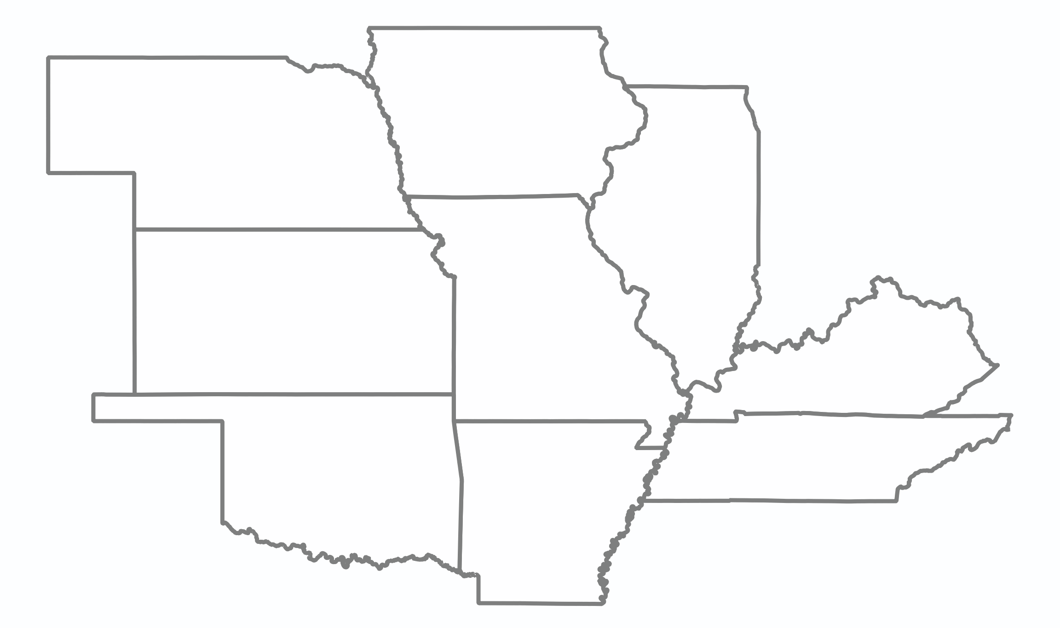
Tobacco Tax in Surrounding States
IA
$1.36
NE
$0.64
IL
$1.98
KS
$0.79
MO
$0.17
KY
$0.60
OK
$1.03
TN
$0.62
AR
$1.15

Slide 13
Benefits of Raising the Tobacco Tax
MO = 9th highest smoking rate
1 in 6 pregnant women in MO smokes
Smoking costs MO Medicaid $644.3 million/year
Smoking has declined in every state
where the tobacco tax has increased

Slide 14
Double Dividend for Missouri Taxpayers
DISCOURAGE KIDS FROM SMOKING
+
REDUCE RELIANCE ON
FUTURE STATE PROGRAMS
Reduced

Slide 15
Our Process
Blueprint & Poll
Community Conversations & Stakeholder Meetings
Develop Policy & Identify Resources
Collect Signatures & Campaign
Notes:
I think I want to redo this slide to make it more readable.

Slide 16
Past Tobacco Tax Increase Attempts
2002 | 2006 | 2012
Prop A | Amendment 3 | Prop B
55 cents | 80 cents | 73 cents
hospital services smoking cessation life science research senior prescription drug assistance early childhood education | Medicaid tobacco prevention & reduction | K-12 higher education smoking cessation
Failed 49.15% to 50.85% | Failed 48.57% to 51.43% | Failed 49.25% to 50.75%
Notes:
Will redo this slide to make it more readable

Slide 17
2012 Prop B Votes by County

Slide 18
What’s Different in 2016?
Statewide Effort
Interest of State Political Leaders
2 Years Grassroots Outreach and Organizing
Early Meetings with Opposition
Bipartisan Support for Early Childhood
Open Seat Presidential Election, High Turnout
Local Input & Local Control

Slide 19
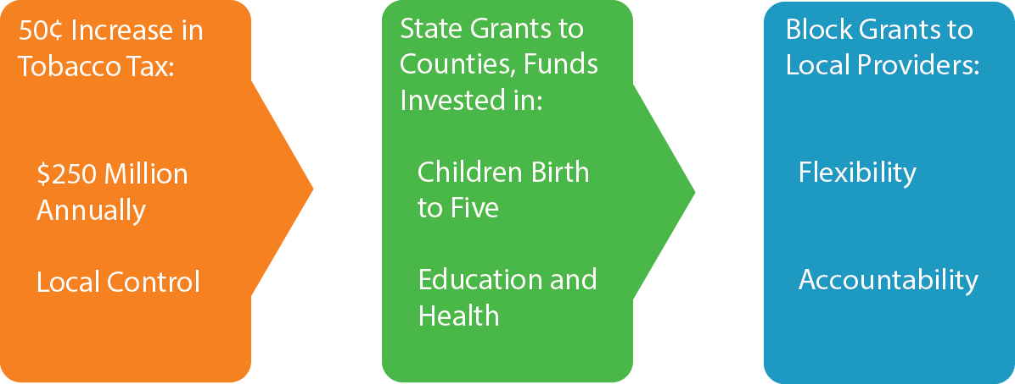
Policy
Starting
Point

Slide 20
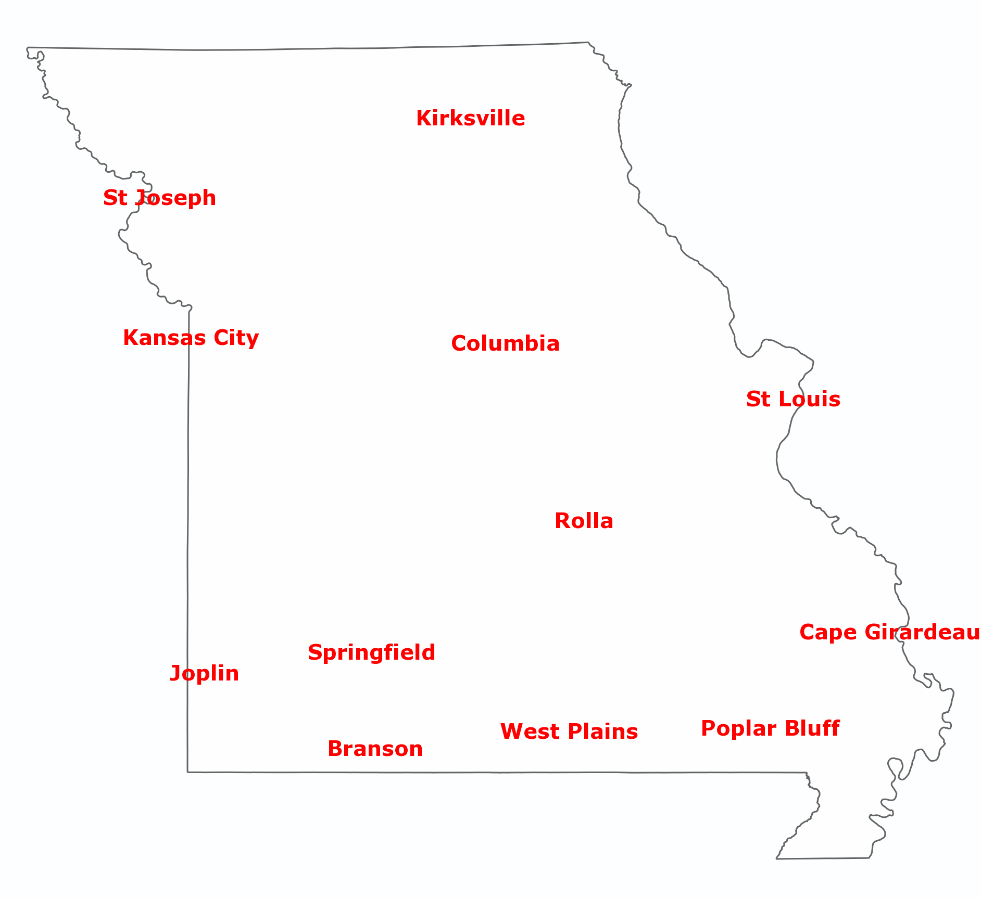

Community Conversations
Visit
RaiseYourHandforKids.org
for reports and updates

Slide 21

Erin Brower
erin.m.brower@gmail.com
(913) 568-4520

