Slide 1
Trouble on Board:
When Conflict arises……
Kathy Nevans
PTA National Board Member
April, 2015

Slide 2
Today
Explore causes and preventative measures
Learn to identify and nullify bad behaviors
When all else fails, learn how remove the problem individual.
Notes:
Much of the information included in this workshop was gathered from the Board Source Book, “Taming the Troublesome Board Member.”

Slide 3
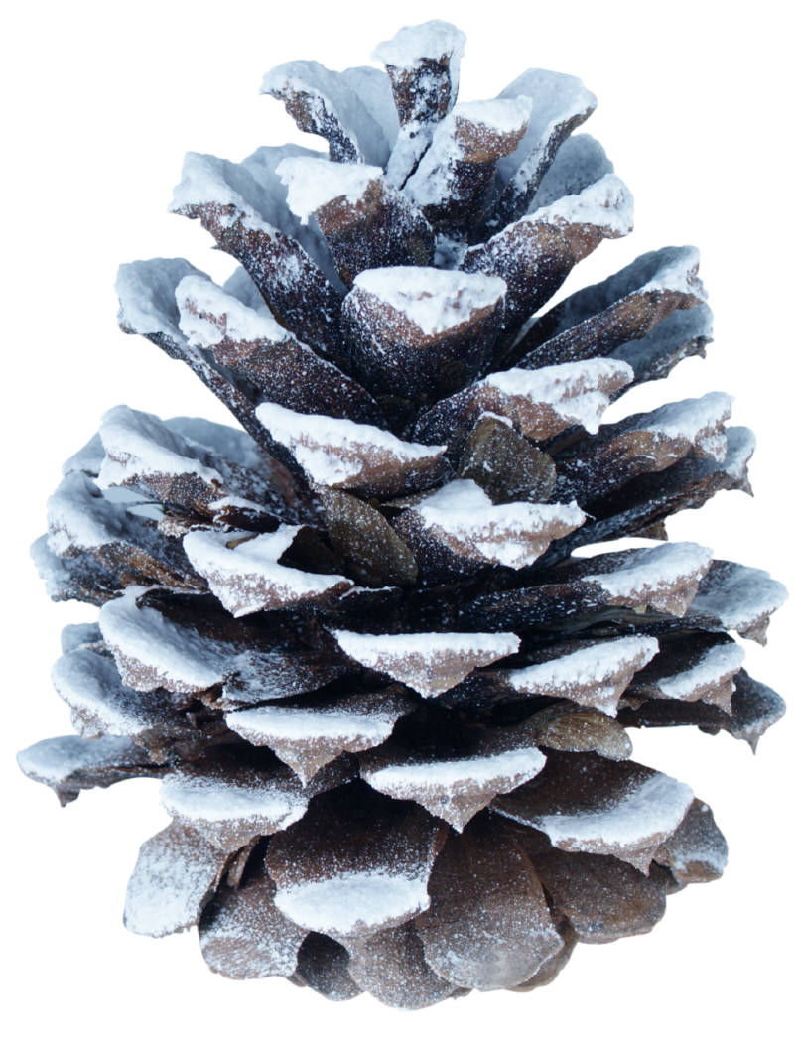
Root Causes: from tiny seeds
Pre-existing Condition:
previous experience, assumption, perception
Home Made:
Lack of training or orientation
No clearly defined job description
Unclear or missing expectations
Recruited for the wrong reason
Notes:
What are the root causes of trouble? How can you begin early intervention? How can you avoid big problems in the future?
Some board members “act out” because of previous experience---they’ve been on a dysfunctional board and have never seen a good one and never received a training.
Many times, troublesome board members—the folks who just don’t do what they are supposed to do or make life miserable for the chair and the rest of the board members—are home grown. Home grown: made at home. Your PTA didn’t provide orientation on ongoing development; your PTA has no job descriptions (so, instead, it has job “assumptions” that are different depending on who you talk to); your PTA expects things from board members but the board members have never been informed of the expectations; or you recruited for the wrong reason and are now stuck with someone who is less than the best possible choice for the position (a friend, “breathing”, went to the bathroom, only person willing to do it).
In any case, the reason that board member is less than perfect is because your PTA allowed them to flounder

Slide 4
Grow big problems...
Ineffective board members
Bad behavior
No accountability
No board awareness of legal responsibilities
Notes:
Just like a tiny pine cone is the start of a redwood, a small problem can grown into a huge problem. Poor or lacking training, for example, can wind up causing bad behavior, board disruption, and board dysfunction. The entire PTA can be impacted by one “bad seed.” PTAs can be destroyed.

Slide 5
Notes:
What started as a bunch of pine cones….resulted in a forest. What starts as a few problems or lack of training or poor recruiting winds up as a forest of problems.

Slide 6
“An ounce of prevention is worth a pound of cure.”
Henry de Bracton, 1240
Notes:
Take action early. Prevention is the key. How do you prevent problems from occurring?

Slide 7
Prevention: Don’t Rush
Don’t fill seats just because….
Evaluate the needs of your PTA
Assess past behavior of individuals
Choose someone to complement board and bring necessary skills
TIP: Board “application” and “interview questions”
TIP: Board needs assessment
Notes:
Recruit for the right reason. Use the President’s QRG (nomination and election, board assessment checklist, application) for help. What does your board need: skills, personality, talents, experience? Seek out the “right” people to fill vacancies. Don’t offer a job to someone automatically—have everyone re-apply when terms are done and use an assessment to find out if the person was happy and effective—and ask yourself if this person was the best person for the job.

Slide 8
Prevention: Education
Orientation
Job descriptions
Roles and responsibilities
Legal responsibilities
Leadership skills development
TIP: Board Contract
TIP: Outgoing person reviews and revises job description
Notes:
Prevention also includes education. Do your board members know their fiduciary responsibilities? (Use President’s QRG, boardsmanship e-learning course). Do you have job descriptions—if not, have an outgoing chair write one up and make sure incoming chair creates a plan of work. Does your board have a copy of the bylaws? Standing rules? Does your PTA follow those rules or go over them with your new and recurring board members? Do you offer the opportunity for board development—either through your state association or national convention or e-learning courses? Training only the local unit president means one person has the info and the rest don’t—a recipe for disaster. Consider asking your board to take one e-learning course between each meeting. E-learning takes about 40 minutes. At the next meeting, take the first 15=30 minutes to debrief, asking each member what they learned or how your PTA can use the info.

Slide 9
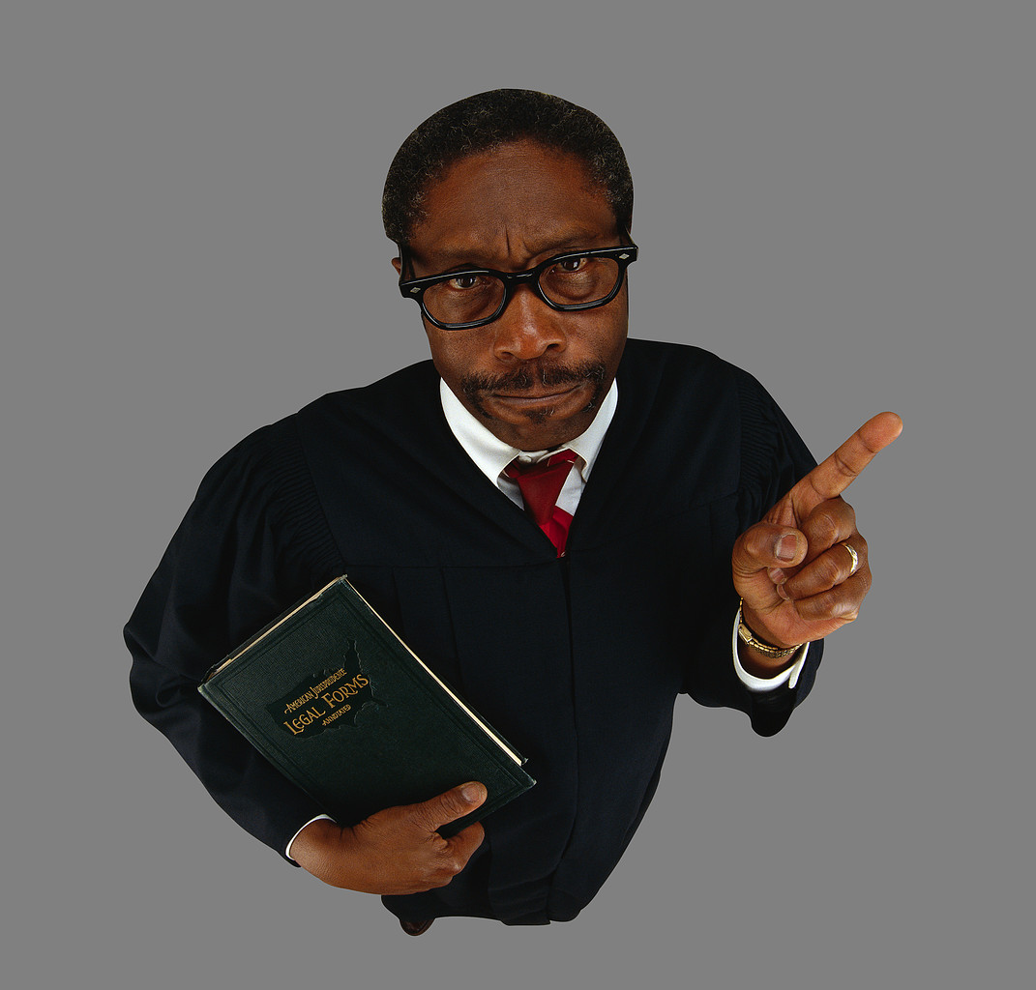
Education: Basic Board Responsibilities
Care
Prudent person
Obedience
bylaws, mission, laws
Loyalty
PTA first
Notes:
And be sure your board understands their basic board responsibilities (in Pres. QRG):
Care—do no harm. Show up, read, prepare, participate. Legal standard: What would a prudent person do in this situation?
Obedience—know and follow the bylaws and standing rules; work to achieve the mission; know and follow state, local and federal policies and regulations.

Slide 10
Prevention: Terms & Removal
Review and Revise Terms:
1-year provisionary term for new board members
2-3 year terms—does this work?
Term limits
Timing off or maximum years of service
Process for removal
Make bylaws work for you and enforce equitably
Allow defense, but do not drag out
Notes:
Another method of prevention is….don’t keep folks around who don’t do what they are supposed to do.
Examine your bylaws’ term limits. Too long? Too short? Do people stay for ever or do they “time off” the board after serving a maximum number of years? Consider bringing a person on in a “provisionary” mode of “acting board member” for 1 year—see if they like your PTA and if they fit in. And make sure your bylaws have a method of removal should a board member create havoc and cause your PTA harm. Roberts Rules has a method, but it is long and drawn-out. More about this later

Slide 11
Prevention: Assessment
Don’t make renewals automatic
Is your board member satisfied?
Is your entire board satisfied with the individual?
TIP: Board and Board Member Self-Evaluation
TIP: Peer-to-Peer Evaluation
Notes:
Prevention also includes assessing. Each year (or term), have your board members assess their own productivity using a board assessment (Pres QRG). How did they score? Ask each member if they are the right person for the job? Did they have what they needed to get the job done? Ask if they feel other board members lived up to their responsibilities? Make assessment and improvement part of your PTA culture and you will avoid those big “redwood” type of problems.

Slide 12
Prevention: Don’t Let Things Go
Address the Issues:
Don’t let things go bad
Accountability
Enforce rules for all
Develop a culture of respect and cooperation
Notes:
Finally, it comes down to this: If you want a good board, you have to work to get it. You cannot be complacent. You need to take action, hold people accountable, not play favorites, and create a culture of excellence

Slide 13
“If you will call your troubles experiences, and remember that every experience develops some latent force within you, you will grow vigorous and happy, however adverse your circumstances may seem to be.”
John R. Miller
Notes:
What “experiences” have you had to help yourself grow? How can you grow through some not-so-great experiences?
Let’s think of all those “problems” and challenges as a way to grow a better PTA so that all children and families will benefit.

Slide 14
“Are you experienced?”
Notes:
Because every one of us has “experienced” a bad board.

Slide 15
“Wait! Wait! I have another question!”
“Sit down, shut up, and get out of my way!”
“I’m not sure we’ve fully explored every single detail and possibility.”
“Rules are meant to be broken.”
“But we’ve never done it that way before!”
“Huh? Was I supposed to do something?”
Notes:
I talked to you about prevention. Prevention—like early intervention in the school setting—is the best method of avoid the redwood-type problems. But, some of you already have those great big tree-like problems in your PTA. How you deal with them is important for setting up the culture you need to become an well-functioning PTA.
We will talk about the six most common type of problem board members and how to deal with them:
The constant questioner—the person who can’t let anything go; the board bully; the micromanager; the rule breaker/outlaw; the obstacles to change; and the no-show.

Slide 16
Wait! Wait! The Questioner
Asks questions until everyone else moans in frustration.
Wants to prove she has done her homework (and others have not).
Sometimes a hidden agenda.
Takes curiosity to new limits.
Drives change—out of chaos arises a phoenix.
Notes:
Let’s start with the constant questioner. This person can never have enough info. While it is part of your duty of care to ask questions and gather info, this person takes it to an entirely different level. Sometimes he/she asks because he/she wants to show off the fact that he/she did their homework and others didn’t. Sometimes there is a hidden agenda. Sometimes it is benign—you have on your hands a thinker, a careful and deliberate person who desires knowledge and is averse to risk—so don’t think all questions are bad, but be sure you are giving this person what they need in advance of the meeting so they are comfortable in decision-making. Sometimes, however, this person simply enjoys driving everyone a little nuts—they believe that questioning everything will drive change and sometimes it gets out of hand.

Slide 17
Question Abatement
Is this a change agent?....a good thing?
Chair speaks to individual before meeting.
Enough background info provided?
Ask where the questions come from.
Focus on the really good questions.
Assign role of “devil’s advocate”
Notes:
To help stop or avoid the constant questioner:
First, ask yourself if this is benign? Is this person a change agent? Is this person asking the types of questions everyone should be asking?
If not benign, the chair may have to speak to the person prior to the meeting to ask for cooperation or to ensure the questioner has the info they need. The chair may ask the board if they have enough info (Do you prepare your board for meetings—do they get info in advance like committee reports and background for action items?). Since board members are supposed to prepare, be sure they questions an thinking are happening outside the meeting and that you have given them what they need before they arrive.
You may ask the person, outside the meeting, what is going on? Are the questions from the board member or is he/she asking on behalf of someone else. As you go through the meeting, focus on the really good questions and give some positive feedback for asking. And, channel the energy—assign that person to quietly listen to the discussion then to ask the ONE or TWO questions the group did not yet bring up—giving the questioner the role of “devil’s advocate” but limiting their questions to only a few.

Slide 18
Get Out of My Way: The Bully
Personal agenda
Does not develop relationships
Language inflames and provokes
Intimidates
Knows everything; has all the answers
Appears to have huge ego; poor self-esteem
Does not expect or deal well with challenge
Notes:
Bullies can be verbally aggressive, passive/aggressive, or controlling. We’ve all met one.
Often a bully has a personal agenda and rarely does a bully have good personal relationships on your board. They use language as a weapon, and intimidate others into silence or cooperation. They appear to know it all (at least in their minds) and have huge egos. However, bullies are often deeply senstitive beneath their tough exteriors and prone to hurt feelings while easily insulted. Bullies do not expect to be challenged.

Slide 19
Bully Balm
Meeting rules, codes of conduct, boundaries
Mission becomes focus
Challenge directly with calm voice
Break into small work groups
Index card approach– ideas, not people
“Are there other perspectives?”
Find area where she is expert and let her be
Board chair 1-on-1.
Notes:
How to deal with a bully?
Set ground rules with your entire board: everyone talks to chair-not to each other, everyone has chance to speak once before some speaks second time, time limit on speaking, timed agenda, etc.
Focus on mission—remind people about the mission at the beginning and during meetings
If a bully acts up, talk directly to that person in a CALM voice and ask them to lower his/her voice, speak to the chair/not to person, use less inflammatory language or more respectful language
Sometimes small groups work—people are comfortable expressing opinion and groups report out—the bully cannot control allthe conversation
Use an index card—pass out and ask for ideas
Chair asks for different perspectives, “what are we missing?” “What did we not say?” “If I wanted to shoot down this idea, what would I be asking?”
For a bully, sometimes making them a committee of one or giving them a job to do that they are good at is enough to satisfy them
And, the board chair may have to have a personal conversation before or after a meeting to try to turn the behavior around.

Slide 20
Let’s explore every single detail Micromanager
High maintenance. Tires everyone out.
Focuses on process and operation; forgets about results and outcomes.
Always wants more info.
Fails to understand board role.
Sometimes sees self as PTA monitor or guard
Sometimes lacks trust in PTA or its leaders
Notes:
Micromanagers are different than constant questioners. These are the folks who don’t understand the concept of “committee” work and want to have control over every minute detail of every decision. They focus on the process, not the outcomes. They always want more info==because they want to get into the weeds and help make the small decisions. They fail to understand the board’s role is oversight. Sometimes they feel the board needs a monitor or guard and have self-assigned, and sometime they lack trust

Slide 21
Micro to Macro
Train on board roles and responsibilities; committee vs. board
Ensure agendas are outcome and strategy focused; don’t go there
Give overviews, stay away from minutiae
Board chair 1-on-1
Are checks and balances already in place?
Watchdog vs. partner relationships on board
Notes:
How to stop micromanaging?
Make sure boards know their oversight responsibilities and the roles of committees versus board (Pres QRG)
Ensure that agendas are outcome oriented—you are not at board meeting to discuss minutiae but to deliver results
Have chairs report only overviews—stay away from brining all the tiny details into the discussion
Board chair may have to talk to this person outside of the meeting and remind them of role or note the disruption
Make sure there is oversight---are committees giving written reports? Are you only talking about real action items or large strategies? Is the agenda well-put-together and timed?
Note to all your board that board members are partners in leadership, a team.

Slide 22
Rules are meant to be broken… Rule Breaker
Misses board meetings
Unprepared, wants you to repeat info
Arrives late, expects to be filled in
Won’t keep to agenda, topic
Disrespectful of collaborative process
Doesn’t understand role of board member
Notes:
We’ve all met him or her. They miss meetings, ignore the bylaws, don’t care about committee charges, arrive at meetings late and expect to be caught up, disrupt, and make life awful for the board chair.

Slide 23
Enforcing the Law
Board member/committee job description
Duty of Care—training
Board contract
Code of Conduct
Do not enable latecomers
Call missing board members after the meeting
Ask to step down or remove
Notes:
How do you nip this in the bud? It’s gong to sound familiar…..
Make sure people know the rules—bylaws, standing rules, meeting rules (are there meeting ground rules?), job description, board expectations.
Make sure all board members know their Duty of Care—they need to be there, on time and prepared or they should not be holding the job of board member
Try creating a Code of Conduct (Google search brings up good examples) and get everyone to agree to it.
Do not cater to late-comer. Keep going. “We’ve already discussed that, I’ll fill you in at the end of the meeting.” Or, “Glad you could make it, here is where we are in the agenda, someone will let you know what happened in your absence at the close of the meeting.” If a board member doesn’t show, the chair should call. “Where were you? We missed you? Did you get the notice? You do know that attendance is part of your responsibility? Please be sure to put the next date on your agenda.”
If people do not show, do not deliver, do not fulfill their role, the board chair may need to ask that person to step down or the board may need to take action to remove.

Slide 24
We’ve never done it that way! Change Resisters
Highly critical of new ideas
Negative attitude; nothing new satisfies
Obstacle to creativity, growth, change
Drives off new board members
Been around for years and years
Notes:
Change is scary. For some, change is downright terrifying. But change is also essential…
Change resisters never heard a new idea they liked; find every obstacle in the book to avoid change, stifle creativity and new ideas—actually stamp them out and drive off creative thinkers. Many times, change resisters have been around for years because they are comfortable with the “known” and have established themselves as keeper of the known. And they do NOT belong on boards.

Slide 25
Moving Mountains
Create and enforce term limits
Focus on priorities; outcomes
Reinforce inevitability of change
Educate—implications of status quo
Explore pros and cons; assess outcomes
Discuss relevancy
Small group brainstorming
Ask to step down for good of group/individual
Notes:
How to allow change to occur in the face of change resisters?
Term limits and timing off boards.
Chair and board focusing on priorities and outcomes—what is working, what is not, is attendance growing, are we meeting the needs of the membership, are we polling and using assessments, etc.
Chairs should reinforce the need to change to adapt to new school populations and new technologies.
Chairs should ensure the board understands its role of assessing and evaluating, ,knowing that change is essential and not changing is deadly
Good technique: explore pros and cons of current idea and new idea—seek them out from group (stops hearing only the negative) and assess potential outcomes of each idea.
Small groups help. Change resister can only stop discussion in one group—others are free to bring out ideas
Chair may have to ask this person to step down…”this doesn’t seem like the right fit anymore” or”the rest of us really want to try some new things and they seem to make you uncomfortable….maybe there is a better place for you to continue doing the work you do for children.”

Slide 26
Was I supposed to do something? The No-Show
Doesn’t follow through on assignments
Doesn’t hand in reports
Doesn’t understand role and job
Unreliable
Does bare minimum or nothing at all
Notes:
Finally, the no=show. They don’t do their jobs, don’t hand in reports, don’t show up for their assignments. Why are they there? Why did you ask this person to be on your board?

Slide 27
Making Something out of Nothing
Ensure expectations are clear
Job descriptions
Board discussion on roles/responsibilities
Are demands manageable? What can go?
“I’m calling to check why you haven’t…..are you OK?”
Leave of absence.
Notes:
Again…sounding familiar:
Ensure everyone knows their jobs and fiduciary responsibilities.
Consider having a group discussion on roles/responsibilities, going around the table at the beginning of each meeting and asking board members what they have done (briefly) since the last meeting.
Make sure your expectations are reasonable. Just because one or two board members are willing to do huge amounts of work doesn’t mean everyone should be expected to do so. Be sure that the job is doable by one person before blaming someone for not doing it.
Chair may need to call and check in and gently ask the person to step up or step away.
Finally, if there is a good reason (new job, sickness, family crisis), the board may consider offering a leave of absence (more later.)

Slide 28
“When you have to make a choice but don’t make it, that is in itself a choice.”
William James
Notes:
Boards that don’t address the issues are actually addressing the issue: they allow the bad behavior to happen, they foster environments where bad behavior flourishes.

Slide 29
The Role of a Leader
Board leadership is not for wimps
Hard choices need to be made
Bad behavior must be confronted
Solutions must be found
Leaders must hold each other accountable
Leaders have the difficult conversations
Notes:
Being a board member is a commitment. It is not for wimps. Being a board chair is more than running a meeting—it is taking responsibility for the proper facilitation of the work of the association.
Leaders need to hold each other accountable and create environments of high expectations for behavior and action.
None of this is easy, but all of it is possible.

Slide 30
When all else fails……
Notes:
If you have set up the proper preventative measures (at the beginning of this presentation) and tried to deal with the situations as they arise, you and your board may need to take some other steps. They are not comfortable….and they are not the first thing you do but the last resort.

Slide 31
Maybe a soft approach….
“I sense that you feel PTA demands too much of your time and that our expectations are unrealistic for you. How can we revise the job description to better meet your needs? Do you want a co-chair?”
“I’m sensing that meetings are not your thing. Would you consider another role in PTA that takes the responsibility of meetings off the table for you?”
Notes:
The chair may need to try a soft approach to gently move someone out of the way or ensure someone knows they are not doing their job.
What other soft approaches can you think of?

Slide 32
Maybe someone needs to go
“I respect your opinion yet we must move on. If you can’t support the board’s decision, I think you should consider leaving the board.”
“It’s hard for me to manage meetings with your (interruptions, negativity). I think it is best if you step off the board now and rejoin it when someone else you prefer is president.”
Notes:
The chair may need to put it out there that this is the time to leave. Maybe this isn’t the right fit?

Slide 33
Leave of Absence
Board must approve or bylaws/standing rules must allow
“disability leave” or “starting a new job” leave
Specific time limits
If person remains on board, counts toward quorum
Suggest this leave to allow someone a gracious exit and allow board to reassign role
Notes:
The chair (and board) may want to offer an opportunity for a break (bylaws must not prevent and board must approve). Leaves of Absence must be for a specific time period with a definite end date (often, as that end date approaches, the chair calls to find out the person just isn’t ready to come back or has decided that maybe they need to step down). Note that the person on leave still counts toward the quorum—the seat is still filled.

Slide 34
Impeachment
Seek resignation first. Impeachment is a last resort.
Keep dignity intact. This is some child’s parent. Limit the negative chatter.
Discuss the issue, not the person.
Bylaws should describe process—use fairly
Robert’s Rules contain process, if necessary
Process in place before problem has a name
Notes:
OK-Say this with me: “THIS IS A LAST RESORT”
Roberts defines the way to remove someone. It must be for just cause, not just because you don’t like someone. Your bylaws define the rules. Typically, the group that elects can remove; so, if the board appointed, the board can easily remove. Removal of an officer elected by members is hard and should be hard. The board should not be able to overrule the membership except in really bad situations. But—always remember—this is a person, someone’s mother or father. Do not make the person your enemy and do not demonize that person in your community. Limit discussion to the issues, not the person. It is best for PTAs to have this process in place before they need it—so that it is not created for one person.

Slide 35
Today
Explore causes and preventative measures
Learn to identify and nullify bad behaviors
When all else fails, learn how remove the problem individual.
Prevention is the key.
Take action—do not allow bad behavior
Ensure an exit is always available
Notes:
Go over what you said you would do….then go over the key take-aways

Slide 36
For more information contact:
Kathy Nevans
kjnevans@aol.com
816-589-4483

