Slide 1
A Digital Gateway
Michele Reed
Vice President and Director of Communications
Missouri PTA

Slide 2
Digital Options
USB FlashDrives
CD / DVD

Slide 3
Digital Options Pros and Cons
Pro: Beats paper
Pro: Can hold large numbers of documents and photos
Con: Have to carry the USB Drive with you.
Con: Have to burn and carry multiple CD’s
Con: Not accessible from phone’s or tablets.

Slide 4
Cloud Options
Google Docs
OneDrive
DropBox
Office 365
Which one do I choose?

Slide 5
Google Docs Pros
No compatibility issues
No software to purchase
Works across multiple platforms and multiple devices(mac and pc).
Can upload office documents and they can be edited without having office on the computer.
Can share folders with certain members.
Can set up a Google Site from within Docs.
Has an app for mobile devices

Slide 6
Google Docs Cons
Con: Everyone needs a Google email
Con: Not everyone likes them.
Con: There is a learning curve.

Slide 7
Google Docs Example

Slide 8
OneDrive Pros
Can edit online in Office
Has lots of storage space for groups
Easy to use
Does not require a specific email account.
Has an app for mobile devices
Each user gets 14GB of personal space

Slide 9
OneDrive Cons
Difficult to get set up.
Storage space can fill up quickly.
App does not allow for access to group.
Can be difficult for users to access.
Must have a Microsoft live account.

Slide 10
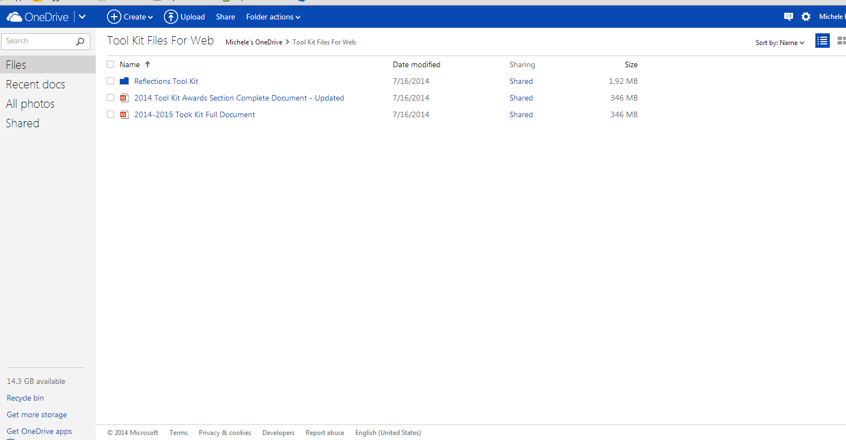
OneDrive Example

Slide 11
DropBox Pros
Can store photos.
Can store documents.
Starts out with 2GB of space – can add more, by inviting friends and completing the tutorial.
Supports multiple devices.
Doesn’t require a specific account.

Slide 12
Dropbox Cons
Must install the app on each device.
Small storage space to start with.
Each user must have the software to open the documents.
Not as user friendly as some of the others.

Slide 13
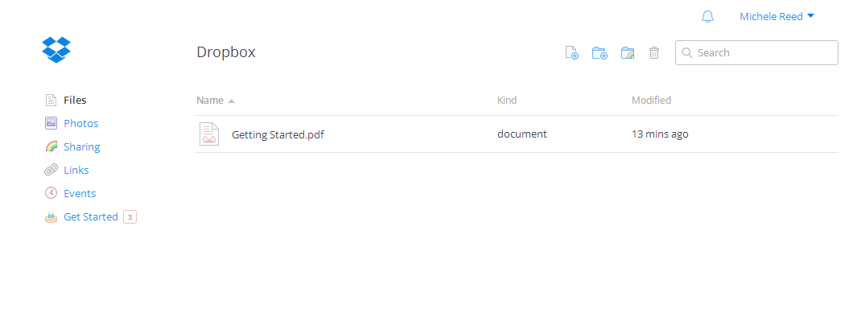
DropBox Example

Slide 14
Office 365 Pros
Free for nonprofit organizations.
Easy to use.
Does not require software to edit documents.
Can have multiple websites in one place.
Can have blogs and conference calls through it.
Can link other websites to it.

Slide 15
Office 365 Cons
Takes time to set it up.
Each component is set up differently
Not easy to set it up.

Slide 16
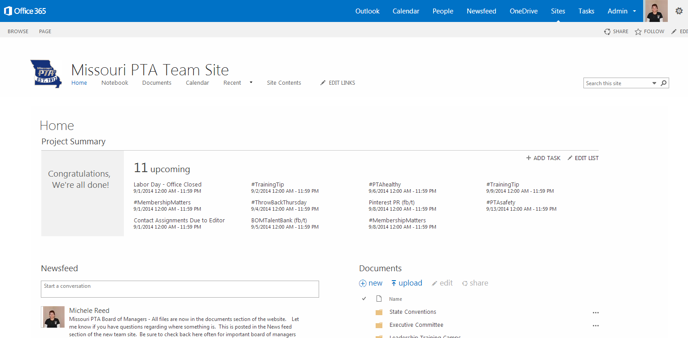
Office 365 Example

Slide 17
Which one do I choose?
Determine what is the best fit for you and your board and membership.
If you want to have links to other web sites, one might work better than others.
Determine how much storage space you might need.
Look at costs – each option has a cost for more storage space.

