Slide 1
Treasurer II
Gateway to… a more advanced look at treasurer
Lori Prussman
lorip@mopta.org
816-262-2664

Slide 2
Insurance
Nonprofit Institutional Fidelity bonding
Defined by amount of funds handled
Requires internal controls
Limitations
Consider general liability and other

Slide 3
State Tax Exempt letter
Issued from MO Department of Revenue
Each PTA must apply for their own
MOPTA can help with
EIN / Letter of determination
Unit in Good Standing status
Group exemption number
Renew / New

Slide 4
Filing for a new tax exempt number

Slide 9
Filing a renewal form

Slide 12
Change request

Slide 14
IRS Basics
All PTAs MUST file annually with IRS
File by the 15th day of 5th month after fiscal year end
DO NOT FILE LATE. File for an extension if needed. Form 8868
For fiscal year 2013-2014; tax year is 2013
All local PTAs part of MOPTA & NPTA. Will be listed as “PTA – Missouri Congress-- (local unit name) “.

Slide 15
990-N Postcard
Gross Receipts -$50,000 or less.
http://epostcard.form990.org – Free online file
15 minutes or less needed to file

Slide 16
Information Needed
EIN Number
PTA Legal Name (will begin with Missouri Congress of Parents and Teachers - Check Local Information Sheet)
PTA Mailing address
President name & home address
Fiscal Year

Slide 17
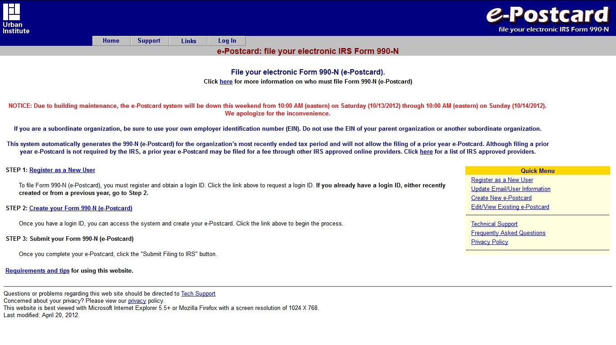

Slide 18
990-N New User
Register with EIN Number & create Password
Open email with activation link & click or paste link to Login page (make sure to write down assigned Login ID & Password; keep with fiscal year tax file)

Slide 19
990-N Returning User
Sign in with previous year’s Login ID & Password
If treasurer change from previous year, update authorized user information
Keep record of all Login IDs & Passwords with tax files

Slide 20
E-Postcard
Create your Postcard with unit information
Submit filing to IRS after confirming everything is correct
An email will arrive with e-postcard acceptance or rejection. If rejected, email will have instructions on how to correct problem.
PRINT THE EMAIL FROM THE IRS THAT STATES YOUR E-POSTCARD HAS BEEN ACCEPTED. Keep a copy for your records for treasurer's book, president's book, secretary's book.

Slide 21
990EZ Tips
Gross receipts between $50,000 & $200,000
Return must be thoroughly filled out; incomplete forms will be rejected
Use Missouri PTA’s Group Exemption Number (GEN) 2198
Schedule A must be filed - check Box 9 on the first page
Use broad terms such as “child advocacy”, “student activities”, “teacher support”, etc. to describe activities

Slide 22
990EZ Tips
Use totals on previous Annual Financial Reports and/or previous 990 filings for Schedule A Part III
Forms and instructions can be found at http://www.irs.gov/Charities-&-Non-Profits
Filing can be done electronically or paper filing, either way save a printed copy.
http://efile.form990.org/ - Free online file site
If your PTA hires a professional make sure they have experience with group non-profit organizations.

Slide 23
Letters from IRS
Respond promptly before the stated deadline, if the deadline has passed call immediately to explain.
Supply requested information. If extenuating circumstances - explain them.
Always use PTA EIN number on all correspondence. Include copies of the IRS letter and any enclosed signature forms with your new/corrected information as instructed.

Slide 24
Letters from IRS
Record dates/times of any phone calls and name(s) of those to whom you’ve spoken and keep copies of all correspondence.
If you have received a letter stating you are incurring penalties and fines, respond immediately.
If you are facing penalties and fines, try to request a waiver, reduction and/or payment plan.

Slide 25
Questions / Discussion

Slide 26
Missouri PTA 2101 Burlington Street Columbia, MO 65202 1-800-328-7330 lorip@mopta.org www.mopta.org
CONTACT INFORMATION

