Slide 1
PTA Advocacy = Caring for Kids
Dorothy Gardner
Missouri PTA President Elect

Slide 2
Cornerstone of PTA
Legislation and advocacy have been the cornerstone of PTA since the beginning.
EveryChild OneVoice
Unique to PTA – this sets us apart from other parent teacher groups.

Slide 3
Advocacy History
Quick history of PTA advocacy and legislation
In 1897 Alice McLellan Birney and Phoebe Apperson Hearst called for action to eliminate threats that endangered children, forming what would become the PTA
Issues that have been tackled by the PTA include: child labor laws, creation of kindergarten classes, public health services, hot lunch program, juvenile justice system and mandatory immunizations.

Slide 4
Who are the players
National PTA Legislative Department
State Legislative Department – Missouri’s is the Department of Legislation and Advocacy
Federal Legislative Chair
State Legislative Chair
State Resolution Chair
Unit/council Legislative Chair

Slide 5
Who are the players
National PTA Legislative Department
Develops the PTA Federal policy
Tracks Federal bills, appropriations, regulations, reauthorization processes, etc.
Issues Actions Alerts on Federal issues
Networks with other National organizations
Organizes testimonies and strategic meetings

Slide 6
Who are the players
Missouri Legislation & Advocacy Department
Develops the Missouri PTA Legislative platform
Tracks bills, testifies and issues Action Alerts
Develops the Legislative Handbook Legislative webpage, Contact articles and monthly legislative suggestive reports (Sept-May)
Networks with other State organizations & groups
Assist units and councils with Town Hall meetings
Oversees State Resolutions and Position Statements

Slide 7
Who are the players
Unit/Council Legislative Chair
Gives legislative updates in the form of reports at meetings and articles for unit/council newsletters
Passes along Action Alerts to unit/council members
Encourages participation in the JC/DC network
Organizes Town Halls (in conjunction with the State Legislative chair), candidate forums, voter registration, candidate informational questionnaires, etc.

Slide 8
If not you then who?
“The world is run by those who show up”
Powerful lobbyist groups spend a great deal of money and time trying to influence elected officials.

Slide 9
Pizza & French fries veggies?
Healthy Hungry Free Kids Act of 2010 once signed into law became the responsibility of the USDA. Food companies producing frozen pizzas, the salt industry, and potato & tomato growers were unhappy and began lobbying congress specifically the Appropriations committee who is responsible for the USDA funding.
Notes:
It was because of the lobbying from these food company industries that tomato paste and potatoes were reclassified as vegetables.

Slide 10
True or False
Because of their 501(c)(3) status, PTAs are only allowed to engage in a limited amount of advocacy activity?

Slide 11
False
PTA are not limited with regard to their advocacy efforts. However the specific act of lobbying must not be a substantial part of the PTAs activities.

Slide 12
Lobbyist or advocates?
Quite often the words “lobbying” and “advocacy” are used interchangeably. However there is a difference. All lobbying is a form of advocacy but not all forms of advocacy are lobbying. Advocacy encompasses a wide variety of activities. In the context of PTA, this means supporting and speaking up for children – in schools, in community and before government bodies and other organizations that make decisions affecting children. Lobbying is defined as the attempt to influence a public official or decision-maker in favor of a specific opinion or cause.

Slide 13
IRS definition of Lobbying
In general, no organization may qualify for section 501(c)(3) status if a substantial part of its activities is attempting to influence legislation (commonly known as lobbying). A 501(c)(3) organization may engage in some lobbying, but too much lobbying activity risks loss of tax-exempt status.
Legislation includes action by Congress, any state legislature, any local council, or similar governing body, with respect to acts, bills, resolutions, or similar items (such as legislative confirmation of appointive office), or by the public in referendum, ballot initiative, constitutional amendment, or similar procedure. It does not include actions by executive, judicial, or administrative bodies.
An organization will be regarded as attempting to influence legislation if it contacts, or urges the public to contact, members or employees of a legislative body for the purpose of proposing, supporting, or opposing legislation, or if the organization advocates the adoption or rejection of legislation.

Slide 14
True or False
PTAs can show support or opposition for specific political candidates

Slide 15
False
501(c)(3) organizations are absolutely prohibited from directly or indirectly participating in, or intervening in, any political campaign on behalf of (or in opposition to) any candidate for elective public office.

Slide 16
PTA Don’ts
Invite only one candidate in an election to come speak to the PTA.
Tell PTA members to only vote for a candidate who supports X position.
Distribute any campaign materials on behalf of a candidate.
Wear campaign buttons or t-shirts during a PTA meeting.
Establish or support PACs (Political Action Committees).

Slide 17
PTA Do’s
PTAs should support issues that are good for children and youth. PTA should oppose issues that are bad for children and youth. That includes state and national legislation, as well as local laws and school district policies. PTA can and should take a stand on bond and levy issues.
PTAs can sponsor public forums (including candidates forums – all candidates must be invited), lectures and debates.
PTAs can send out questionnaires to all candidates asking in an unbiased way for their positions on issues. The results must be reported accurately and without editorial comment.
PTAs can conduct voter registrations. The registration must be open to anyone, regardless of which party or candidates they want to vote for after registering.
Remind members to vote.
Educate candidates on issues important to PTA.

Slide 18
Legislation
Main issues for 2015
ESEA Reauthorization
School Funding
Child health, protection, and nutrition
Family Engagement

Slide 19
Trivia
When was the Elementary and Secondary Education Act (ESEA) also referred to as No Child Left Behind due for reauthorization by Congress?

Slide 20
2007
Signed into law in 1965 by President Lyndon Johnson, the most recent authorization was enacted by President George Bush in 2002.

Slide 21
Issues
How the PTA address issues
Mission and purpose
Resolutions
Position Statements
National Positions

Slide 22
PTA Mission and purpose
Mission
A powerful voice for all children
A relevant resource for all families and communities, and
A strong advocate for the education and well-being of every child

Slide 23
PTA Mission and purpose
Purpose
To promote the welfare of the children and youth in home, school, community, and place of worship
To raise the standards of home life
To secure adequate laws for the care and protection of children and youth.
To bring into close relation the home and the school, that parents and teachers may cooperate intelligently in the education of children and youth
To develop between educators and the general public such united efforts as will secure for all children and youth the highest advantages in physical, mental, social, and spiritual education.

Slide 24
Issues
The resolutions and position statements passed and approved by the membership define how and if we can address or speak to an issue.
When representing PTA on a particular issue always present the will of the membership not your own personal views.

Slide 25
Issues
Check to see if PTA has a stance
http://www.pta.org/advocacy/content.cfm?ItemNumber=3444&navItemNumber=3481
http://www.mopta.org/legislation/resolutions.html
Contact MOPTA Legislative Department

Slide 26
Action Alerts
How MOPTA and NPTA gets information out on issues
Take Action Alerts
http://cqrcengage.com/npta2/homeJC/DC network
http://www.mopta.org/subscribe-to-legislative-alerts.html

Slide 27
Issues not addressed
There are many issues affecting children that are not addressed by PTA resolutions and positions.
Writing a resolution – consider taking the NPTA webinar, refer to the Legislative Handbook and contact the MOPTA Legislation Department.

Slide 28
Kid’s First Town Hall
Hosting a Town Hall
Legislative Handbook
Getting to know how your legislators think about PTA issues
Opportunity to network with your legislators
MOPTA provides a moderator for the event and assists you with formulating questions.

Slide 29
What is the best way to correspond with Legislators
Personal letters
Emails
Faxes
Personal visits

Slide 30
What is the best way to correspond with Legislators
D. Personal visits

Slide 31
What is the best way to correspond with Legislators
A brief personal visit creates a connects and leaves a lasting impression.
The second best way to correspond is by email

Slide 32
Corresponding with Legislators
Personal Visits
Make an appointment ahead of time and arrive promptly.
Make sure your legislator knows you are speaking on behalf of the PTA. Bring copies of the current MOPTA Legislative Priorities flyer.
Present yourself in a professional manner – business casual is acceptable.
Be reasonable in presenting your position(s). Be a good opponent by fighting the issue, not the person.
Present the facts and reasons why your PTA is involved in the issue – your elevator speech.
Thank your Legislator for their time and interest.

Slide 33
Corresponding with Legislators
Emails/letters
Keep it brief, clear, and concise.
State the bill you are addressing by number or popular name.
Make sure you state why you want the bill supported or opposed.
Avoid abbreviations or trendy letters, fonts or symbols.
Include your contact information – home address.
Proofread!!!

Slide 34
Child Advocacy Day
Held at the Capitol in Jefferson City on April 1st 2015
This event pulls together child advocates from across the state to collectively raise awareness of the importance of issues related to children.

Slide 35
Advocacy – Yes you can
Pick a resolution and education members and the community
Send copies of your newsletter to state and federal representatives
Encourage voter registration and voting!!
Attend a school board meeting
Invite community leaders to attend special events
Notes:
Substance abuse adopted in 2010 – collaborate with district personal or the Highway patrol to provide educational articles in your newsletters or bring in a guest speaker to a meeting.
Newsletter is a great way to show how parents, teachers, and the community are working together to make education excel.
Community leaders may not be aware what PTA is really about – show them by inviting them to special events – are you having a family reading night or reflections awards – perfect way to engage the community.

Slide 36
Resources http://www.mopta.org www.pta.org/advocacy
Advocacy resources webpage
Legislative Chair Report Template
Letter to Legislator Template
Access to NPTA Online Advocacy Toolkit
Voter information and registration
Media contacts
Links to additional resources and sites
Capital Chatter webpage
Resolutions webpage
National Advocacy page – advocacy toolkit, PTA votes, Federal public policy, Common Core Standards, etc.

Slide 37
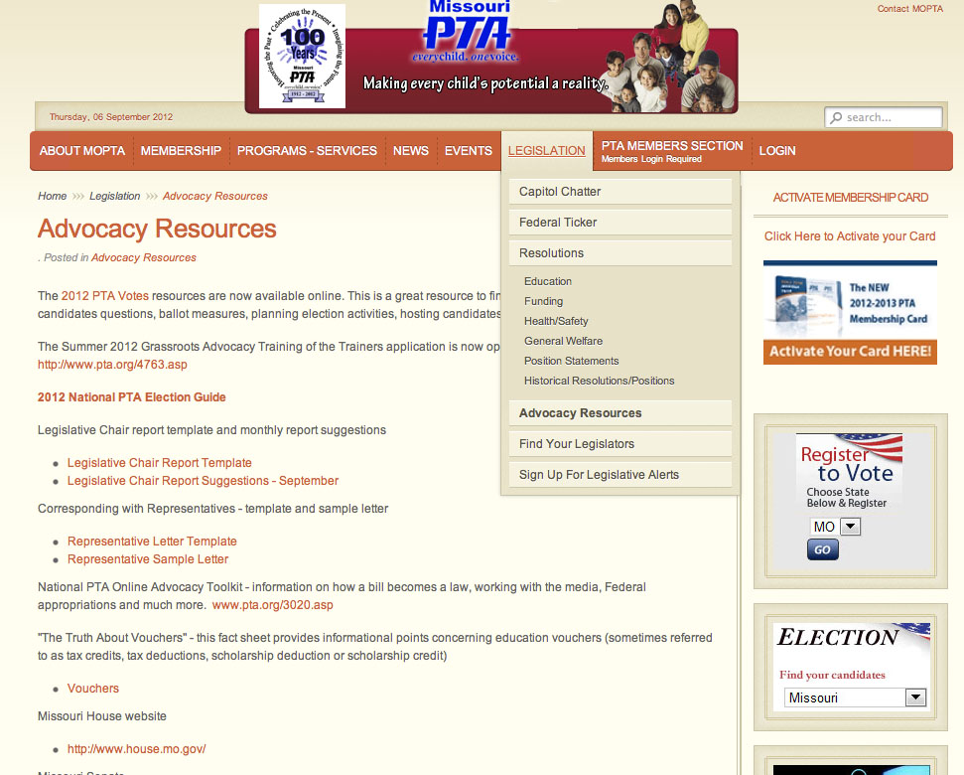
Notes:
Missouri PTA Legislative and Advocacy Online resources:
Capitol Chatter – legislative happenings includes MO Legislature Bill Watch List
Federal Ticker – Direct link to National PTA’s Advocacy pages
Resolutions – list of all Missouri PTA Resolutions and positions statements
Advocacy Resources – Links to various outside sites, template downloads, Legislative Chair reports

Slide 38
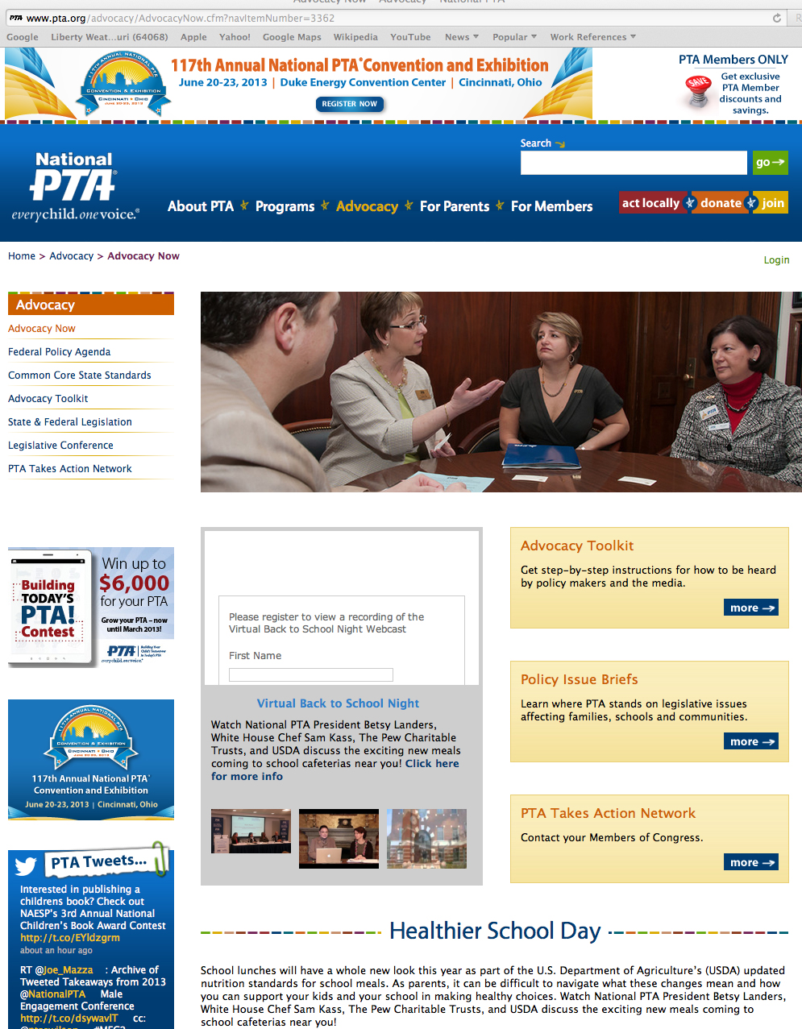
Notes:
National PTA’s brand new Advocacy section of their webstie

Slide 39
AtLaw Award
Individual Award
requirements & form
Unit/Council Award
requirements & form

Slide 42
Need Help
Where to look
Who to contact
Dorothy Gardner
Vice President,
MOPTA President Elect
dorothyg@mopta.org
Kim Weber
MOPTA President
kimw@mopta.org

