Slide 1
Healthy Parents, Healthy Children: Promotion of Optimal Family Lifestyle Habits and Weight Regulation
Denise E. Wilfley, Ph.D.
Scott Rudolph University Professor of Psychiatry,
Medicine, Pediatrics and Psychology
Washington University in St. Louis

Slide 2

“It is likely that the current generation of children and adolescents in the United States will be the first since 1960 to have higher mortality rates due to cardiovascular disease, including coronary heart disease and stroke, than their parents.”
Hennekens & Andreotti, 2013, Am J Med

Slide 3
Overview
  Describe the impact of obesity on youth
  Highlight importance of early intervention
  Provide evidence for family-based behavioral treatment
  Discuss benefits of technology for greater reach
  Illustrate how parents can engineer socio-environmental contexts to raise healthy, vibrant children

Slide 4

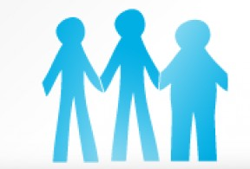
Prevalence of Obesity among
U.S. Children and Adolescents
The Good and Bad News about Obesity: It’s No Longer Rising, But It’s More Dangerous than Ever

Slide 5
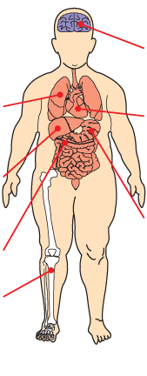




Childhood Obesity:
Health Risks Now and Later
Psychosocial
Eating disorders
Poor self-esteem
Social isolation and stigmatisation
Depression
Neurological
Pseudotumour cerebri
(idiopathic intracranial hypertension)
Pulmonary
Exercise intolerance
Obstructive sleep apnea
Asthma
Cardiovascular
Hypertension
Dyslipidaemia
Coagulopathy
Chronic inflammation
Endothelial dysfunction
Obesity Problems Fuel Rapid Surge of Type 2 Diabetes among Children
Gastrointestinal
Gallstones
Gastro-oesophageal reflux
Non-alcoholic fatty liver disease
Child Obesity Seen as Warning of Heart Disease
Endocrine
Insulin resistance
Impaired fasting glucose or glucose intolerance
Type 2 diabetes
Precocious puberty
Menstrual irregularities
Polycystic ovary syndrome (females)
Children's Life Expectancy Being Cut Short by Obesity
Renal
Glomerulosclerosis
Childhood Obesity Linked to Poorer Math Performance, Study Says
Musculoskeletal
Ankle sprains
Flat feet
Tibia vara
Slipped capital femoral epiphysis
Forearm fracture
Obese Kids More Vulnerable to Bullies

Slide 6


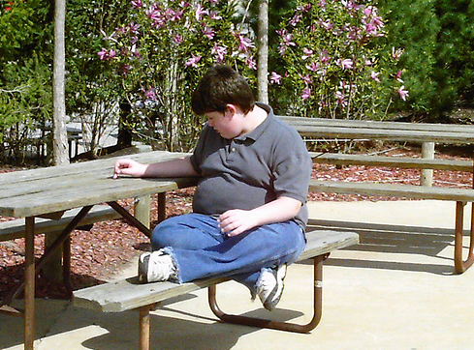
The Impact of Obesity Stigma on Children
Quality of life rated as low as young cancer patients on chemotherapy

Slide 7
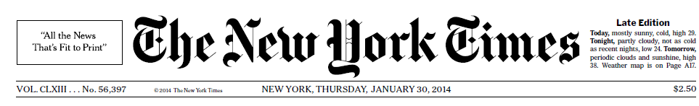
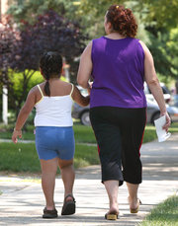
OBESITY IS FOUND TO GAIN ITS HOLD IN EARLIEST YEARS
“For many obese adults, the die was cast by the time they were 5 years old.”
“Efforts must start much earlier and focus more on the children at greatest risk.”

Slide 8
Tracking BMI-for-age From Childhood
Into Adulthood
Whitaker et al., 1997, New Engl J Med

Slide 9
Impact of Obesity
Comorbid Diseases
Quality of Life
Disability
Obesity
↑Mortality
↑Medical
Costs

Slide 10
Polling Question
Without intervention, children who are obese are likely to:
“Grow out of” obesity as they get taller
Revert to normal weight status when they reach puberty
Remain overweight as adolescents and
adults
D. Revert to normal weight status when they reach adulthood

Slide 11
Polling Question
Without intervention, children who are obese are likely to:
“Grow out of” obesity as they get taller
Revert to normal weight status when they reach puberty
Remain overweight as adolescents and adults
Revert to normal weight status when they reach adulthood

Slide 12
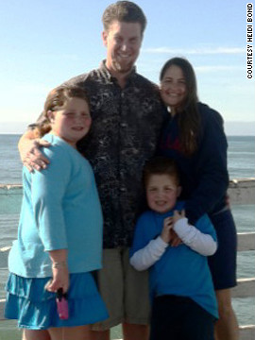
Missed Opportunities for Intervention
As a baby, Breanna had a hearty appetite; her parents joked that she would grow up to be like her dad: a 6 foot, 200 pound man
At one year old, Breanna weighed close to 25 pounds
Pediatrician assured family she would grow into the weight
In preschool, she was bigger than her classmates
Parents hired a nutritionist, and she started dance class and swim team, but her weight continued to climb
“Kids teased me…They called me chubby and fatty-o.”
“It was horrible for me and my husband…We felt helpless. We honestly didn't know what to do.”
Jacque Wilson, CNN. December 12, 2012

Slide 13
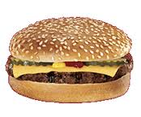
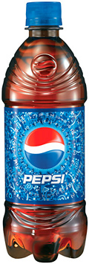
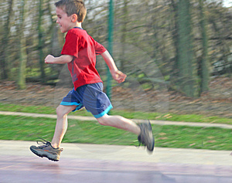

The Energy-Balance Equation:
It’s Not Enough
Energy Intake (Calories)
Energy Output (Physical Activity)
Running for 3.5 hours

Slide 14
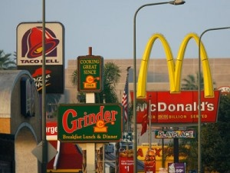
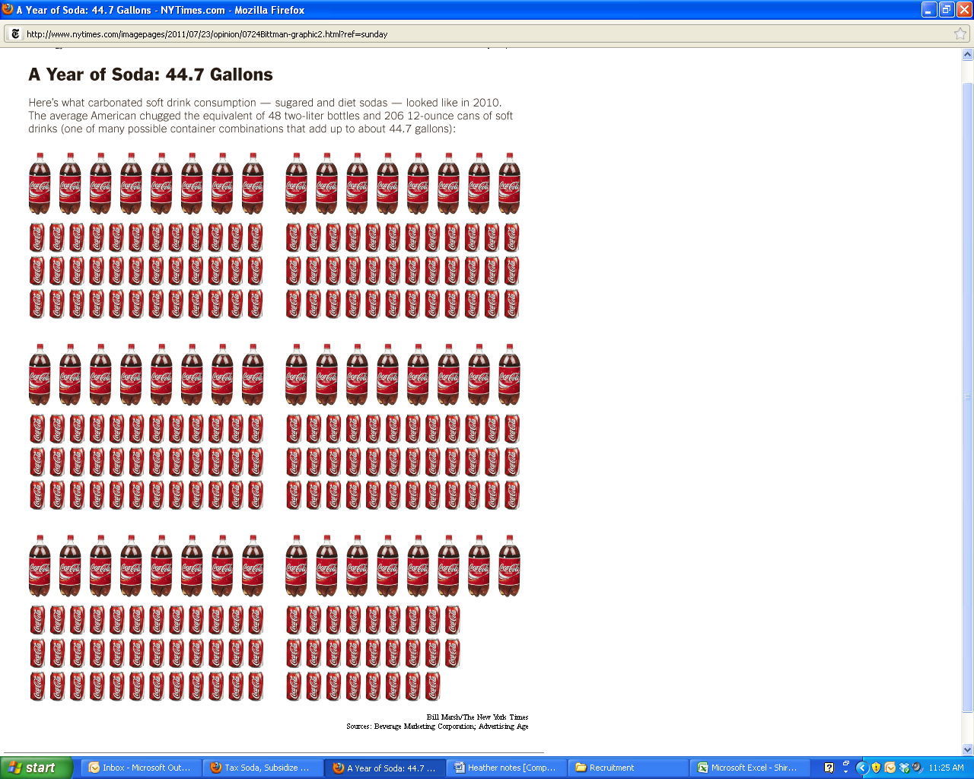
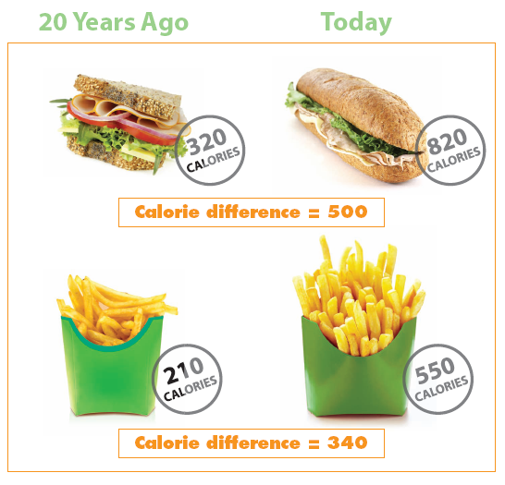
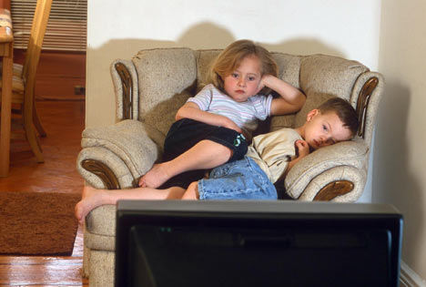
Main Drivers of the Obesity Epidemic
Genetic risk increases susceptibility

Slide 15
Polling Question
A genetic predisposition to obesity usually cannot be overcome, even when changes are made to the environment.
True
False

Slide 16
Polling Question
A genetic predisposition to obesity usually cannot be overcome, even when changes are made to the environment.
True
False

Slide 17
Potent Risk Factors
  Parental overweight and child overweight
  Weight-inducing medications (mood stabilizers and antipsychotics)
  Impaired mental health (e.g., depression, binge eating) and behavioral patterns (e.g., sleep duration)
  Social/ethnic profiles:
  Higher rates in low SES families
  Lower educational attainment
  Higher rates in Blacks, Hispanics, and Native Americans
Freedman, 1999, Pediatrics ; Ludwig, 2007, New Engl J Med

Slide 18
Importance of Targeting Overweight in Youth
  High prevalence and related health costs have quadrupled
  Increases risk for adult obesity and for greater severity of obesity in adulthood
  Childhood is a critical period of change in body fat and distribution
  Health risk is independent of adult weight status
  Clinical impairment in psychosocial domains is common

Slide 19
  Unhealthy Weight Control Methods Among Adolescents
 | Non-overweight girls | Overweight Girls | Non-overweight boys | Overweight boys
Unhealthy (e.g., fasting, skipping meals, smoking more cigarettes) | 48.3% | 71.5% | 23.5% | 49.5%
Extreme (e.g., diet pills, vomiting, diuretics) | 9.6% | 17% | 3.5% | 5.5%
Neumark-Sztainer, 2002, Arch Pediatr Adolesc Med

Slide 20

  Early Intervention is Crucial
  Prevents harmful effects
  Harnesses parental support
  Fosters healthy habits
  Small weight losses can
  make a big impact

Slide 21
Evidence for Early Intervention
  Age at the start of treatment has a robust impact on treatment outcome
  In one study, for each year younger, a child had a 47% greater chance of achieving a clinically significant reduction in BMI
  Clinically significant reductions are seen much less often in adolescence
Danielsson et al., 2012, Arch Pediatr Adolesc Med; Danielsson et al., 2012, Obes Facts;
Reinehr et al., 2010, Am J Clin Nutr; Reinehr et al., 2009, Obesity; Sabin et al., 2007, J Clin Eval Clin Prac

Slide 22
How Much Weight Change in One Year is Necessary for Normalization of Weight Status in Children?
BOYS
Age | 90th | 95th | 97th
8-9 years | 5.38 | -0.09 | -4.72
9-10 years | 6.59 | -0.35 | -6.35
10-11 years | 6.06 | -2.23 | -9.44
11-12 years | 7.08 | -2.69 | -11.13
12-13 years | 8.60 | -2.54 | -12.10
GIRLS
Age | 90th | 95th | 97th
8-9 years | 7.10 | 1.04 | -4.01
9-10 years | 7.41 | -0.11 | -6.39
10-11 years | 7.87 | -1.15 | -8.66
11-12 years | 7.28 | -3.37 | -12.24
12-13 years | 5.84 | -6.42 | -16.64
Goldschmidt, Wilfley, Paluch, Roemmich & Epstein, 2013, JAMA Peds

Slide 23
Polling Question
An 8 year-old girl at the 97th BMI percentile would need to lose about 4 pounds (1.8 kg) in order to achieve normal weight status in 1 year. If that same girl were 12 years old, she would need to lose how much weight in order to achieve normal weight status?
More than 15 pounds
Less than 4 pounds
The same amount of weight as when she was younger
No weight, because she would have grown out of her weight problem by then

Slide 24
Polling Question
An 8 year-old girl at the 97th BMI percentile would need to lose about 4 pounds (1.8 kg) in order to achieve normal weight status in 1 year. If that same girl were 12 years old, she would need to lose how much weight in order to achieve normal weight status?
More than 15 pounds
Less than 4 pounds
The same amount of weight as when she was younger
No weight, because she would have grown out of her weight problem by then

Slide 25
Infrequent Support in Primary Care Settings is Insufficient
  LEAP (Live, Eat, and Play) Program
  Screening, followed by 4 consultations with PCPs over 12 weeks to target behavior change in overweight or mildly obese 5-10 year olds
  No improvements in BMI, physical activity, or nutrition compared to usual care
  High Five for Kids
  Motivational interviews provided by nurse practitioners over 1 year for overweight or obese 2-6 year olds
  Small BMI improvements in girls and lower SES families only
Wake et al., 2009, BMJ; Taveras et al., 2011, Arch Ped Adol Med

Slide 26
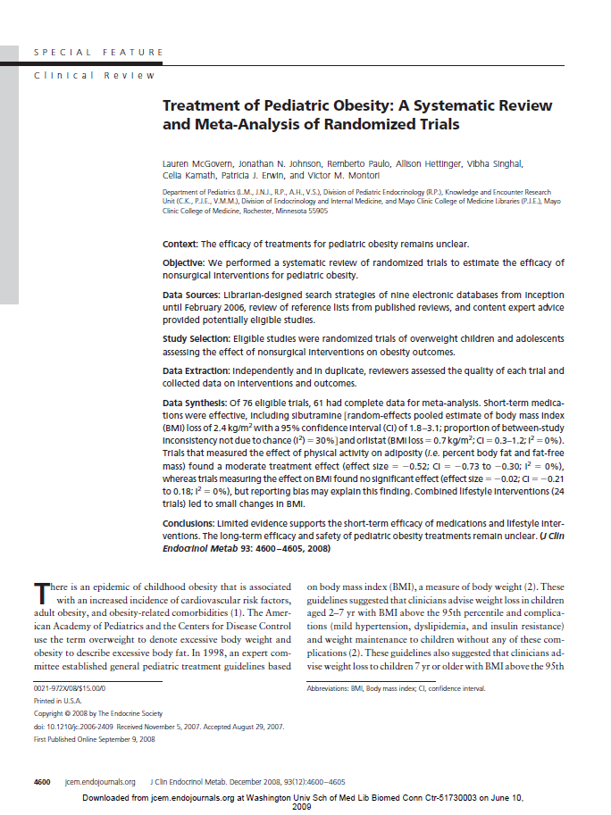
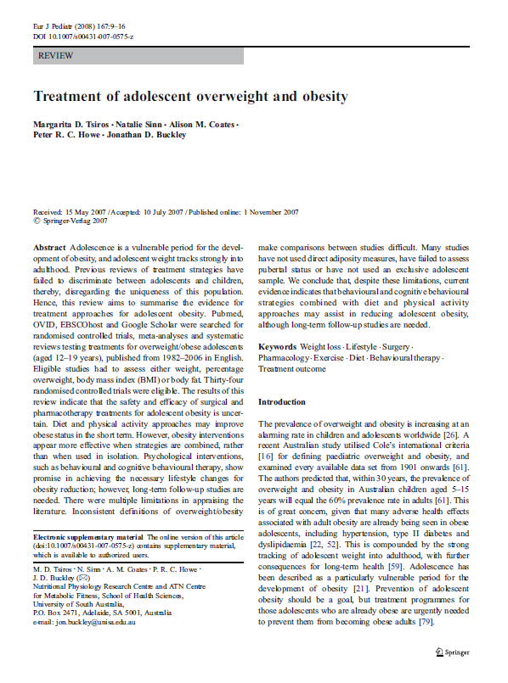
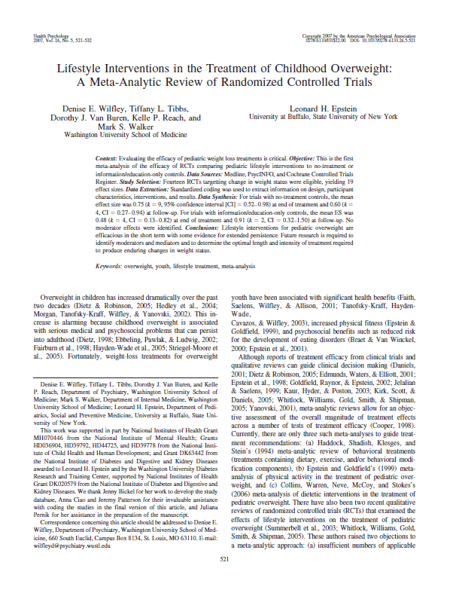
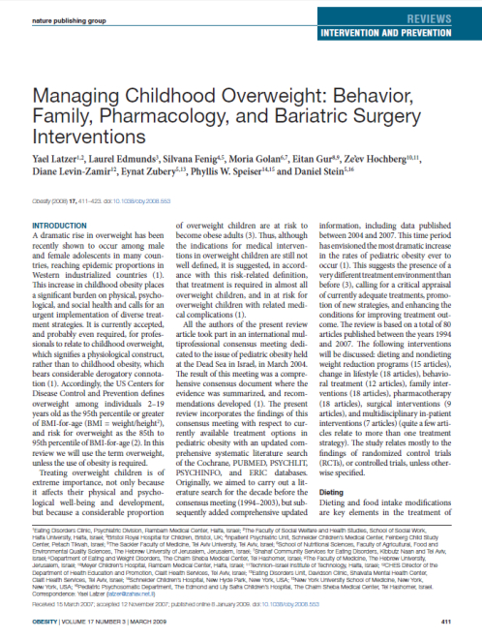
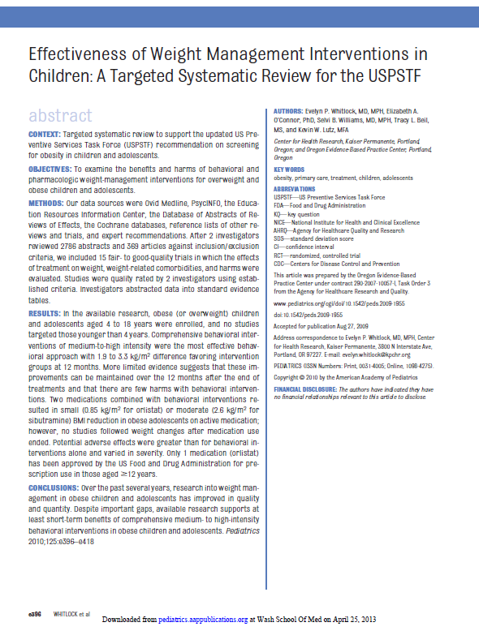
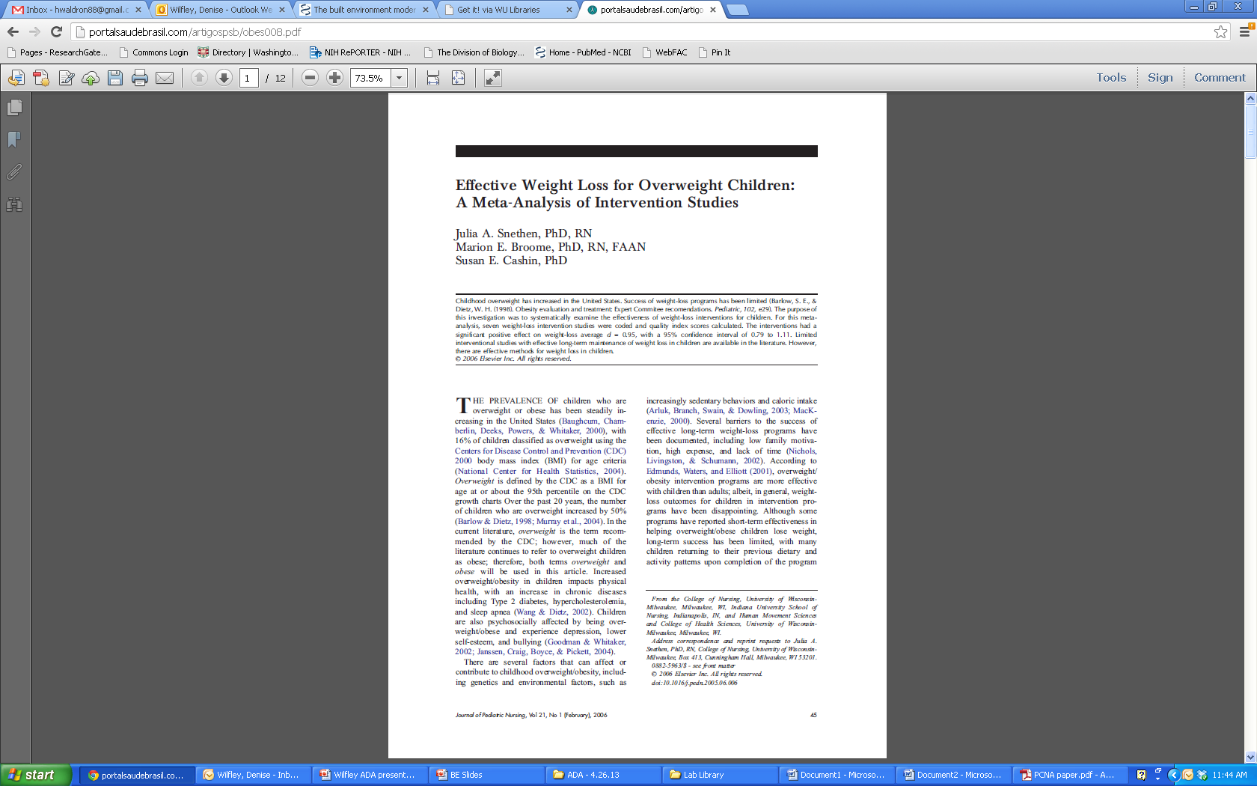
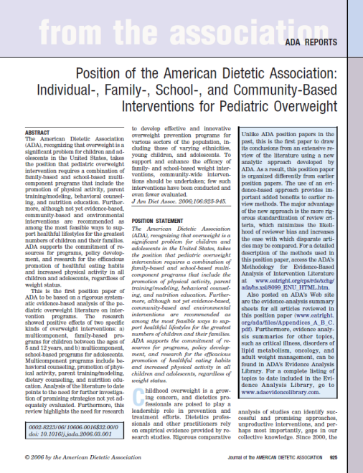
Multiple Meta-Analyses Document Significance of Lifestyle Interventions
Adding a family component stressing parental involvement to behavioral lifestyle interventions increases their effectiveness and parents should be targeted along with children to achieve the greatest reduction in child overweight
Young et al., Clin Psychol Rev; McGovern et al., 2008 J Clin Endocrinol Metab;
Wilfley et al., 2007, Health Psych; Latzer et al., 2008 Obesity; ADA 2006 J Am Diet Assoc

Slide 27
U.S. Preventive Task Force
RECOMMENDATION: The USPSTF recommends that Clinicians screen children aged 6 and older for obesity and offer them or refer them to intensive counseling and behavioral intervention to promote improvements in weight status (grade B recommendation). Pediatrics
Recommended Interventions
Refer patients to comprehensive moderate- to high-intensity programs that include dietary, physical activity, and behavioral counseling components.
Height and weight, from which BMI is calculated, are routinely measured during health maintenance visits
USPSTF, 2010, Pediatrics

Slide 28
National Institute for Health and
Care Excellence (NICE)
  Recommendation: Ensure family-based, multi-component lifestyle weight management services for children and young people are available as part of a community-wide, multi-agency approach to promoting a healthy weight and preventing and managing obesity
  Core elements of the recommended services include:
  Behavior-change techniques including strategies to help the family identify how changes can be implemented and sustained at home
  Positive parenting skills training
  Emphasis on importance of encouraging all family members to eat healthily and to be physically active, regardless of weight
NICE, 2013

Slide 29
  Importance of Intervening with
  the Family
  Obesity is multi-generational
  Robust predictors of childhood obesity associated with home/family
  Home food availability
  Family meal frequency
  Parent feeding practices
  Parent support for physical activity
  Household routines
  (meal patterns, sleep,
  TV viewing) impact BMI
  Potential for generalization of
  treatment effects to
  entire family
Percentage of Calories Eaten across Contexts
Anderson & Whitaker, 2010, Pediatrics; Black & Aboud, 2010, J Nutr; Larson et al., 2013, Obesity;
Liu et al,. 2013, Plos One; Campbell et al., 2013, Appetite; Haines et al., 2013, JAMA Peds; Ohly et al., 2013, Appetite;
Kral, 2010, Physiology and Behavior; Gerards et al., 2012, BMC Public Health; Epstein et al., 2001, Obesity Research

Slide 30
Polling Question
Weight loss programs for overweight children that involve the parents and the home environment are more effective than programs targeting the child alone.
True
False

Slide 31
Polling Question
Weight loss programs for overweight children that involve the parents and the home environment are more effective than programs targeting the child alone.
True
False

Slide 32
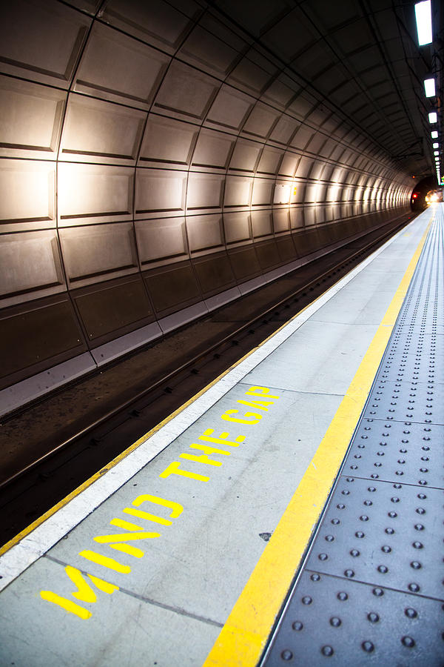
Mind The Gap
  Despite national recommendations, most children do not receive evidence-based care for obesity
  Under-recognized
  Lack of knowledge and training regarding care needed
  Stigmatized
  Minimal to no insurance reimbursement
  Access to programs is limited
  Many successful programs have to rely on national research grant funding for support

Slide 33
Family-based Behavioral Intervention
  First line of treatment for children and adolescents
  Targets reduction in energy intake and increase in energy expenditure in both youth and caregivers
  Recognizes that knowledge alone is not sufficient
  Focuses on successive changes using family support
  Core strategies include: self-monitoring; reinforcement; stimulus control
  Shown to impact: overweight, psychosocial health, and health-related parameters (e.g., blood pressure, cholesterol, insulin sensitivity)
Jelalian et al., 2010, J Pediatr; Kalarchian et al., 2009, Pediatrics;
McGovern et al., 2008, J Clin Endocrinol Metab; Tsiros et al., 2008, Eur J Pediatr;
Savoye et al., 2007, JAMA; Wilfley et al., 2007, Health Psychol; Ho et al., 2012, Pediatrics

Slide 34
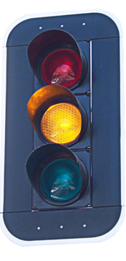
Traffic Light Plan
Energy Intake:
Eating Plan
Red—Stop and think!
High in fat (>5g/serving) and sugar
Less nutrient dense
Examples: chocolate, fries, ice cream
Yellow—Caution; slow!
Nutrient adequate
Medium energy density
1-5 g of fat/serving
Examples: crackers, dried fruit
Green – Go!
Nutrient rich
Low Energy Density (LED)
Examples: fruits, vegetables
Energy Expenditure:
Physical Activity Plan
Red—Stop and think!
Sedentary activities
“Screen time”
Examples: watching
TV, playing computer games
Yellow—Caution; slow!
Mildly active
Better than sedentary activities
Examples: walking the dog, swings, playground
Green – Go!
Vigorously active
Highest energy expenditure
Burns the most calories
Examples: running, riding bikes, rollerblading
Epstein & Wilfley, 2005

Slide 35

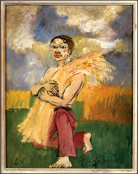
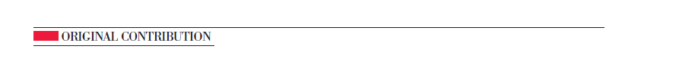
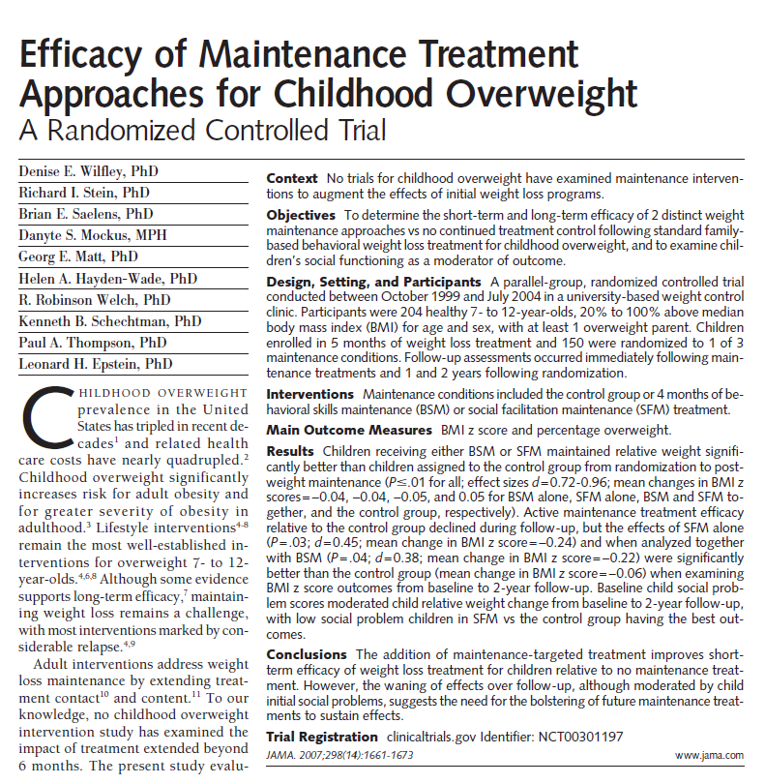
Family-Based Treatment is Efficacious
  With treatment, children successfully maintain their weight loss
  Parent success associated with child success
  Treating the family is cost-effective

Slide 36
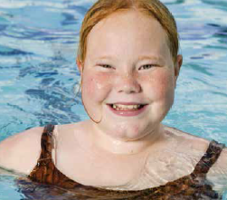
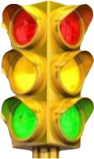


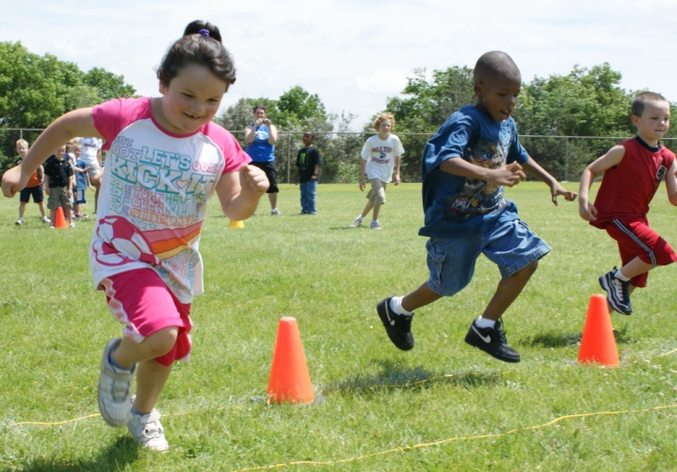
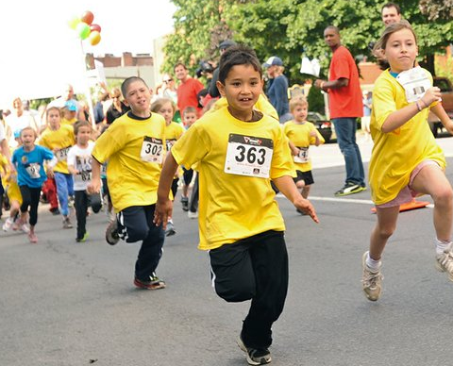
Engineer the Environment to Support Health

Slide 37
Enhanced Social Facilitation Maintenance Treatment
Community
School
Neighborhood
Peers
Caregivers
relevant at
all levels
Caregivers
Child Behaviors
Weight
Status
CHILD
Phase 1 Targets
Application of self-regulatory skills to weight maintenance
Strengthen the Home context to support healthy eating and physical activity
Phase 2 Targets
Strengthen the Peer context to support healthy eating and physical activity
Strengthen navigation of the Community context; utilizing opportunities for physical activity and healthy eating and problem-solving constraints
Phase 3 Targets
Use self-regulatory skills to prevent relapse
Solidify social network and community resources to promote healthy weight-related behaviors
Strengthen and consolidate the use of weight maintenance skills across all contexts
Wilfley et al., 2010, Obesity
Notes:
37

Slide 38
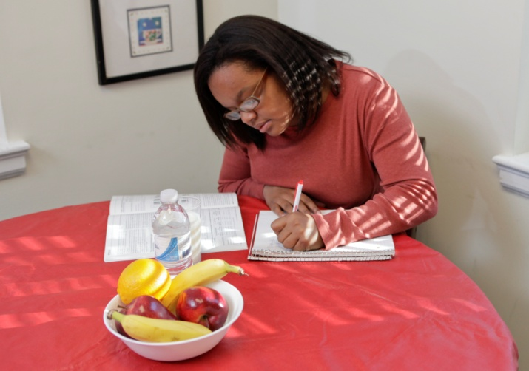
Healthy Self and Home
  Healthy routines
  Meals: 3 per day and planned snacks
    Plan and eat meals at home
  Sleep: 7-9 hours for adults, 9-11 hours for children
  Healthy home environment
  Enlist the cooperation of all members of the home to support healthy eating and physical activity
  Evaluate “environmental” barriers to healthy eating and physical activity within the home
  Healthy “self talk”
  Identify negative thoughts (called “thought bugs”)
    “Negative thoughts are a lot like bugs: They are around us often, can sneak up on us, and we want to stomp them out!”
Image Source: Yale Rudd Center for Food Policy & Obesity

Slide 39



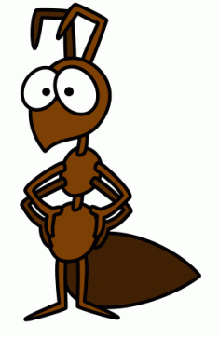
  “Stomping Out” Negative Thought Bugs
Bug | Distortion | Example Thought | Stomp it Out!
The Stinging Bee | Something negative based on only one event. | “I ate too much, I must be bad at eating healthy.” | Every day is a new day; you are free to make a better choice tomorrow.
The Quitter Critter | Say something negative about self and think it will never change. | “I had too many RED foods this week- I will never meet my goal!” | Remember not to give up; little changes add up to big results.
The Why Fly | Feeling sorry for yourself: “Why me?” | “It’s not fair that I have to eat healthy; everyone around me is eating RED foods.” | Remember that you always have a choice and feel proud for choosing healthier options.
The Can’t Ant | Telling yourself you can’t accomplish a goal. | “I can’t lose ½ a pound by next week.” | Give it a try!

Slide 40
  Stigma and the Media
  Explain how media impacts weight-related behaviors, and appearance related judgments
  Challenge the myth that heavy people cannot be healthy or beautiful
  “You can’t judge a book by its cover”
  Find multiple ways to evaluate the self that are not related to appearance or weight

Slide 41
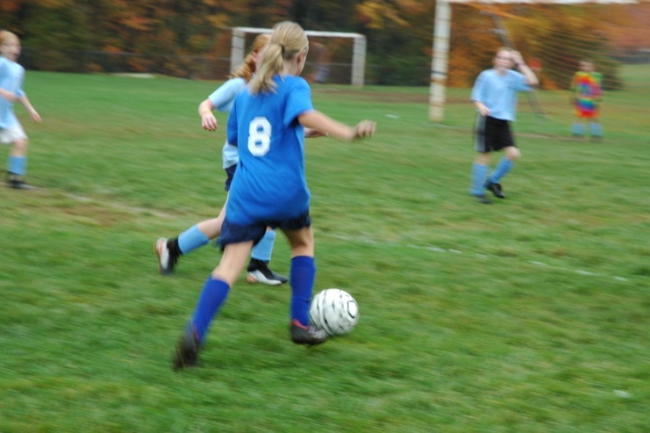
  Peer Support
  Build healthy peer networks
  “Map” social networks that promote or inhibit healthy eating and physical activity
  Promote active get-togethers with peers as alternative reinforcers to food and sedentary activity
  Use effective strategies for coping with teasing or getting along with others

Slide 42
  Social Skills Training
Top Skills | Parental Role | Give it a try!
Develop interests | Play games and go on outings with child; encourage trying new things. | Try a new GREEN activity: Zumba anyone?
Join organized activities | Find clubs or organized sports teams in which to involve child and get to know other parents. | Try going for a mother and daughter walk in the park. If that isn’t your speed, what about a bike ride?
Be a good sport | Point out examples of good and bad sportsmanship when watching sporting events with child. | Have children role play “good sport” and “bad sport” behaviors.
Have active get-togethers | Help child choose healthy friends and support good friendship choices. Talk to other parents when dropping off or picking up child from get-togethers. | Plan a get-together with a friend ahead of time: choose three fun, ACTIVE, things for your child to do with friends.
Become a healthy host | Set up a “healthy house” for guests. Keep GREEN foods accessible and keep RED foods out of sight. | Ask friends to tell you what their favorite fruits are and serve those when they visit.
Join others at play | Observe children playing, and teach child how to join in when others are playing. | Find a creative way to join an activity—maybe offer to hold the jump rope?
Start a conversation | Practice conversation starters with child. | Come up with some good questions to get conversations started— “I like to watch the Cardinals. Do you like baseball?”
Take the fun out of teasing | Listen and help develop appropriate responses to teasing. | Tease the tease: “That joke is so old it’s got dust on it!”

Slide 43
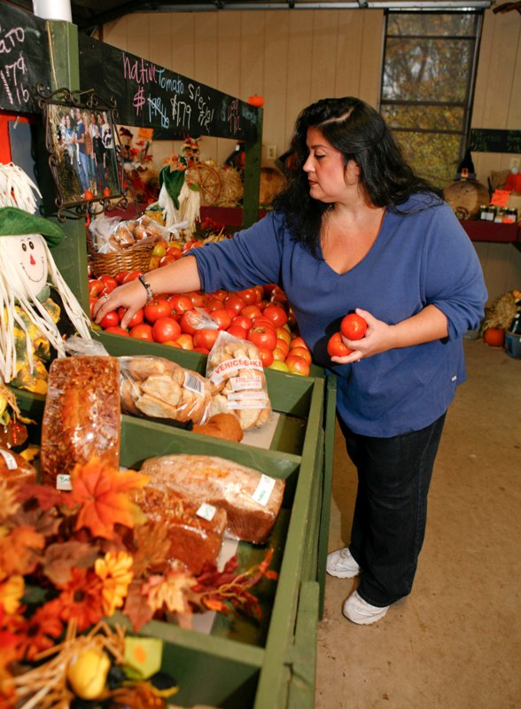
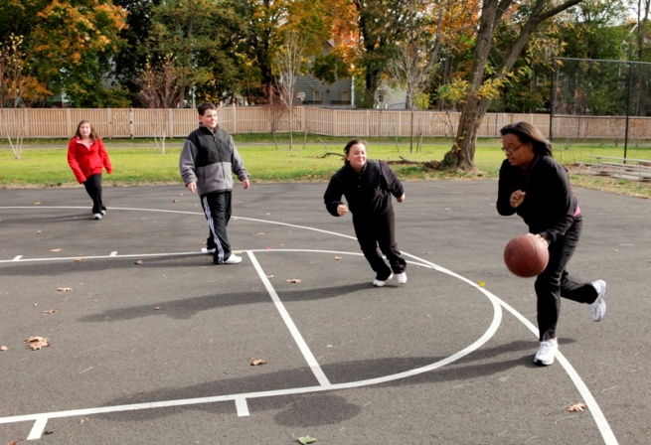
  Community Support
  Assess the community environment
  Identify and utilize community resources (e.g., parks, recreation centers, farmers markets)
  Identify barriers to and opportunities for
  physical activity and healthy eating
  Participate in healthy & active teams,
  organized events and activities
  Advocate for healthier options in
  school and workplace
  environments
Image Source: Yale Rudd Center for Food Policy & Obesity

Slide 44
  Weight Maintenance Across Contexts
  Self-regulatory skills to identify lapses and to present relapse
  Maintain regular self-weighing
  Recognize that small changes in weight sign need to return to self-monitoring
  Build or identify prompts for healthy behaviors across multiple contexts
  In the home (e.g., sports equipment out and accessible)
  Within social networks (e.g., certain friends associated with walking at lunch time)
  In the community (e.g., announcements from local recreation centers serve as reminders to stay physically active)

Slide 45
Polling Question
Which of the following parenting styles are most effective at helping a child manage obesity?
Permissive style—allowing a child to make their own choices about food/activity.
Coercive style—heavily restricting and controlling a child’s food/activity choices.
Authoritative style—setting limits with a child regarding food/activity choices.
None of the above. Parenting style does not have a significant impact on weight status.

Slide 46
Polling Question
Which of the following parenting styles are most effective at helping a child manage obesity?
Permissive style—allowing a child to make their own choices about food/activity.
Coercive style—heavily restricting and controlling a child’s food/activity choices.
Authoritative style—setting limits with a
child regarding food/activity choices.
D. None of the above. Parenting style does not have a significant impact on weight status.

Slide 47

Small Changes Can Have a Big Impact

Slide 48
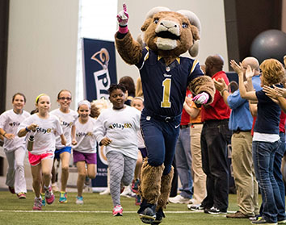
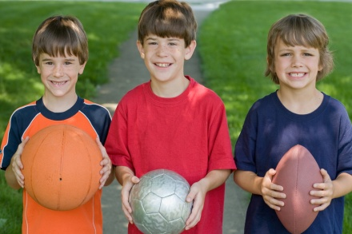

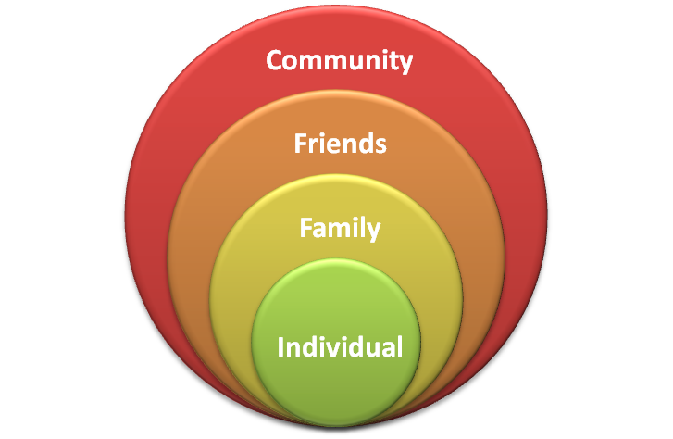
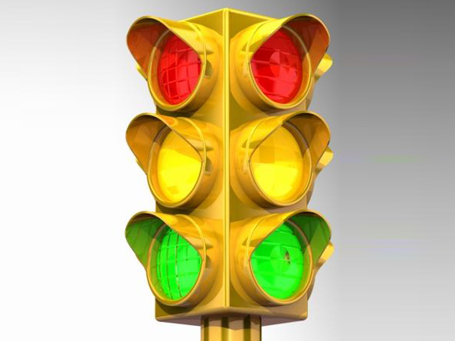
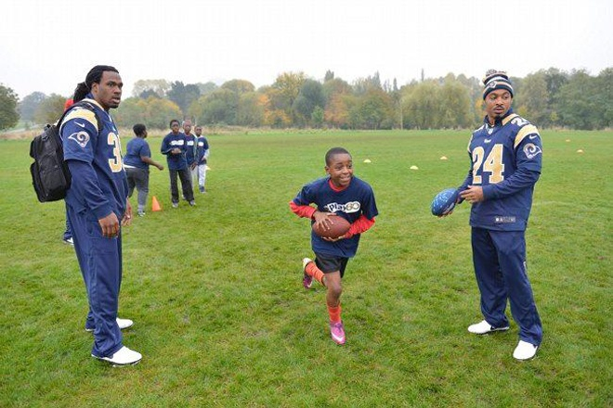
Promoting Health Across All Levels
  Evidence-based prevention and early intervention strategies for children and families
  Intervene across homes, schools, and communities where children and adults live, work, learn, and play
  Harness social support for lasting behavior change
  Use the Traffic Light Plan to anchor healthy eating and activity behaviors
Increasing support resources for GREEN behaviors and
reducing RED
behaviors across
all levels
Notes:
Effective treatments like FBT and other supported by USPSTF recommendations are not available to the many children in need
Children receive low-intensity care that is not rooted in evidence or have to be referred to a specialist treatment center (which are few and far between)
Many of these treatment centers have to rely on grant funding to stay afloat (ex. Children’s Mercy KC)
Major barrier here is lack of insurance coverage
Problem around country and in Missouri that warrants urgent attention
Treat and Reduce Obesity Act (Adult focused federal bill)
On June 19, 2013, U.S. Senators, Tom Carper (D-DE) and Lisa Murkowski (R-AK), and U.S. Representatives, Bill Cassidy (R-LA) and Ron Kind (D-WI), introduced legislation to ensure that Medicare beneficiaries have access to an array of approved obesity prevention and treatment tools.
The Treat and Reduce Obesity Act provides Medicare beneficiaries and their healthcare providers with meaningful tools to reduce obesity by improving access to weight-loss counseling and new prescription medications for chronic weight management. The bill also requires the Health and Human Services Department to develop and implement a comprehensive new research and outreach plan to combat the obesity epidemic.

Slide 49

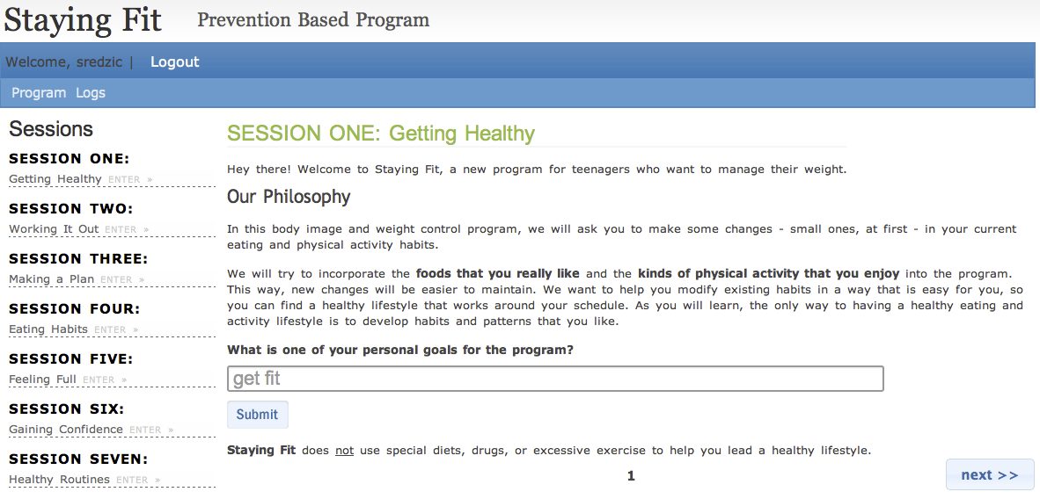
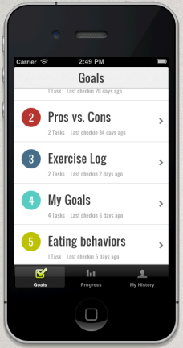
Harnessing Technology for Scale-Up
Internet-based tools facilitate expansion and growth without using significant person-based resources
StayingFit: A Prevention-based Program
  Online program (16 weekly sessions + booster)
  Teaches skills and behavioral strategies to:
    Adopt healthy eating and
    activity behaviors
    Overcome barriers in
    making healthy changes
    Improve body esteem
    Reduce unhealthy eating
    attitudes and behaviors

Slide 50
The Defined Population (e.g. all 9th grade students in a school) for a Universal and Targeted School-based Program:
All students in
a school
Notes:
Mickey: I deleted: (4) how can programs utilize cells phones, social media and other emerging communication technologies to increase engagement and effectiveness , for lack of time. You only have 15minutes.

Slide 51
The Reach Within a School of an
Internet Program Provided Online
Independent of the school:
Percentage of students at-risk who are reached by a typical intervention – very low percentage
Notes:
Mickey: I deleted: (4) how can programs utilize cells phones, social media and other emerging communication technologies to increase engagement and effectiveness , for lack of time. You only have 15minutes.

Slide 52
The Reach of Universal and Targeted Programs within a Defined Population (e.g., all 9th /10th grade students in a school):
Notes:
Mickey: I deleted: (4) how can programs utilize cells phones, social media and other emerging communication technologies to increase engagement and effectiveness , for lack of time. You only have 15minutes.

Slide 53
Reduced BMI in Adolescents at High Risk for Obesity
  StayingFit has resulted in:
  Significantly lower BMI z-scores over time among students who were overweight
  Weight maintenance in students who are normal weight
No increases in weight/shape concerns
Increases in fruit and vegetables consumption and physical activity
*
Healthy Habits Track
Weight Management Track
      Taylor et al., 2012, Int J Obesity Suppl; Jones et al.,under review, J Med Int Res

Slide 54
Our Vision: Facilitate Delivery Across Socio-environmental Contexts
Normal Weight
High Risk for Overweight
Overweight
Obese
INDIVIDUAL
Staying Fit: Healthy Habits Maintenance Track
Staying Fit: Selective Weight Gain Preventive Track
Staying Fit: Indicated Weight Loss Track
Staying Fit:
Indicated Weight Loss Track; Referral:
FBT Specialist
Targets key psychosocial factors leading to excess weight gain
(e.g., depression, impulsivity, binge eating, & weight/shape concerns)
FAMILY
Staying Fit: Parent Track (Online and Mobile)
PEER
Staying Fit: Social Networking and Discussion Boards
Universal School-Based Intervention
Promotion of Physical Activity and Healthy Eating
SCHOOL
Notes:
Individually tailored, online interventions can yield a significant return on investment:
Provide an efficient delivery system that transcends existing barriers to care
Conserve person-based resources
Tailor to local environment
Decrease costs
Maximize capacity to serve a diverse population
Reduce the burden of healthcare service delivery

Slide 55
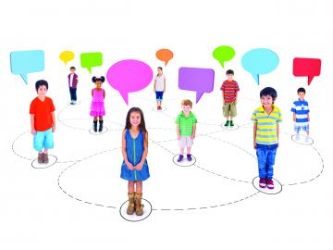
Mobile Technologies and Social Networking Across Contexts
Self-Monitoring, Tailored Feedback and Rewards
Youth Advocacy
  Youth-driven intervention can increase ownership,
  and sustainability
Web-based Social Support
  Real-time social support provided by apps such as Twitter may enhance
  weight loss
Frerichs et al., 2012. Prev Chronic Dis.; Turner-McGrievy & Tate, 2013. Transl Behav Med

Slide 56
Linking to the Community to Increase Impact and Reach
StayingFit:
All 6th-8th graders
in a middle school
In this example, the
defined population
is all 6-8th grade students at a Branson, MO middle school

Slide 57
Linking to the Community to Increase Impact and Reach
StayingFit:
All 6th-8th graders
in a middle school
Community Organizations
(i.e., YMCA):
Link to community resources
Offer after-school activities to support physical activity
Implement rewards system for healthy choices

Slide 58
Linking to the Community to Increase Impact and Reach
StayingFit:
All 6th-8th graders
in a middle school
Community Organizations
(i.e., YMCA):
Link to community resources
Offer after-school activities to support physical activity
Implement rewards system for healthy choices
Health Care System
(i.e., Cox Branson):
Provide evidence-based care for obesity
Assist in assessment, management, and treatment

Slide 59
Linking to the Community to Increase Impact and Reach
StayingFit:
All 6th-8th graders
in a middle school
Community Organizations
(i.e., YMCA):
Link to community resources
Offer after-school activities to support physical activity
Implement rewards system for healthy choices
Health Care System
(i.e., Cox Branson):
Provide evidence-based care for obesity
Assist in assessment, management, and treatment
Grocery Stores:
Provide access to healthy foods
Reinforce messages

Slide 60
Linking to the Community to Increase Impact and Reach
StayingFit:
All 6th-8th graders
in a middle school
Community Organizations
(i.e., YMCA):
Link to community resources
Offer after-school activities to support physical activity
Implement rewards system for healthy choices
Health Care System
(i.e., Cox Branson):
Provide evidence-based care for obesity
Assist in assessment, management, and treatment
Grocery Stores:
Provide access to healthy foods
Reinforce messages
Link to families

Slide 61
Linking to the Community to Increase Impact and Reach
Public Health Department:
Infrastructure
Support with height/weight measurement
Sustainability

Slide 62
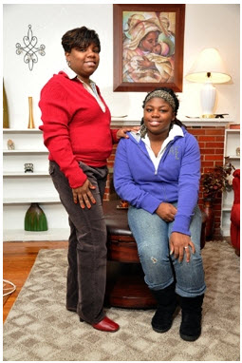
Call for Early Intervention
Jazmyne and her mother* enrolled in the TODAY trial
for management of Jazmyne’s Type 2 Diabetes:
Prevent future medical costs by providing targeted intervention in infancy, childhood, and adolescence.
  “At 14, she started feeling really bad … headaches, nauseated, fatigue […],” her mother said. “When she went for her checkup before school, the doctor was alarmed.”
  Post-treatment: Jazmyne’s headaches got better and her mood swings improved. Daughter and mother lost 90 pounds, combined.
*The St. Louis American, January 22, 2010

Slide 63
How Do You Raise a Healthy Child?
  Model healthy lifestyle behaviors and positive body esteem
  Establish healthy structure and routines
  Make the healthy choice the easy choice
  Avoid stigmatizing your child, yourself, and others
  Employ positive, consistent parenting techniques
“Families are crucial — unless the whole family gets involved in a plan to adopt a healthier lifestyle, it will be difficult for the individual to succeed”
-Francis S. Collins, Director, National Institutes of Health

Slide 64
Summary
  Early intervention for pediatric obesity is crucial to prevent its serious health and psychosocial consequences
  Family-based behavioral interventions and socio-ecological approaches are promising
  Parents are central to successful promotion of healthy lifestyle and weight
  Health is profoundly affected by the community in which a child lives and integration of practice-, family-, community-based, and policy interventions is essential

Slide 65
Future Directions: A Vision
“Ensure that every child and family engages in healthy eating and weight management practices.”
  Increase identification of overweight and access to evidence-based care
  Small changes yield effective outcomes: providers can play an important role
  Translate evidence-based interventions into routine practice
  Focus on prevention and early intervention model tailored based on severity and risk
  Advocate to make the healthy choice the easy choice
  Integrate intervention across multiple levels of care
  Collaborative partnerships: “It takes a village…”
Wilfley et al., 2011, Pediatr Clin N Am

Slide 66
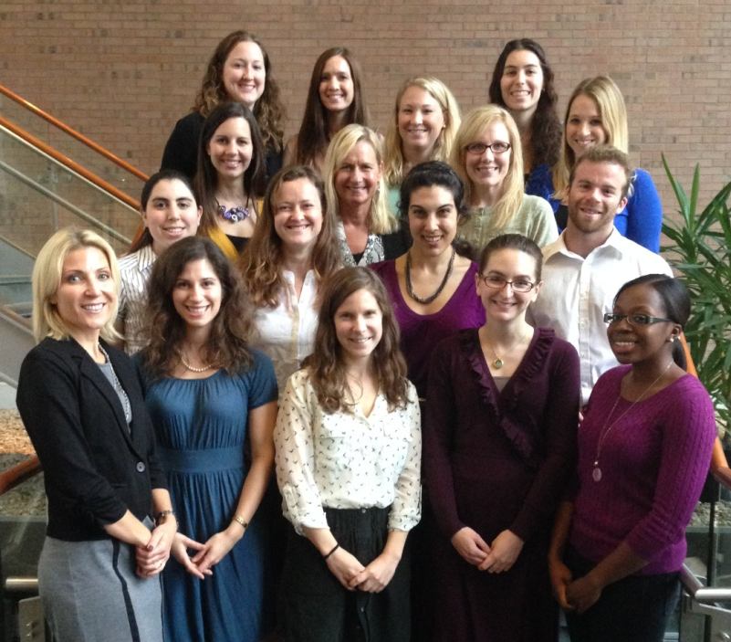
Acknowledgements
Wash U Research Team:
Caryn Alper, Myra Altman, Holley Boeger, Meghan Byrne, Jackson Coppock, Dawn Eichen, Ellen, Fitzsimmons-Craft, Katie Garland, Jackie Hayes, Andrea Kass, Katie Keenoy, Rachel Kolko, Angela Lima, Sara McMullin, Grace Monterubio, Danielle Ridolfi, Casey Sanli, Cameron Sisler, Rick Stein, Michelle St. Paul, Dorothy Van Buren, Rob Welch, Alison Yee
Collaborators:
Stewart Agras, Len Epstein, Christopher Fairburn, Thrudur Gunnarsdottir, Anja Hilbert, Kathy Pike, Michael Perri, Brian Saelens, Marian Tanofsky-Kraff, Barr Taylor, Ruth Weissman, Terry Wilson, TODAY Study Group
Grant Support:
NIMH grant #R01MH064153
NHLBI grant #T32HL007456
NCMHD grant #P20MD000505
NIDDK grant #R03DK065757
Missouri Mental Health Foundation
Skaggs Foundation Community Initiative Grant
NIMH grant #R01MH095748
NIMH grant #U01MH076255
NIMH grant #K24MH070446
NIMH grant #R01MH081125
NICHD grant #R01HD36904
NIMH grant #R01MH100455
National Eating Disorders Association Feeding Hope Fund Grant

Slide 67

Work Together to Optimize Health for Children, Families, and Communities
Notes:
With or without words?

Slide 68
Case Example: Small Changes Can
Make a Big Impact
Video Link: http://www.siteman.wustl.edu/ContentPage.aspx?id=6783

