Slide 1
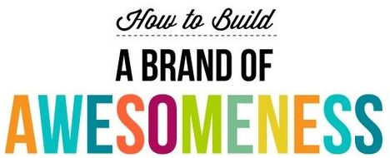
MoPTA Convention 2014
Presentation by Andrea Battaglia, MoPTA PR Chair
When you’re good, you’ll tell others about it. When you’re great, others will tell you.
Branding is what people say about you when you’re not in the room.
Communication is how you convey your message.
Select graphics used from Pinterest.com - MackWebSolutions.com

Slide 2
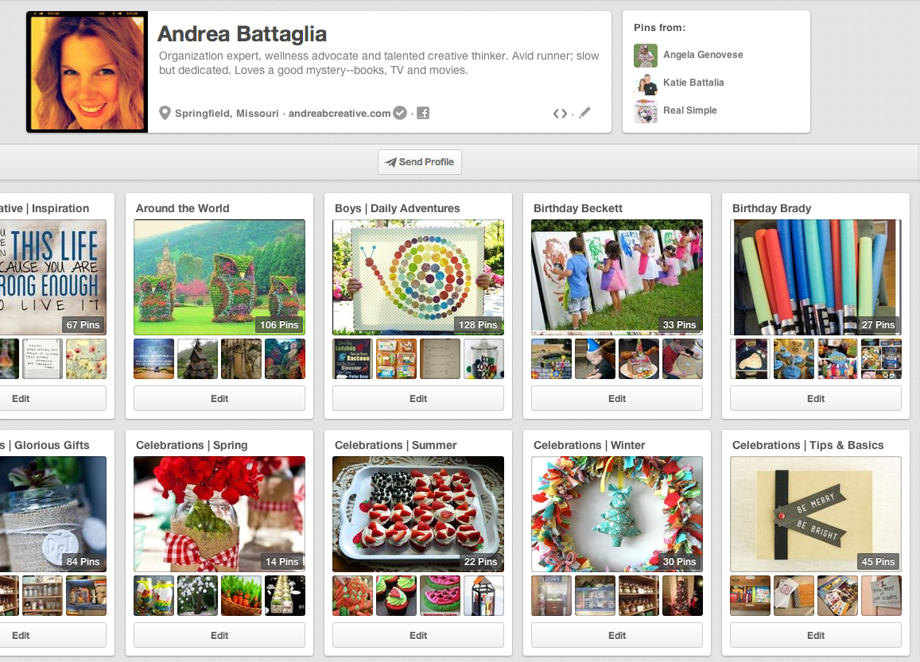
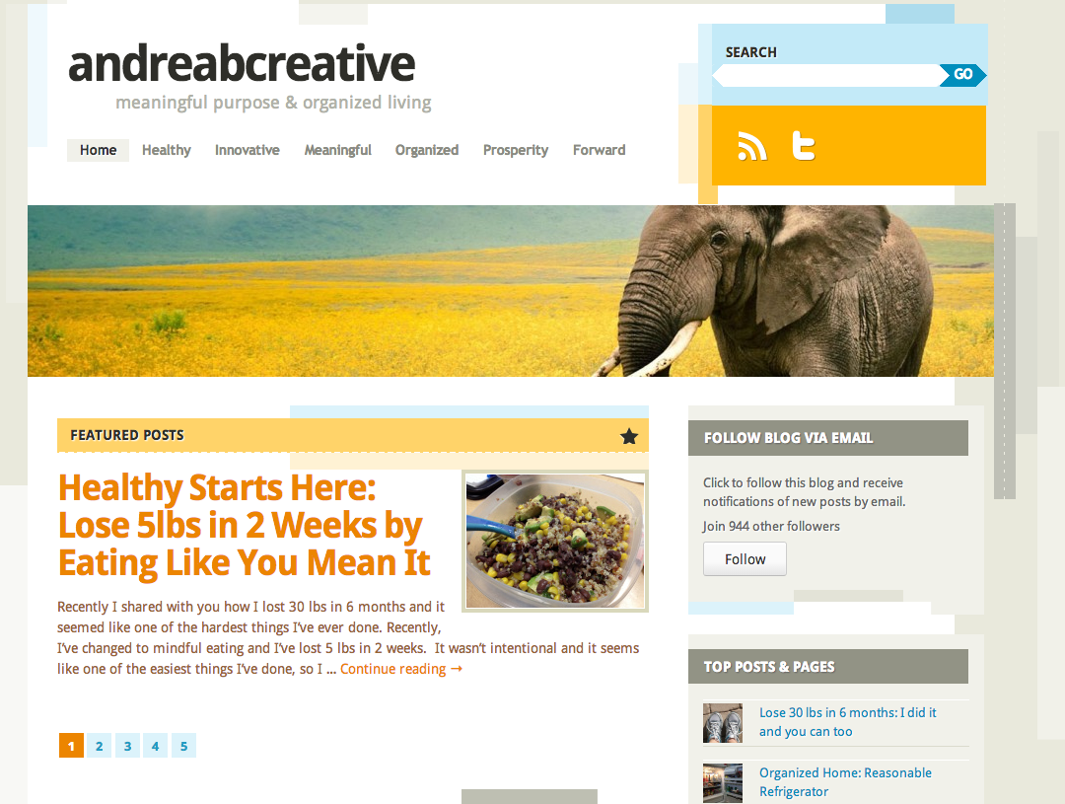
Andrea Battaglia Presenter Information
Work in Marketing & Strategy, helping groups effectively manage communication
Organization Expert & Wellness Advocate, manage social media for www.andreabcreative.com sites, with more than 40,000 views. Focus is Organized Living & Meaningful Purpose
Professional Trainer & Facilitator for groups of all sizes and competency levels

Slide 3
Building your Brand
Most people think building a brand starts with the build step – but your work begins far in advance of your communicated message.

Slide 4
Building your Brand: Define
Define your objectives
Define your target audience
Define your goals
Define why build your brand
Build awareness
Build reputation about your organization
Define how you will encourage participation and loyalty

Slide 5
Building your Brand: Elect/Select
Elect/Select your passionate & committed team
Don’t separate/segment internal & external teams

Slide 6
Building your Brand: Develop
Develop your strategy
Develop your SMART goals
Develop what you want to do
Develop when you want to do it
Develop how you’re going to keep your strategy going
Develop who is going to do each goal/action for your strategy

Slide 7
Building your Brand: Empower
Empower your team and set them up for success
Empower professionalism - address concerns, questions and resistance
Empower confidence & trust by your responsible, relevant actions
Empower realistic strategies – set priorities and timelines

Slide 8
Building your Brand: Learn
Learn your audience - Your stakeholders (parents, teachers, community, school board – and of course, children!)
Learn the current trends – always be reading to stay relevant and/or ahead of current trends
Learn your stakeholders - Meet new people and remember why you started (the human element)
Learn to be present and available
Learn to create your own good fortune

Slide 9
Building your Brand: Create
Create value by building foundational content
Create your message to reach your target audience and communicate value through consistent messages
Create your brand everywhere
Social Media & Website
Brochures/Newsletters
Communication – email, meetings, messages to members and stakeholders

Slide 10
Building your Brand: Share
Share messages following the 80/20 Pareto Rule
Share successfully - using human outreach as your main strategy
Share using the most effective strategy for your stakeholders, may be a multi-communication strategy
Email & Newsletters
Social Media & Website
Posting messages at School

Slide 11
Building your Brand: Build
Build your brand and foster growth
Be actively present and available – don’t wait for things to happen, make them happen
Feature stakeholders
Recognize and celebrate awesome
Hold events
Help others
Be human (relatable, reliable, advocate – voice of reason)
Give back

Slide 12
Building your Brand: Measure
Measure and track progress – events, attendance, participation
Over communicate – keep everyone involved
Measure and make changes
Work on needed improvements
Always bring it back to your goals

Slide 13
Building your Brand
Contact me for assistance with Branding, Communication, PR, Advertising, Social Media
Andrea Battaglia, MoPTA PR Chair
Email: andreab@mopta.org

