Slide 1
“The World Would Be a Better Place If…”
Reflections Program 2014-2015

Slide 2
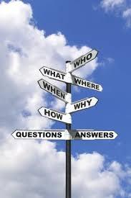
So...what is Reflections?
The National PTA Reflections program is PTA’s cornerstone arts program. It was developed to encourage students to explore their talents and to express themselves.

Slide 3
The World would be
a better place
Reflections
has inspired MILLIONS of students to reflect on a specific
theme and create original artwork.
if...

Slide 4
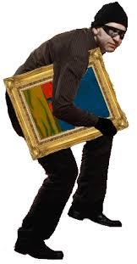
Ahem...
Original.
Artwork
Express YOURSELF!
Not someone else!

Slide 5
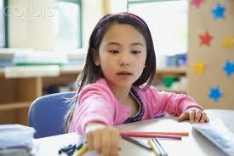
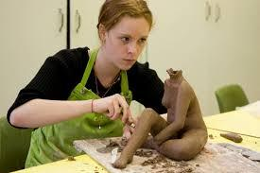
Each year, students in Grades Pre-K through 12 are recognized for
bringing the theme to life!

Slide 6
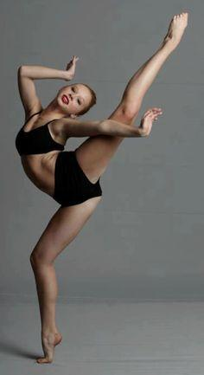
Through
DANCE
Choreography

Slide 7
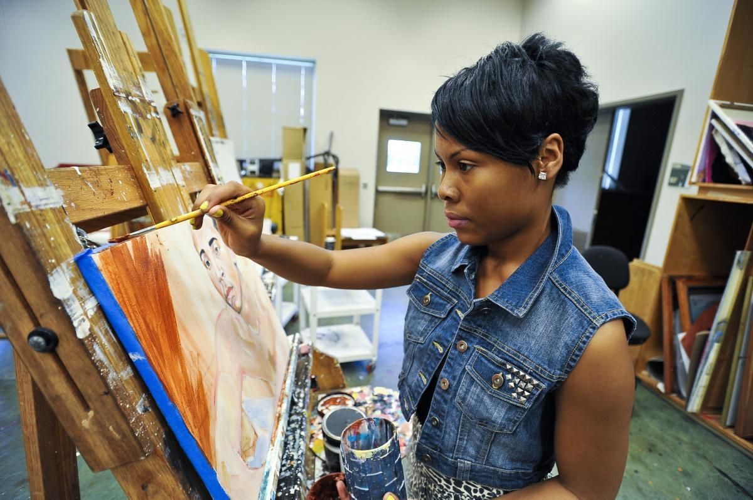
Photography and Visual Arts

Slide 8
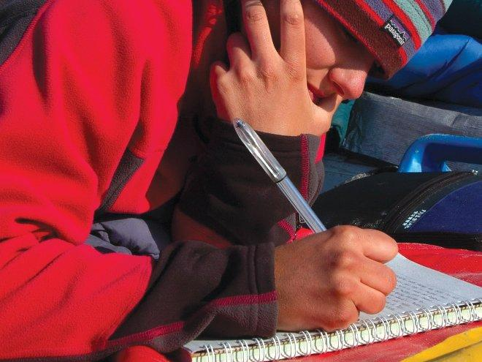
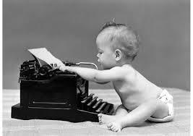
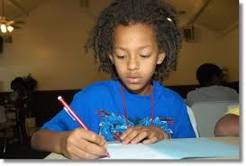
Through
Writing
Literature

Slide 9
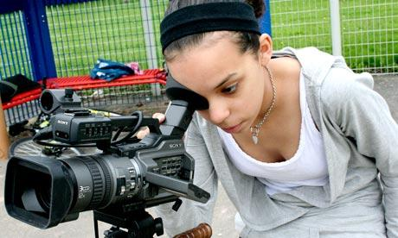
Film Production

Slide 10
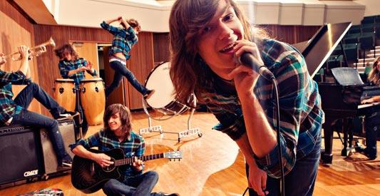
Music
Composition

Slide 11
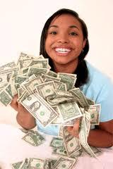
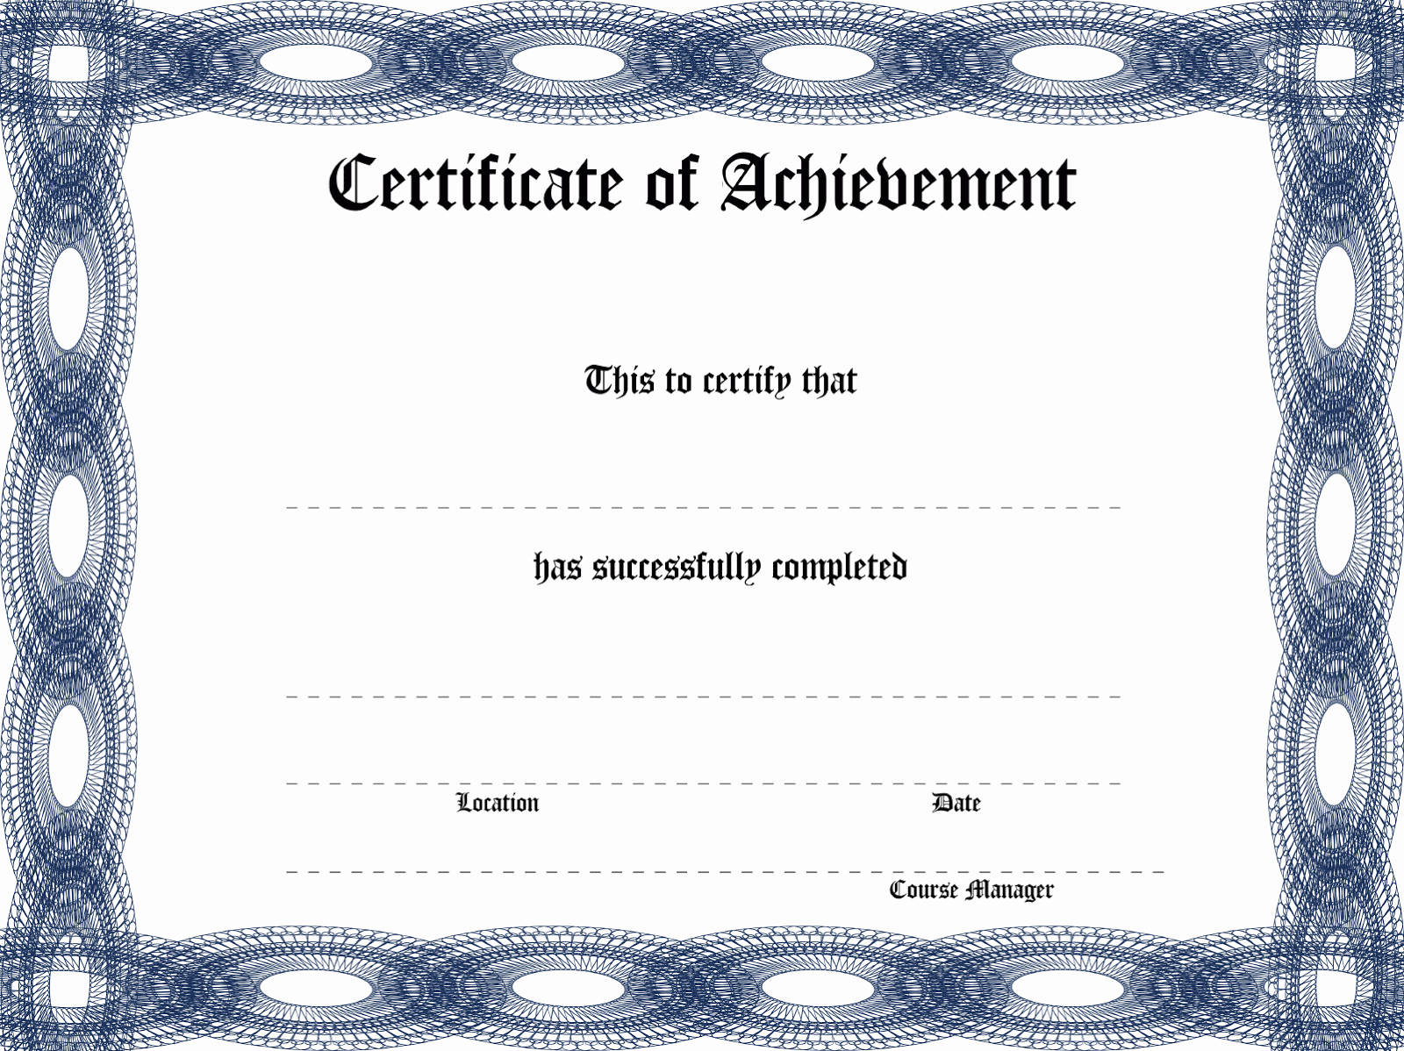
Prizes include:
$$Cash$$
A Trip for two!

Slide 12
Now that you know the “What.”
Let’s break down the “How to...

Slide 13
Get
IT
DONE!

Slide 14
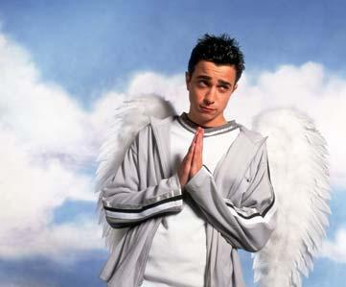
Adult and Parent Coordinators

Slide 15
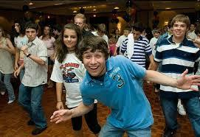
P
E
E
R
EDUCAT
T
O
R
P
E
E
R
MOTIVATOR
P
E
E
R
C
O
M
M
U
N
I
C
A
T
O
R
Crazy Confident!

Slide 16
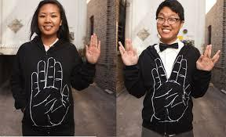
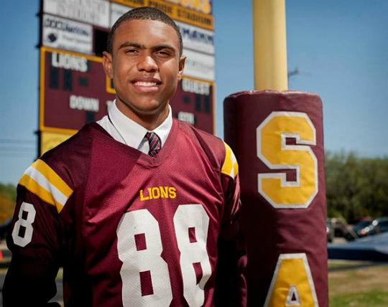
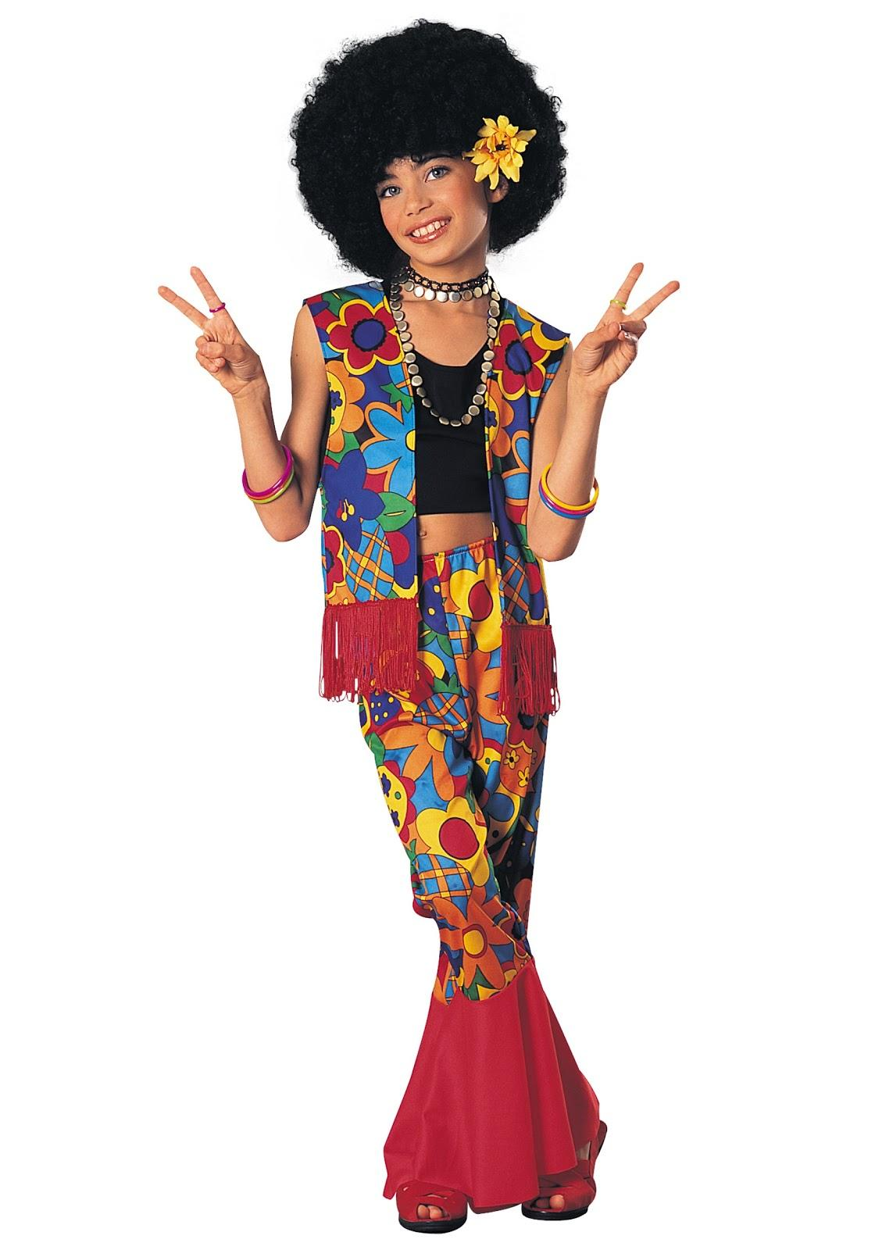
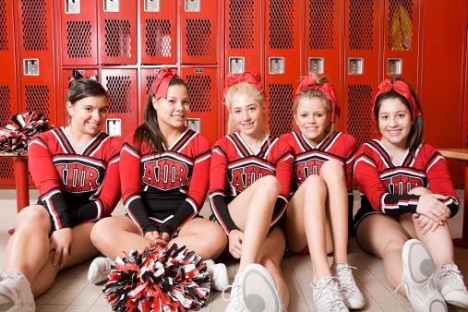
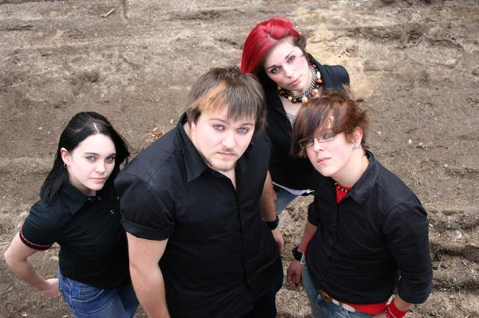
P
E
E
R
LIAISON

Slide 17
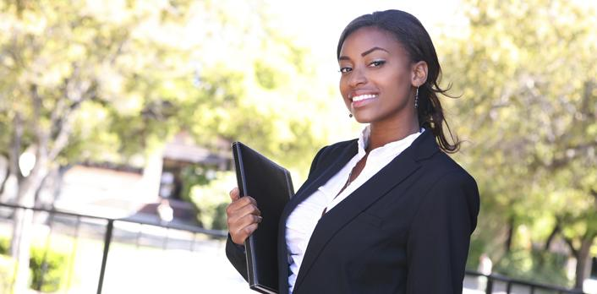
Community Educator
INTELLIGE NT
ORGAN I ZED
Community Organizer

Slide 18
So u think u’ll do Reflections?
Umm..Free fame and $$$. Duh.

