Slide 2
What are your school’s greatest challenges?

Slide 3
?
?
Relationships
New technologies
Curriculum
?
School Security
Technology
Funding
?
?
Test scores
Student Health
?
Leadership
?
Poverty
Students’ attitudes
Bullying

Slide 4
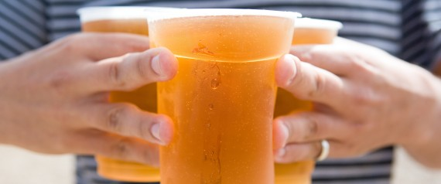

Slide 5
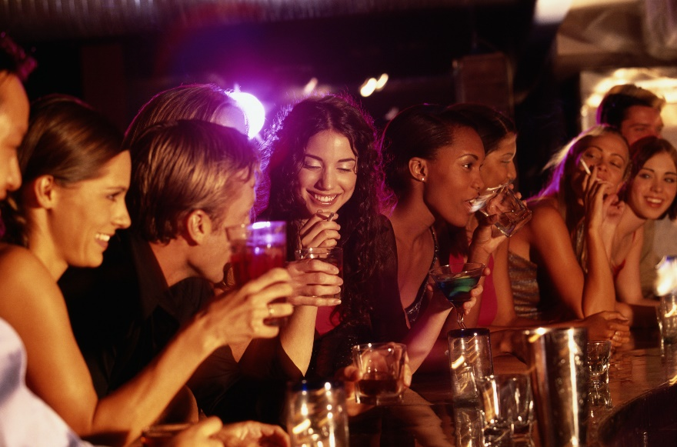
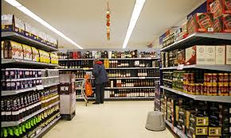
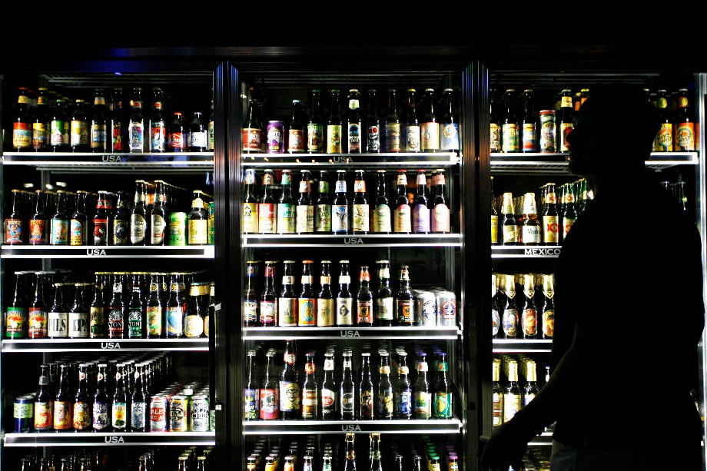

Slide 6
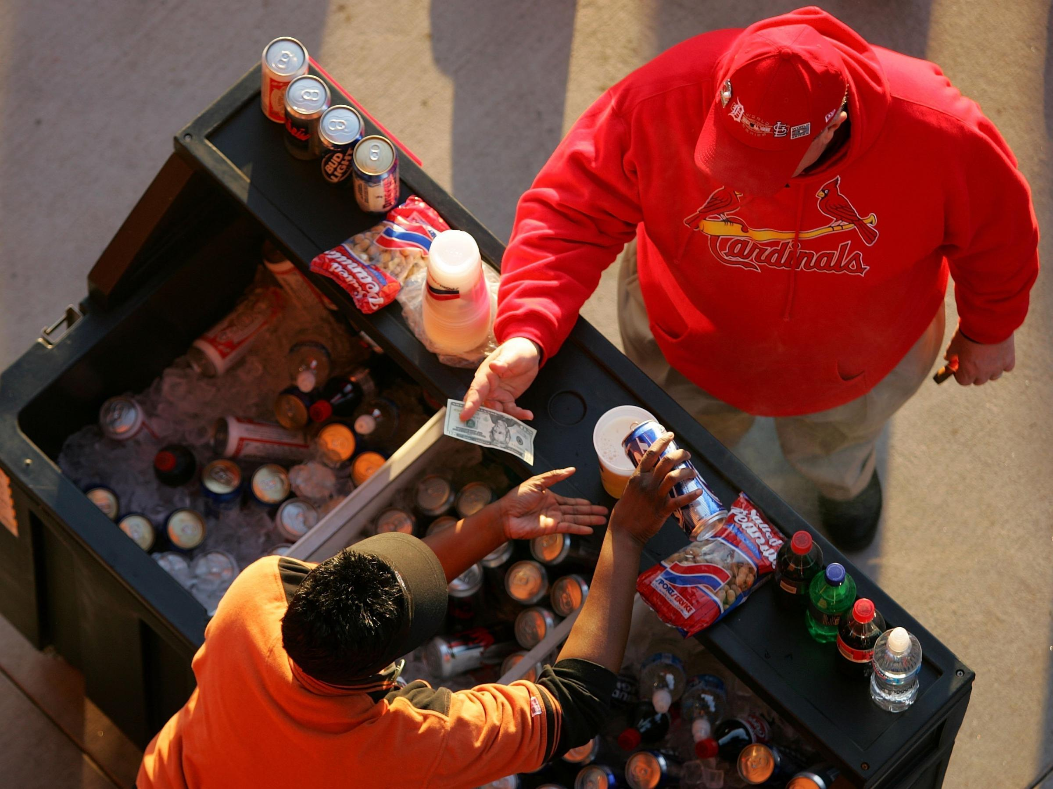

Slide 7
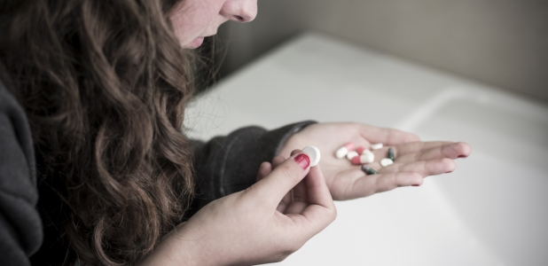
Alcohol is the most commonly used and abused drug among youth in the United States.

Slide 8
Teens ages 12 to 20 drink 11% of all alcohol consumed in the United States.

Slide 9
Twenty-five percent of youth ages 12 to 20 drink alcohol.

Slide 10
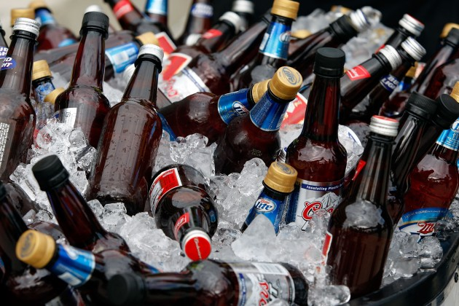
But which ages are drinking?

Slide 11
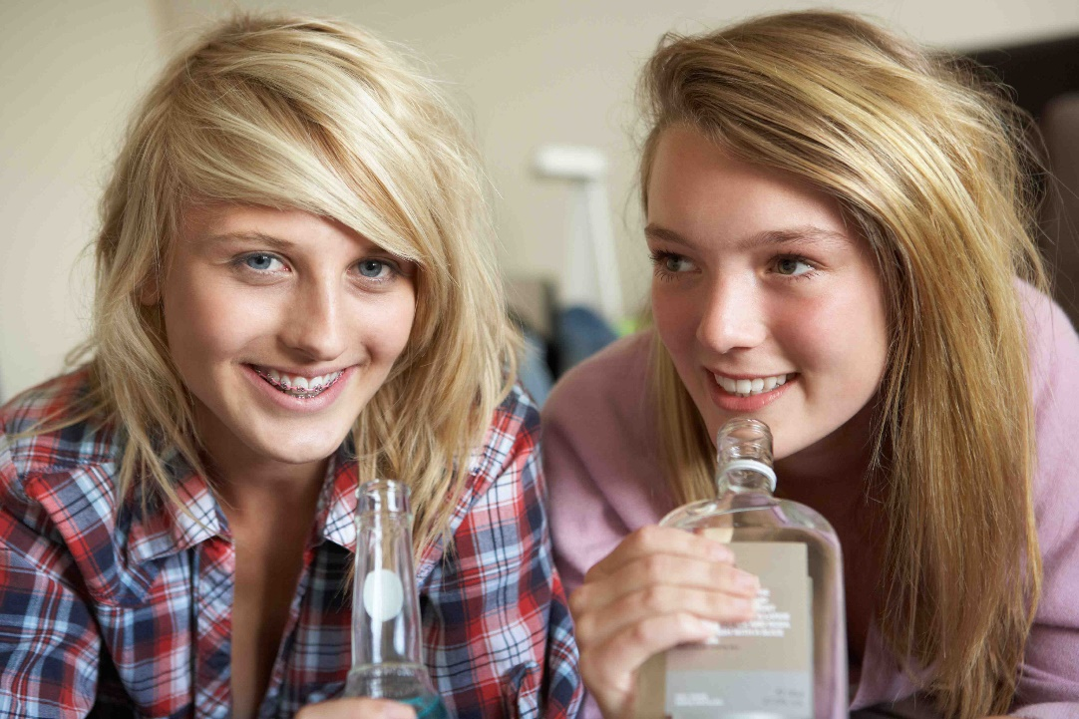
In the last 30 days 4 out of 10 8th graders have drunk alcohol.

Slide 12
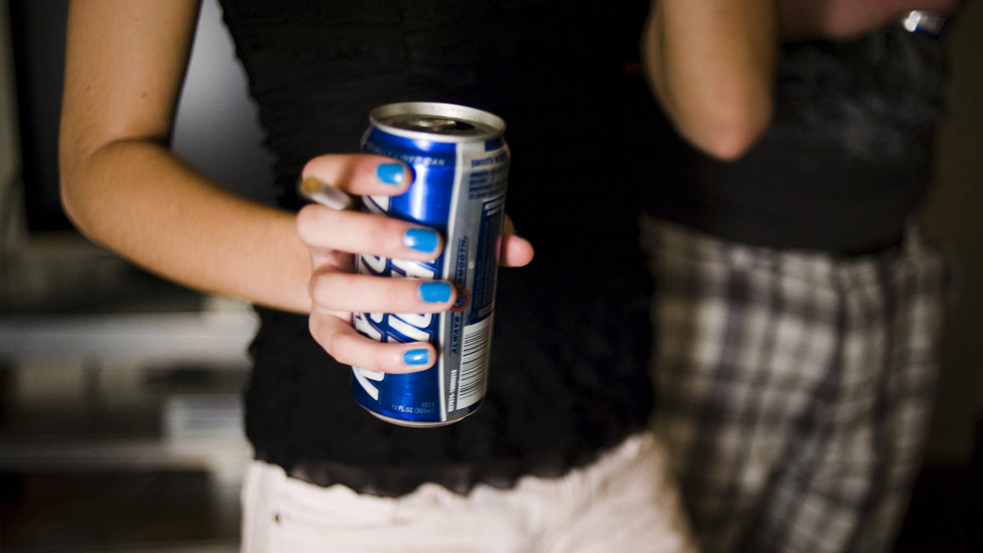
In the last 30 days 7 out of 10 12th graders have drunk alcohol.

Slide 13
Initial curiosity about alcohol can quickly become a habit.

Slide 14
An adolescent may become addicted to alcohol in as little as 6 TO 18 MONTHS.

Slide 15
ONE IN FIVE alcoholics in the United States is a teen between the ages of 13 and 17.

Slide 16
Youth who begin drinking before the age of 15 are FOUR TIMES more likely to become an alcoholic than those who wait until 21.

Slide 17
But there’s more.

Slide 18
Alcohol is responsible for more than 4,300 ANNUAL DEATHS among underage youth.

Slide 19
That equals about 11 deaths each day.

Slide 20
Which means that about every other hour we lose another life.

Slide 21
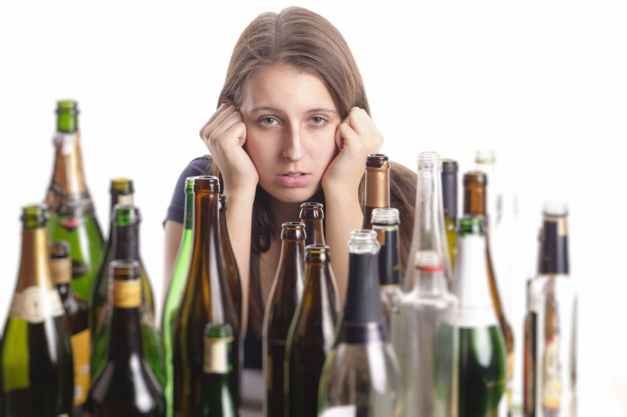

Slide 22
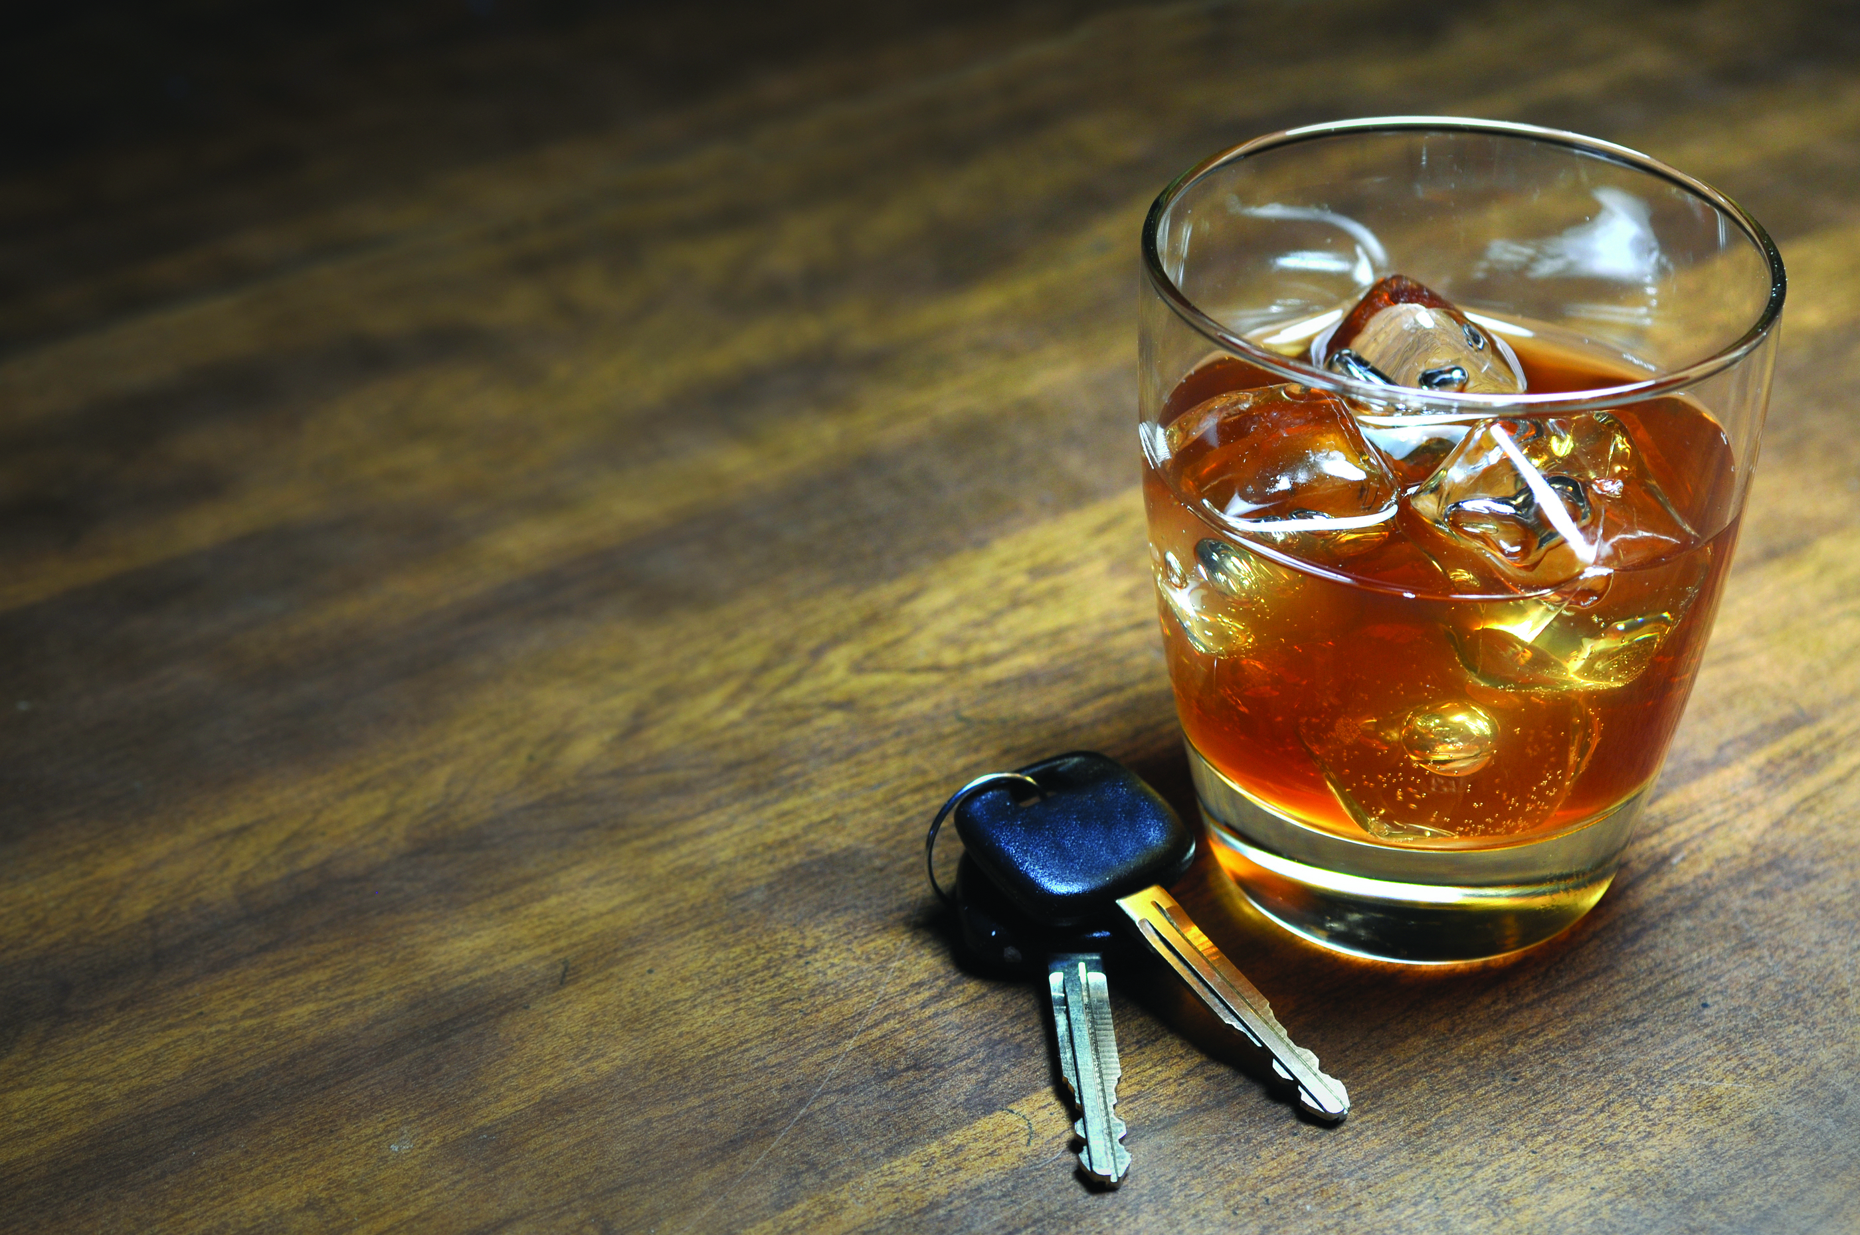
How has alcohol affected your school or community?

Slide 23
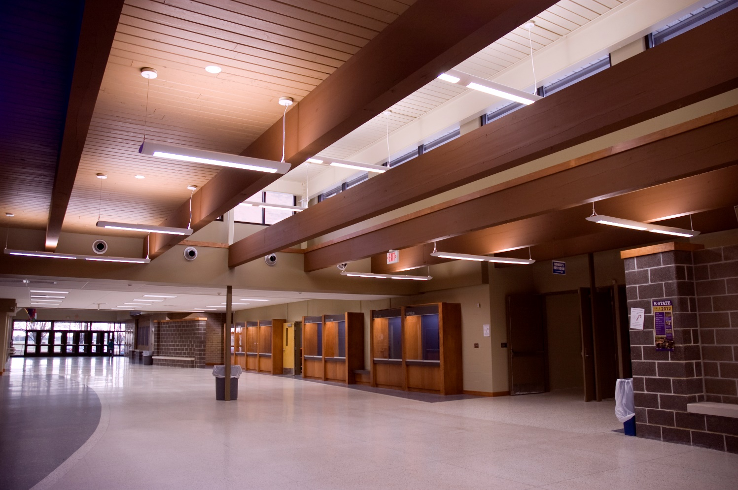
What is your school doing to fix the problem?

Slide 24
What else can be done?

Slide 25
“Excessive alcohol use is a leading cause of preventable death that kills many Americans in the prime of their lives. We need to redouble our efforts to implement scientifically proven public health approaches to reduce this tragic loss of life and the huge economic costs that result.” - Ursula E. Bauer, director of CDC's National Center for Chronic Disease Prevention and Health Promotion, June 2014

Slide 26
Change the culture of underage drinking.

Slide 27
www.missourisafeandsober.com

Slide 28
1. Middle school program
2. Parent program
3. High school program

Slide 29
1. MIDDLE SCHOOL PROGRAM

Slide 30
2. PARENT PROGRAM

Slide 31
Parent Video Excerpt: The Honorable Peggy Davis – (1:09)
Video Clip – Removed for Web Posting

Slide 32
Student Video Excerpt: Bailey Boatwright (4:01)
Video Clip – Removed for Web Posting

Slide 33
3. HIGH SCHOOL PROGRAM

Slide 34
REGISTER your school.

Slide 35
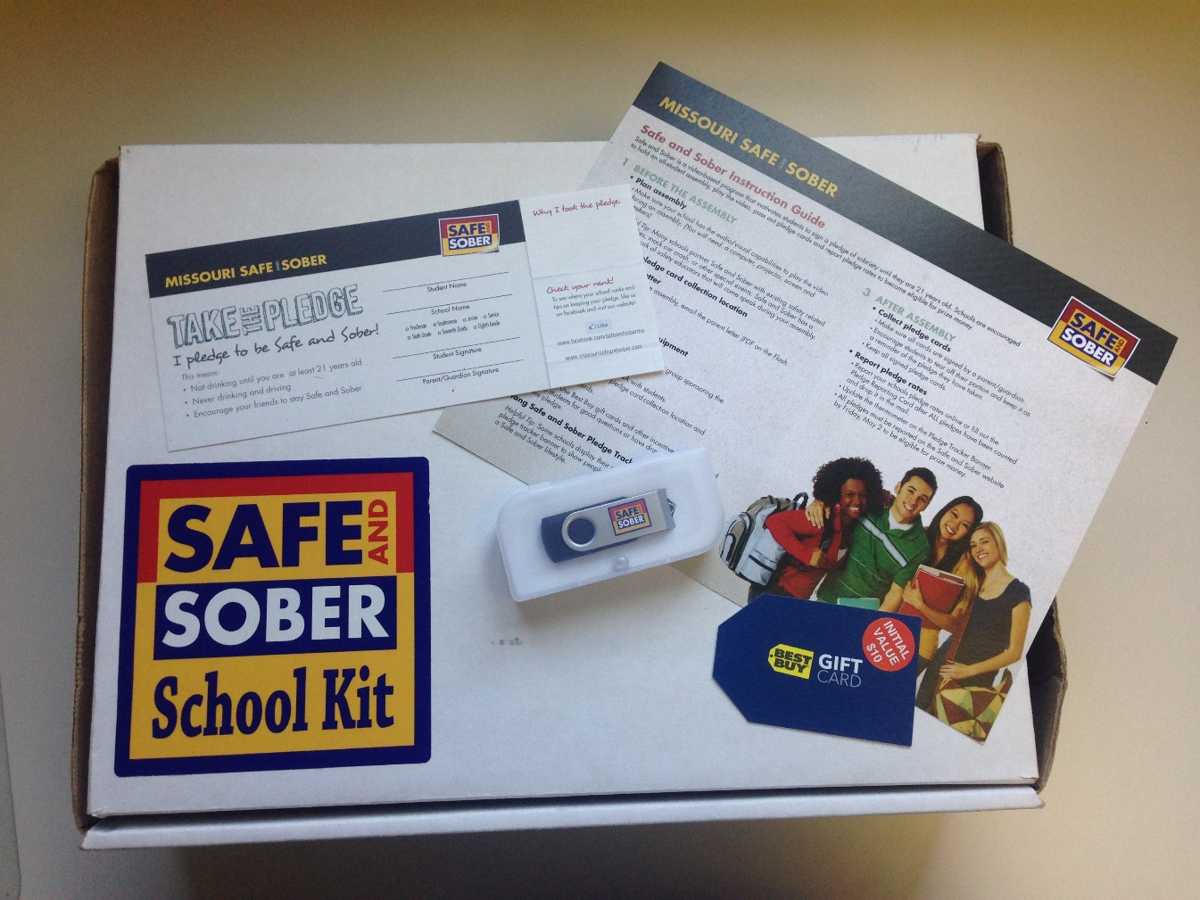
RECEIVE a pledge kit.

Slide 36
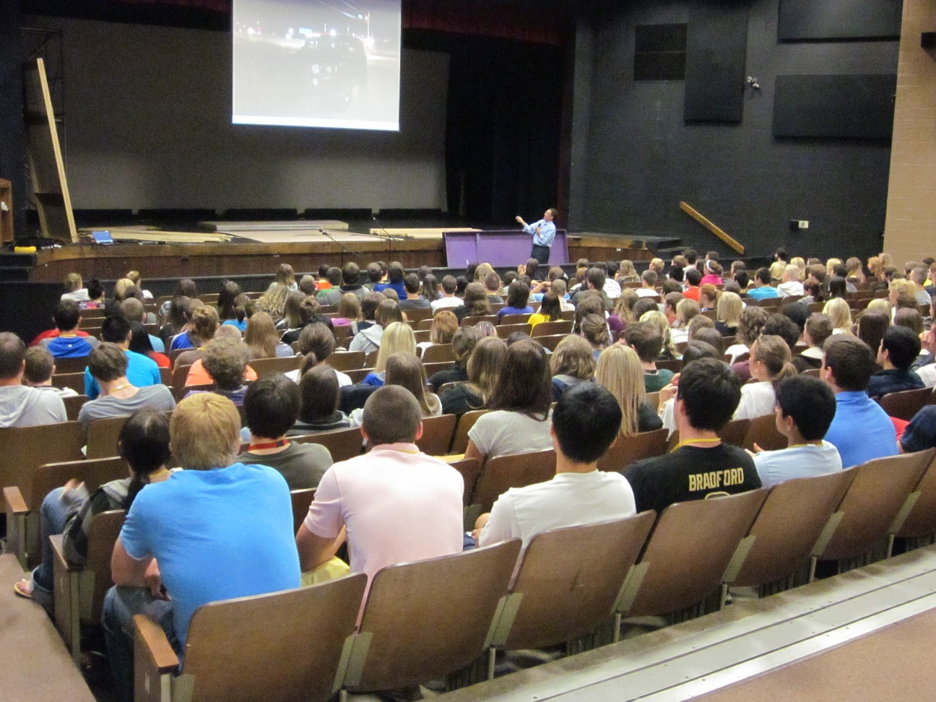
RALLY together.

Slide 37
Student Video Excerpt: Marlana Felty
Video Clip Removed for Web Posting

Slide 38
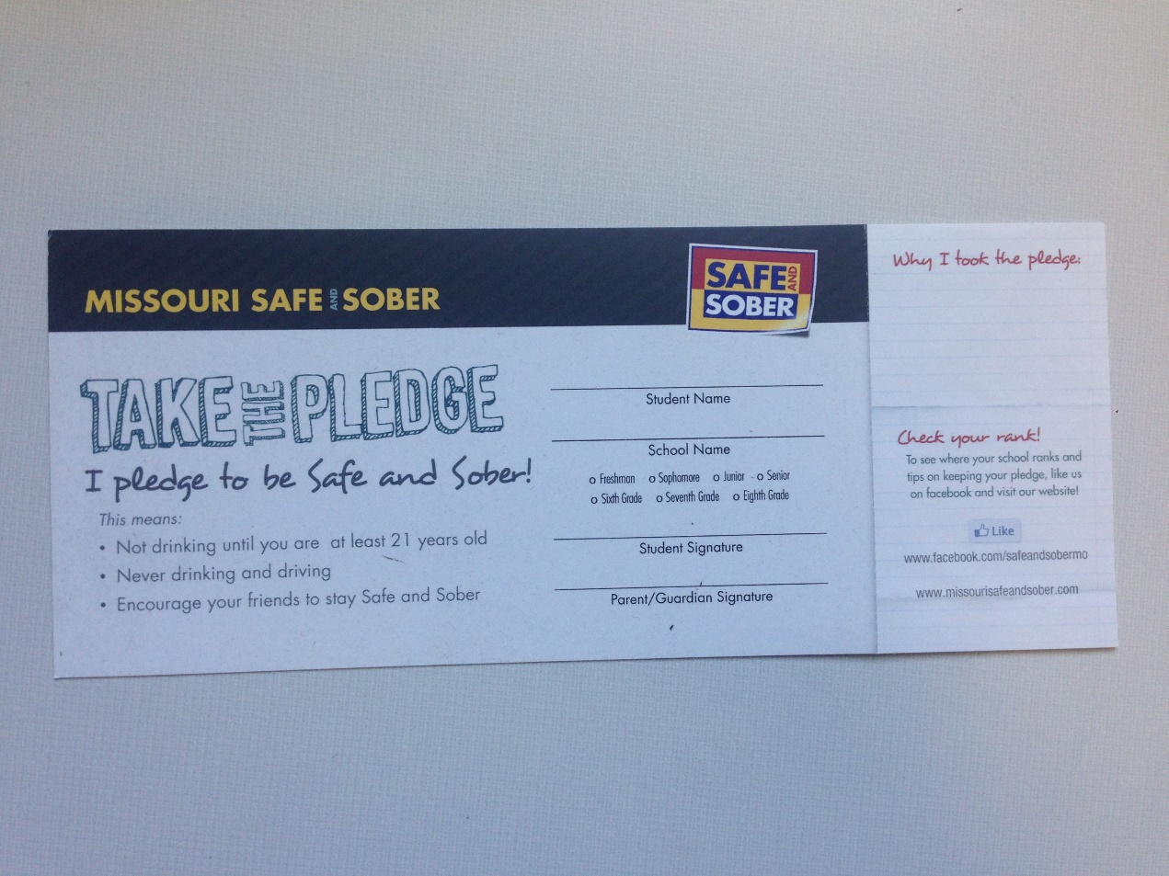
REPORT your pledge rates.

Slide 39
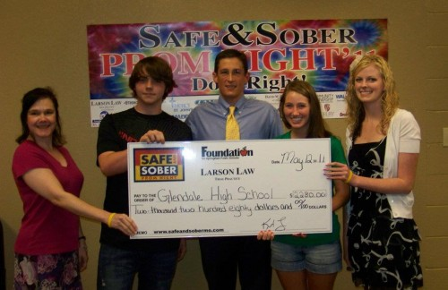
REWARD your school.

Slide 40
Register
Receive
Rally
Report
Reward

Slide 41
(ADD LOGO) 2013-2014 189 schools 76,000 high school students + MS Students + Parents

Slide 42
“We chose to use Safe and Sober because it has been proven to be AN EFFECTIVE PROGRAM to use to bring schools, parents and students together in the fight against underage drinking.” – Mickee Anderson, Counselor at South Iron R-1

Slide 43
“Our Safe and Sober assembly and video MADE AN IMPACT on our student body.” – Teresa Nash, Principal at Ava High School

Slide 44
“The program helped inform our students about the harmful effects of alcohol and the consequences that often come from its misuse … This program helped contribute to the fact that NONE OF OUR STUDENTS were involved in alcohol-related incidents for prom or end-of-the year activities.” – Brian Smith, Principal at Orchard Farm High School

Slide 45
Register Now: www.missourisafeandsober.com

Slide 46
Questions?

Slide 47
(ADD LOGO) "Never doubt that a small group of thoughtful, committed people can change the world. Indeed, it is the only thing that ever has." - Margaret Mead

