Slide 1

National Representative
2014 – 2015
Connect for Respect
Notes:
[NOTE TO SPEAKER….pass out handouts prior to the session starting)
[SAY] I am proud and excited to present this workshop on behalf of the National PTA. Thank you for taking your time to come to this session.
[INTRODUCE YOURSELF] (Name, where you are from, how long you have been engaged in PTA, PTA positions, your role at the convention and/or leadership training)
[SAY] Enough about me. Let’s find out who is in the room…
Raise your hand if you are a:
Unit leader
State leader
Council, regional, district leader
Member looking to become a PTA leader
(based on the above responses, select from the appropriate options below)
[SAY] Now let’s find out what roles people are currently in. Raise your hand if you are involved with:
Membership
Health & Safety
Programs
Family Engagement Chair
Fundraising
Finance
State Board
Council or Unit Board
Some of you did not raise your hands – what areas of your PTA are you involved in?
[ASK] What are you hoping to get from this workshop?
[CLICK TO NEXT SLIDE]

Slide 2
3 Learning Objectives
Understand the problem of bullying
Explain why school climate is important to preventing bullying
Discover how you and your PTA can support a solution with Connect for Respect
Notes:
[SAY] By the end of this workshop, you will be able to..
Understand bullying – its causes and effects
Explain why school climate is key to preventing bullying
Identify what you -- as a student parent or educator -- can do with your PTA to create a safer, more supportive for students to learn, grow and connect respectfully with others
[CLICK TO NEXT SLIDE]

Slide 3
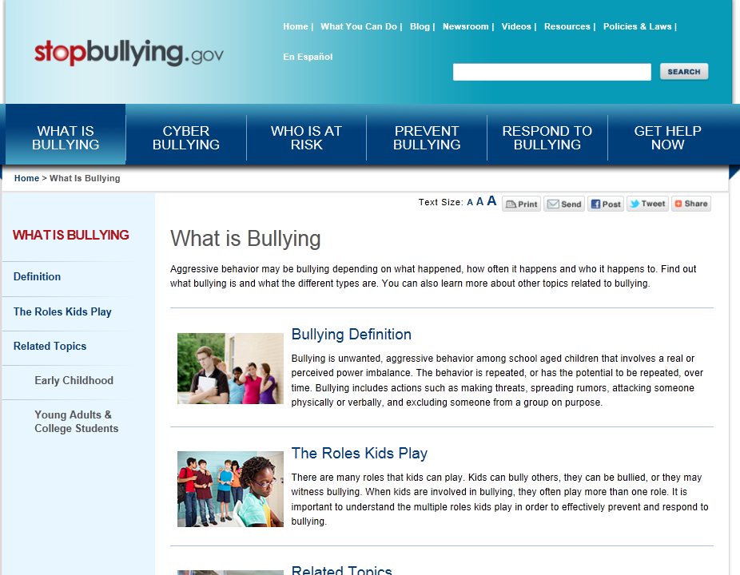
Notes:
[SAY]
To understand the problem of bullying, National PTA vetted nearly 100 organizations and bullying prevention organizations. We conducted a secondary literature review and primary market research – talking with students, PTA leaders and school experts – about bullying prevention efforts.
During this research phase of our program development, we also played an advisory role in developing StopBullying.gov, an interactive Web site with many resources. And we relied on this information hub for many of our educational messages and approach to bullying, which I will share with you today. Throughout the presentation, I will cite this web site or other organizations with an expertise in bullying prevention or school climate so that you can trust that you are getting the most relevant, research-informed strategies and information from National PTA.
[CLICK TO NEXT SLIDE]

Slide 4
What is bullying?
  Aggressive behavior that intends to cause harm, distress, or humiliation
  Repeated behavior over time
  Actions fueled by perceived imbalance of strength or power
Notes:
[SAY]
You have all probably heard a lot about bullying in recent years- it’s always been around, but it seems like it has garnered a lot of attention in the media recently. Currently, there is more research to determine the best prevention and intervention methods, and schools are taking more action to prevent bullying. In fact, many of you are probably becoming pretty familiar with the topic through presentations and school forums.
[ASK] (Facilitate discussion about bullying)
What is bullying?
What does it look like?
What does it feel like?
Who does it involve?
[SAY] (Guide discussion to cover these defining characteristics of bullying)
Researchers and practitioners generally agree that bullying has three defining characteristics:
[CLICK to advance bullets]
Aggressive behavior that intends to cause harm, distress, or humiliation
Repeated behavior over time
Actions fueled by perceived imbalance of strength or power (not a conflict between peers)
It is important to note that bullying is a form of victimization (or peer abuse) and shares some characteristics with other forms of victimization, such as domestic violence and child maltreatment. This means that bullying can truly leave a long-term traumatic impact on the overall well-being of a child. Research has shown that even the bystanders and witnesses of bullying are impaired by the hostile atmosphere it creates.

Slide 5
Bullying negatively impacts more than you may realize…
Students who are bullied
Students who bully
Students who witness bullying
And the overall school climate
Notes:
[SAY]
The science shows that bullying behavior negatively impacts all students whether they are targets of bullying, students with bullying behaviors or fall into the category of witnesses – or bystanders – to bullying.
As you’d expect, children who are targets of bullying are more likely to experience depression, anxiety, and decreased academic achievement. In very rare cases, bullied children may retaliate through violent measures, such as bullying others or even pursuing violence or taking actions that show they could be violent – such as bringing a weapon to school. And very rarely – more rarely than it is often reported – students who are targets of bullying succumb to the humiliation and harm themselves.
And the students who bully? In the moment, they may have the power but in the long run – they are likely to continue to engage in violent and risky behavior well into adulthood. They may be more likely to abuse drugs and alcohol, get into fights, receive criminal convictions, and be abusive in their other relationships.
Notice, we didn’t call this student – the bully? We said students who bully. That was intentional. Bullying is a behavior – to bully is a verb -- it is not a person. We can address, correct and prevent future bullying behaviors. Many kids who bully have been bullied by others – peers, parents, siblings, others – in their short lifetimes. We have to address their bullying actions while seeking positive solutions that resolve the anger within them so that this behavior stops. So that this behavior doesn’t become their norm in life. That takes a measure of discipline for the action – but it also takes compassion and trusted guidance. So you will never hear us call a student a bully. Because PTA is focused on making sure every child has the opportunity to achieve their potential. When you cut any student down with words – their potential is limited.
There is a third group that might hit very close to home if you don’t already feel connected to the two types of students we’ve discussed and that’s -- students who witness bullying. Recent research shows that students who witness bullying are negatively impacted. These students are more likely to feel anxious or depressed, miss or skip school, and have increased likelihood of using tobacco, alcohol, or other drugs.
When you think about it – is there a student who isn’t touched by bullying? The answer is no. And that’s why we are focused on improving the overall school climate.
[CLICK to reveal last bullet]
The National School Climate Council defines school climate as the “quality and character of school life.”
So what does that mean?

Slide 6
Bullying and School Climate
Coursework is Engaging
Strong Curriculum
Effective Teachers
Positive School Climate
Learning is supported by families
Students feel respected
Safe and Welcoming Environment
Notes:
[SAY]
Three key factors contribute to creating a school climate including:
A strong curriculum
Effective teachers
And a safe and welcoming environment
[CLICK] (There are four clicks to animate the components of school climate in the graphic)
The result is that families know they are welcome on campus and participate in their students’ learning;
Coursework is engaging
Students feel respected and more teachers look forward to coming to work
And when you put these together – you’ve created a positive school climate.
Over the last 30 years, there has been a growing body of research to show how school climate is associated with academic achievement, as well as effective risk prevention, graduation rates, and teacher retention.
In fact, research shows when bullying is a part of the school climate, students do not feel emotionally or socially safe, and may also not feel physically safe. This kind of negative climate may impede academic achievement among students. (Adapted from http://www.edpubs.gov/document/ed005207w.pdf?ck=1)
You may remember how it felt from your school days. Or you may see it happen every day at work. Bullying behavior creates an unhealthy, unproductive tension that is difficult to function in. Everyone is affected by the negativity.
So how does it get fixed? You might quickly think of the boss – the school principal. While the school principal sets the expectation for school climate – it is not the principal’s job to fix the school climate. It takes a commitment from students – yes, students!– teachers, school staff, families, and others in the community who work together to develop, live, and contribute to a positive social environment.
That was a lot of information to absorb. Let’s take a minute and apply some of the theories to your real-world experiences.
[CLICK TO NEXT SLIDE]

Slide 7
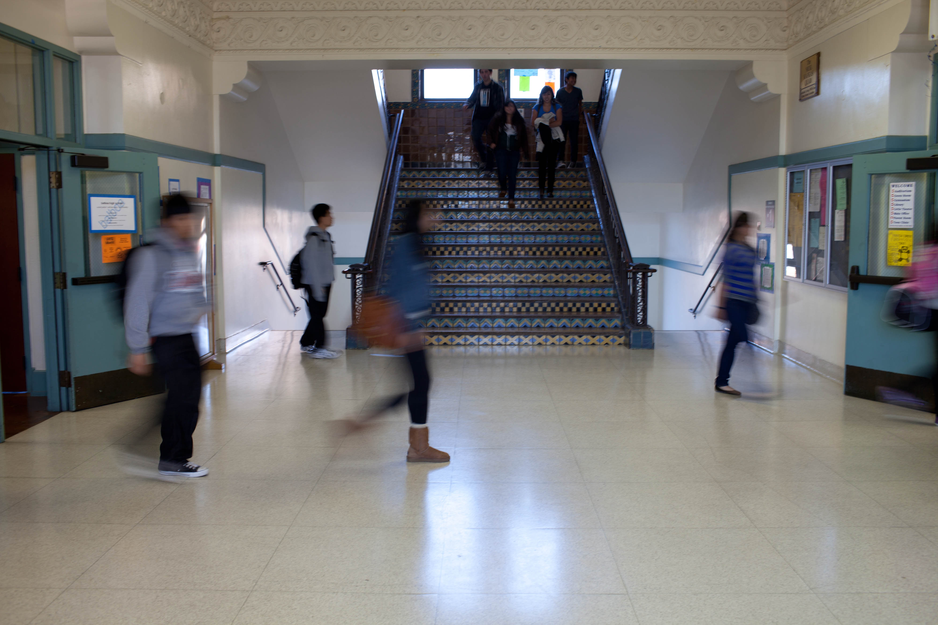
Discuss: Your School Climate
Do you feel welcome at your school?
Do students have positive peer relationships?
How is teacher morale?
What are the challenges that your school faces?
Notes:
[ACTIVITY - THINK. PAIR. SHARE.]
For the next few minutes, jot down some observations about your school climate. What is your school climate like? Consider the curriculum, coursework, teacher effectiveness and morale, welcoming and safe environment. What supports are in place to foster a positive school climate – enrichment programs, family engagement strategies, professional development for teachers, character education programs?
What challenges your school climate? Is it peer relationships or bullying? Teacher morale? Lack of resources? Community stressors? Other challenges?
Take a minute to write down your thoughts. Then pair with someone next to you to share.
(Allow for independent thinking for 2-3 minutes, then invite people to share with their neighbor for 2-3 minutes)
[DISCUSSION]
Ok, who wants to share more about their school climate?
What are the challenges?
What’s going on at your school to foster healthy, supportive peer relationships and teacher-to-student relationships?
(Facilitate 5-minute dialogue with audience sharing experiences)
[SAY]
Thank you for sharing.
[CLICK to advance slide]

Slide 8

Improving
School Climate:
PTA’s Connect for Respect
Notes:
[SAY]
Now that you know more about the problem of bullying and the theories of working toward an overall more positive school climate.
Let’s talk about how National PTA guides local PTAs and PTSAs to engage students, families, school personnel and the community in an action plan to address school climate challenges, such as bullying. That’s what we call Connect for Respect. This strategy was launched a few years ago, but in 2014, we rejuvenated it in many ways beginning with the program goal.
[CLICK to advance slide]

Slide 9
Goal:
To build safe and supportive
school environments filled with
healthy peer relationships.
Notes:
[SAY]
It is through these findings that National PTA’s Connect for Respect aims to address the overarching issue of school climate in order to prevent and decrease bullying. Our program goal is to support safe and supportive school environments filled with healthy peer relationships. In many ways, PTA partners with schools to ensure that the curriculum is engaging, teachers feel supported and families are engaged to support student learning. But what are we doing to help create a safe and welcoming environment? How are we engaging students in our approach?
Those types of questions in our research phase of program design led us to this broader focus on school climate.
The most effective schools build a culture of respect that is pervasive throughout the school – respect among students, respect among parents, respect among school staff, respect among students and school staff, respect among parents and school staff – mutual respect is prevalent in all relationships at effective schools. Research says that building a culture of respect is more effective in addressing the overall problem of bullying than focusing narrowly on specific bullying incidents. Specific bullying incidents need to be addressed, but the problem as a whole won’t stop without one word: respect.
Students and families are key drivers of respect. Strong family-school partnerships translate into healthier school climates.
[CLICK to advance slide]

Slide 10
National PTA Standards for
Family-School Partnerships
Notes:
[ASK] Raise your hands if you are familiar with PTA’s National Standards for Family-School Partnerships?
[SAY]
These standards are a framework for you to use when engaging families – students and parents – in initiatives that aim to support student success or school improvements.
National PTA developed these standards several years ago based on research that shows when families, schools and community members work together – students are more successful, families are more equipped to support their learning, social and emotional development, and teachers feel more supported.
These standards articulated, for the first time, what family engagement should look like at the school level. So what does this have to do with bullying?
Every program that National PTA designs helps you to achieve these standards. So how does Connect for Respect do that?
Standards 1 and 2, “Welcoming all families into the school community” and “Communicating effectively” are the foundation of mutual respect among the school, PTA, and families you represent. This is how you first connect and sustain strong relationships that are focused on the needs of students above all else.
Considering the issue of bullying, supporting student success means creating a safe learning environment where students have an equal opportunity to excel without fear or humiliation. School staff collaborate with families to nurture social and emotional development.
Speaking up for every child means – finding the most effective way to prevent bullying, protecting all students involved – all students. That includes the student who bullies. When you speak up for every child, you question what is causing that behavior and what is needed to stop it from happening in the future?
Sharing power translates to engaging a range of stakeholders in the discussion around the school climate and prevention of bullying. And the stakeholders have equal power in the dialogue and action planning – and these stakeholders include students. We’ll talk more about our Connect for Respect program tools that will support you as you convene this dialogue and determine a prevention plan together.
Finally, collaborating with community speaks to the reality that bullying is a behavior that does not occur in a school building alone – it happens in other places where students interact, learn and connect – online and offline. If your school and PTA are addressing this problem together, you should consider other community organizations that are prevalent in your students’ lives – youth sports, faith-based and library organizations or nearby businesses – that may want to be part of the solution because they, too, witness the problem.
You see how these standards can be your roadmap to effectively engaging families in partnership with your school? If you are a PTA leader, this is your opportunity to increase membership too as more families see the important role your PTA plays in making school a safer, more supportive place for their student. They may want to deepen their involvement in PTA or support your efforts in a deeper way as members.
[CLICK TO THE NEXT SLIDE]

Slide 11
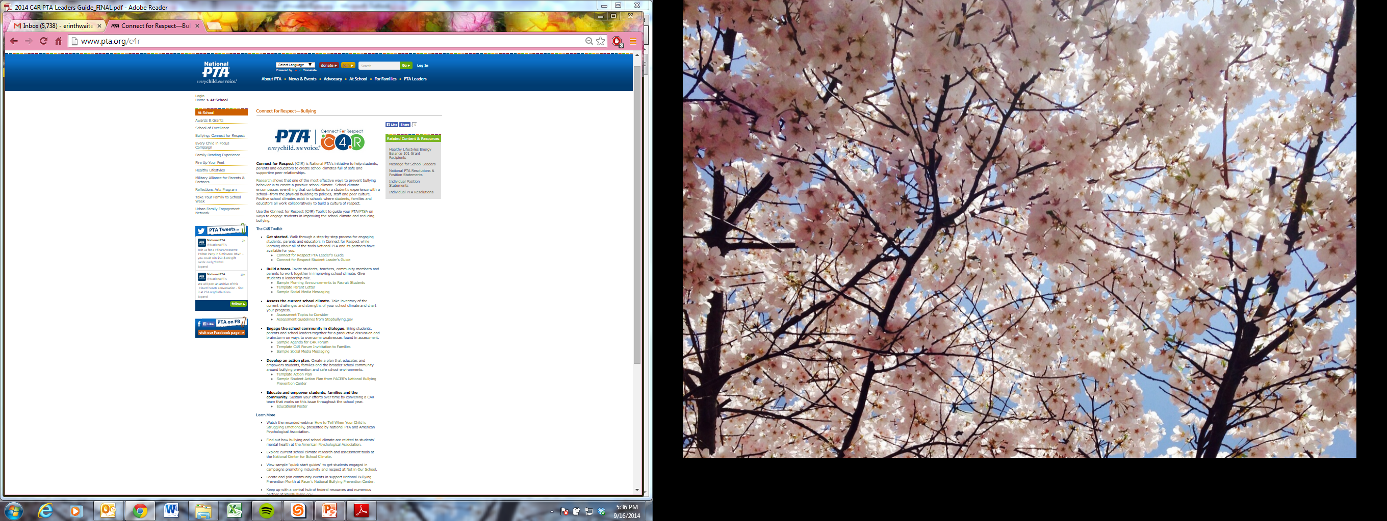
Get Started:
Visit PTA.org/C4R to access:
  PTA Leader Guide
  PTSA Student Leader Guide
C4R Toolkit: PTA.org/C4R
Notes:
[SAY]
Enough with the theories. Let’s dive into how you can take action.
To help plan a Connect for Respect initiative, we have pooled all the relevant resources and templates into a “digital toolkit” on pta.org/C4R.
On this page, you will find PTA Leader’s Guides, template tools, and links to partner resources.
[CLICK TO NEXT SLIDE]

Slide 12
Notes:
[SAY]
Connect for Respect is a 4-step process:
First, you will build a Connect for Respect team.
Second, the Connect for Respect team – or C4R team for short -- will assess the school climate.
Third, the C4R team will engage the school community at Connect for Respect forums.
At the forum, the school community will develop an action plan.
Throughout the school year, the C4R team will chip away at the plan, empowering students, family members, school staff and community members to take the steps that will improve the school climate and prevent bullying.
Let me show you the tools we have available for each step of the plan.
[CLICK TO NEXT SLIDE]

Slide 13
Build a C4R Team:
Recruit students, families, teachers, school staff, community members
Share the Leaders Guides with C4R team
Visit PTA.org/C4R to access:
  Morning announcements
  Parent letter
  Social media messages
C4R Toolkit: PTA.org/C4R
Notes:
[SAY]
First, you must build your Connect for Respect team. This team should be reflective of the entire school community – especially students. We’ll talk in a minute about that.
The best way to build a team that is deeply engaged is to share information. Share the links to the Leaders’ Guides and the digital toolkit.
Consider the types of leadership roles you will need, such as:
Family Engagement – the person who takes the lead promoting efforts to families, gaining their insights and growing involvement from families
Student Engagement – the person who takes the lead recruiting students, gaining their insights, and promoting efforts to students
School Staff Engagement – the person that keeps all the school staff informed about the activities, gains their insights, and promotes the ways to get involved
Event manager – the person who coordinates the logistics for the Connect for Respect Forum and other C4R events
If you have many people who want to help – they can determine where they fit best in terms of supporting the effort and which leader they will work with.
[CLICK TO NEXT SLIDE]

Slide 14
Tips for Engaging Students:
Understand what motivates student leaders
Guide, don’t decide
Offer your knowledge, experience, resources
Model respect and provide encouragement
Serve as a liaison with school
Other tips?
C4R Toolkit: PTA.org/C4R
Notes:
[SAY]
Students are on the “front lines” of school climate, and they must be at the forefront of your C4R efforts. You will need more than just a few student representatives on your team—you need a critical mass of committed, engaged student leaders who will take ownership of the program with your
support and encouragement.
Engage student leaders from nearby middle schools and high schools as peer mentors to younger students at feeder schools.
An existing leadership group, such as the student council, may be an obvious place to start. However, be sure that the students on
your planning and action teams are diverse and represent a variety of social groups within the school.
The following are some tips to make your work with student leaders rewarding for all:
• Understand what motivates student leaders. Take some time to get to know them—why are they interested in this project, what
are their goals for the future, and how can you help those two things work together?
• Guide, don’t decide. Instead of making decisions for students, act as a sounding board to support their own critical thinking. Then, help students reflect on the decisions they have made, especially those with less-than-positive outcomes.
• Offer your knowledge and experience. Share resources and tools that have worked well for you in the past, as well as personal experiences that may help students keep things in perspective and persevere when they hit a snag.
• Serve as a liaison with the school administration. Help students understand the school’s perspective, rules and guidelines. Be their advocate if students are struggling to be heard.
• Model respect. Students will look to you to set the tone. In all interactions—with student leaders, fellow PTA leaders, and the school administration—communicate respectfully, welcome all perspectives and follow through on your commitments.
• Provide encouragement. Show students that you believe in their abilities, help them set and achieve goals, and encourage them to challenge themselves. Find ways to recognize their accomplishments—this will keep students engaged and help to attract future leaders.
[IF STUDENTS ARE PRESENT, ASK ]
Student leaders in the room. What tips would you give? What should PTA leaders do – or not do – when working with you on this or other initiatives?
[ASK]
You all have experience working with students. What works for you?
[CLICK TO NEXT SLIDE]

Slide 15
Assess the School Climate:
Meet with school leaders to discuss:
  Data (e.g., incidents, student/parent perceptions)
  Policies
  Existing curriculum (e.g., PBIS, Olweus)
  Existing programs (e.g., Character Counts)
Explore the environment considering:
  Student safety
  Student learning
  Social connections
C4R Toolkit: PTA.org/C4R
Notes:
[SAY]
The next step is to assess the school climate. Why is this important? Well, the principle of “work smarter, not harder” is why. It is important to determine where you need to focus your energy – and what already exists that you can build from. There’s no need to recreate the wheel- if your school already has programs in place to prevent bullying and improve school climate, then your team can work to support and reinforce those programs.
The first step of assessing the school climate is to meet with the school leaders. Be sure to engage your student leaders in this conversation. Talk about the quantitative – or numeric data that exists related to bullying incidents. Ask about whether there has ever been a parent or student survey and let the school leader know that you’d like to conduct one, if not.
Talk about the policies in place for preventing and addressing bullying.
Does your school have any existing curriculum or character education program? If so, ask how could families be more informed and engaged in that effort?
Now take a walk. Explore the school environment. Are there any areas where student safety may be a concern – or environments that are not conducive to learning or making positive social connections? We have tools available on the C4R Kit to help you assess these questions.
[CLICK TO NEXT SLIDE]

Slide 16
Assess the School Climate (cont.):
Gather feedback from students, school staff, families and others in the community
Visit PTA.org/C4R to access:
  Environmental assessment tools
  Sample surveys
  Model policies
C4R Toolkit: PTA.org/C4R
Notes:
[SAY]
Next, you’ll want to gather feedback from students, school staff, families and others in the community who regularly interact with students of the school, such as a community-based aftercare program.
You could send a survey, host a focus group, conduct phone interviews, etc.
We have links to a number of tools at PTA.org/C4R to help you gather this feedback.
[CLICK TO NEXT SLIDE]

Slide 17
Engage the School Community:
Promote and host a Connect for Respect Forum for your school community
  Goal
  Key findings from school climate assessment
  Group discussion focused on solutions
  Next steps
Visit PTA.org/C4R to access:
  Sample agenda
  Event promotion tools
C4R Toolkit: PTA.org/C4R
Notes:
[SAY]
The next step in the process is to engage the school community by hosting a Connect for Respect Forum. There is not a one size fits all approach to this forum. Yours might be a small gathering of 10 or 15 people, or it might be a large public forum with as many as 200. It could be a town hall type of conversation or a roll-up your sleeves kind of workshop with tables that breakout for discussions.
Recruit a parent, school leader or community member who has experience facilitating large group discussions before and ask him/her to help you create the agenda in a way that maximizes audience participation to gain the most perspectives.
For example, you may have a student share the goal and key findings from your school climate assessment in partnership with the school principal or another school or PTA leader. Then, you can break out into small groups to talk about solutions that educate, empower or improve an environment or policy. After you break out, there could be large group discussion and sharing. Then finally, you will develop some short-term next steps that will help you get to the goal.
This is a great opportunity to recruit new members of the C4R team. People will feel passionately about what happens next – so invite them to be part of it!
We have a number of tools to help you plan for your Connect for Respect Forum, such as a sample agenda and event promotion tools.
[CLICK TO NEXT SLIDE]

Slide 18
Develop and Deploy an Action Plan:
Create 3-4 specific and measurable objectives to:
  Educate and empower students to be respectful
  Enact environmental or policy improvements
  Enhance existing curricula or programs
Gather resources to sustain your efforts
Measure progress and celebrate the C4R team’s impact on your school
Visit PTA.org/C4R to access:
  Sample education messages
  Fundraising tools
C4R Toolkit: PTA.org/C4R
Notes:
[SAY]
There will be a ton of information, new perspectives and great ideas to digest after your Connect for Respect Forum. Create 3-4 specific and measurable objectives to educate and empower students to be more respectful to each other, make improvements to the environment or policies, or enhance existing curricula or programs by deepening family engagement in these efforts.
This is the beginning of a sustained effort focused on school climate. You may need to seek financial or in-kind support for some of your efforts, and you’ll need to meet in a consistent and regular way throughout the year to chip away at this action plan.
Measure your progress and celebrate in a big way the way your C4R team is improving your school.
We have a number of tools available at PTA.org/C4R to help you, such as a sample action plan, educational messages for morning announcements and fundraising tools.
[CLICK TO NEXT SLIDE]

Slide 19
Feedback: programs@pta.org
Notes:
[SAY]
What we hope to achieve with this program is to support safe and supportive school environments filled with healthy peer relationships. We hope you think this program will help you accomplish that. But like all of our programs – we are constantly working to improve them. The best way to do that is to hear from you. Email us at programs@pta.org so we know what you need – and tell us how you’ve implemented the program. If you’ve created something you think is great – let us know!
We’ll also be following and celebrating your efforts on Twitter using the hashtag #PTAC4R.
We want to celebrate your efforts nationwide and share your story because your story will inspire others.
Speaking of sharing, have you seen National PTA’s initiative called #ShareAwesome?
[CLICK TO NEXT SLIDE]

Slide 20

PTA’s Digital Citizenship & Internet Safety Campaign
Shareawesomenow.org
Notes:
[SAY]
Today’s families use digital technology in every aspect of life – from socializing to learning, gaming and shopping! Through ShareAwesome, National PTA and our sponsor LifeLock provide ways families can create open, evolving conversations about safe, positive decisions when using digital tools.
This initiative complements Connect for Respect beautifully because we all know some of the bullying incidents that happen occur in digital environments. So explore this more at shareawesomenow.org and see how you can enhance your Connect for Respect efforts in an awesome way.
[CLICK TO NEXT SLIDE]

Slide 21
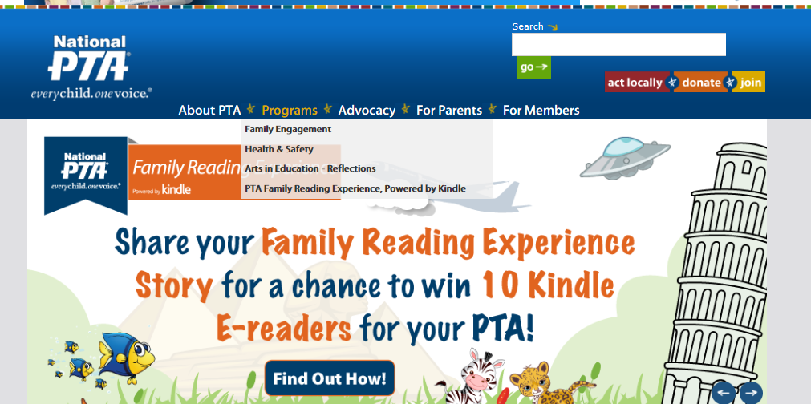
Visit PTA.org/Programs and PTA.org/Awards
Notes:
[SAY]
Before we wrap up, let me tell you a few other ways National PTA can help you.
The National PTA team is rolling out new programs, grants, resources – all the time. Visit PTA.org/programs to explore these resources and bookmark the page to visit every now and then to see what’s changed. Also, make it a point before every PTA meeting to check PTA.org/awards to see the grant opportunities National PTA has to offer.
[CLICK TO NEXT SLIDE]

Slide 22

Advocacy
Sign up for PTA Takes Action
Access Advocacy Toolkit
Review National PTA Federal Policy Agenda
Join fellow PTA advocates for the National PTA Legislative Conference
For more information, visit pta.org/advocacy
Notes:
[SAY]
National PTA also offers many different opportunities for you to advocate and work towards long term change on issues that impact children.
[CLICK]
You can join the PTA Takes Action Network to stay informed on legislative issues affecting families, schools, and communities, and to take action to write your members of Congress when they are considering legislation.
[CLICK]
You can access the Advocacy Toolkit which is designed to help child advocates speak up for the health and wellbeing of all children. Use this resource for everything from writing your legislators to scheduling Capitol Hill visits—even to reach out to the media.
[CLICK]
Each year National PTA publishes a federal public policy agenda that outlines policy priorities and recommendations for Congress. The priorities are selected based on the timeliness of the issue, opportunities for National PTA to provide leadership and expertise to Congress, alignment to National PTA’s mission and resolutions, and ability to achieve a meaningful policy change that will produce positive results for children and their families.
[CLICK]
The Legislative Conference Join is an exciting three-day event that provides in-depth discussion about PTA’s public policy priorities through interactive workshops, keynote speakers, advocacy trainings and more.
[CLICK]
For information on National PTA Advocacy, visit www.pta.org/advocacy.
[CLICK TO NEXT SLIDE]

Slide 23
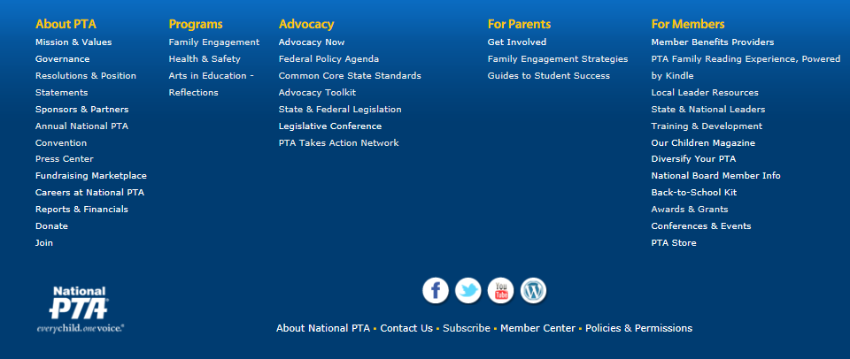
Visit PTA.org to stay connected!
Site map for other programs, tools and resources
Social media (Facebook, Twitter, YouTube, Pinterest)
Subscribe to e-newsletters
Notes:
[SAY]
How many times have I said “go to PTA.org?” today? So many times – I lost count!
But how do you find all of the tools we’ve mentioned? Here’s where I’d start. Go to pta.org and scroll all the way down. There, you will see a high-level site map that will point you to our programs, tools and resources. We also have a very robust search function that you can use.
I also want you to check out our social media. Many times we hear from local leaders, “I wish I knew that!” Following PTA’s social media is a great way to keep up with the many new programs and resources we are unveiling in the coming year. This includes local PTA grant and in-kind donation opportunities!
Finally, take a look at the very bottom – if you can see it, you’ll see two important links: Contact us and Subscribe. When you click on “Contact Us,” you’ll be directed to a page that includes a staff list and email forms. You are our members – and our staff are here to serve you!
When you click on “Subscribe…”
[CLICK TO NEXT SLIDE]

Slide 24
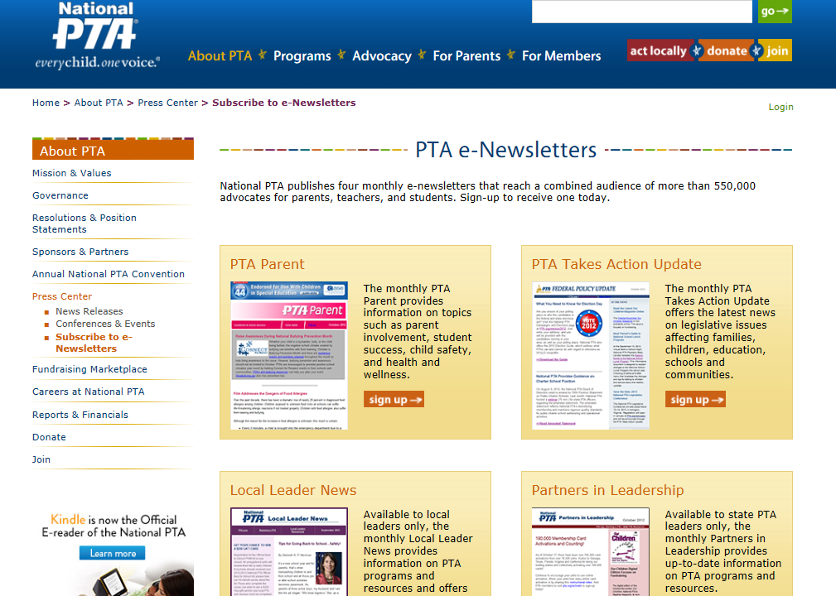
Notes:
[SAY]
You will see all of the options for our newsletters. National PTA has improved these e-newsletters tremendously in recent months to be focused on what you need to know – new PTA programs, advocacy actions, funding opportunities, best practices in member recruitment.
[CLICK TO NEXT SLIDE]

Slide 25
Membership Benefits
You Are a Part of a Network:
54 PTA Congresses: including Puerto Rico, Europe DOD, and Virgin Islands
Over 20,000 PTAs and over 4.3 million members
You Are a Part of a Network with Benefits:
AARP, eTrak, Hertz, iFocus, MetLife, RSC, Sharp, and Staples
Visit PTA.org/Benefits to learn more
You Are a Part of a Network with Support:
Customizable membership applications, marketing materials, and information on new and existing benefit providers
Visit PTA.org/Today to learn more
Notes:
[CLICK]
[SAY]
And remember, as a PTA member, you are part of a network made up of 54 congresses, including Puerto Rico, Europe DOD, and the Virgin Islands
With over 20,000 PTAs across the country and over 4.3 million members,
[CLICK]
you can be sure that you are part of a network with benefits.
Whether you're buying school supplies for the kids, or renting a car for your next family vacation, PTA members can save money on everyday purchases thanks to National PTA's Member Benefits Provider Program.
Our current benefit offers include AARP, eTrak, Hertz, iFocus, MetLife, RSC, Sharp, and Staples.
Visit PTA.org/Benefits to learn more about how PTA members can save time and money and for the latest information on new and existing benefit providers.
[CLICK]
And as a valuable PTA member, you are also part of network with support.
National PTA offers many resources for PTA unit leaders including customizable membership applications, marketing materials, and much more. Visit PTA.org/Today to learn more.
Now that you know all about what we have to offer…you’re ready to go plan a program!
[CLICK TO NEXT SLIDE]

Slide 26

Questions?
Notes:
[ASK] Are there any questions?
[FACILITATE DIALOGUE]
[SAY] Thank you for your time, enthusiasm and passion for growing a diverse PTA that supports the academic success and overall being of every child!

