Slide 1

A “Taste” of
Youth
Mental Health First Aid
Presented by:
Jean Harris-Sokora

Slide 2
Mental Health First Aid-What is it?
Mental Health First Aid (MHFA) is the help
offered to a person (young or adult) experiencing
a mental health challenge, mental disorder, or a
mental health crisis. The first aid is given until
appropriate help is received or until the crisis
resolves.
Mental Health First Aid does not teach people to diagnose or to provide treatment.

Slide 3
Why Mental Health First Aid ?
Mental health problems are common
Mental health problems often develop during adolescence
The sooner an individual gets help, the more likely they are to have a positive outcome
Youth and young adults experience mental health problems differently than adults
Misunderstanding and discrimination are often associated with mental health problems
People may not be well informed
Professional help is not always on hand
Notes:
Why is it important for those who work with youth? What role in youth’s lives do you play? Many of these are common to the adult course, but some are not because of developmental issues. It’s estimated that ½ of all mental disorders begin by age 14 and ¾’s by age 24.

Slide 4

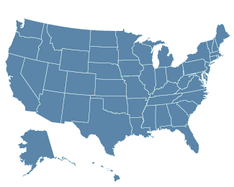
Program Milestones
Created in Australia in 2001
  (University of Melbourne)
Currently in 17 countries
Piloted in the U.S. in 2008
U.S. youth program pilot in 2012
Notes:
Countries include: Scotland, China, Canada, Finland, Singapore, Ireland, Wales, England, Cambodia, Japan, South Africa, Thailand and New Zealand

Slide 5





Mental Health First Aid in the News
October 10, 2011 | Morning Edition | by Kelly Weiss
Mental First Aid: How To Help In An Emotional Crisis
October 18, 2011 | Talk of the Nation | by Neal Conan
Mental Health First Aid in the Workplace
January 23, 2011 | by Michael Winerip
Positives With Roots In Tragedy On Campus
October 18, 2011 | For Your Health
January 18, 2011 | by Rachel Saslow
Shooting in Tucson Sparks Interest in ‘Mental Health First Aid' Courses
March 12, 2012 | by Kim Painter
Classes Teach ‘First Aid' for Mental Health Crises

Slide 6
Evidenced Effectiveness
Four published randomized control trials and a qualitative study (in Australia)
  Increases mental health literacy
  Expands individuals’ knowledge of how to help someone in crisis
  Connects individuals to needed services
  Reduces stigma
Study on 33 US college campuses 2009-2011
  Increased mental health literacy
  Reduction in social distance (decreased stigma)

Slide 7
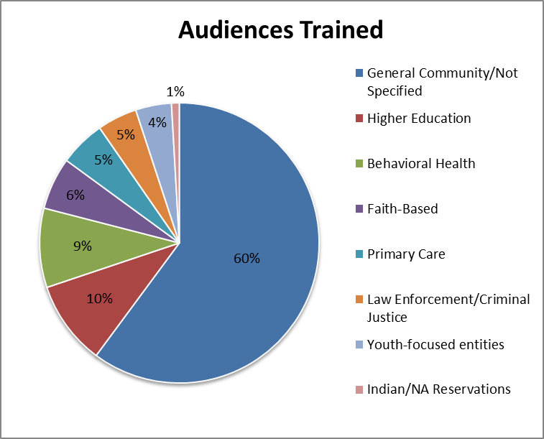
Notes:
General Community/ Not Specified:
School staff, youth groups, camps, parents, EAP, HR and Workplace Wellness
College and University
Faith Community
Government Employees and Elected Officials
Law Enforcement and Public Safety
Libraries
Social Service Agencies and Homeless Shelters

Slide 8

Nearly 100,000 First Aiders in the US
trained by 2,700 Instructors
AK
728 (14)
WA
2,303 (59)
MT
188 (2)
VT
184 (12)
ME
130 (4)
ND
271 (3)
OR
1,351 (25)
MN
1,603
(18)
ID
405 (9)
NH
10 (1)
SD
1,105 (16)
WI
307
(8)
NY
1,838 (60)
MA
639 (22)
WY
13 (0)
MI
3,315
(64)
RI
304 (5)
NE
389 (11)
IA
5,577 (79)
PA
3,757 (168)
CT
1,562 (23)
NV
70 (2)
IN
321
(24)
OH
555
(18)
NJ
566 (15)
UT
390 (23)
IL
5,029
(84)
DE
28 (3)
CA
12,448 (463)
CO
5,590 (148)
WV
0 (1)
KS
3,522 (76)
MO
6,498
(261)
VA
1,741 (58)
MD
3,192 (228)
KY
303 (7)
708 (23)
NC
1,611 (21)
DC
566 (47)
AZ
3,543 (82)
NM
2,750 (57)
OK
1,254 (23)
AR
462
(13)
TN
SC
116 (5)
Percentage OF
Population Trained
MS
673
(38)
AL
539
(10)
GA
2,019
(69)
0.1% or more
TX
4,208 (151)
LA
123
(4)
0.04%-0.99%
0.025%-0.039%
FL
966
(28)
0.01%-0.024%
Less than 0.01%
HI
0 (1)
No data
PR
138 (2)

Slide 9

Vision
By 2020, Mental Health First Aid in Missouri and the USA will be as common as CPR and First Aid

Slide 10


Youth MENTAL HEALTH FIRST AID USA

Slide 11
Program Roadmap:
Part One
What is Youth Mental Health First Aid?
Adolescent Development & Mental Health Problems in Youth
What you may see:
  Signs and Symptoms
  Risk Factors and Protective Factors
Mental First Aid Action Plan
vi

Slide 12
Program Roadmap:
Part Two
Using the Mental Health First Aid Action Plan
  In Non-Crisis Situations
  In Crisis Situations
vi

Slide 13
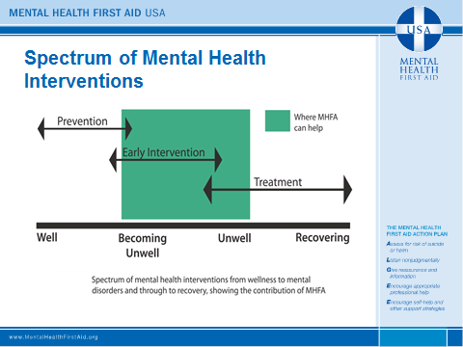

Slide 14
What is your Role?
“In the place of the parent”
  Mandatory reporting laws
  Privacy rights of young people
  Communicating with parents and other care-givers
Your own child
Clergy
Friend or Neighbor
Peer
18
Notes:
Particularly with youth, need to know your role. In loco parentis.

Slide 15

WHAT YOU MIGHT SEE?

Slide 16
What are some of the disorders we discuss in the course?
ADD/ADHD
Anxiety Disorders
Bipolar Disorder
Depression
Eating Disorders
Psychosis
Substance Use Disorders

Slide 17

Typical Adolescent Development
Physical Changes
Mental Changes
Emotional Changes
Social Changes
10
Notes:
Alternative Format: A quicker version of this exercise can be done as table assignments. Break the room into four groups and assign each group the task of identifying examples of how you might see typical developmental changes in each category: Physical, Mental, Social and Emotional.

Slide 18

Resiliency
Most youth pass through adolescence with relatively little difficulty despite all of these challenges.
When difficulties are encountered, youth tend to be quite resilient:
  Thrive
  Mature
  Increase their competence
14

Slide 19

WHAT YOU MIGHT DO?

Slide 20
MHFA ACTION PLAN
Mental Health First Aid teaches a five-step action plan, ALGEE, for individuals to provide help to someone who may be in crisis.
A - Assess Risk of Suicide or Harm
L - Listen Non-judgmentally
G - Give Reassurance and Information
E - Encourage Person to Get Appropriate Professional Help
E - Encourage Self-help Strategies

Slide 21

Applying Mental Health First Aid for Crises
Suicidal thought and behaviors
Non-suicidal self-injury
Panic attacks
Adult affected by traumatic events
Children affected by traumatic events
Acute psychosis
Medical emergency from alcohol abuse
Aggressive behavior

Slide 22
ALGEE-Action A:
Assess the risk for suicide or harm

Slide 23


ALGEE-Action L
Listen non-judgmentally

Slide 24
Exercise -Kim’s Story- Scene 1
Kim is a 12-year-old girl who recently moved to the area, just in time to start a new middle school. She has struggled to fit in and establish close friends, although she is generally an outgoing, happy young
girl. Lately, she seems moody and you notice that she’s not trying as hard to cultivate friendships.
Even her appearance seems a little off—like she’s not paying as much attention to her wardrobe or her hair.
Group Discussion: You are a teacher at Kim’s school. How would you approach her?
Notes:
EXERCISE – Scenarios Scene 1
Set-up: Much of the remainder of this session will focus on various steps in a single, ongoing
exercise. Overall, the exercise will introduce participants to a youth and identify their relationship with that youth. To prepare this exercise, select the scenarios that you want to use. Carefully
consider the roles that your participants play; note that you should match the severity of the scenario to the roles of the participants. Also think about including at least one parent role even in
professional settings as you will often have participants who are engaged with you both professionally and in parent/guardian roles.
Tip: Consider copying each scenario onto different colors of paper so that you can easily tell which group has which scenario as the exercise continues. Then, cut the various steps (1, 2, 3, etc.) for each scenario. You may want to organize this exercise by putting all the slips for a single youth into one envelope; however, you will only distribute one piece of the story at a time.
Tell participants that you are introducing them to a youth who may need their help. Assign a youth scenario to each table, and give them the first strip, which ends with the phrase: “how would you approach her/him?” Assign each table a role: parent/guardian, teacher, youth group leader, case worker, etc..
Facilitation: Give the group five minutes to discuss how they would approach the youth, reminding them to take notes. Then, ask each group to summarize what they know so far and describe how they would reach out. (Do not tell the group that they will be getting more of the story as this session unfolds).
Rather than having the participants just say what they would do, encourage them to use the actual words they would use in the conversation. This exercise is most powerful if you have the group role play actually talking to the young person.
Ask the groups what helped them determine whether or not their youth was in crisis. The scenarios are written so that the youth in scene one is not in crisis.
Take-away: State now that they’ve explored how they may approach a youth, and assessed for if they are in crisis, that they’re now going to continue to learn about the other actions in ALGEE to help them have a conversation with the youth.

Slide 25
ALGEE -Action G
Give
Reassurance
and Information

Slide 26
Exercise -Kim’s Story- Scene 2
When you talk with Kim, you learn that she’s really lost her confidence and is feeling desperate to fit in.
She feels hopeless, ugly and rejected. She says that she’ll be better liked if she could just lose weight.
(Kim is already quite thin.)
Directions: Give Kim reassurance and information, without yet moving to encouraging professional or self-help.

Slide 27

ALGEE - Action E
Encourage
Appropriate
Professional Help

Slide 28

ALGEE-Action E
Encourage Self-help
and other Support
Strategies

Slide 29
Exercise -Kim’s Story –Scene 3
As you continue to talk, Kim is very focused on losing weight and avoiding food. She eventually shares that she’s overwhelmed and feels like she has no control over her life.
Directions: Put together a full conversation you expect to have with Kim, incorporating the actions of Encouraging Appropriate Professional Help and Encouraging Self-Help and Other Support Strategies.

Slide 30
Exercise -Kim’s Story - Final
In class today, Kim seems like she can barely stay awake. When you try to talk with her after class, she seems disoriented and wobbly. As you’re trying to connect with her, she passes out.

Slide 31

Taking Care of the First Aider
Have I decided what I will do for self care?
Who can I debrief with now?
If I feel upset or distressed later, who can I call?
If I share with others, how do I ensure the confidentiality of the young person?
Do I or my family need a break?
119

Slide 32


MHFA -How can I get it?

Slide 33
Jean Harris-Sokora. LMSW, CCDP-D, MSAPA
Call or email to schedule a Youth Mental Health First Aid Training
  314-459-4477
  jsokora@pfh.org
Trainings are offered at no charge and can be done in
  One 8 hour day
  Two 4 hour days

