Slide 1
Advocacy Training

Slide 2
ADVOCACY
Advocacy - Supporting and speaking up for our children
Lobbying – The attempt to influence a public official or decision-maker in favor of a specific cause or opinion
PTA was founded on Advocacy, it’s what sets us apart from other parent groups
PTA Advocacy efforts work in conjunction with other aspects of PTA
Notes:
Define advocacy and lobbying. All lobbying is advocacy but not all advocacy is lobbying.
Examples of advocacy vs. lobbying
Advocacy
Telling your member of Congress how a federal grant your organization received has helped your constituents.
Educating a member of Congress about the effects of a policy on your constituency.
Inviting a member of Congress to visit your organization so that he/she may see firsthand how federal funding or a policy affects day-to-day operations and the difference it makes.
Lobbying
Asking your member of Congress to vote for or against, or amend, introduced legislation.
Emailing a “call to action” to your members urging them to contact their member of Congress in support of action on introduced legislation or pending regulations.
Preparing materials or organizing events in support of lobbying activities.
Advocacy is one of PTAs founding principals. We are the largest grassroots parent advocacy organization.
Our advocacy efforts work in conjunction with other aspects of PTA. Without membership our voice in Jefferson City or Washington DC would not make much of a difference. Without the resolutions we adopt, PTA wouldn’t be offering programs on bullying or distracted driving.
Our BOM must lead by example. We ask membership to activate their membership cards, so we activate ours so we can answer questions on how to do it. We receive training on reflections and how that process works in our state so we can answer questions from our membership. This is no different. We have to set the tone and standard and lead by example.

Slide 3
ADVOCACY HISTORY
Quick history of PTA advocacy and legislation
In 1897 Alice McLellan Birney and Phoebe Apperson Hearst called for action to eliminate threats that endangered children, forming what would become the PTA
Issues that have been tackled by the PTA include: child labor laws, creation of kindergarten classes, public health services, hot lunch program, juvenile justice system and mandatory immunizations.

Slide 4
WHO ARE THE PLAYERS
National PTA Legislative Department
Develops the PTA Federal policy
Tracks Federal bills, appropriations, regulations, reauthorization processes, etc.
Issues Actions Alerts on Federal issues
Networks with other National organizations
Organizes testimonies and strategic meetings

Slide 5
WHO ARE THE PLAYERS
State Legislative Department – Missouri’s is the Department of Legislation and Advocacy
Develops the Missouri PTA Legislative platform
Tracks bills, testifies and issues Action Alerts
Develops the Legislative Handbook Legislative webpage, Contact articles and monthly legislative suggestive reports (Sept-May)
Networks with other State organizations & groups
Assist units and councils with Town Hall meetings
Oversees State Resolutions and Position Statements

Slide 6
WHO ARE THE PLAYERS
Federal Legislative Chair
Liaisons with National Legislative department
Passes along Federal information and Action Alerts to the state board, units and councils
Represents Missouri at the National Legislative Conference & PTA on the Hill annual event
Responsible for the state Legislation and Advocacy Department

Slide 7
WHO ARE THE PLAYERS
State Legislative Chair
Keeps abreast of bills in Missouri Legislative assembly
Issues Action Alerts on state issues
Works with units and councils in the planning and organizing of Town Hall meetings
Assists unit and council legislative chairs

Slide 8
WHO ARE THE PLAYERS
State Resolution Chair
Has a working knowledge of Missouri Resolutions and Position Statements
Evaluates Resolutions sent to the state for consideration at convention
Sends MOPTA resolutions on to the National PTA
Determines implementation for resolutions and positions

Slide 9
WHO ARE THE PLAYERS
Unit/council Legislative Chair
Gives legislative updates in the form of reports at meetings and articles for unit/council newsletters
Passes along Action Alerts to unit/council members
Encourages participation in the JC/DC network
Organizes Town Halls (in conjunction with the State Legislative chair), candidate forums, voter registration, candidate informational questionnaires, etc.

Slide 10
IF NOT YOU, THEN WHO?
“The world is run by those who show up”
Powerful lobbyist groups spend a great deal of money and time trying to influence elected officials.

Slide 11
LOBBYIST OR ADVOCATES?
Quite often the words “lobbying” and “advocacy” are used interchangeably. However there is a difference. All lobbying is a form of advocacy but not all forms of advocacy are lobbying. Advocacy encompasses a wide variety of activities. In the context of PTA, this means supporting and speaking up for children – in schools, in community and before government bodies and other organizations that make decisions affecting children. Lobbying is defined as the attempt to influence a public official or decision-maker in favor of a specific opinion or cause.

Slide 12
IRS DEFINITION OF LOBBYING
In general, no organization may qualify for section 501(c)(3) status if a substantial part of its activities is attempting to influence legislation (commonly known as lobbying). A 501(c)(3) organization may engage in some lobbying, but too much lobbying activity risks loss of tax-exempt status.
Legislation includes action by Congress, any state legislature, any local council, or similar governing body, with respect to acts, bills, resolutions, or similar items (such as legislative confirmation of appointive office), or by the public in referendum, ballot initiative, constitutional amendment, or similar procedure. It does not include actions by executive, judicial, or administrative bodies.
An organization will be regarded as attempting to influence legislation if it contacts, or urges the public to contact, members or employees of a legislative body for the purpose of proposing, supporting, or opposing legislation, or if the organization advocates the adoption or rejection of legislation.
Notes:
Remember
501(c)(3) organizations are absolutely prohibited from directly or indirectly participating in, or intervening in, any political campaign on behalf of (or in opposition to) any candidate for elective public office.

Slide 13
PTA DON’Ts
Invite only one candidate in an election to come speak to the PTA.
Tell PTA members to only vote for a candidate who supports X position.
Distribute any campaign materials on behalf of a candidate.
Wear campaign buttons or t-shirts during a PTA meeting.
Establish or support PACs (Political Action Committees).

Slide 14
PTA DOs
PTAs should support issues that are good for children and youth. PTA should oppose issues that are bad for children and youth. That includes state and national legislation, as well as local laws and school district policies. PTA can and should take a stand on bond and levy issues.
PTAs can sponsor public forums (including candidates forums – all candidates must be invited), lectures and debates.
PTAs can send out questionnaires to all candidates asking in an unbiased way for their positions on issues. The results must be reported accurately and without editorial comment.
PTAs can conduct voter registrations. The registration must be open to anyone, regardless of which party or candidates they want to vote for after registering.
Remind members to vote.
Educate candidates on issues important to PTA.

Slide 15
NATIONAL LEGISLATIVE CONCERNS
National PTA 2014 Federal Public Policy agenda
Education – ESEA due for reauthorization
Child health and nutrition
Juvenile Justice and Delinquency – JJDPA due for reauthorization (last reauthorization 2002)
School Safety
Notes:
The entire Public policy Agenda and an Executive summary can be downloaded from PTA.org – Advocacy – Public Policy Agenda http://pta.org/advocacy/content.cfm?ItemNumber=3222&navItemNumber=556

Slide 16
STATE LEGISLATIVE CONCERNS
Local control of schools
Increased funding for programs & services aimed at the prevention of child abuse, neglect and maltreatment
Tax credits or tax deductions
Increased parent involvement in their children’s education
Funding for renovation & construction school facilities, and improve the routes to schools
Early Childhood Education

Slide 17
ISSUES
The PTA addresses issues that are in line with our Mission and Purposes.
The resolutions and position statements passed and approved by the membership define how and if we can address or speak to an issue.
When representing PTA on a particular issue always present the will of the membership not your own personal views.

Slide 18
CHECK TO SEE IF PTA HAS A STANCE
http://www.pta.org/public_policy.asp
http://www.mopta.org/legislation/resolutions.html
Contact MOPTA Legislative Department

Slide 19
ACTION ALERTS
How MOPTA and NPTA gets information out on issues
Take Action Alerts
http://cqrcengage.com/npta2/home?navItemNumber=3451
JC/DC Network
http://www.mopta.org/subscribe-to-legislative-alerts.html
Notes:
National PTA has a new Takes Action Network. It is powered by the Engage platform. Missouri PTA will be updating their JC/DC Network and begin using the Engage platform as well. Look for this update soon. You will still be able to acess our JC/DC network through our website.

Slide 20
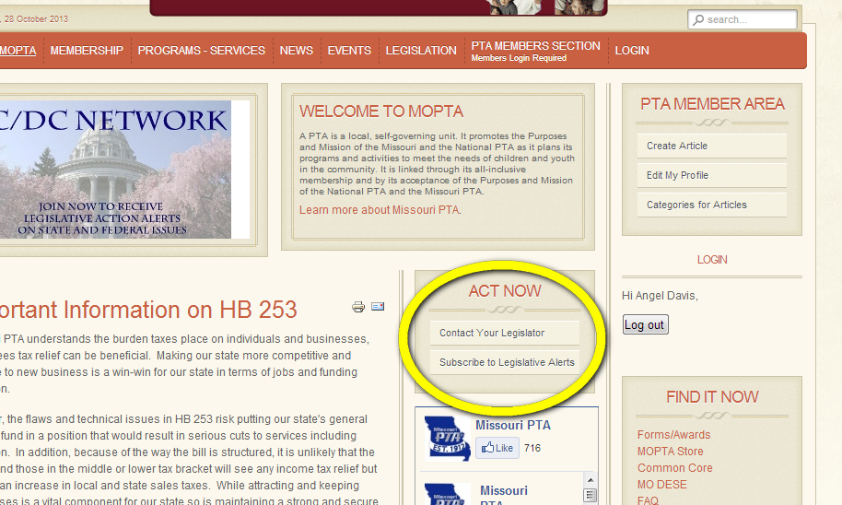
JC/DC NETWORK
JC/DC Network is MOPTA’s call to action email alert system
Notes:
JC/DC Network is an email we send when a committee is moving on a bill we are watching or when a vote on a bill we are watching in coming in the house or senate. We don’t send out a lot of alerts, only when we really need our membership to contact their legislators.
There is a link on the mopta website “Subscribe to Legislative Alerts”

Slide 21
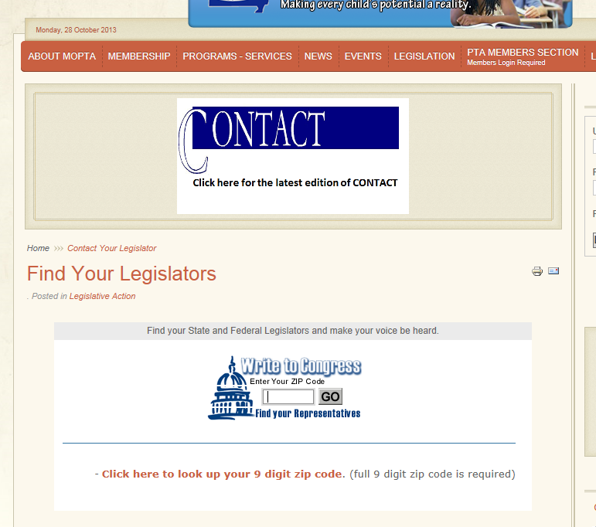
JC/DC NETWORK
Notes:
You can also look up your legislator’s contact information by entering your +4 zip code.

Slide 22
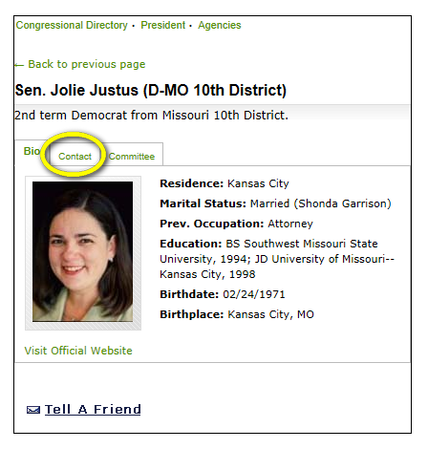
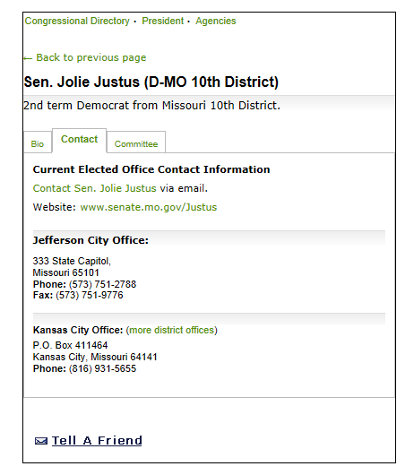
JC/DC NETWORK

Slide 23
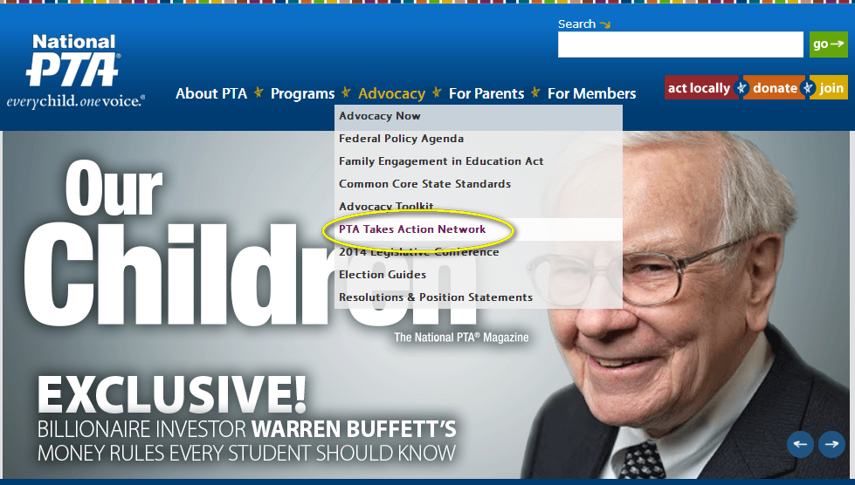
PTA TAKE ACTION
PTA Take Action is National PTA’s call to action email alert system
Notes:
Just as we have our JC/DC network, national PTA has the Take Action Alerts. Click on the PTA Takes Action Network link from the Advocacy dropdown menu.

Slide 24
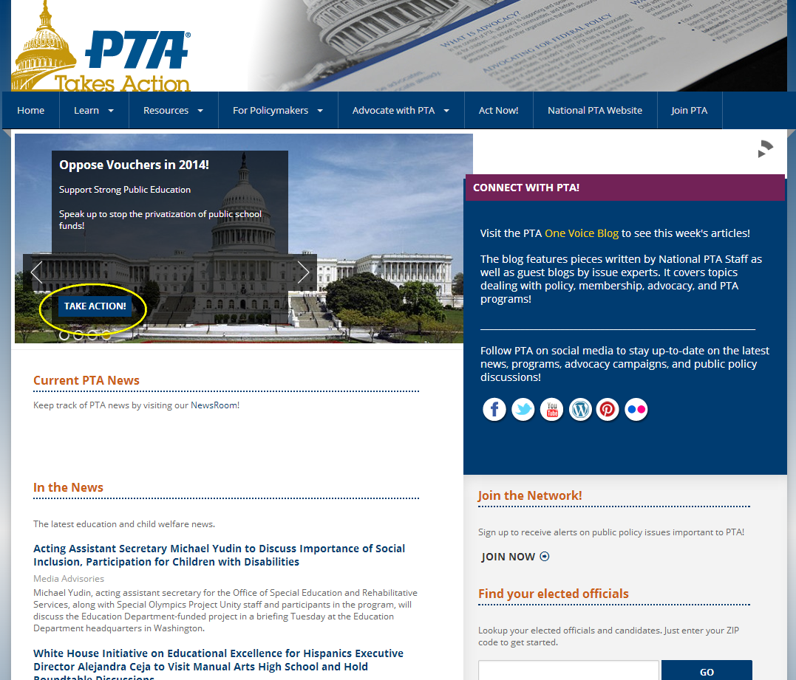
PTA TAKE ACTION
Notes:
You can respond to any of the Action Alerts by clicking on the Take Action button

Slide 25
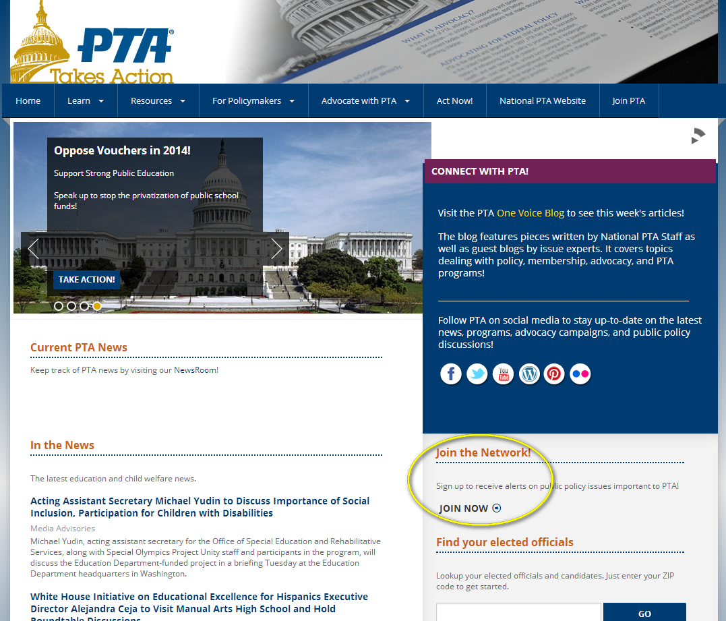
PTA TAKE ACTION
Notes:
You can Join the Action Alert Network and receive email updates about Legislative issues from National PTA

Slide 26
PTA TAKE ACTION
Notes:
You can also connect up to your elected officials using the Take Action site

Slide 27
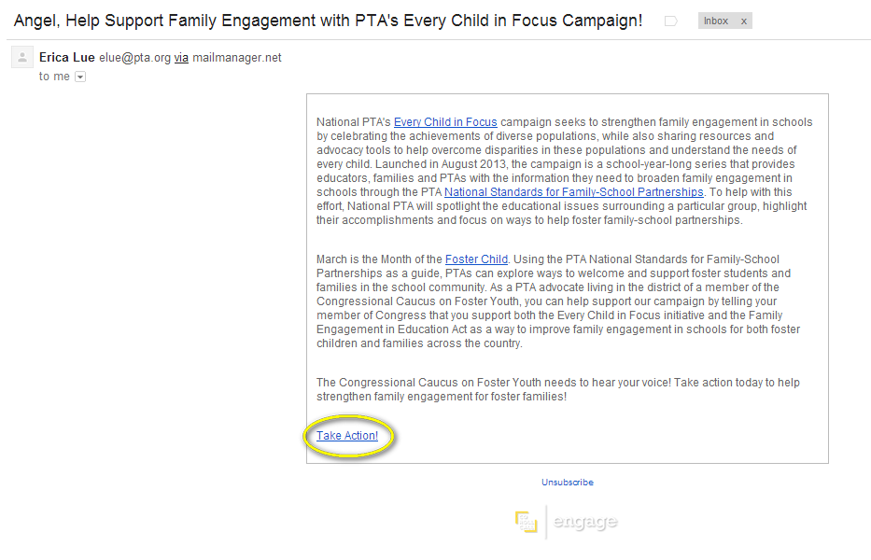
PTA TAKE ACTION
Notes:
The Take Action network will send you an email, clicking on the Take Action link will allow you to submit an emails to your legislators. Responding to an Action Alert takes just 3 clicks.

Slide 28
CORRESPONDENCE
A brief personal visit creates a connects and leaves a lasting impression.
The second best way to correspond is by email
Keep a word document with emails to and from legislators
Send in word document with AtLaw application
Lots of responses will be form letters
Non-form letters should be forwarded on to VP of Leg.
angeld@mopta.org

Slide 29
CORRESPONDENCE
Personal Visits
Make an appointment ahead of time and arrive promptly.
Make sure your legislator knows you are speaking on behalf of the PTA. Bring copies of the current MOPTA Legislative Priorities flyer.
Present yourself in a professional manner – business casual is acceptable.
Be reasonable in presenting your position(s). Be a good opponent by fighting the issue, not the person.
Present the facts and reasons why your PTA is involved in the issue – your elevator speech.
Thank your Legislator for their time and interest.

Slide 30
CORRESPONDENCE
Emails/letters
Keep it brief, clear, and concise.
State the bill you are addressing by number or popular name.
Make sure you state why you want the bill supported or opposed.
Avoid abbreviations or trendy letters, fonts or symbols.
Include your contact information – home address.
Proofread!!!

Slide 31
ISSUES NOT ADDRESSED
There are many issues affecting children that are not addressed by PTA resolutions and positions.
Writing a resolution – consider attending the Resolution workshop, refer to the Legislative Handbook and contact the State Resolution Chair or the Vice President of Legislation and Advocacy

Slide 32
MOPTA KIDS FIRST TOWN HALLS
Hosting a Town Hall
Legislative Handbook
Getting to know how your legislators think about PTA issues
Opportunity to network with your legislators
State Legislative Chair assists and provides a MOPTA moderator for the event

Slide 33
CHILD ADVOCACY DAY
Jefferson City, MO each April
Excellent time to speak with legislators
Talking points/Leave behinds provided
Have the option of having someone with you when speaking to legislators
Promote Child Advocacy Day to units and members
Notes:
Members of the State Board and Legislation and Advocacy Department will be on hand to go with you to speak to your legislators if you want.

Slide 34
TALKING TO LEGISLATORS
Make an appointment
Dress professionally
Be on time
Address legislators with title – Senator or Representative
Be honest
Utilize talking points/leave behinds
Thank them for their time and service

Slide 35
RESOURCES
Advocacy resources webpage
Legislative Chair Report Template
Letter to Legislator Template
Access to NPTA Online Advocacy Toolkit
Voter information and registration
Media contacts
Links to additional resources and sites
Capital Chatter webpage
Resolutions webpage
National Public Policy page – advocacy toolkit, PTA votes, Federal public policy, Common Core Standards, etc.
www.mopta.org/legislation www.pta.org/public_policy.asp

Slide 36
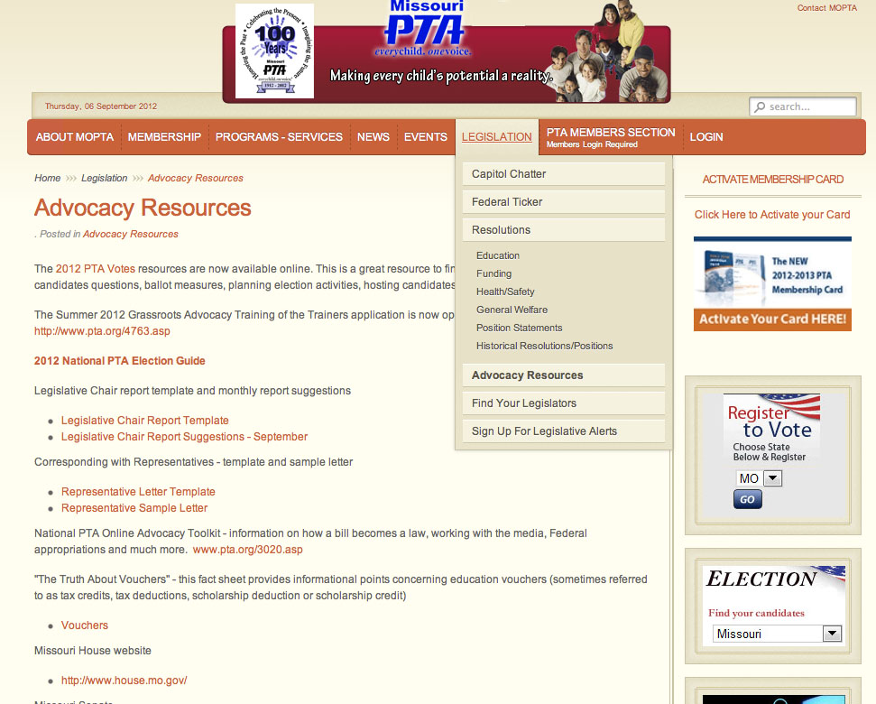
www.mopta.org/legislation
www.mopta.org/legislation www.pta.org/public_policy.asp

Slide 37
AtLaw AWARD
2013 – 4 individual awards and 6 unit/council awards
2014 goal – 50 individual awards
Notes:
Anyone can receive the AtLaw (Advocacy through Legislation) Award. It is almost as simple as tracking your correspondence and sending in the application.

Slide 38
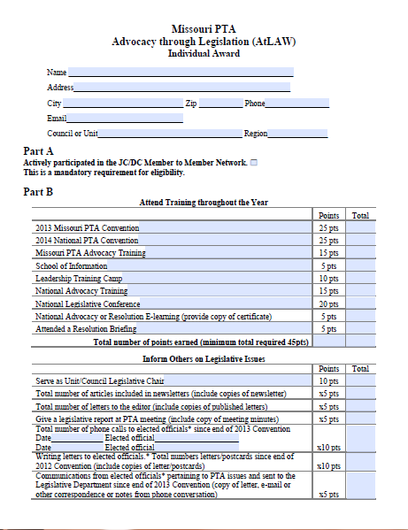
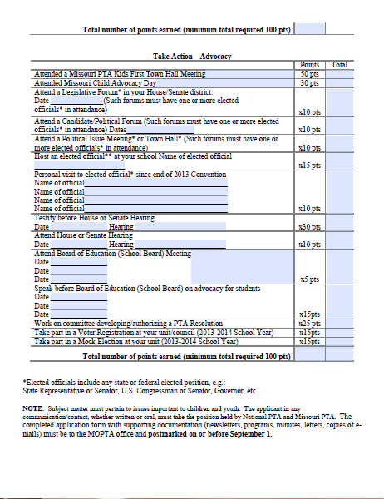
INDIVIDUAL AtLaw AWARD
Notes:
Anyone can receive the AtLaw (Advocacy through Legislation) Award. It is almost as simple as tracking your correspondence and sending in the application.
To receive the AtLaw award, you track your advocacy efforts throughout the year. You can receive points for activities such as attending conventions, schools of information and advocacy training, contacting your elected officials, attending Town Halls, Child Advocacy Day and Board of Education meetings.

Slide 39
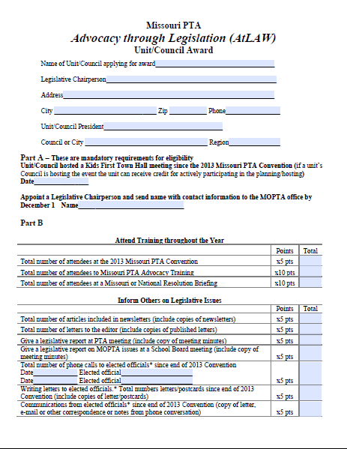
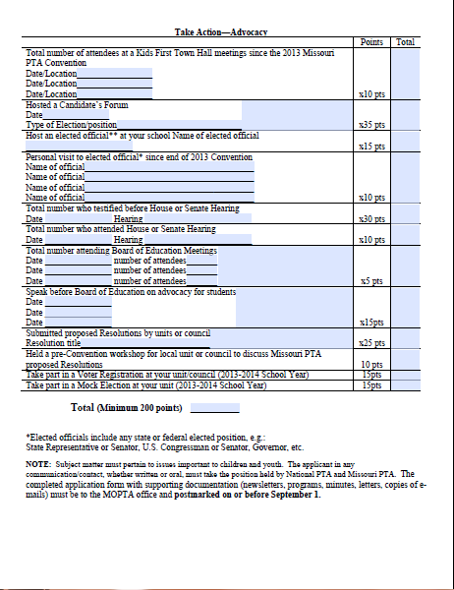
UNIT/COUNCIL AtLaw AWARD
Notes:
Anyone can receive the AtLaw (Advocacy through Legislation) Award. It is almost as simple as tracking your correspondence and sending in the application.

Slide 40
NEED HELP?
Where to look
Who to contact
Angel Davis
Vice President,
Legislation and Advocacy
angeld@mopta.org
Michelle McLaughlin
State Legislation Chair
michellem@mopta.org
Kim Weber
MOPTA President
kimw@mopta.org
Dorothy Gardner
MOPTA President-Elect
dorothyg@mopta.org

