Slide 1
2013
Missouri PTA Convention
Reflections –Inspiring
Michele Reed
Vice President and Director of Programs

Slide 2
What is Reflections?
Began in 1969 by Mary Lou Anderson
Designed to Enhance Arts Education
A multi-level program with awards given at the local unit, council, state and national levels.
Notes:
Colorado PTA Board member Mary Lou Anderson started the Reflections program. She wanted to make sure that students still received a valuable arts education as schools during this time were begining to cut the arts in their school curriculum. The program was designed to enhance the arts education students are receiving in school and allow them to express themselves in the use of a variety of medium. The Reflections program is for students in preschool through grade 12. The Reflections program helps parents encourage the creativity and lifelong learning of their children and offers children recognition for their artistic endeavors. Parents, teachers and community members all play a critical role in providing a positive learning environment for children. Supporting the PTA Reflection Program is one way you can increase student achievement, foster student talents, and promote the arts in your home, your school and your community.
What do we mean by a multi-level program? It means that students must submit entries to the local unit – they are then judged at this level according to the rules as outlined in the tool kit, and the entries that are chosen to advance move on to the state level. The entries submitted to the state level are then judged again and the top scoring entry in each age division in each category is then sent to the national level where the entries are judged again. The national level is the final level of judging.

Slide 3
What is Reflections?
Judged on interpretation of the theme, creativity and artistic merit. The entries best fulfilling these three criteria progress to the next level.
At the State level one entry from each age group in each arts area is sent to National PTA.
Despite the “contest” format, the emphasis is on children having the chance to create an original works of art, experimenting with different ways of expressing themselves, and feeling good about their work, rather than just winning.
Notes:
Now that you have some background information on what Reflections is, let’s look at how Reflections relates to National PTA’s National Standards for Family – School Partnerships.

Slide 4
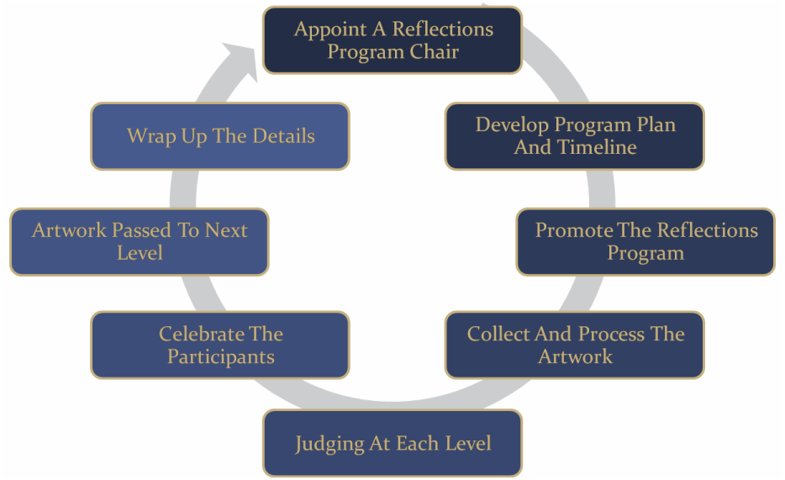
Reflections Program Cycle

Slide 5
Reflections and the National Standards
Standard 1: Welcoming All Families into the School Community
Standard 2: Communicating Effectively
Standard 3: Supporting Student Success
Standard 4: Speaking Up for Every Child
Standard 5: Sharing Power
Standard 6: Collaborating with Community
Notes:
The first standard states: Families are active participants in the life of the school, and eel welcomed, valued and connect to each other, to school staff and to what students are learning and doing in class. How does Reflections relate to this?
As Reflections chairs and president’s you should promote the PTA Reflections program to all families in the school. Emphasize that every child’s participation is valued and offer tips on how parents can support their children’s artistic expression.
To reach everyone, translate program information into families’ native languages. Depending on your resources, you could send out translated fliers, have translators at meetings, create a poster that highlights the year’s theme in different languages, or work with teachers to help explain the program to students and parents.
To get parents in the school doors, invite them to exhibits and performances of PTA Reflections Entries.
The second standard: Communicating Effectively – Families and school staff engage in regular, two-way meaningful communication about student learning.
Share Reflections Program information and reminders through a variety of channels: the school or PTA website, newsletters, PTA meetings, promotions at community businesses, the backpack express, etc. Don’t expect parents and other caregivers to be able to attend PTA meetings or receive any one type of communication. Always provide information for questions and feedback.
Starting a PTA Reflections discussion group or blog can be another way to share information and engage families in the program. Communicate key dates and other information with a PTA reflections calendar. Use an end-of-year survey to ask for feedback and help measure your successes and challenges.
The third standard: Supporting Student Success: Families and school staff continuously collaborate to support students’ learning and healthy development both at home and at school, and have regular opportunities to strengthen their knowledge and skills to do so effectively.
Arts learning experiences promote reading and language skills mathematics skills, thinking skills social skills, and more.(1) Use PTA Reflections as an opportunity to educate parents and caregivers about the benefits of arts education for children’s academic, social and lifelong success. Emphasize that PTA Reflections is designed to support students’ learning by enhancing quality arts education. Work with your school’s classroom and arts teachers to coordinate efforts. PTA Reflections entries can be created in or outside of school and the program can help support the curriculum.
(1)taken from the article by Sandra Ruppert, “Critical Evidence: How the Arts Benefit Student Achievement”(National Assembly of State Arts Agencies and Arts Education Partnership, 2006), www.nasaa-arts.org/publications/critical-evidence.shtml (accessed November 26,2009).
Standard 4: Speaking Up for Every Child – Families are empowered advocates for their own and other children, to ensure that students are treated fairly and have access to learning opportunities that will support their success.
You can use the Reflections program to rally families to speak up for the value of arts education – to reach out to teachers, school administrators, and legislators to fight to keep the arts in your school, despite budget cuts. Arts education is a fundamental part of learning for grades K-12 and allows students to hone the skills that will prepare them for the highly competitive labor marked of the 21st century.
Showcase the benefits of the arts for students, and demonstrate your school community’s commitment to preserving arts education, by publicizing your PTA Reflections Program. Reach out to local media about the launch of the program, the selection of winners and any exhibits of artwork. Invited community centers, libraries and businesses to display artwork and program information.
Standard 5: Sharing Power – Families and school staff are equal partners in decisions that affect children and families and together inform, influence, and create policies, practices and programs.
PTA Reflections gives students an opportunity to share their thoughts and perspectives on a given theme. It also gives students an opportunity to determine that theme. Each year’s national PTA Reflections theme is selected from hundreds of ideas by students. Give your students a voice; encourage them to enter the annual theme search.
Give parents and caregivers a voice by inviting them to volunteer with the PTA Reflections Program. Ask people to contribute their skill sets to promoting the program, cataloging entries, arranging the judging, preparing exhibits, etc. Welcome new volunteers and new ideas.
Standard 6: Collaborating with Community – Families and school staff collaborate with community members to connect students, families and staff to expanded learning opportunities, community services and civic participation.
Seek community partners to support PTA Reflections with prizes, exhibit space, and more. Also, partner with the community on programs to enhance arts education in the classroom or other learning environments. Each year, National PTA awards a limited number of matching grants of up to $1,000 to local PTAs for student-centered programs focused on arts education, with special consideration given to programs that reach large numbers of at-risk students. For more information about the Mary Lou Anders Reflections Arts Enhancement Grants, go to www.PTA.org/ArtsGrants.
Now that we have looked at the National Standards for Family-School Partnerships and how they can relate to Reflections – let’s look at how to run a successful Reflections program in your school.

Slide 6
2013-2014 Reflections theme:
Believe, Dream, Inspire
Notes:
First thing you need to know is that the theme for the 2010 – 2011 school year is Together We Can. All entries that are submitted should be created with the theme in mind. When promoting the Reflections program to your school community – be careful to not give ideas for the current theme – show examples from past themes; otherwise it is possible that all of your entries will have the same idea as the example you gave.
Now let’s look at the available art areas and age divisions..

Slide 7
Reflections Art Areas:
Dance Choreography
Film/Video Production
Literature
Musical Composition
Photography
Visual Arts
Notes:
The six art areas that students can create entries in are dance choreography, film/video production, literature, musical composition, photography and visual arts. Now you need to know what the age divisions are and we will look at some examples of how many entries you can submit.

Slide 8
Reflections Age Divisions:
Primary: Preschool through Grade 2
Intermediate: Grade 3 – Grade 5
Middle/Jr.: Grade 6 – Grade 8
Senior: Grade 9 – Grade 12.
Special Artist Division
Notes:
The Age Divisions for Reflections are as follows: Primary: Preschool through Grade 2, Intermediate: Grade 3 – Grade 5; Middle/Jr.: Grade 6 – Grade 8; and Senior: Grade 9 – Grade 12. National PTA and Missouri PTA believe that each child with a disability should be provided a free and appropriate public education. Therefore, the Reflections Program at the national level and the state level does not have a special division for students with disabilities. National PTA and Missouri PTA believe it is the right of parents to place their child in the Reflections Program grade division that best reflects the child’s developmental age. Now let’s look at the Missouri PTA rules in detail

Slide 9
Missouri State PTA rules
A maximum of 3 entries per category per grade division.
You must be a “Unit in Good Standing” by January 16, 2014.
The online submission process is complete for advancing entries.
Do NOT put students’ names on the front of the artwork.
Missouri PTA prefers all entries are submitted electronically in the appropriate format as described in Appendix F of the Reflections Tool-Kit.

Slide 10
What makes a Unit in Good Standing
Officers form turned in by March 31.
Membership Dues have been paid by dates required.
Your bylaws have been approved within the last 3 years.
Your unit has submitted a copy of their 990 tax filing.
Your unit has submitted their annual financial review.
Your unit has submitted their annual report.
Notes:
Officers form turned in by March 31st – This form is available in your president's winter packet – that they should have received in December. Even if many of your officers are returning for a second year or another term this form needs to be completely filled out and sent to the state office. This form is also located on the Missouri PTA website under the Forms/Award page. Please make sure you send all of the information including your Reflections Chairs – this is what I use to contact Reflections Chairs. Also if you have changes during the year – please email the state office with those changes. We realize that life events happen and things change so if your officers change during the year please be sure you update that information with the state office. If you are unsure whether this form is turned it, check with your president and/or secretary or call the state office.
Membership dues have been paid monthly. Check with your treasurer to make sure that your dues have been paid.
Bylaws are current and approved within the last 3 years – how do you know when they are due and when they were last approved? The state procedure and bylaws chairman will send you a letter letting you know it is time to review your bylaws and update them. If you are not sure you can always contact your president, Regional Director or the state office and they can tell you those dates.
Your unit has submitted a copy of their 990 tax filing – many of you submit your taxes with the e-postcard and receive an email from the IRS. This email usually comes to the president or treasurer. They need to forward that information to the Missouri state office.
Your unit has submitted their annual financial review. The information on what needs to be included in this report is in your president’s Tool Kit.
Your unit has submitted their annual report. Once again this information is received by the President’s in their Tool Kit. Now I want to go show you some samples of these forms.

Slide 11
Judging Information
Set a deadline that gives yourself plenty of time.
Who do I get to judge my unit’s entries?
Check all entries you receive to make sure that they are within the rules of the category before you send them to your judges.
Notes:
When starting the reflections program and making copies you need to be sure that you specify your own unit deadline. It is best that you start with the deadline your entries are due to Missouri PTA and work backwards. I would suggest that you give your judges two weeks to have the entries and get them judged. You need at least one week before you send your entries to the judges and a week after you get them back to get final scoring tabulations completed, winners notified and final preparations to send the entries to Missouri PTA by the January 14, 2011 4:30 p.m. deadline. So allowing only the suggested 4 weeks your unit deadline would need to be no later than December 12, 2010. When I was Reflections Chair at the local unit, I would usually always set my deadline for the first Friday after the Student’s Thanksgiving Break – sending reminders home before the break and then again twice the week of the deadline. This gave me ample time to do what I need to get done.
One of the most frequent questions I get asked is who do I get to judge my unit’s entries? Judges can come from several different places. Here are some guidelines – professional photographers, owners or instructors of dance studios, art teachers, journalists, band directors or professional musicians, teachers, community members of civic organizations. The list can be endless – just remember 2 suggestions I have– 1) This is a great way to get community members involved with your PTA and your school. 2) If you use teachers, try to get teachers from another school to judge your entries – this way the teacher won’t recognize the students work.

Slide 12
Judging Information
Blind judging should be done. This is a process where the judge can not see the name of the student submitting the work.
Include the Judges score card when you send your entries to be judged. Also when having your entries judged make sure you include the category rules and the general student participation rules for the judges.
Notes:
Take the time to fold the student entry form at the fold line before sending the entry to the judges. This will help ensure that the judging is conducted blindly.
New this year is a judges scorecard. This should be sent to your judges with a copy of the general student rules and the category rules for the category they are judging. This is an excel spreadsheet that can be downloaded from the Missouri PTA website

Slide 13
Ways to get more students to participate
Have a Display at Back to School Night
Show students examples
Ask teachers to encourage students to participate
Be creative
Send out reminder notes
Display at all unit meetings.
Offer samples in your packet.
Notes:
Have a display at back to school night – you can set up a display with samples – you might have collected – usually you might know children with past entries to borrow – or if your previous chair took pictures of her display of the previous year you can use those. Be sure to explain to parents what Reflections is – have your deadline’s set and posted during this time as well. Be creative in what you do to get kids to participate as well as showcasing their artwork at the end of the year. A way to encourage students to participate is to work with your schools principal and teachers to offer some sort of extra credit or a homework pass. Having a display at your unit meetings will get all sorts of parents notified about the program. Some schools run powerpoint presentations similar to what we do at showcase – this cuts down on table space – this requires some planning as it is nice to have pictures of the artwork in the powerpoint. If you have an inspiration at your board and unit meetings especially invite one of your past state winners to come and share their experience with Reflections – this is great for Film video students and dance choreography students – be sure that if you have dance Choreography students that the area they are dancing in is safe enough and they have enough room.

Slide 14
Need More information
Council Reflections Chair
Your Regional Director
Missouri PTA Reflections Email: reflections@mopta.org
Missouri State PTA Office
1-800-328-7330
office @mopta.org
Missouri PTA Website: www.mopta.org
Notes:
Where do I go if I have questions: If you are a local unit reflections chair – then I would first contact your council reflections chair if you are a member of a council. If they don’t know the answer to your question then you can ask your president, regional director and the state reflections chair. You can also contact the Missouri State PTA Office.

