Slide 1
Social Media Role in PTA
Facebook, Twitter and Pinterest

Slide 2
Facebook, Twitter and Pinterest
Guide through set-up
Suggest basic guidelines to follow
Tips on types of information to share on Social Media

Slide 3
Building your PTA with Social Media
You can share:
Your purpose
Advocacy efforts
Membership Drives
Programs
Fundraising
Foster conversations to engage and inspire

Slide 4
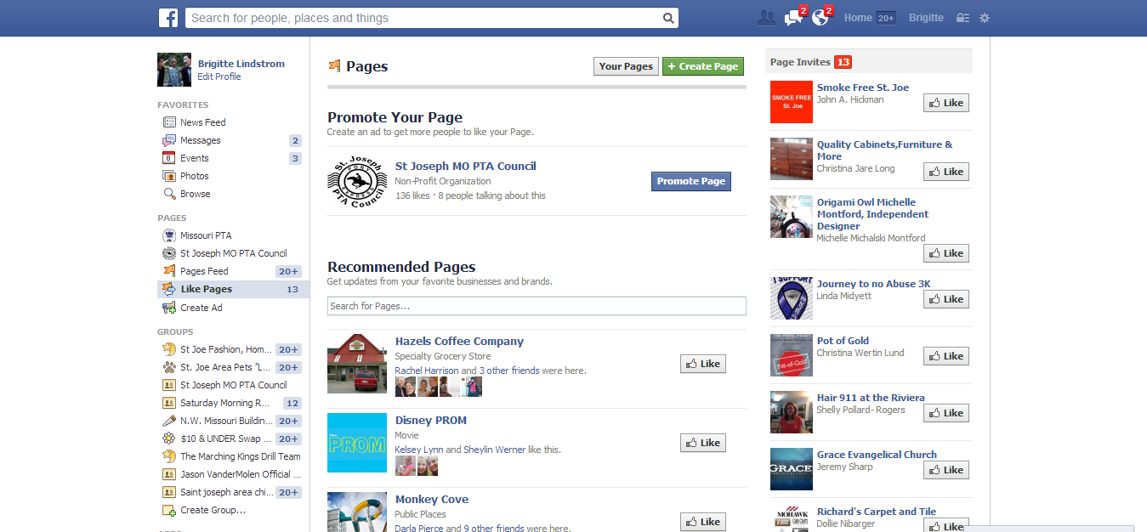
Create a Facebook Page
www.facebook.com/page

Slide 5
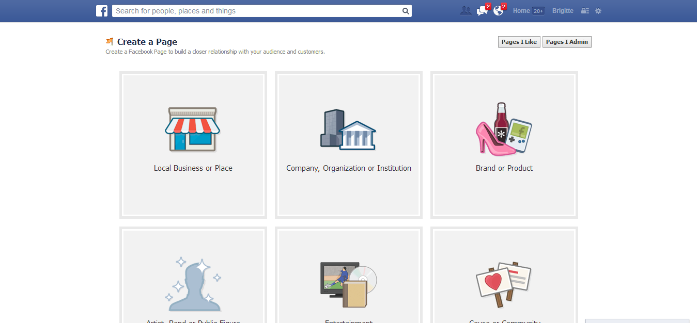
Select Organization type, Non-Profit and Name Page

Slide 6
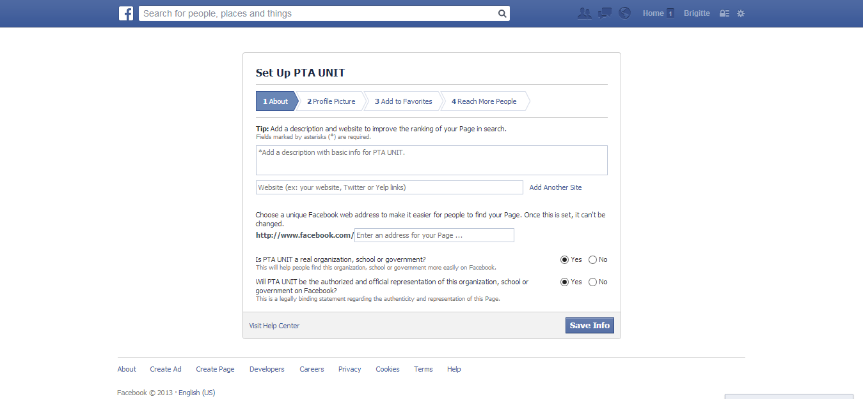
Add a description and website information

Slide 7
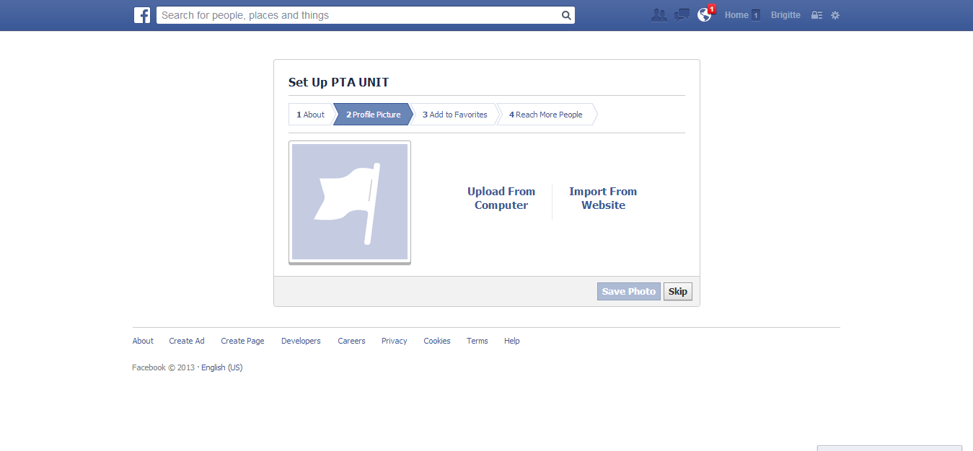
Personalize Page for your Unit

Slide 8
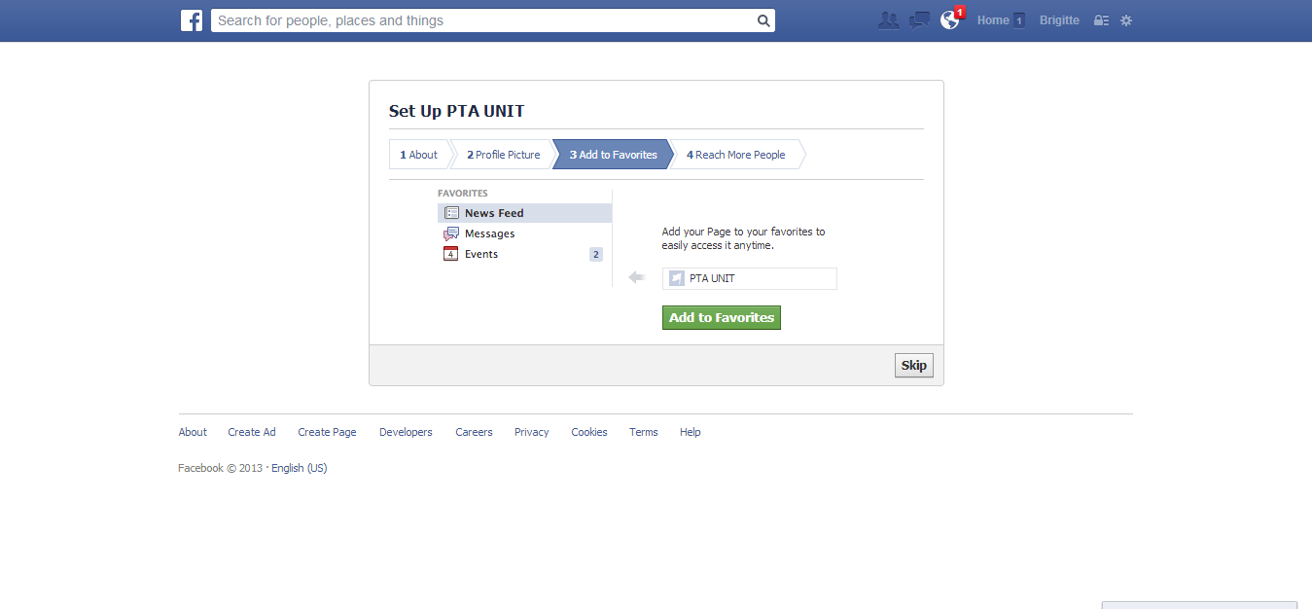
Add to Favorites

Slide 9
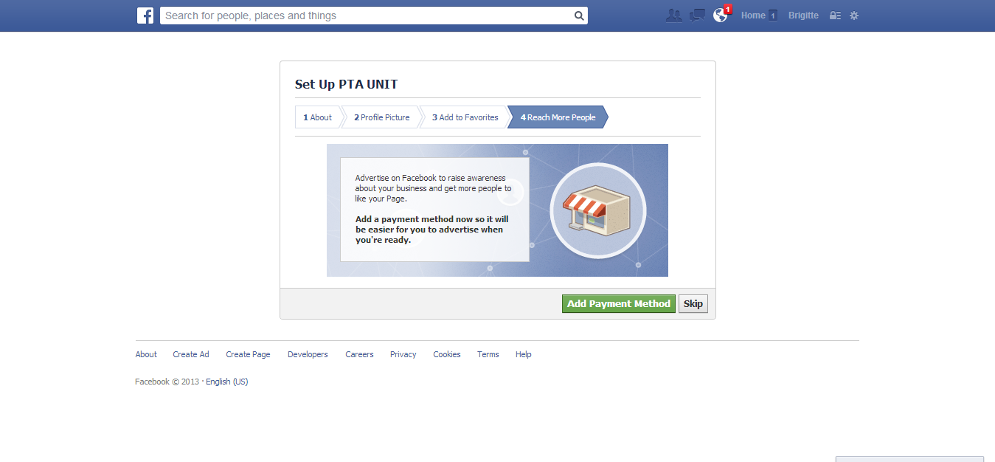
Reach More People

Slide 10
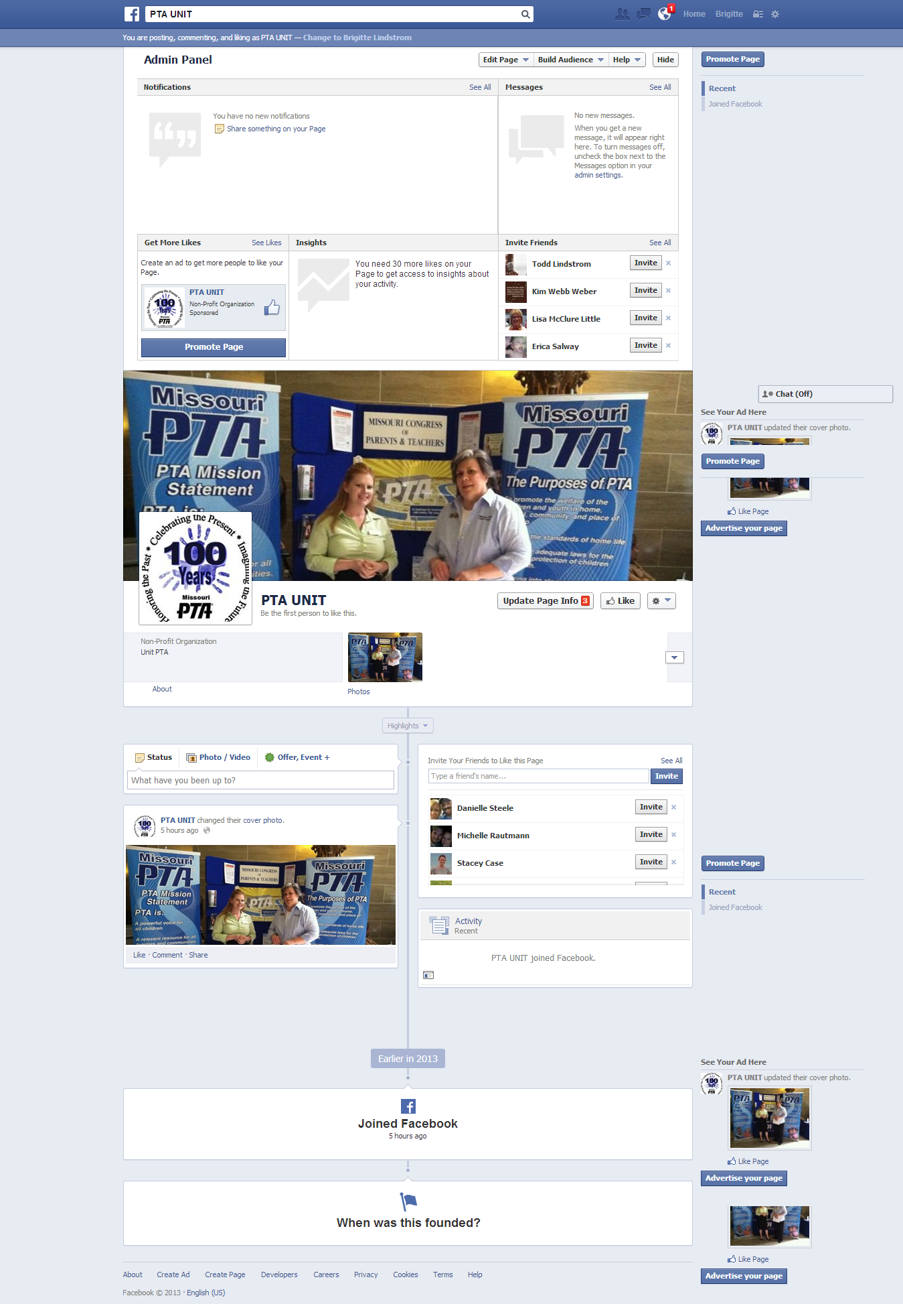
Admin Page
Post
Edit
Invite

Slide 11
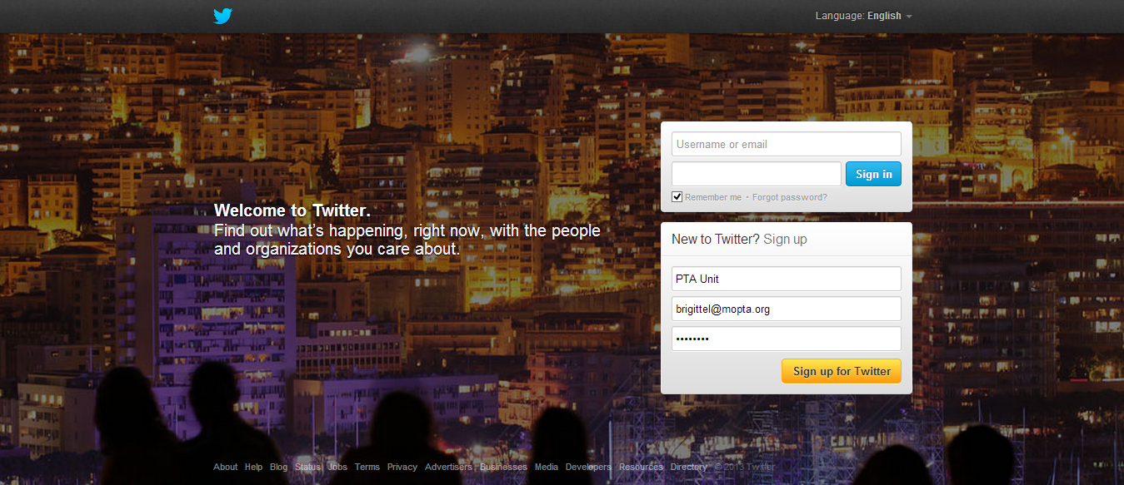
Create a Twitter Account
Www.twitter.com
Unit name, email and password

Slide 12
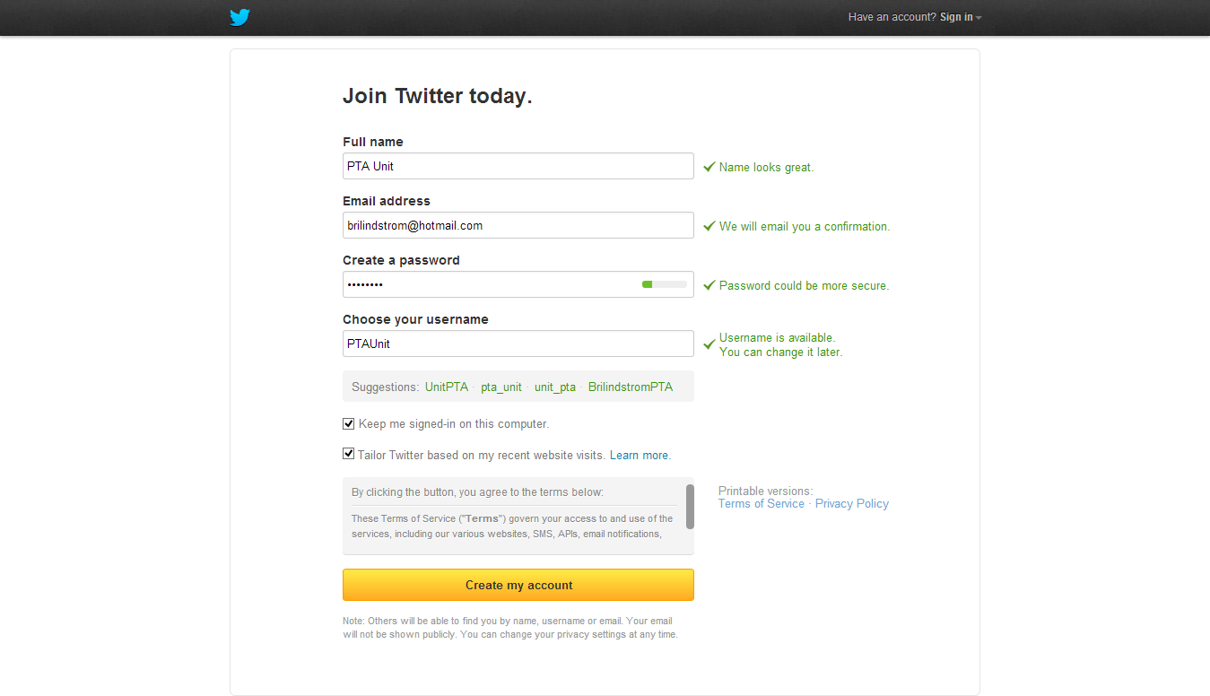
Create Account

Slide 13
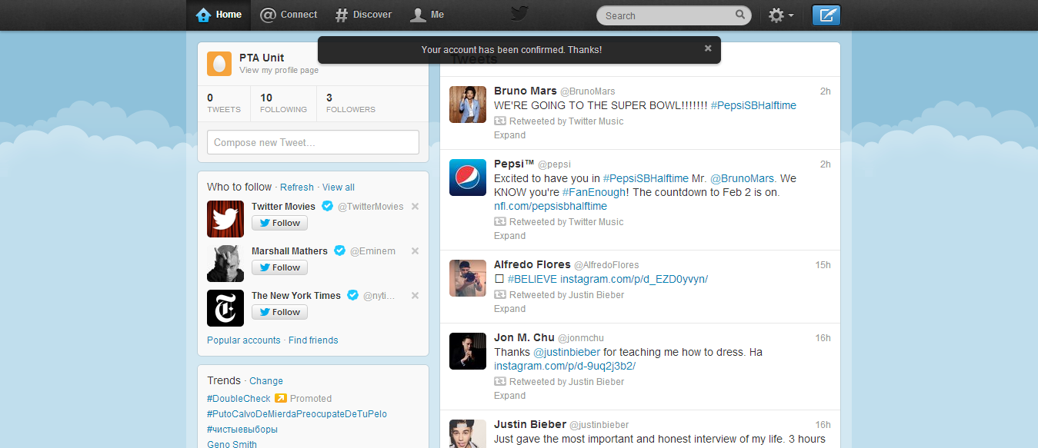
Confirm Account
Confirm account through email
Personalize and Tweet

Slide 14
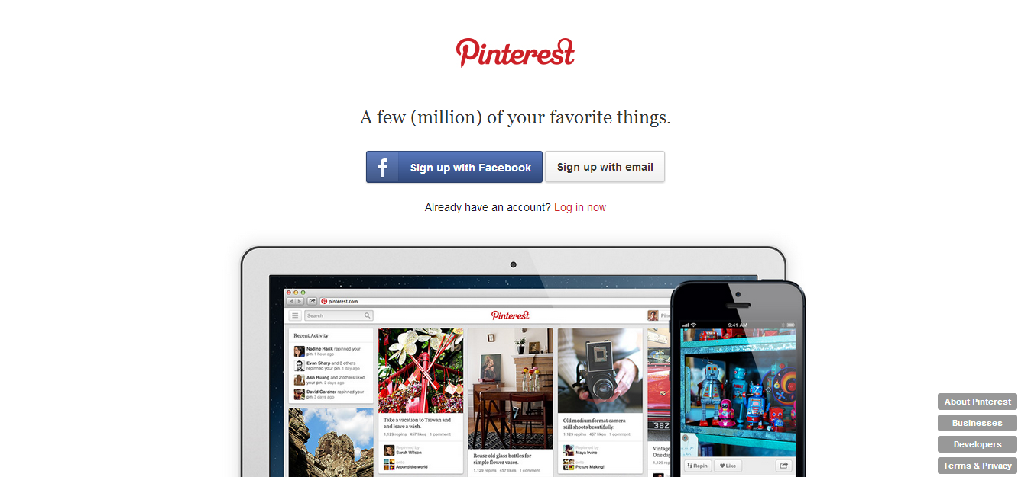
Create a Pinterest Account
www.pinterest.com

Slide 15
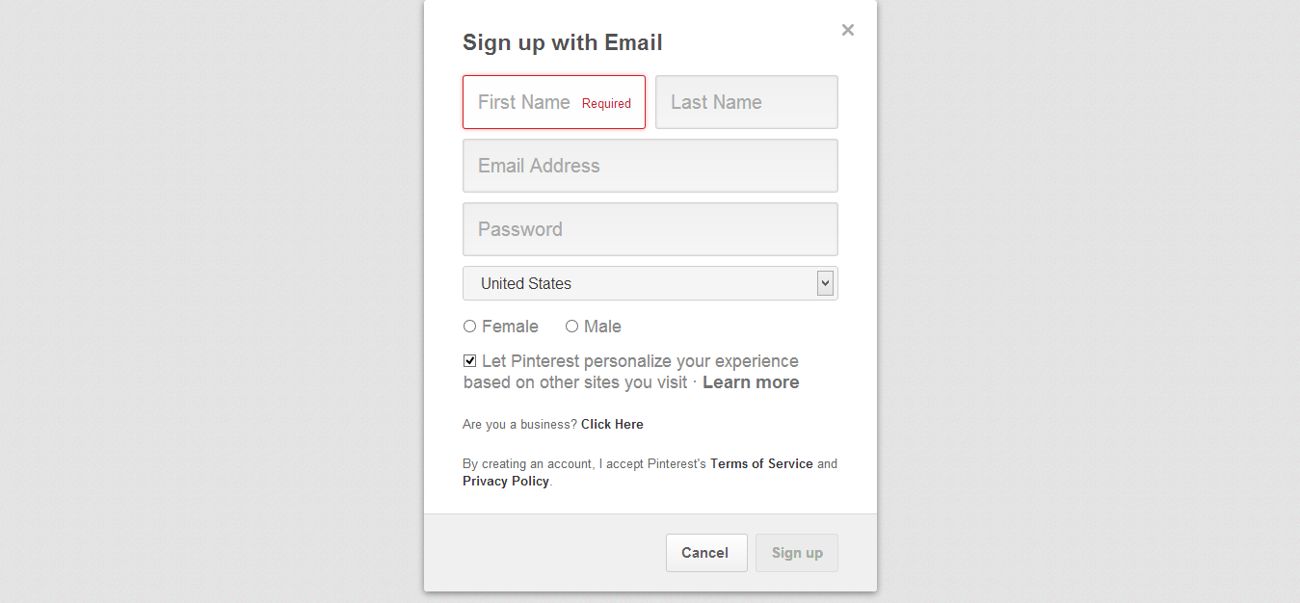
Email sign-up

Slide 16
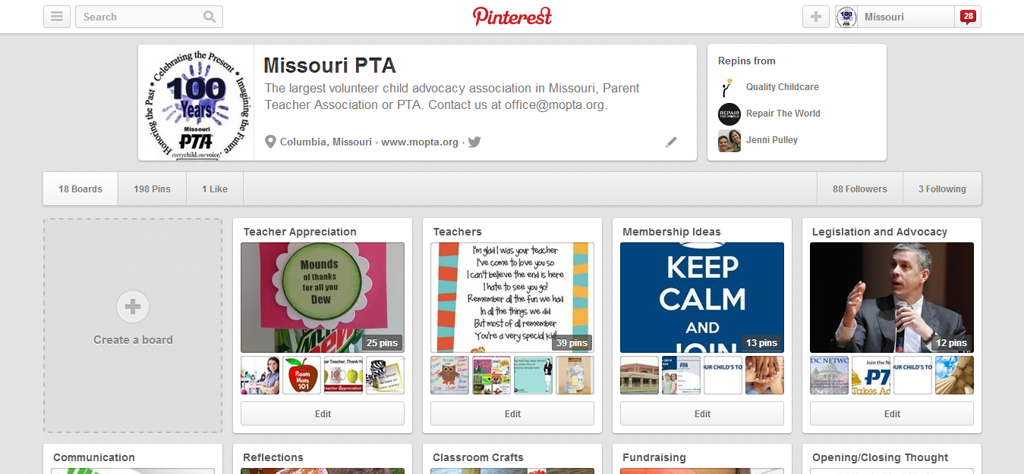
Missouri PTA on Pinterest

Slide 17
Program Your Page or Account
Know your Story – Bring your efforts to life
Know your Audience – Content
Set Goals – Define and Prioritize
Set Guidelines – Post Approval Process

Slide 18
Develop a Posting or Tweeting Plan
Share personal and engaging content
  posts seen in timelines with updates from friends
  capture attention fast

Slide 19
Posting or Tweeting Plan
Meet with unit officers and school administation to set posting or tweeting guidelines.
Great Content will spark conversation and people will share your updates.
Be Conversational, Personal, Authentic
  Speak in the first person
  Build an online personality
  Share updates from members

Slide 20
Posting or Tweeting Plan
Open two-way Dialogue
  Ask questions in status updates
  Respond to people who comment on posts
  Repost great ideas from members

Slide 21
Posting or Tweeting Plan
Get Visual with Content
Use Photos and Videos
Create Events
Share links to breaking news or articles from the local paper or TV station
Celebrate your milestones

Slide 22
Other Types of Posts
Schedule Regular Posts on Specific Topics
Post “on-the-ground” pictures from the field, during events
Links from your unit, Missouri or National PTA websites
Press Releases

Slide 23
Grow your Community
Invite everyone in your friends list
Ask unit officers to do the same
Backpack mail
Website – social plug-in
Membership email lists
Personal invitation

Slide 24
Top 5 Tips & Tricks
Develop your voice
Offer exclusive content
Create a conversation
Post from phone app.
Use Plug-ins

Slide 25
Top 5 Best Practices for Engaging your Audience
Keep it short
Rich media draws attention
Post regularly
Try a “Fill-in-the-Blank” post
Be timely and relevant

Slide 26
Questions

Slide 27
Thank you

