Slide 1
Website – A Simple Guide to Creating One
Catherine Sweeny
VP and Director of Communications
Missouri PTA

Slide 2
Goal of this workshop
Understand the components of a website
Provide basic knowledge to enable you to create a basic website

Slide 3
Steps to creating a website
Register your domain name
Setup your hosting account
Enter information into the website
Updating your website

Slide 4
Register your Domain Name
The domain name is what your website will be known by
i.e abcelementarypta.org
There are several options for registering your domain
www.Godaddy.com
www.register.com
Website builders will also be able to register your domain

Slide 5
Identifying a Good Domain Name
Identifying A Good Domain Name
If you are not sure what you should look for in a domain name, here are 4 guidelines that will help you pick a good one:
1. Good domains are short. The shorter your domain, the better. Choosing a domain with three or more words is fine as long as the domain makes sense.
2. Good domains are easy to spell. Your domain needs to be easy to spell, or else your visitors will end up on some other website. This means that you should avoid tricky and foreign words if possible.
3. Good domains are descriptive. Your domain must indicate to visitors what your website is about. Why? Because most people will use your domain when linking to your website, and if the domain itself is descriptive, people will be more likely to click on it and to visit your website
4. Good domains have a .com, .net or .org extension. The one which pertains to your PTA unit is the .org. The extension identifies what type of organization you are. The ”.org” is primarily used by non-profits or trade associations

Slide 6
Domain Name – next step
How To Find If the Domains Are Available
List of potential domain names for your website.
Once you have a list of possible names you need to check to see if the name is available.
Whois tool – the tool will tell you if a domain name is available for use.
One such tool is AjaxWhois.com, it is a user friendly tool to help you identify if your name is available.

Slide 7
Registering your Domain Name
Two ways to register the Domain Name
Once you have identified your domain name and checked to see if it is available, you will need to register it.
1. The hosting companies will give you the option to register a new domain name for a nominal fee per month or year.
2. You can also utilize a website hosting company which offers to host your website domain for free.
a. The downside of this is that the hosting website will be part of your of website name as well as it will be a “.com” since it is part of their commercial site.
b. The hosting company will run ads on your website

Slide 8
Hosting companies
Many companies will charge you for both domain names and web hosting accounts. The following is a list of hosts that will give you a FREE domain name when you purchase web hosting: (This list is not inclusive)
MOPTA is not affiliated with any of the sites below
Bluehost
Hostmonster
iPage
FatCow
Justhost
Webstarts
Dreamweaver

Slide 9
Building your website
The following outline is for a free website hosting
You will follow the same directions whether it is your website is free or you pay a monthly fee.

Slide 10
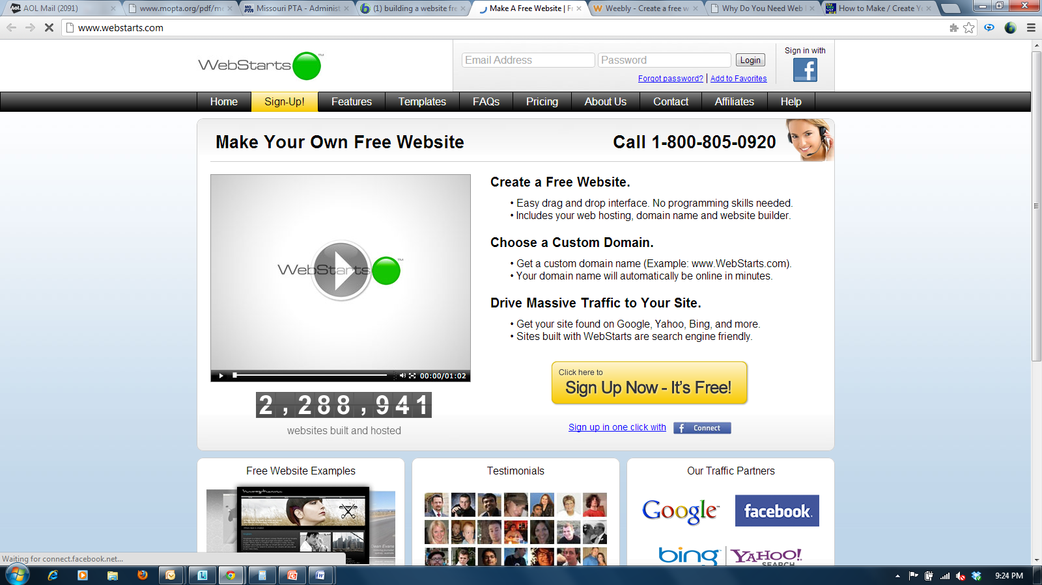
Starting to build your website

Slide 11
Select your template style

Slide 12
Register for your free website

Slide 13
Decide about your domain name

Slide 14
Add information to website
the link to my site is: http://abcelementarypta.WebStarts.com
Notes:
Since I selected the free option, my website has webstarts.com included in the name. If I had chosen to pay the 4.98 per month, I would have selected .org instead.

Slide 15
Begin to edit the website

Slide 16
Edit Your Website Name

Slide 17
Select your emblem

Slide 18
Adding stories/information

Slide 19
Adding pages

Slide 20
Control Panel Page

Slide 21
Copying and Pasting

Slide 22
Storing Files
How do you store your pdf’s or photos?
File Transfer Protocol (FTP) is a standard network protocol used to transfer files from one host or to another host over the Internet.
What type of FTP host are available?
School FTP server
Firezilla Client
CuteFTP
Others

Slide 23
Linking files

Slide 24
Linking files

Slide 25
Linking files
Notes:
Reflections is now a live link to the Missouri PTA website Reflections information

Slide 26
Final stages
Remember to save after all additions or changes to a web page
Make sure that the login and password is available to 2 members of the executive board in case your webmaster changes your unit
Define the approval method for posting information
Notes:
Will it be posted daily or once a week
Who approves the articles – president??

Slide 27
Finished website

Slide 28
Important
Make sure to keep the information on your website pertinent and up to date
Check for spelling errors
Link your website to your school website and ask them to put a link on their website

