Slide 1
Creating An Effective Media Plan For Your Unit
Catherine Sweeny
Missouri PTA
Vice President and Director of Communications

Slide 2
The Four Generations of PTA
Silent generation
Baby Boomer
GenX
GenY

Slide 3
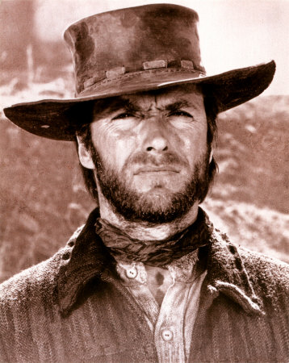
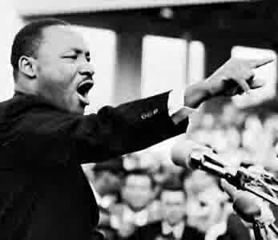
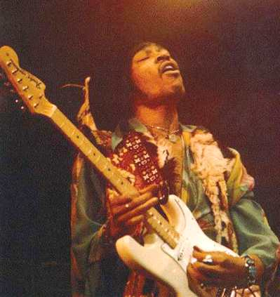
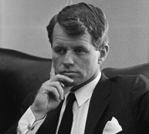
The Silent Generation

Slide 4
The Silent Generation 1925-1945
Younger member just turned 65
High percent of volunteers
Will call the school or PTA officer
Want information in paper form
Prefer to meet in person for meetings
Notes:
When call expect the school or PTA officer to have the information they want on hand
If you want them to fill out a survey make sure it is in paper form
They have the time and the inclination to volunteer

Slide 5
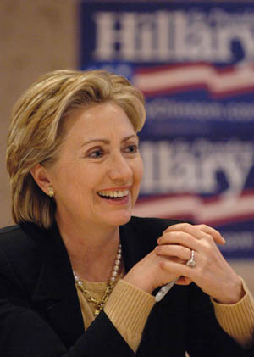
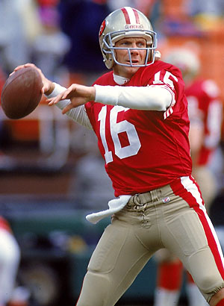
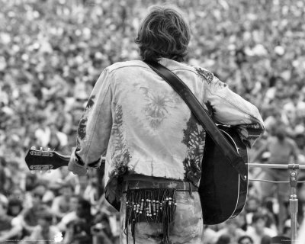
Baby Boomer

Slide 6
Baby Boomer 1946-1962
Saved the world in the 60’s & 70’s
Starting second careers in educations & nonprofits
Will call the school or PTA officer
Wants information in paper form
Prefer to meet in person for meetings
Notes:
Saved the world once and ready to do it again
Many are leaving private industry, government and military for a second career in education and non-profits
When call expect the person on the other end to have the information they need
Survey need to be in paper form
They bring wisdom from experience and passion

Slide 7
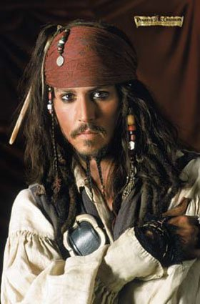
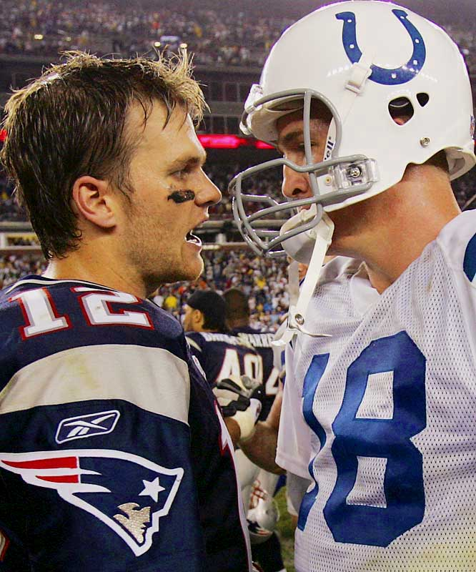
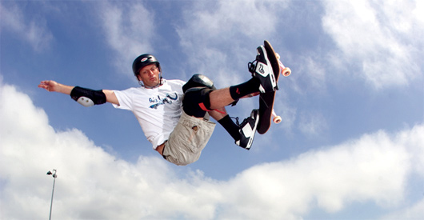
Gen X

Slide 8
Gen X 1963-1980
Hard working & independent
Concerned with balancing work & life
Uses a wide variety of technology & networking
Wants information electronically
Comfortable meeting via conference calls and video conferencing
Notes:
Ready for the boomers to move aside
Don’t want to be like the boomer generation for whom work was life
Are part of their groups 24/7/365
Wants EVERYTHING electronically – survey better be online or it will get recycled
Wants information in a variety of platforms – text, email, twitter, facebook, the web
Perfectly comfortable using platforms like Skype, GoToMeeting.com, Live meeting or FaceTime
This group includes parents, teachers, and school administrators

Slide 9
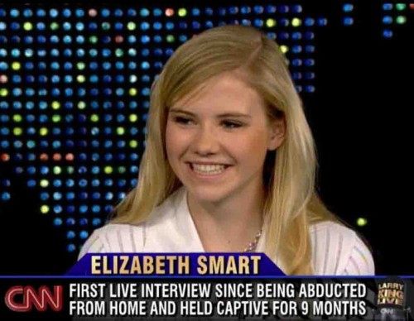
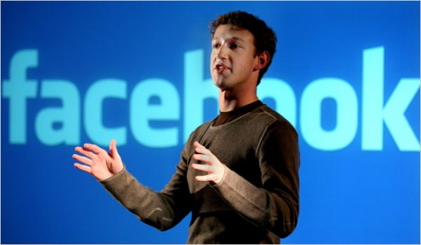
Gen Y or Millennials

Slide 10
Gen Y or Millennials 1981-2002
Have a group mentality
Oldest are out of college and in the workforce
Life is a social network
Actively use a wide variety of technology and networking
Wants information electronically
Comfortable meeting via conference calls and video conferencing
Notes:
Nearly as large a group as their Baby Boomer parents
Network in a way older generations can not comprehend
Life is a social network – date, play, work, decide, volunteer and donate in groups
More likely to text then us the phone, part of their group 24/7/365
Survey better be electronic
Use text, email, twitter, facebook, web, skye, GoToMeeting.com, Live Meeting, Facetime
They are a package deal – you get them and their friends

Slide 11
Communication Platforms
Flyers & Posters
Newsletters
District announcements/communications
Email
Website
Social Networking

Slide 12
Flyers & Posters
Highlight a single event or program
Used to get the word out to students
Usually come home in the backpack

Slide 13
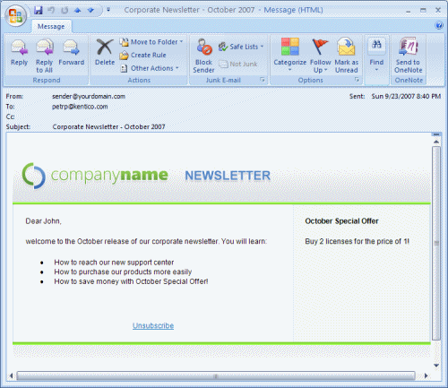
Newsletters paper and electronic
Delivers all your current news for a particular period of time – information must be timely and relevant
Highlight upcoming events/programs
Recap recent events/programs
Spotlight accountability
Celebrate successes and thank volunteers
Maintain a consistent publishing schedule
Select a catchy but brief title
Break up newsletter with easy to locate and read headlines
Appearance is important

Slide 14
District announcements/communications
District announcements
Localized school announcements
Keep the message brief, timely and include contact information
Notes:
Many school districts already have a communication system in place you can utilize. Think of it as a shout out to the entire community.
This could be a district wide or localized to a particular school – announcements
Information is usually packed in there so keep it brief.

Slide 15
Email keeping in touch with current members
Set up an email system
Set parameters
How it will work
Who is responsible
How often email is sent
General oversight
Just Between Friends
Dedicate an email address
Destination point & basic address for consistent regular communication
All outgoing message need to be sent using the same dedicated address to avoid confusion
Can advertise the address
Never become outdated
Can be redirected to various volunteer’s own in-boxes
Notes:
Make sure all the officers are aware of how it works
Everyone becomes familiar with basic address for regular communication

Slide 16
Email keeping in touch with current members
Develop an efficient method for collecting and maintaining email addresses
Expand beyond the membership roster
Include sign-up link on website, face-to-face events, school electronic announcements, order forms, newsletters, etc.
Target specific recipients
Code your email developing several styles
Members can specify what email they would like to receive
Develop internal lists to communicate with Board
Notes:
Beyond the roster – invite interested community members to join the list
Target examples: PTA monthly meeting – report includes a synopsis of that month’s meeting, Carnival – only information pertaining to the planning and execution of this event, PTA newsletter – attachment of the electronic edition of the newsletter
Internal lists with Board – communicate with your executive committee, executive board and various committee members

Slide 17
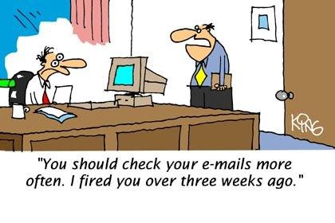
Email keeping in touch with current members
Pre-schedule important messages
Wisely utilize the subject bar
Decide on an acronym to be used as the first word in all subject lines
Update the subject bar when responding
Example: SHPTA Carnival: planning brief #1 – Karie response Oct. 4. Others respond to the original email using different names and dates until the chair restarts the process – SHPTA Carnival: planning brief #2
Subject bar should reflect exactly what can be expected
Notes:
Pre-schedule messages: quick reminders exactly when they are needed (reminders, updates or last minute changes) – Never forget a thank you (the message is waiting for them right at the end of the event)– Direct member to a survey
Subject bar – this is the why or why not your email gets read – let’s the recipient know what to expect
Example explanation: members reply by adding to the subject bar their name and date
Subject bar – avoid vague headings

Slide 18
Email keeping in touch with current members
Be concise and to the point
Important information should always be first
Send several shorter emails that directly relate to the subject bar
Sender should use their full name at the start of the email
Utilize bulleted lists instead of an information dump
Provide time saving information
Encourage feedback
Pose specific question to receive opinions
Report back on previous request
Example: “Thanks to the 13 people who shared the following…”
Avoid the vague request – instead ask for help with specific needs
Example: “Can you do any of these things? Carnival set up Friday from 3-4; accompany the Kindergarten class Thursday from 1-2 at the book fair; decorate bulletin board at your convenience.
Notes:
Many people never read beyond the preview window
Shouldn’t have to scroll down to see who sent
Bullet lists make key information stand out
Examples of time saving information: Links to online driving directions, Online minutes, links to articles

Slide 19
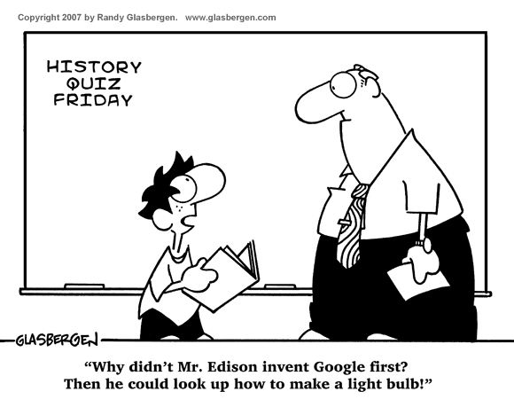
Website Virtual home of your PTA
This is the FIRST place Gen X and Gen Y will look for information about your PTA!
Appearance is important
Users are looking for information not an eye-catching poster
Avoid using graphics that take long to load
Avoid backgrounds or colors that make the site difficult on the eyes
“3 Click Rule”
Users should be able to find what they are looking for in 3 clicks or less
Make sure the layout is easy to navigate – links are clearly marked
Notes:
If don’t follow the 3 click rule – users get frustrated and will not return

Slide 20
Website Virtual home of your PTA
What should you include?
All the information any member might be looking for
Contact information
Meeting minutes
President’s message – local, state & national
Legislative alerts & governmental contact information
Committee assignments & reports
Updated calendar of events
Digital backpack – pdf all those flyers
Volunteer & donation opportunities
Fundraising & rebate information
Newsletters in pdf format
Summary of PTA benefits
Mission & Purpose of PTA
Current news & events
Links to state, national, school & education sites
Sign up link for email list
Link to your social networking sites
Keep the site updated!!!!!!!!

Slide 21
Social Networking going to where the people are
More than just a channel – it is an ecosystem where everything is linked
Allows the means to not only interact but hear what is being said
Not a fad. This is engaged marketing that is here to stay. The democratization of media.
Notes:
Did you know it took radio 33 years to reach 50 million users? It took T.V. 13 years. But only took social networking 9 months to reach 100 million users.
Gives you the means to not only interact but hear what is being said
The venues may change for example MySpace.
The people who actively use this format believe in the celebrity of the individual.

Slide 22
Social Networking going to where the people are
Twitter – the text message of the Internet
Users post short 140 character messages
Message can be linked together via the #
Example: #everychildonevoice
Has been used as a news source
Example: Tsunami warning posted on Twitter before it hit the main media
Connects other with similar interests
FACT: of the 500 million users 60% are in the US and 88% login everyday.
Notes:
June 2010 65 million tweets were being sent – March 2013 over 400 million tweets per day

Slide 23
Social Networking going to where the people are
Facebook – the multimedia version of Twitter
Allows users to follow favorite brands –
brands set up sites similar to a personal profile that updates posts and sends out newsfeeds
Information posted can be easily shared by users
2nd most visited site after Google
50% of users visit daily
Top photo platform on the Internet
Notes:
Users spend a total of 700 million minutes per month on this site – this dwarfs the time spent on Google

Slide 24
Social Networking going to where the people are
Blog – long form content sharing platform. Great venue for commentary & debate
YouTube – 4th most visited site on the Internet

Slide 25
Social Networking going to where the people are
Rules of Engagement
Content is Key
What you write and when you write it
Pick the right platform for your content
People want content when they open their computers – they are actively looking for it
Quality matters
Posts need to be timely, relevant and engaging
Content needs to be correct
Be knowledgeable about your policies before posting
Audience matters
Social networking is a two way street – Be Nice & Be one of them
Participate as an active listener
Don’t be afraid of negative comments
Notes:
Content is key – what you write and how you write it – don’t just blast out information you need to engage your audience.

Slide 26
Engage Me
http://www.youtube.com/watch?v=uRUTtpk9EHg

