Slide 1
Treasurers Workshop
An Overview

Slide 2
Treasurer Basics
Elected to Office
Custodian of all PTA funds
Receives & disburses funds
Prepares financial reports
Maintains records
Supports Unit in Good Standing status

Slide 3
Treasurer Resources
National PTA; www.pta.org,
- Local Leaders Resources
- Training & Develop
- OC Magazine
- Back to School Kit
Missouri PTA; www,mopta.org
- 2013 Tool Kit, Treasurer section
- Winter Packet, Treasurer pages
- Money Talks video
- Contact magazine
Unit bylaws and Standing Rules

Slide 4
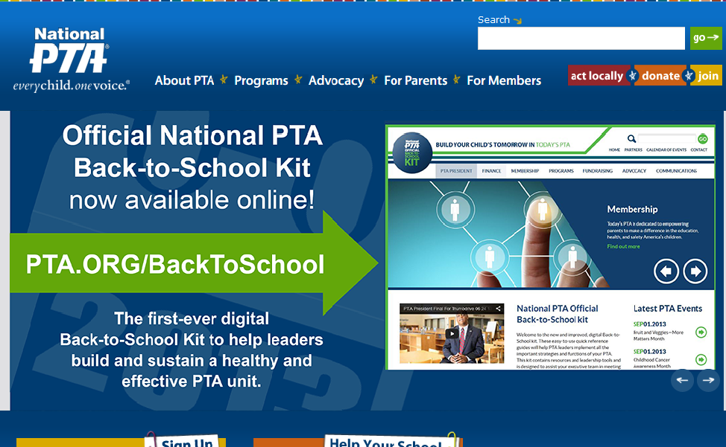
www.pta.org; “For Members”; Local Leader Resources / Training & Develop.

Slide 5
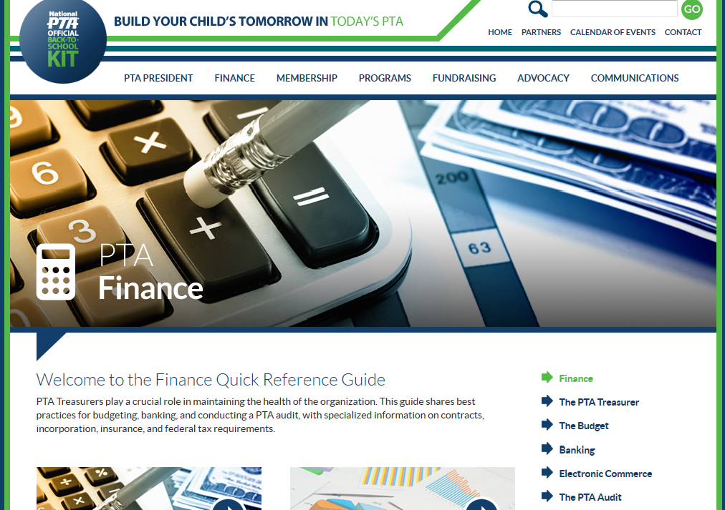
http://www.ptakit.org/Finance/index.aspx

Slide 6
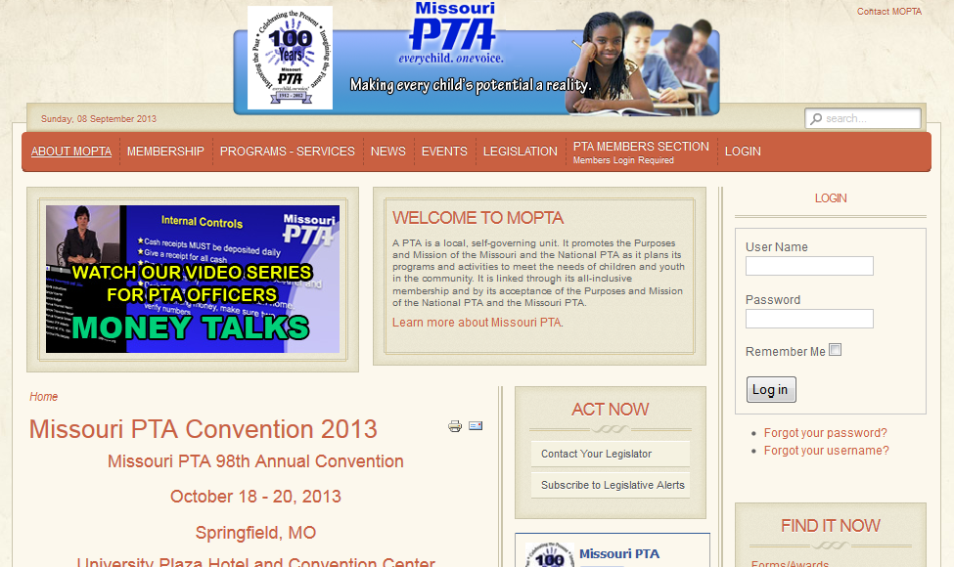
www.mopta.org; User Name: Diversity; Password: Means

Slide 7
Unit/Council Bylaws
Article II – Purposes
Article III – IRS Status
Article IV – Unit in Good Standing
Article V – Dues
Article VI – Election to Office
Article VII – Duties of Treasurer (signers, dues, Annual Financial Review)
Article XIV – Fiscal year

Slide 8
Timeline
Election
Banking
Supplies
Bookkeeping
Budget Planning & Approval
Set up Internal Controls
Monthly Duties
Annual Duties

Slide 9
Banking
Use PTA account exclusively
Paper Trail
Signers
EIN not SSN
Mailing address
Online viewing
Credit Cards & Debit cards not recommended
- See NPTA recommendations for usage

Slide 10
Supplies
Records
Checkbook/blank checks
Receipt book
Deposit book
Bank bag
Endorsement stamp
Accounting Program
Stapler, post-its, paperclips, pens/pencils, envelopes, stamps, rubber bands, etc.

Slide 11
Bookkeeping
Choose method
Keep up checkbook entries
Log funds received
Log funds disbursed
Maintain budget entries
Keep everything current

Slide 12
Budget
Planned by committee
Prepared using records and plans
Includes anticipated receipts and anticipated expenses
Review by board
Approved by General Membership
Amended as needed (by vote of general membership)
Tool Kit pgs. 7, 8

Slide 13
Internal Controls – Money Received
Two people count
Receipts written
Record cash & check log
Deposit same day – night deposit
Keep paper trail of all transactions
Never mix with school funds
Never hold cash
Consider service for insufficient funds

Slide 14
Fund Raising Example
Catalog sales collected daily
Fundraiser chair & assistant
- Count daily
- Balance against order (copy order)
- Sellers name on checks
- Make summary – both sign
- Turn over funds and summary copy to Treasurer daily
Chair & Treasurer
- Re-count against summary
- Write receipt/deposit record – both sign
Deposit
- Endorse & record all checks
- Make out deposit slip
- Make deposits daily

Slide 15
Internal Controls – Money Disbursed
All disbursements by check
All disbursements within budget
Two person authorization
Checks signed by Treasurer & 2nd signer
Keep paper trail of all transactions
Pay dues
Never sign blank checks or checks made to “Cash”

Slide 16
Internal Controls - Reconciliation
Third party reconciliation
  NPTA recommends non-signer reconcile bank statement
  AIM requires initials of non-signer on statement
Duplicate bank statements/online viewing
Reconcile account monthly
Clarify discrepancies

Slide 17
Reports – Monthly
Begin with last balance
Report funds received
Report funds disbursed
End with current balance
Report by budget line not check number
Report at monthly meeting but do not approve (report is filed for audit)
Tool Kit pg. 9

Slide 18
Reports – Fiscal Year End
Begin with first day of fiscal year
Report funds received by budget line
Report funds disbursed by budget line
Report ending balance
Preliminary report at last meeting of year
Final report includes last day of fiscal year
Approved by general membership along with audit/financial review
Copy due to MOPTA by December 1st.
Tool Kit pg. 10

Slide 19
Reports – Annual Financial Review/Audit
Yearly review of all finances for fiscal year
Annual Financial Review – by committee
Audit – by professional
To be approved by membership
Copy due to MOPTA by December 1st.
Tool Kit pgs. 11,12, 21, 22

Slide 20
IRS Filing
All PTAs must files annually
http://www.irs.gov/Charities-&-Non-Profits
http://www.ptakit.org/Finance/index.aspx
- Federal Requirements
990 EZ/990 plus Schedule A
Due to IRS 15th day of 5th month
Copy to MOPTA by December 1st.
Tool Kit pgs. 14-18

Slide 21
State Tax Exempt letter
Issued from MO Department of Revenue
Each PTA must apply for their own
MOPTA can help with
  EIN / Letter of determination
  Unit in Good Standing status
  Group exemption number
Renew / New
Tool Kit pg. 19

Slide 22
Insurance
Nonprofit Institutional Fidelity bonding
Defined by amount of funds handled
Requires internal controls
Limitations
Consider general liability and other

Slide 23
Homework
Review printed materials
Review National PTA website
Watch MOPTA video Money Talks

Slide 24
Questions / Discussion

Slide 25
Missouri PTA
2101 Burlington Street
Columbia, MO 65202
1-800-328-7330 office@mopta.org www.mopta.org
CONTACT INFORMATION

